Slide 1
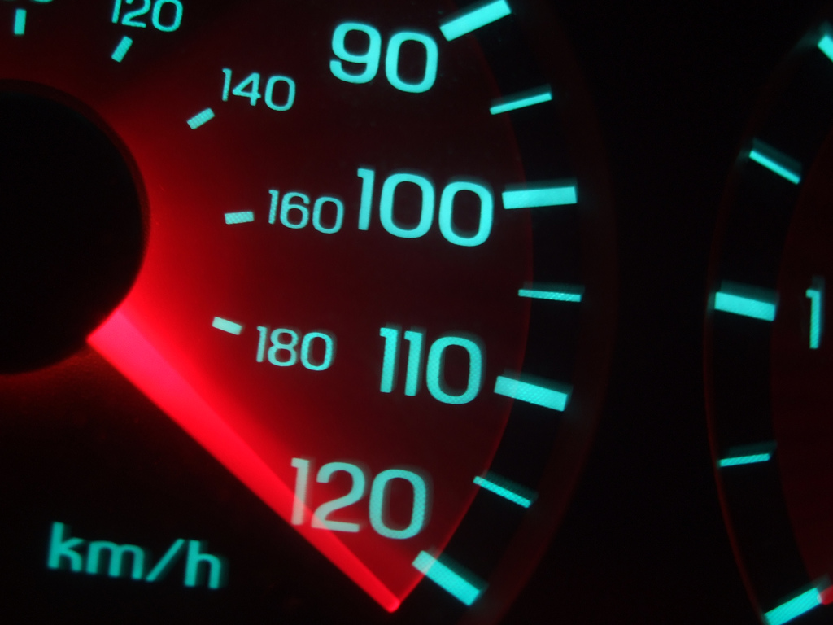
in
search
of
speed
http://stevesouders.com/docs/speedgeeks-20091026.pptx &.zip
Disclaimer: This content does not necessarily reflect the opinions of my employer.
Notes:
YtseJam Photography, "Going nowhere fast", http://www.flickr.com/photos/thatguyfromcchs08/2300190277/

Slide 2
Google, Bing biz metrics: http://en.oreilly.com/velocity2009/public/schedule/detail/8523
Yahoo! biz metrics: http://www.slideshare.net/stoyan/yslow-20-presentation
Shopzilla biz metrics: http://en.oreilly.com/velocity2009/public/schedule/detail/7709
Netflix outbound traffic: http://en.oreilly.com/velocity2008/public/schedule/detail/3632
Google, Bing charts: http://www.watchingwebsites.com/archives/proof-that-speeding-up-websites-improves-online-business
Aptimize WAX: http://blogs.msdn.com/sharepoint/archive/2009/09/28/how-we-did-it-speeding-up-sharepoint-microsoft-com.aspx
Strangeloop Networks: http://www.watchingwebsites.com/archives/proof-that-speeding-up-websites-improves-online-business
SproutCore: http://blog.sproutcore.com/post/196959232/how-sproutcore-makes-your-app-run-faster
HTTP Archive Format: http://www.stevesouders.com/blog/2009/10/19/http-archive-specification-firebug-and-httpwatch/
@font-face: http://www.stevesouders.com/blog/2009/10/13/font-face-and-performance/

Slide 3



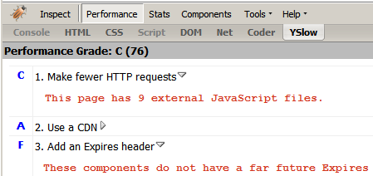







Slide 4

the importance of frontend performance
9%
91%
17%
83%
iGoogle, primed cache
iGoogle, empty cache
Notes:
Data source: Steve Souders
Tested on IE6 on Comcast cable modem (~5 mbps) medium powered PC, April 2008.

Slide 5

14 Rules
Make fewer HTTP requests
Use a CDN
Add an Expires header
Gzip components
Put stylesheets at the top
Put scripts at the bottom
Avoid CSS expressions
Make JS and CSS external
Reduce DNS lookups
Minify JS
Avoid redirects
Remove duplicate scripts
Configure ETags
Make AJAX cacheable
Notes:
photo courtesy of Vicki & Chuck Rogers: http://www.flickr.com/photos/two-wrongs/205467442/

Slide 6
Even Faster Web Sites
Splitting the initial payload
Loading scripts without blocking
Coupling asynchronous scripts
Positioning inline scripts
Sharding dominant domains
Flushing the document early
Using iframes sparingly
Simplifying CSS Selectors
Understanding Ajax performance..........Doug Crockford
Creating responsive web apps............Ben Galbraith, Dion Almaer
Writing efficient JavaScript.............Nicholas Zakas
Scaling with Comet.....................Dylan Schiemann
Going beyond gzipping...............Tony Gentilcore
Optimizing images...................Stoyan Stefanov, Nicole Sullivan

Slide 7
Google
+ 0.4 sec
searches ⬇ 0.6%
Notes:
Google, Bing: http://en.oreilly.com/velocity2009/public/schedule/detail/8523
Yahoo!: http://www.slideshare.net/stoyan/yslow-20-presentation
Shopzilla: http://en.oreilly.com/velocity2009/public/schedule/detail/7709
Netflix: http://en.oreilly.com/velocity2008/public/schedule/detail/3632

Slide 8
Yahoo!
+ 0.4 sec
traffic ⬇ 5-9%
Notes:
Google, Bing: http://en.oreilly.com/velocity2009/public/schedule/detail/8523
Yahoo!: http://www.slideshare.net/stoyan/yslow-20-presentation
Shopzilla: http://en.oreilly.com/velocity2009/public/schedule/detail/7709
Netflix: http://en.oreilly.com/velocity2008/public/schedule/detail/3632

Slide 9
Bing
+2 sec
revenue ⬇ 4.3%
Notes:
Google, Bing: http://en.oreilly.com/velocity2009/public/schedule/detail/8523
Yahoo!: http://www.slideshare.net/stoyan/yslow-20-presentation
Shopzilla: http://en.oreilly.com/velocity2009/public/schedule/detail/7709
Netflix: http://en.oreilly.com/velocity2008/public/schedule/detail/3632

Slide 10
Shopzilla
-5 sec
revenue ⬆ X%
hw ⬇ Y%
Notes:
Google, Bing: http://en.oreilly.com/velocity2009/public/schedule/detail/8523
Yahoo!: http://www.slideshare.net/stoyan/yslow-20-presentation
Shopzilla: http://en.oreilly.com/velocity2009/public/schedule/detail/7709
Netflix: http://en.oreilly.com/velocity2008/public/schedule/detail/3632

Slide 11
Netflix
outbound bandwidth ⬇ 43%
Notes:
Google, Bing: http://en.oreilly.com/velocity2009/public/schedule/detail/8523
Yahoo!: http://www.slideshare.net/stoyan/yslow-20-presentation
Shopzilla: http://en.oreilly.com/velocity2009/public/schedule/detail/7709
Netflix: http://en.oreilly.com/velocity2008/public/schedule/detail/3632

Slide 12
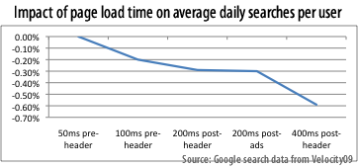
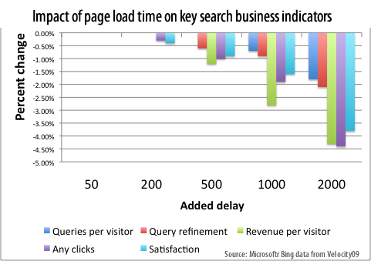
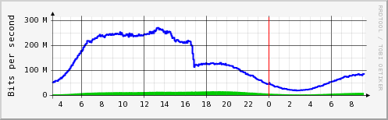
Notes:
http://www.watchingwebsites.com/archives/proof-that-speeding-up-websites-improves-online-business
0.21% decrease even 5 weeks after the delay was removed – users perception of a site is learned
Netflix: http://en.oreilly.com/velocity2008/public/schedule/detail/3632

Slide 13
fast performance =
  better user experience
  more traffic
  more revenue
  reduced costs

Slide 14
so...
why don't more people do it?

Slide 15
it's
too
hard!

Slide 16

Notes:
http://www.youtube.com/watch?v=m888nlVxZu8

Slide 17
if it wasn't hard everyone would do it
the hard is what makes it great

Slide 18
this year's theme:
Fast by Default

Slide 19
Aptimize WAX
  concatenate scripts
  concatenate stylesheets
  sprites, data: URIs
  far future Expires
  minify JS and CSS
  automatically in real time
Notes:
http://blogs.msdn.com/sharepoint/archive/2009/09/28/how-we-did-it-speeding-up-sharepoint-microsoft-com.aspx

Slide 20
WAX on:
  http://sharepoint.microsoft.com
  # requests empty: 96  35
  # requests primed: 50  9
    scripts 7, stylesheets 12, images 25
    pages faster: 46-64% empty, 15-53% primed
Notes:
http://blogs.msdn.com/sharepoint/archive/2009/09/28/how-we-did-it-speeding-up-sharepoint-microsoft-com.aspx

Slide 21
Strangeloop Networks
  "typical ecommerce site"
  pages per visit: 11  16
  time on site: 24  30 mins
    conversions: •16%
    order value: •5.5%
Notes:
http://www.watchingwebsites.com/archives/proof-that-speeding-up-websites-improves-online-business

Slide 22
Rails
  far future Expires
  concatenate scripts
  domain sharding
  configure ETags
    pipeline: async scripts, spriting, minification, flushing

Slide 23
SproutCore
  concatenate scripts
  concatenate stylesheets
  versioning (future Expires)
  stylesheets at the top
  scripts at the bottom
  minify JS & CSS
  remove dupe scripts
Notes:
http://blog.sproutcore.com/post/196959232/how-sproutcore-makes-your-app-run-faster

Slide 24
WPO

Slide 25
Why do some sites feel slow
?

Slide 26

Google Mail
Notes:
3000 kbps up, 600kbps down
single CPU Thinkpad X61
Windows XP
IE 7

Slide 27
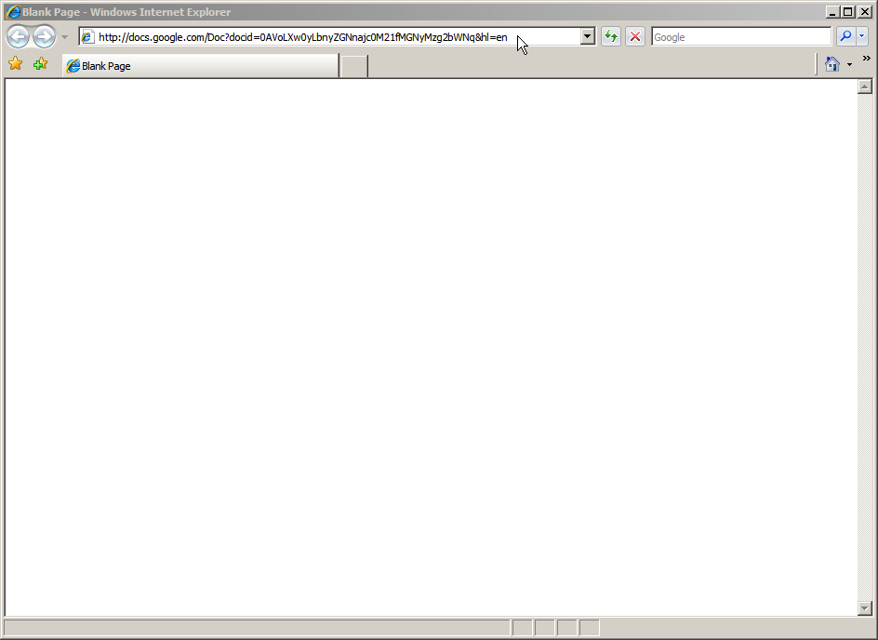
Google Docs
Notes:
3000 kbps up, 600kbps down
single CPU Thinkpad X61
Windows XP
IE 7

Slide 28

AOL
Notes:
3000 kbps up, 600kbps down
single CPU Thinkpad X61
Windows XP
IE 7

Slide 29

Twitter
Notes:
3000 kbps up, 600kbps down
single CPU Thinkpad X61
Windows XP
IE 7

Slide 30
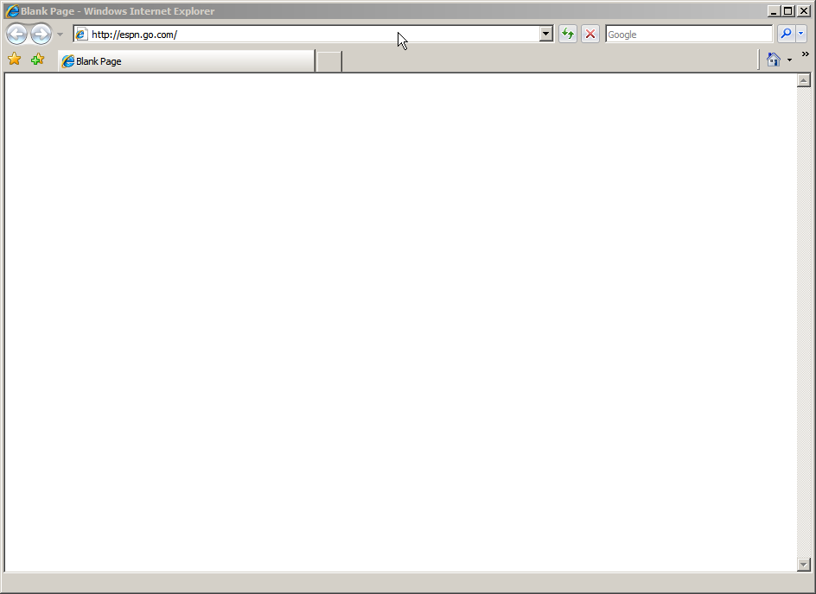
ESPN
Notes:
3000 kbps up, 600kbps down
single CPU Thinkpad X61
Windows XP
IE 7

Slide 31

Best Buy
Notes:
3000 kbps up, 600kbps down
single CPU Thinkpad X61
Windows XP
IE 7

Slide 32

IKEA
Notes:
3000 kbps up, 600kbps down
single CPU Thinkpad X61
Windows XP
IE 7

Slide 33

CNN
Notes:
3000 kbps up, 600kbps down
single CPU Thinkpad X61
Windows XP
IE 7

Slide 34
(lack of)
Progressive Rendering

Slide 35
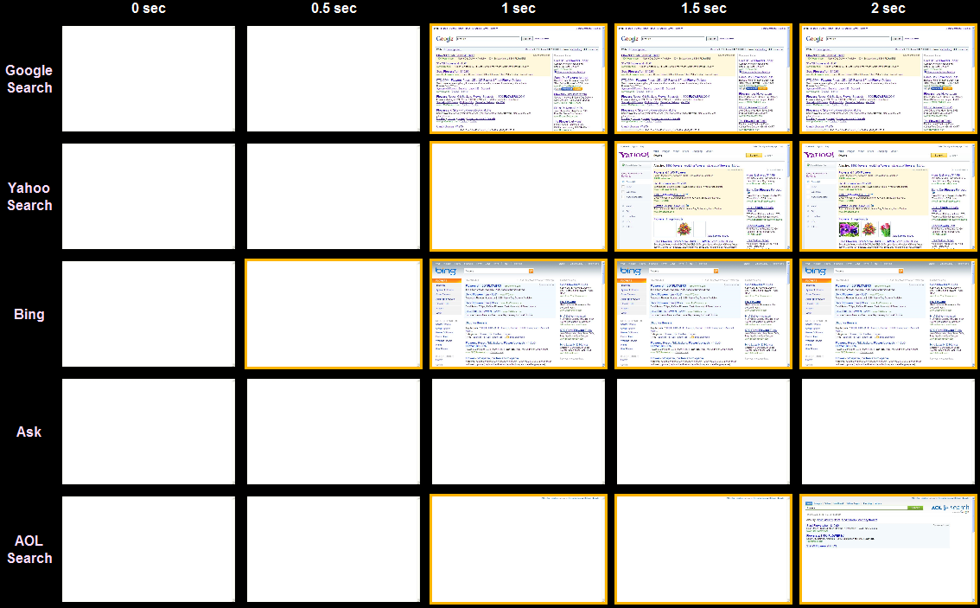
Search
Notes:
http://stevesouders.com/p3/index.php?sites=google-search,yahoo-search,bing,ask,aol-search&ival=500

Slide 36

WebPagetest.org
  VA, UK, NZ
  IE7, IE8
  Dial, DSL, FIOS
  empty, empty & primed
  quad core
Pat Meenan (AOL)

Slide 37
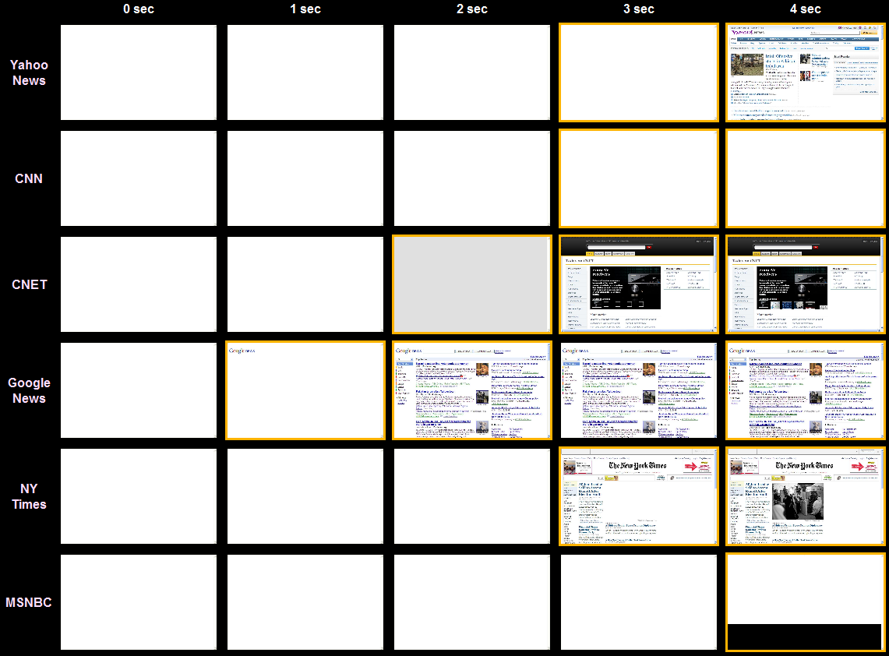
News
Notes:
http://stevesouders.com/p3/index.php?sites=yahoo-news,cnn,cnet,google-news,nytimes,msnbc,foxnews&ival=1000

Slide 38
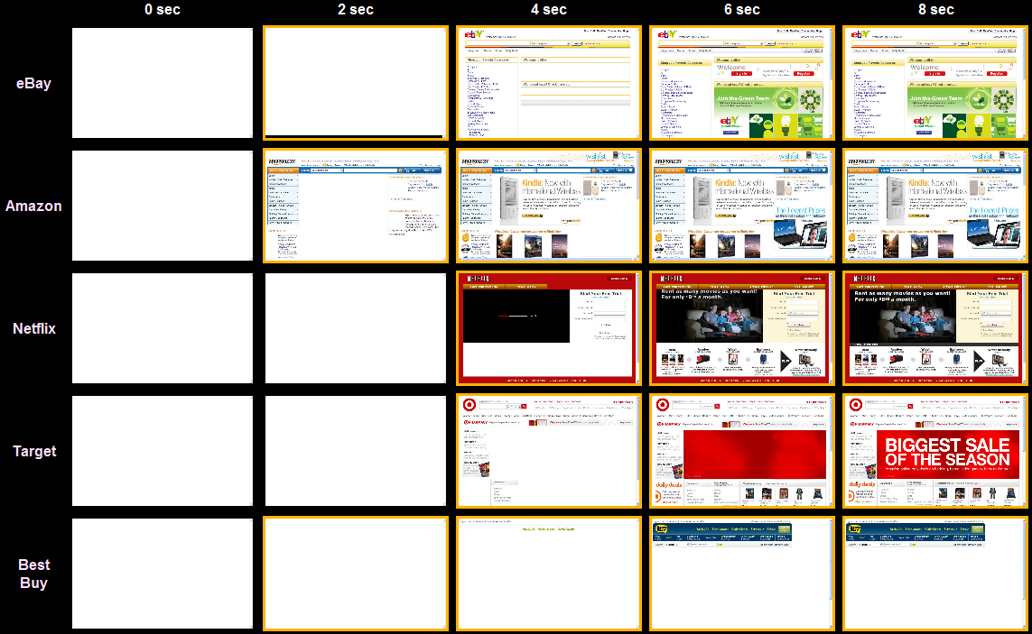
Shopping
Notes:
http://stevesouders.com/p3/index.php?sites=ebay,amazon,netflix,target,bestbuy,ikea&ival=2000

Slide 39
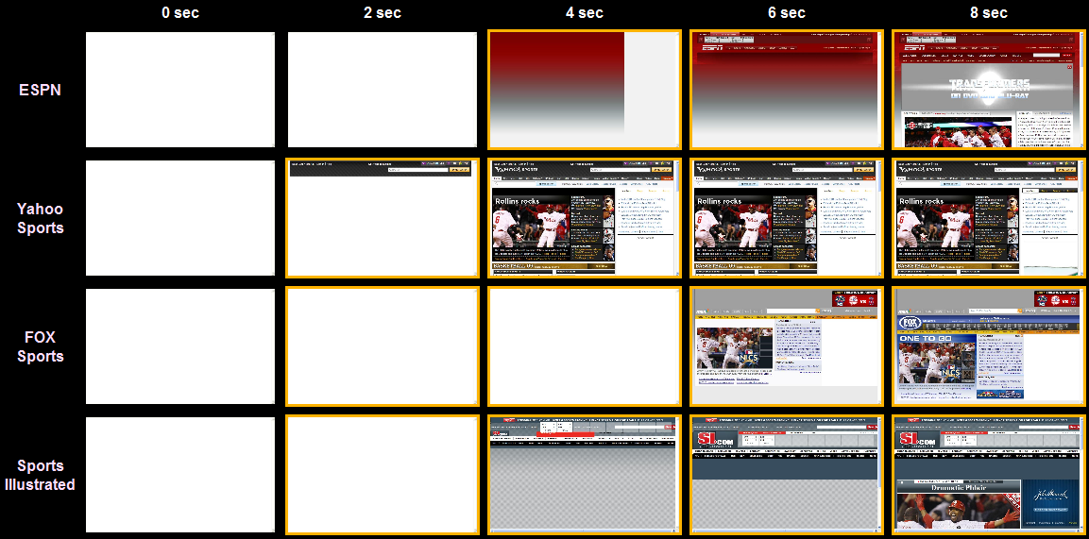
Sports
Notes:
http://stevesouders.com/p3/index.php?sites=ebay,amazon,netflix,target,bestbuy,ikea&ival=2000

Slide 40
Progressive Enhancement
deliver HTML
defer JS
avoid DOM
decorate later

Slide 41
Progressive Enhancement

Progressive Rendering

Slide 42
recent news

Slide 43
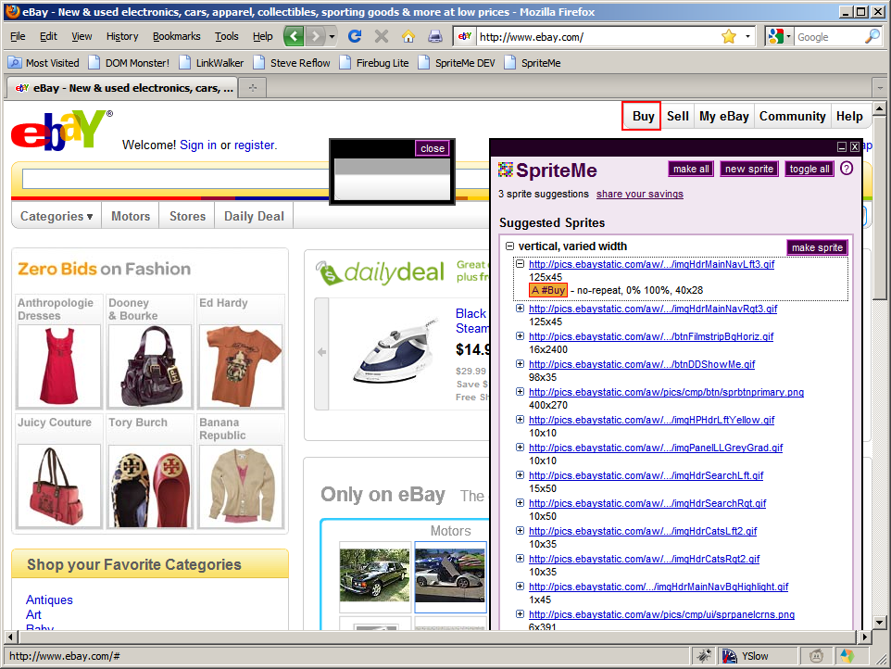
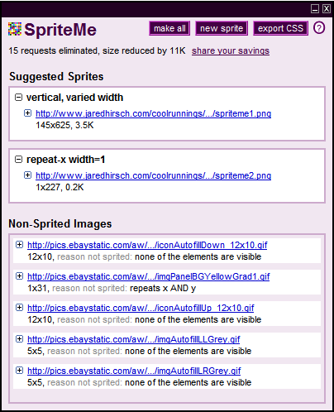
finds BG images
groups into sprites
generates sprite
recomputes BG pos
injects into page
http://spriteme.org/

Slide 44
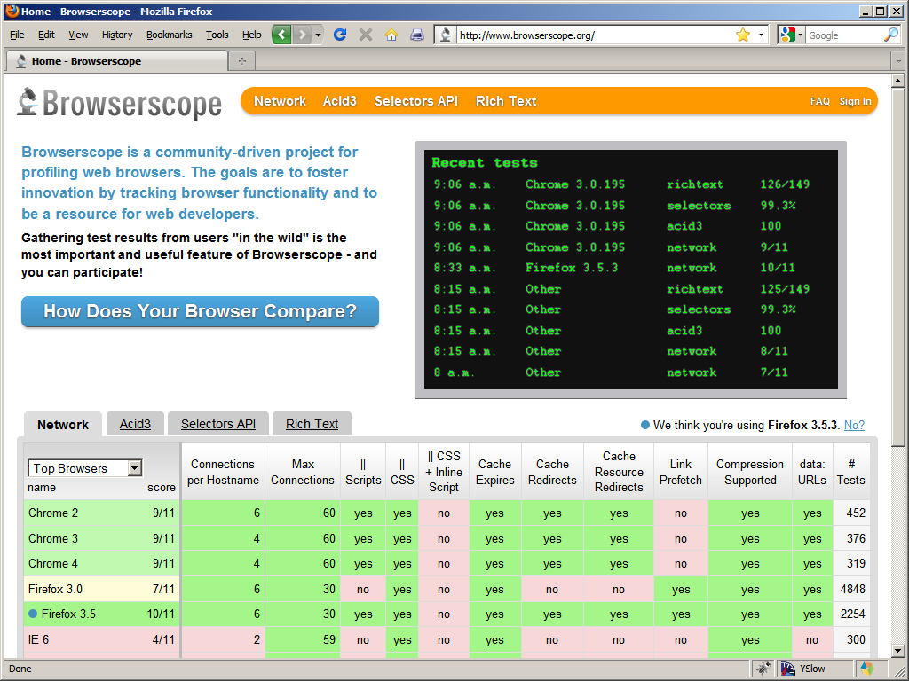

Browserscope

Slide 45
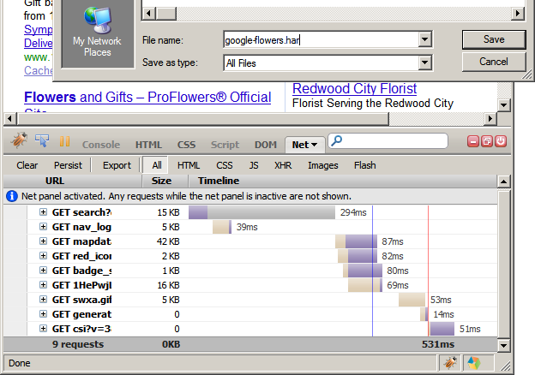
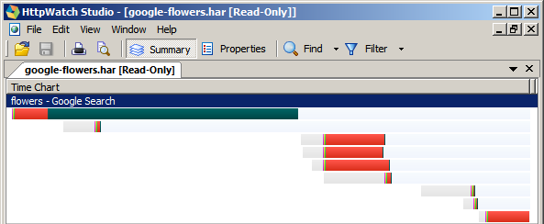
HTTP Archive Format
(HAR)
Notes:
http://www.stevesouders.com/blog/2009/10/19/http-archive-specification-firebug-and-httpwatch/

Slide 46
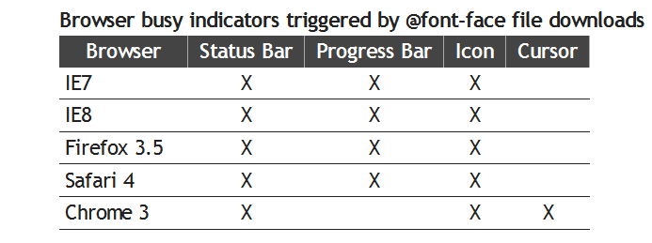
@font-face
blocks rendering in IE if below SCRIPT tag
declare above all SCRIPTs
Notes:
http://www.stevesouders.com/blog/2009/10/13/font-face-and-performance/

Slide 47
performance analyzers (HPWS)
 | YSlow | Page Speed | Pagetest | VRTA | neXpert
combine JS & CSS | X | X | X
use CSS sprites | X |  |  | X
use a CDN | X |  | X
set Expires in the future | X | X | X | X | X
gzip text responses | X | X | X | X | X
put CSS at the top | X | X
put JS at the bottom | X
avoid CSS expressions | X | X
make JS & CSS external
reduce DNS lookups | X | X
minify JS | X | X | X
avoid redirects | X | X |  | X | X
remove dupe scripts | X | X
remove ETags | X |  | X |  | X

Slide 48
performance analyzers (EFWS)
 | YSlow | Page Speed | Pagetest | VRTA | neXpert
don't block UI thread
split JS payload |  | X
load scripts async |  | X |  | X
inline JS b4 stylesheet |  | X
write efficient JS
min. uncompressed size
optimize images |  | X | X
shard domains |  | X |  | X
flush the document
avoid iframes
simplify CSS selectors |  | X |  | X

Slide 49
performance analyzers (other)
 | YSlow | Page Speed | Pagetest | VRTA | neXpert
use persistent conns |  |  | X | X | X
reduce cookies | 2.0 | X | X |  | X
avoid net congestion |  |  |  | X
increase MTU, TCP win |  |  |  | X
avoid server congestion |  |  |  | X
remove unused CSS |  | X
specify image dims |  | X
use GET for Ajax | 2.0
reduce DOM elements | 2.0
avoid 404 errors | 2.0
avoid Alpha filters | 2.0
don't scale images | 2.0 | X
optimize favicon | 2.0

Slide 50
takeaways
focus on the frontend
run YSlow
and Page Speed!
progressive enhancement  progressive rendering

Slide 51
SPEED is the next competitive advantage
use it
...before someone else does

Slide 52

Steve Souders
souders@google.com
http://stevesouders.com/docs/speedgeeks-20091026.pptx & .zip
Notes:
"thank you" by nj dodge: http://flickr.com/photos/nj_dodge/187190601/

Slide 53
Google, Bing biz metrics: http://en.oreilly.com/velocity2009/public/schedule/detail/8523
Yahoo! biz metrics: http://www.slideshare.net/stoyan/yslow-20-presentation
Shopzilla biz metrics: http://en.oreilly.com/velocity2009/public/schedule/detail/7709
Netflix outbound traffic: http://en.oreilly.com/velocity2008/public/schedule/detail/3632
Google, Bing charts: http://www.watchingwebsites.com/archives/proof-that-speeding-up-websites-improves-online-business
Aptimize WAX: http://blogs.msdn.com/sharepoint/archive/2009/09/28/how-we-did-it-speeding-up-sharepoint-microsoft-com.aspx
Strangeloop Networks: http://www.watchingwebsites.com/archives/proof-that-speeding-up-websites-improves-online-business
SproutCore: http://blog.sproutcore.com/post/196959232/how-sproutcore-makes-your-app-run-faster
HTTP Archive Format: http://www.stevesouders.com/blog/2009/10/19/http-archive-specification-firebug-and-httpwatch/
@font-face: http://www.stevesouders.com/blog/2009/10/13/font-face-and-performance/

