Slide 1
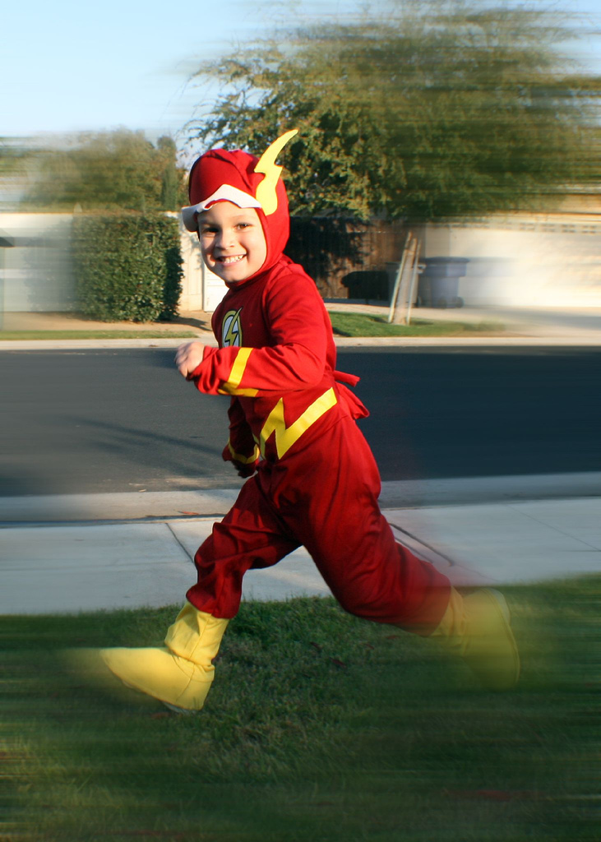
The Perceptionof Speed
@souders
Notes:
Sometimes our perception of how fast things are doesn't match reality.
http://www.flickr.com/photos/photohype/288124023/

Slide 2
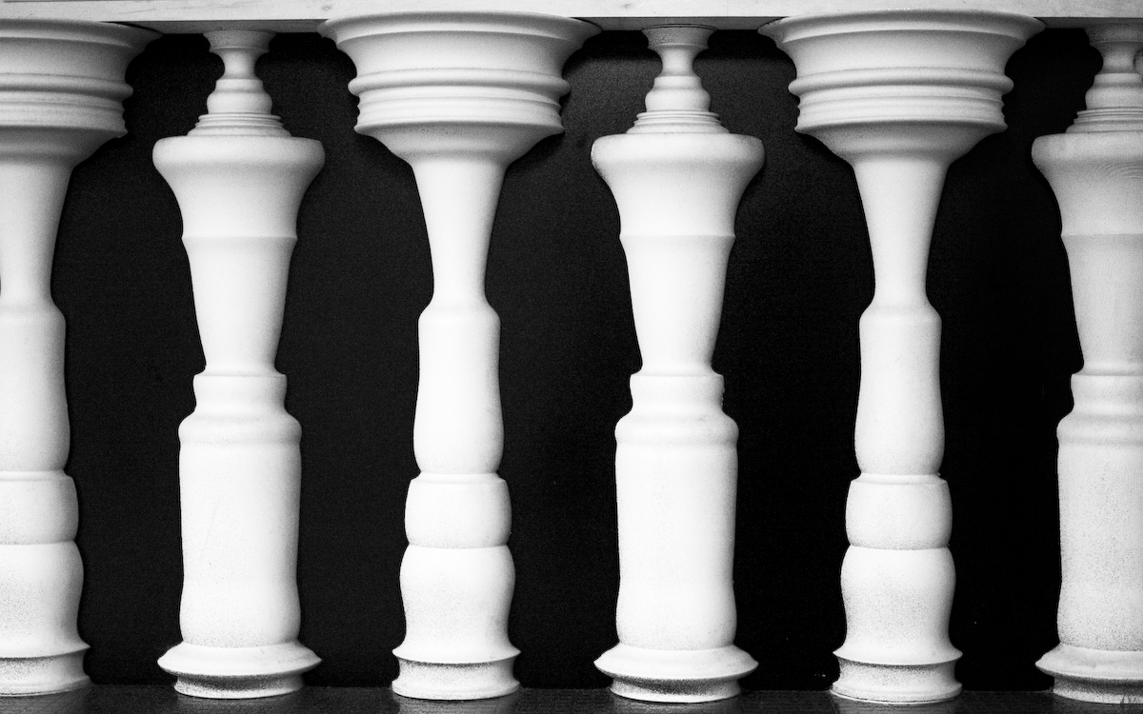
Notes:
Just like the optical illusions we knew as youth, there are illusions of speed.
I wanted to find some real world examples where our perception of speed was completely divorced from the actual speed.
http://www.flickr.com/photos/shashachu/443215138/

Slide 3
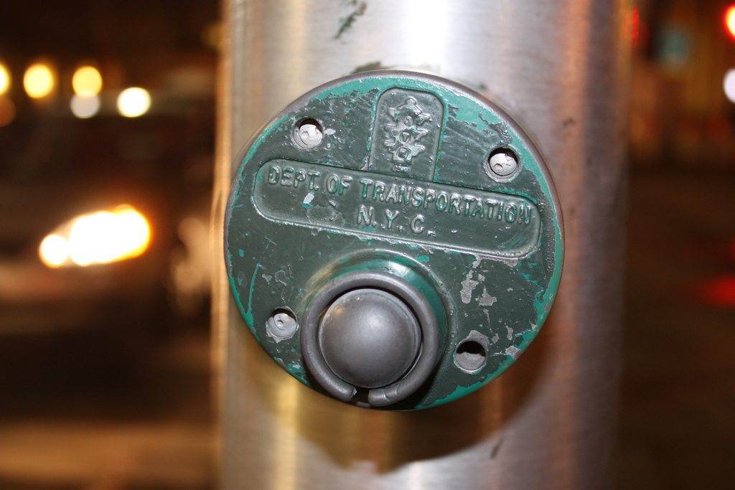
nytimes.com/2004/02/27/nyregion/27BUTT.html
Notes:
http://www.flickr.com/photos/35094885@N08/4390813150/in/photolist-7G14M1-d6BXUy
75%+ disconnected according to NYC Dept of Transporation (2,500 of 3,250)
mechanical placebos leftover from switch to computer-controlled signals in 1980s
The city deactivated most of the pedestrian buttons long ago with the emergence of computer-controlled traffic signals, even as an unwitting public continued to push on, according to city Department of Transportation officials. More than 2,500 of the 3,250 walk buttons that still exist function essentially as mechanical placebos, city figures show. Any benefit from them is only imagined.
Most of the buttons scattered through the city, mainly outside of Manhattan, are relics of the 1970's, before computers began tightly choreographing traffic signal patterns on major arteries. They were installed at a time when traffic was much lighter, said Michael Primeggia, deputy commissioner of traffic operations for the city's Transportation Department.
Typically, semi-actuated signals were positioned at intersections of a major thoroughfare and a minor street. The major road would have a green light until someone pressed the button or a sensor in the roadway detected a car on the minor street. Then, after 90 seconds or so, the light would change.
By the late 1980's, most of the buttons had been deactivated, their steel exteriors masking the lie within. But city officials say they do not remember ever publishing an obituary, and the white and black signs stayed up, many of them looking as new and official as ever.

Slide 4
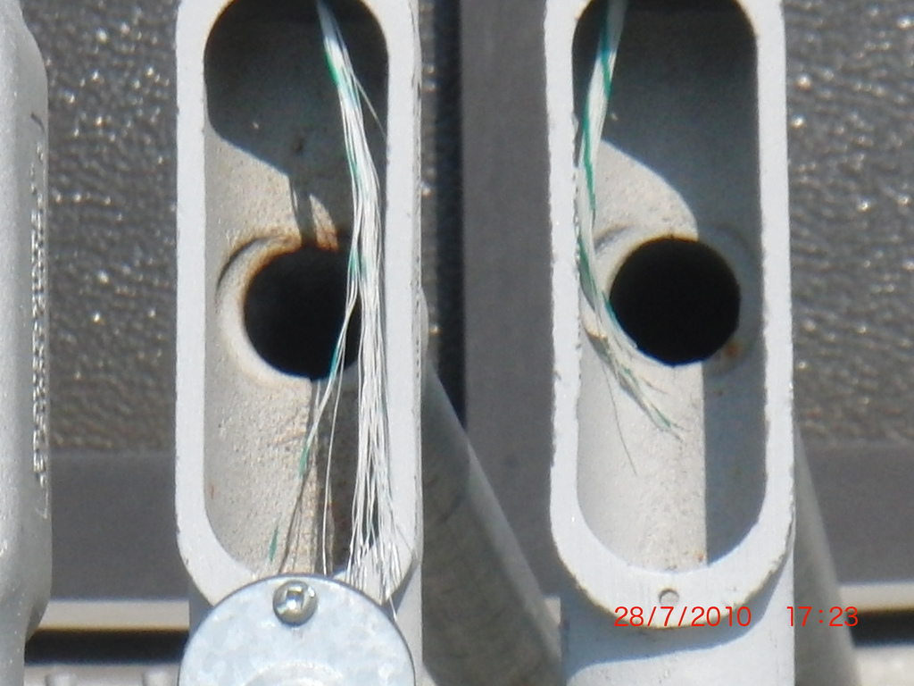
2,500 of 3,250 buttons deactivated
nytimes.com/2004/02/27/nyregion/27BUTT.html
Notes:
http://www.flickr.com/photos/escapefromyonkers/4847397650/
75%+ disconnected according to NYC Dept of Transporation (2,500 of 3,250)
mechanical placebos leftover from switch to computer-controlled signals in 1980s
The city deactivated most of the pedestrian buttons long ago with the emergence of computer-controlled traffic signals, even as an unwitting public continued to push on, according to city Department of Transportation officials. More than 2,500 of the 3,250 walk buttons that still exist function essentially as mechanical placebos, city figures show. Any benefit from them is only imagined.
Most of the buttons scattered through the city, mainly outside of Manhattan, are relics of the 1970's, before computers began tightly choreographing traffic signal patterns on major arteries. They were installed at a time when traffic was much lighter, said Michael Primeggia, deputy commissioner of traffic operations for the city's Transportation Department.
Typically, semi-actuated signals were positioned at intersections of a major thoroughfare and a minor street. The major road would have a green light until someone pressed the button or a sensor in the roadway detected a car on the minor street. Then, after 90 seconds or so, the light would change.
By the late 1980's, most of the buttons had been deactivated, their steel exteriors masking the lie within. But city officials say they do not remember ever publishing an obituary, and the white and black signs stayed up, many of them looking as new and official as ever.

Slide 5
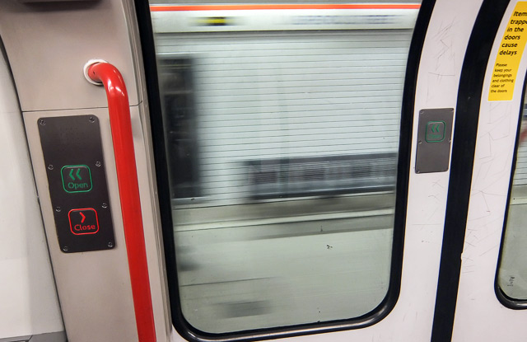
on every Underground train, the doors are operated by the driver
londonist.com/2013/04/why-are-there-buttons-on-tube-train-doors.php

Slide 6
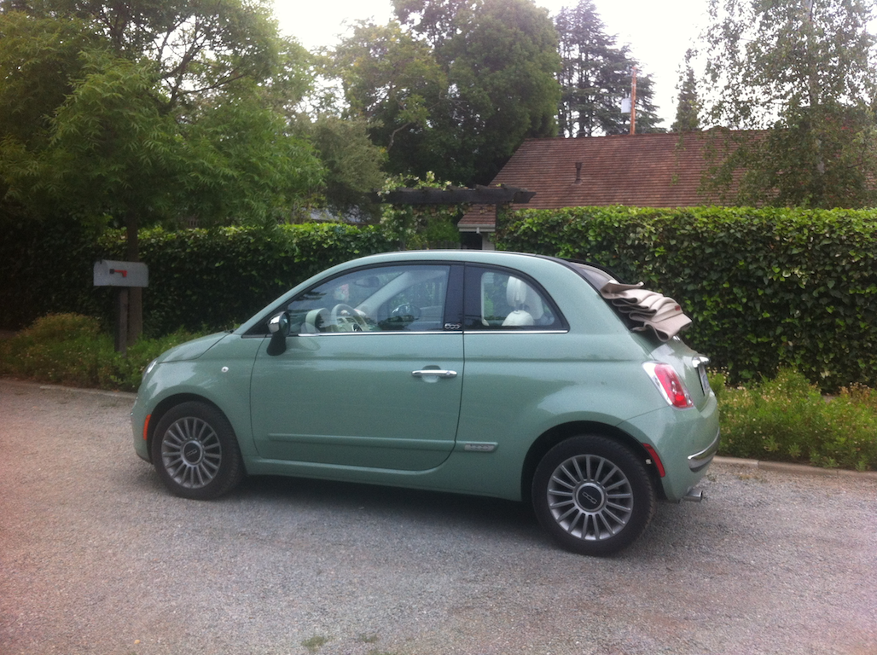
Notes:
1.4 liter, 101 hp
0-60 in 12.4 seconds
Ford Fiesta: 1.6L, 197 hp
Honda Fit: 1.5L, 117 hp
Smart Passion: 1L, 70 hp
“Engaging Sport mode does quicken throttle response and tightens up the electric power steering, giving the 500 an even zippier feel” - http://www.motorweek.org/reviews/road_tests/2012_fiat_500

Slide 7
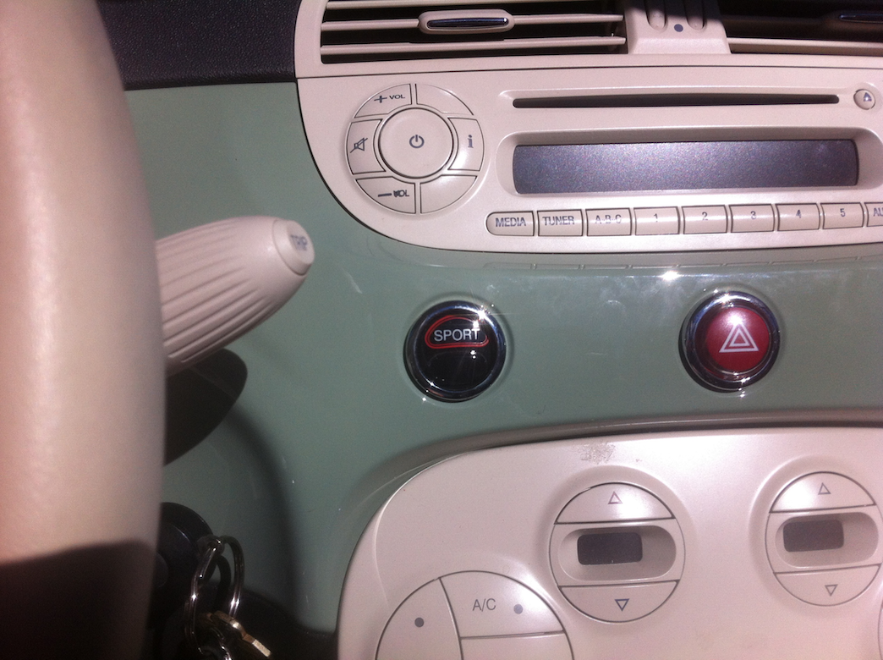
half the horsepower of a Ford Fiesta
Notes:
1.4 liter, 101 hp
0-60 in 12.4 seconds
Ford Fiesta: 1.6L, 197 hp
Honda Fit: 1.5L, 117 hp
Smart Passion: 1L, 70 hp
“Engaging Sport mode does quicken throttle response and tightens up the electric power steering, giving the 500 an even zippier feel” - http://www.motorweek.org/reviews/road_tests/2012_fiat_500

Slide 8
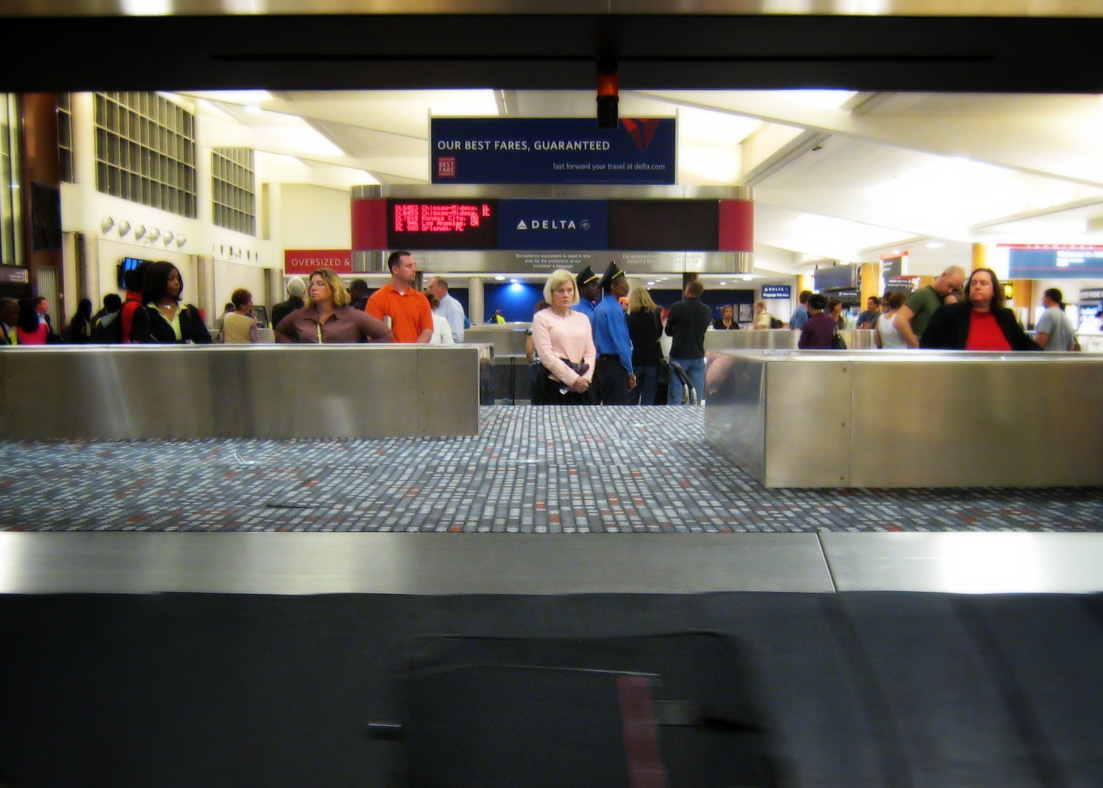
nytimes.com/2012/08/19/opinion/sunday/why-waiting-in-line-is-torture.html
Notes:
http://www.flickr.com/photos/dougww/2608181637/
Houston Airport
before: 1 min walk to baggage claim, 7 min wait for bags
after: 6 min walk, 2 min wait

Slide 9
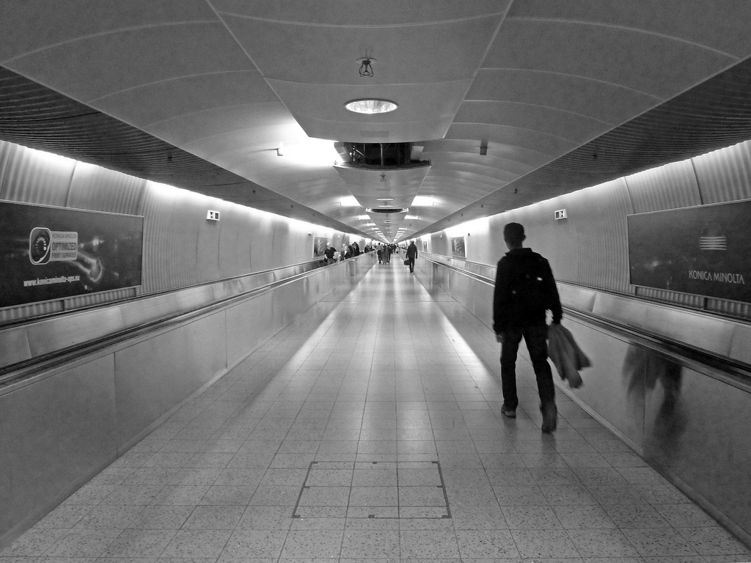
increased distance from gate to bags 6x
nytimes.com/2012/08/19/opinion/sunday/why-waiting-in-line-is-torture.html
Notes:
http://www.flickr.com/photos/hdz/8292495879/
Houston Airport
before: 1 min walk to baggage claim, 7 min wait for bags
after: 6 min walk, 2 min wait

Slide 10
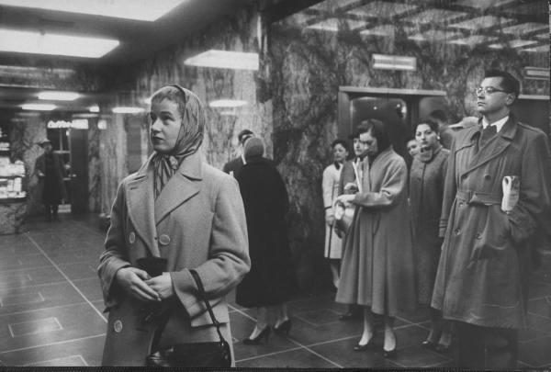
uie.com/articles/download_time/
Notes:
http://www.asktog.com/basics/03Performance.html
A classic example occurred in the 1930s in New York City, where "users" in a large new high-rise office building consistently complained about the wait times at the elevators. Engineers consulted concluded that there was no way to either speed up the elevators or to increase the number or capacity of the elevators. A designer was then called in, and he was able to solve the problem.
What the designer understood was that the real problem was not that wait time was too long, but that the wait time was perceived as too long. The designer solved the perception problem by placing floor-to-ceiling mirrors all around the elevator lobbies. People now engaged in looking at themselves and in surreptitiously looking at others, through the bounce off multiple mirrors. Their minds were fully occupied and time flew by.

Slide 11
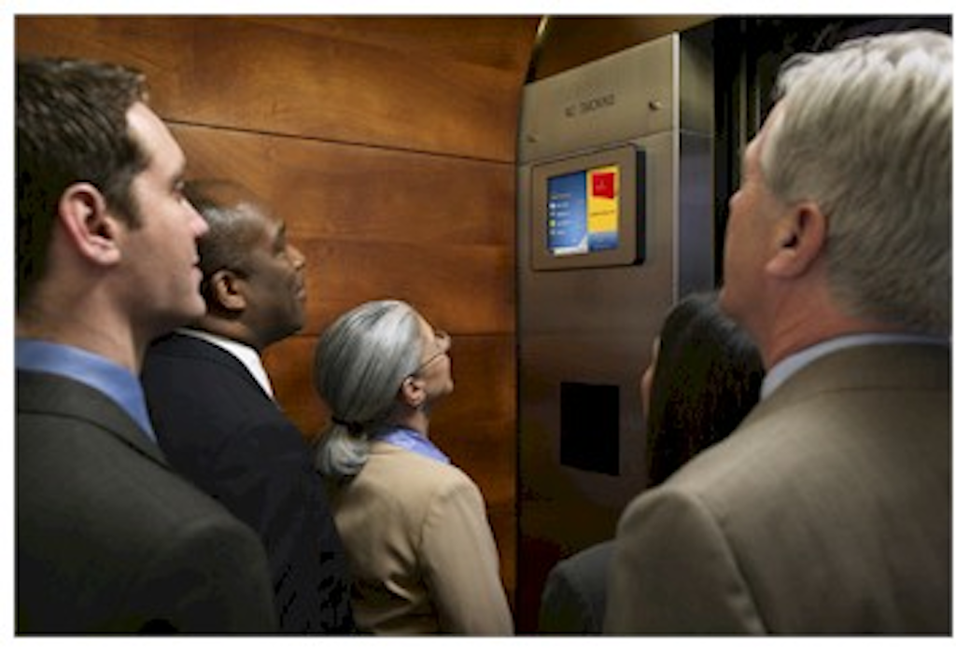
placed mirrors & TVs in elevators & lobbies
uie.com/articles/download_time/
Notes:
http://www.medialifemagazine.com/your-clients-message-rising-to-the-top/

Slide 12
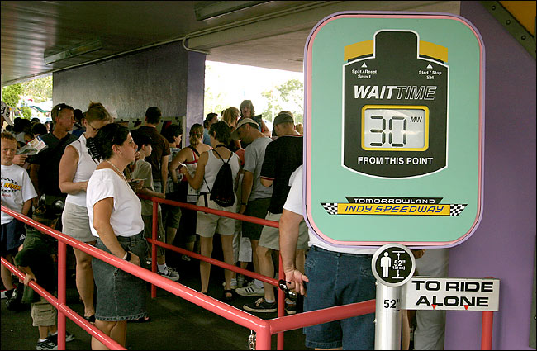
overestimate waittime
hide length of line
nytimes.com/2012/08/19/opinion/sunday/why-waiting-in-line-is-torture.html
Notes:
http://megowan.wordpress.com/2011/01/04/the-secret-objectives-of-queues/
Waiting less than expected makes people happier.
=> so Disney overestimates the wait time
And people are more concerned about the LENGTH of a line than how fast it moves.
=> so Disney hides the length of lines by wrapping them around buildings
“Disney…overestimates times for rides.”
“beating expectations buoys our mood.”
“people who wait less than they anticipated leave happier than those who wait longer than expected”
“we are more concerned with how long a line is than how fast it’s moving. Given a choice between a slow-moving short line and a fast-moving long one, we will often opt for the former, even if the waits are identical. (This is why Disney hides the lengths of its lines by wrapping them around buildings and using serpentine queues.)

Slide 13
?
goodness
speed
(work)

Slide 14


Creating your blog…
news.ycombinator.com/item?id=2007385
Notes:
http://www.flickr.com/photos/laughingsquid/2744068499/
Jeff Veen – redesigning Blogger – the blog wizard was TOO fast

Slide 15
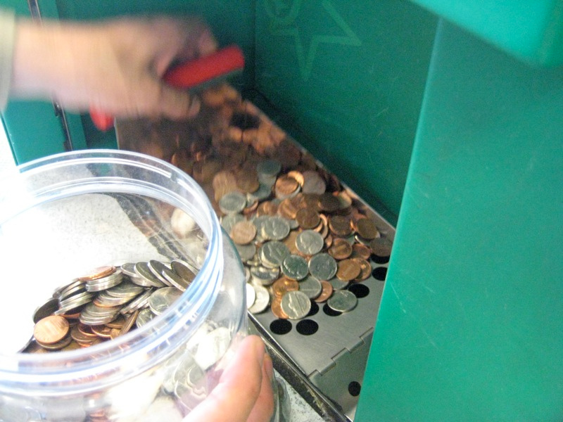
update coin count at slower rate
news.ycombinator.com/item?id=2007385
Notes:
http://www.flickr.com/photos/calamity_hane/4655070224/
Customers thought it was impossible for a machine to count change accurately at such a high rate.
=> Displayed results at a slower rate.
=> Sound of change counting is a recording.
The machine is able to calculate the total change deposited almost instantly. Yet, during testing the company learned that consumers did not trust the machines. Customers though it was impossible for a machine to count change accurately at such a high rate.
Faced with the issues of trust and preconceived expectations of necessary effort, the company began to rework the user experience.
The solution was fairly simple. The machine still counted at the same pace but displayed the results at a significantly slower rate. In fact, the sound of change working the way through the machine is just a recording that is played through a speaker.

Slide 16
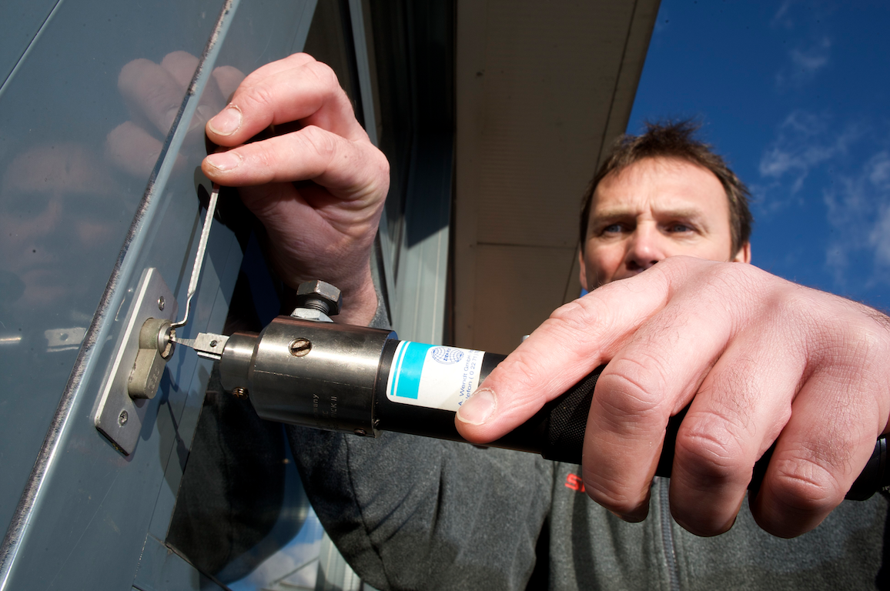
take longer opening locks => bigger tips
danariely.com/2010/12/15/locksmiths/
Notes:
http://soslocksmithny.com/

Slide 17
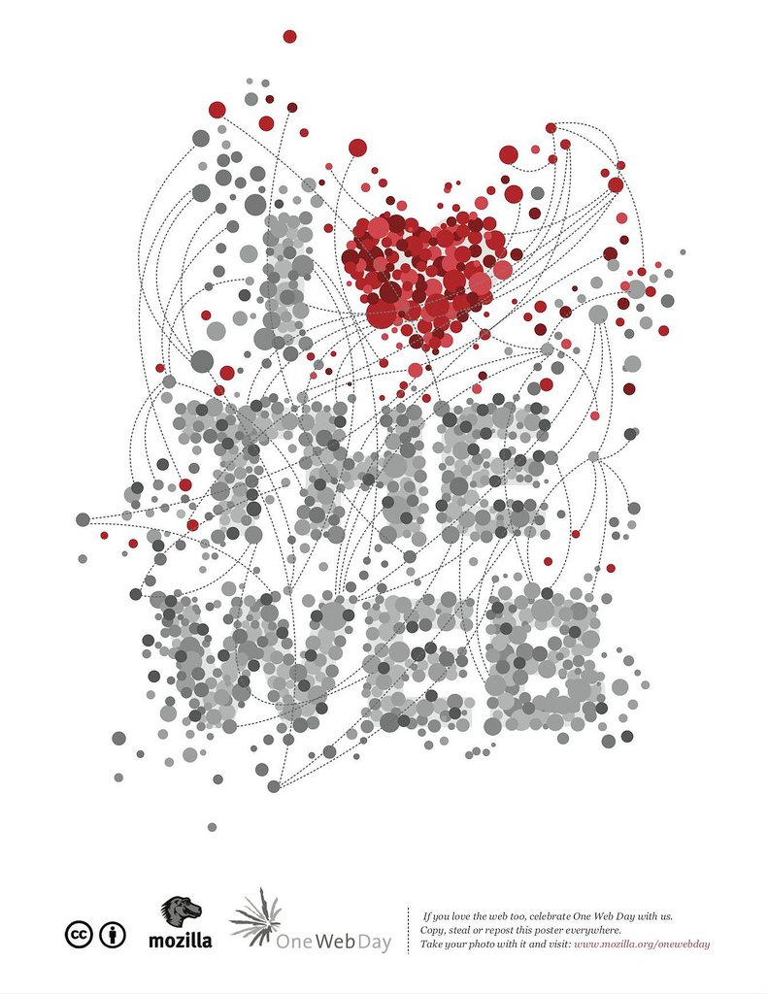
Notes:
http://www.flickr.com/photos/dullhunk/3930915541/

Slide 18
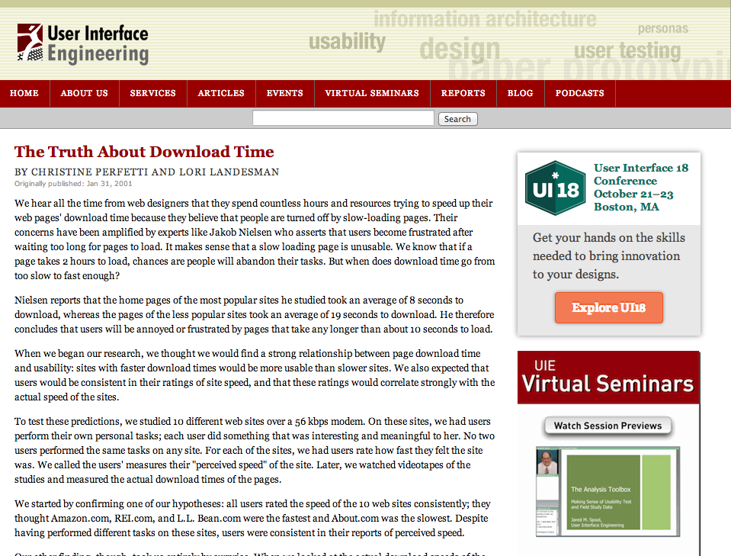
“Amazon.com, rated as one of the fastest sites by users, was really the slowest”
uie.com/articles/download_time/
Notes:
“There was still another surprising finding from our study: a strong correlation between perceived download time and whether users successfully completed their tasks on a site.”
“when people accomplish what they set out to do on a site, they perceive that site to be fast.”
“When users are complaining about the download speed of your site, what are they actually complaining about? Are you better off making the site load faster or ensuring that users complete their tasks?”

Slide 19
Notes:
http://www.flickr.com/photos/shashachu/443215138/

Slide 20
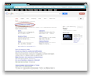
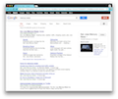


click link
create BODY
start render
<html><script
<body><script
DNS
time to first byte
content
connect
previous page isn’t cleared until BODY is created
stevesouders.com/blog/2012/12/05/clear-current-page-ux/
Notes:
One of the earliest browser change to improve the perception of speed was when the page is cleared.
Opera and Chrome also have a timeout, so sometimes they’ll clear the screen BEFORE the body is created.

Slide 21
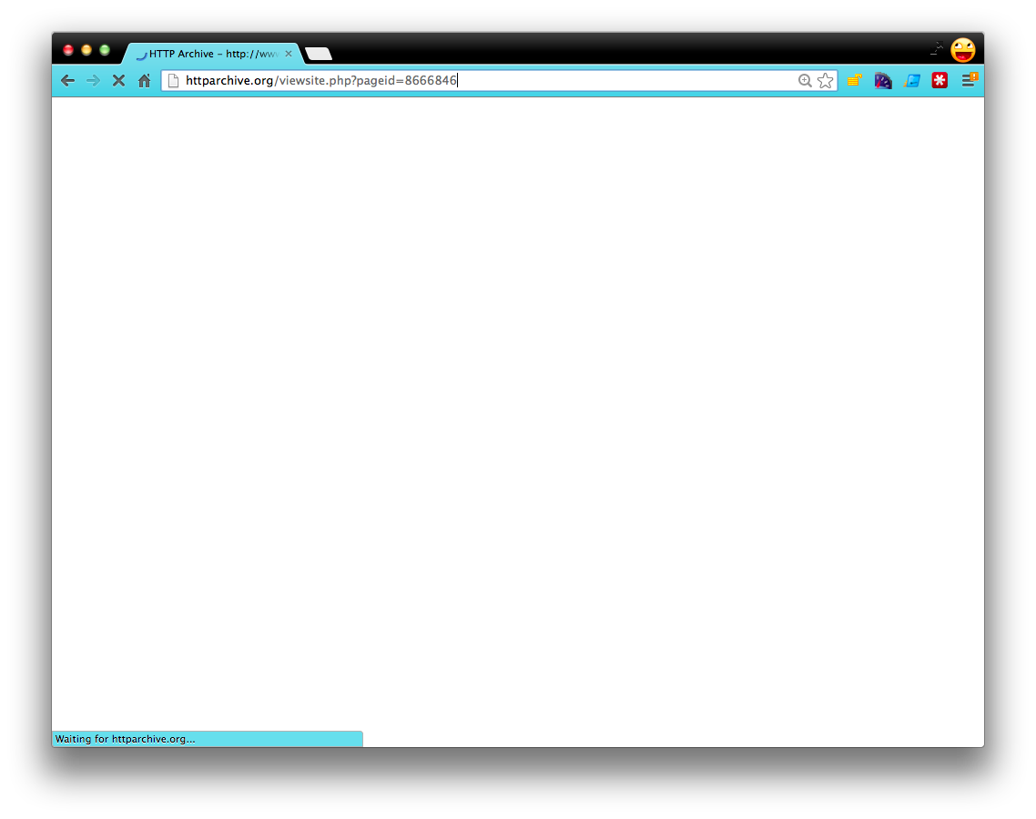
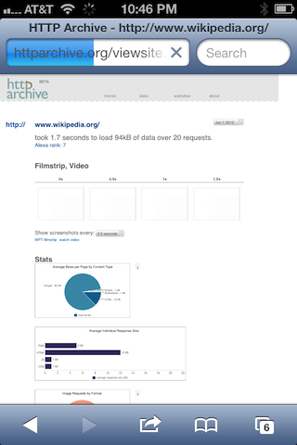


1. tab icon
Busy Indicators
6. network
5. reload icon
3. cursor
4. progress bar
2. status bar
stevesouders.com/blog/2013/06/16/browser-busy-indicators/
Notes:
The network indicator is only applicable for Mobile Safari.
The progress bar indicator is only applicable for Opera, Safari, Android, Chrome Mobile, and Mobile Safari.
Mobile browsers don’t have tabs, status bars, nor cursors (currently) so those indicators aren’t applicable.

Slide 22
tests
click link
<SCRIPT ASYNC ...>
dynamic script before onload
dynamic iframe
dynamic script
dynamic stylesheet
dynamic image
dynamic CSS background image
XHR
long JS execution
stevesouders.com/blog/2013/06/16/browser-busy-indicators/

Slide 23
tests
}
click link
<SCRIPT ASYNC ...>
dynamic script before onload
dynamic iframe
dynamic script
dynamic stylesheet
dynamic image
dynamic CSS background image
XHR
long JS execution
sync UX
}
no busy indicators
async UX
stevesouders.com/blog/2013/06/16/browser-busy-indicators/
Notes:
Many of the test cases didn’t trigger any of the browser busy indicators.
(Except on iOS the network spinner was triggered for every test that involved an HTTP request.)
sync – get mail
async – update stock quotes or friends’ status
GOOD NEWS for all those image beacons!

Slide 24
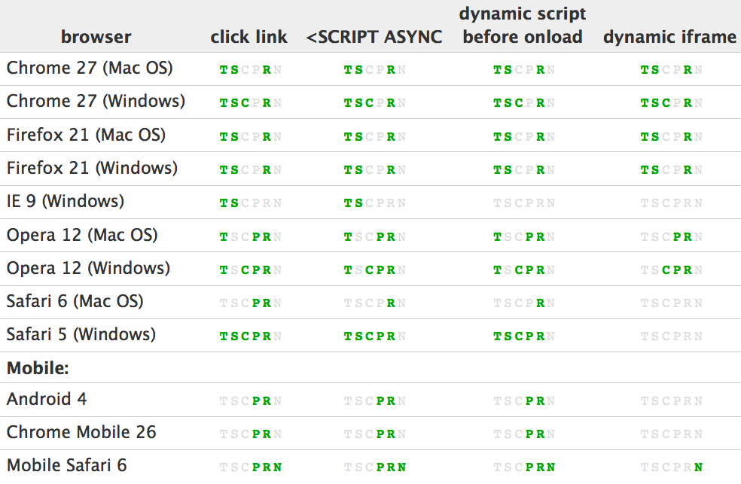
T = Tab icon
S = Status bar
C = Cursor
P = Progress bar
R = Reload icon
N = Network spinner
stevesouders.com/blog/2013/06/16/browser-busy-indicators/
Notes:
The network indicator is only applicable for Mobile Safari.
The progress bar indicator is only applicable for Opera, Safari, Android, Chrome Mobile, and Mobile Safari.
Mobile browsers don’t have tabs, status bars, nor cursors (currently) so those indicators aren’t applicable.

Slide 25
inconsistent across browsers
stevesouders.com/blog/2013/06/16/browser-busy-indicators/
Notes:
The network indicator is only applicable for Mobile Safari.
The progress bar indicator is only applicable for Opera, Safari, Android, Chrome Mobile, and Mobile Safari.
Mobile browsers don’t have tabs, status bars, nor cursors (currently) so those indicators aren’t applicable.

Slide 26
cursor is only triggered on Windows
stevesouders.com/blog/2013/06/16/browser-busy-indicators/
Notes:
The network indicator is only applicable for Mobile Safari.
The progress bar indicator is only applicable for Opera, Safari, Android, Chrome Mobile, and Mobile Safari.
Mobile browsers don’t have tabs, status bars, nor cursors (currently) so those indicators aren’t applicable.

Slide 27



Google Plus
Twitter
Facebook
WebView:
non-standard busy indicators!
Notes:
iPhone4 iOS6

Slide 28





Native Apps:
no busy indicators!

Slide 29
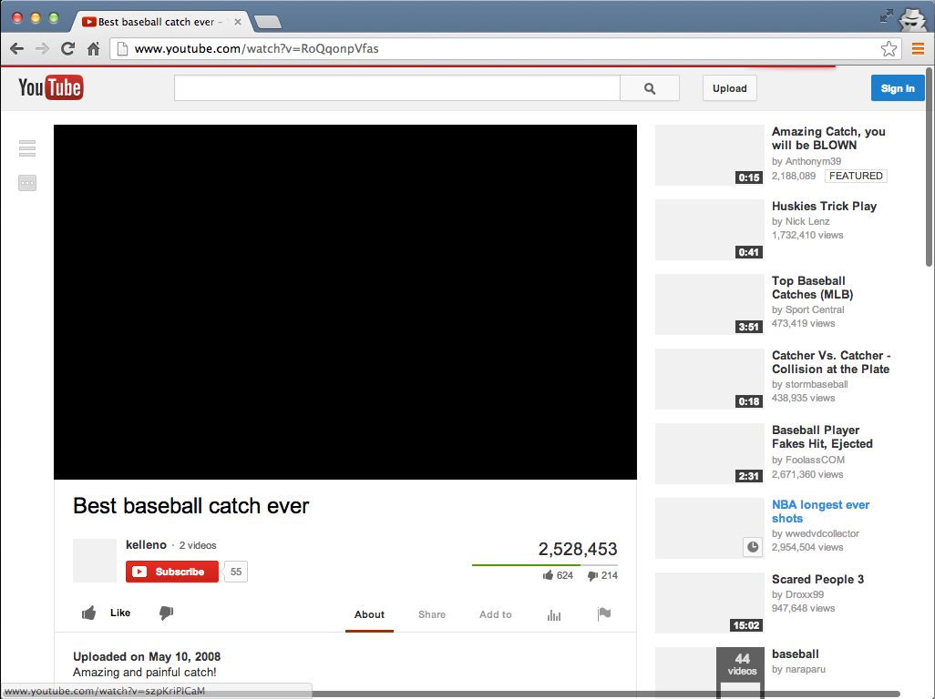

Slide 30
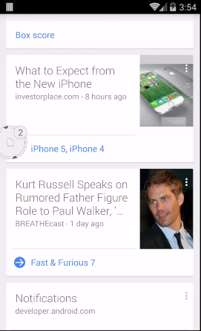
play.google.com/store/apps/details?id=com.linkbubble.playstore
Notes:
https://play.google.com/store/apps/details?id=com.linkbubble.playstore

Slide 31
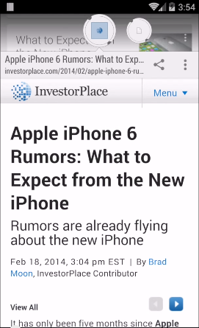
play.google.com/store/apps/details?id=com.linkbubble.playstore
Notes:
https://play.google.com/store/apps/details?id=com.linkbubble.playstore

Slide 32
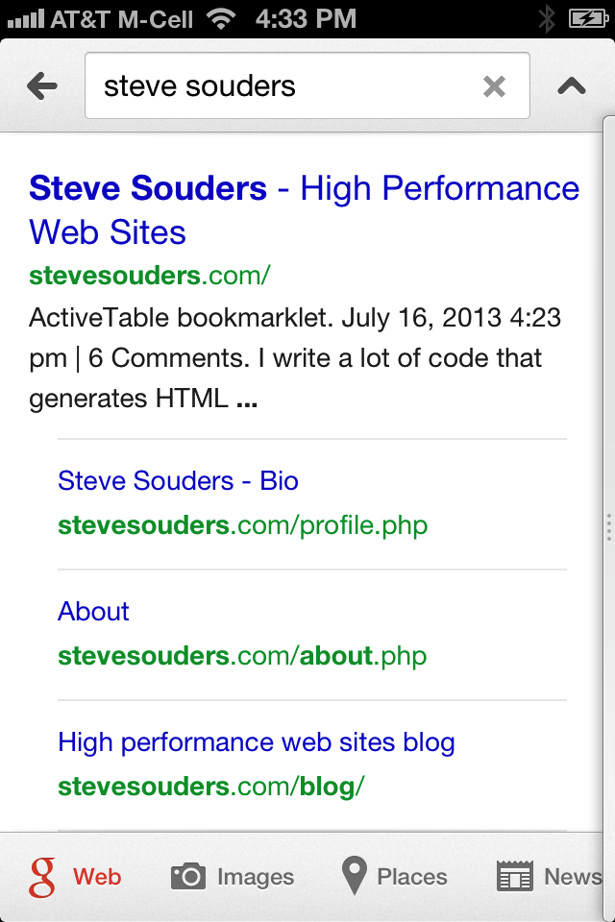
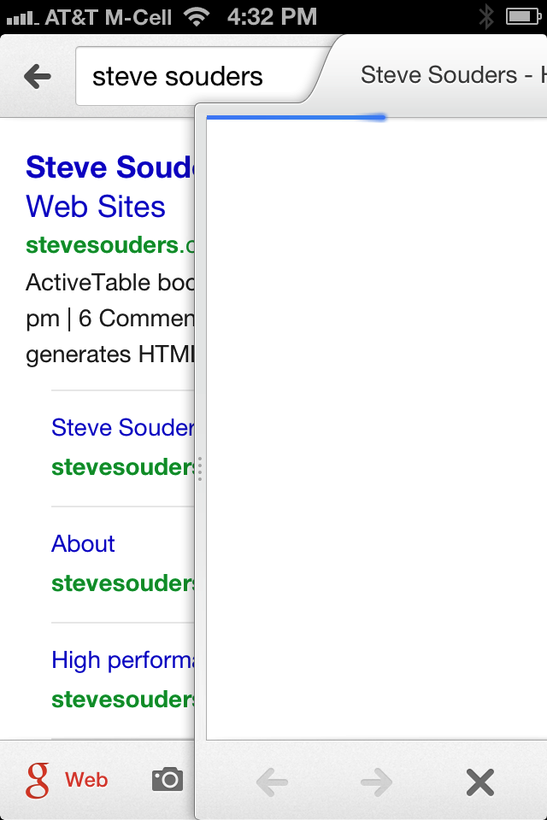
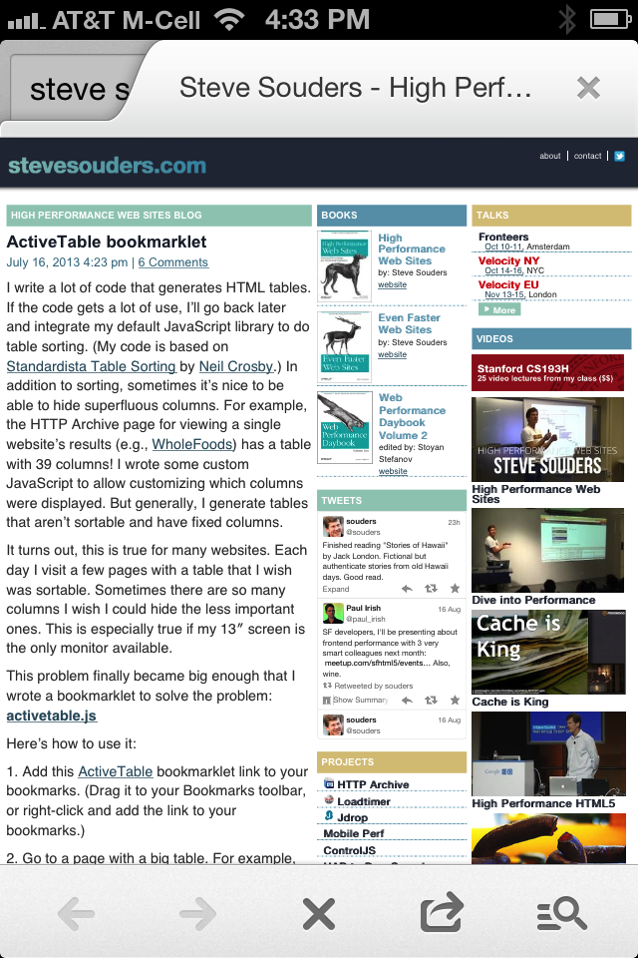
“natural” progress indicators
Notes:
Google Search App on iOS

Slide 33
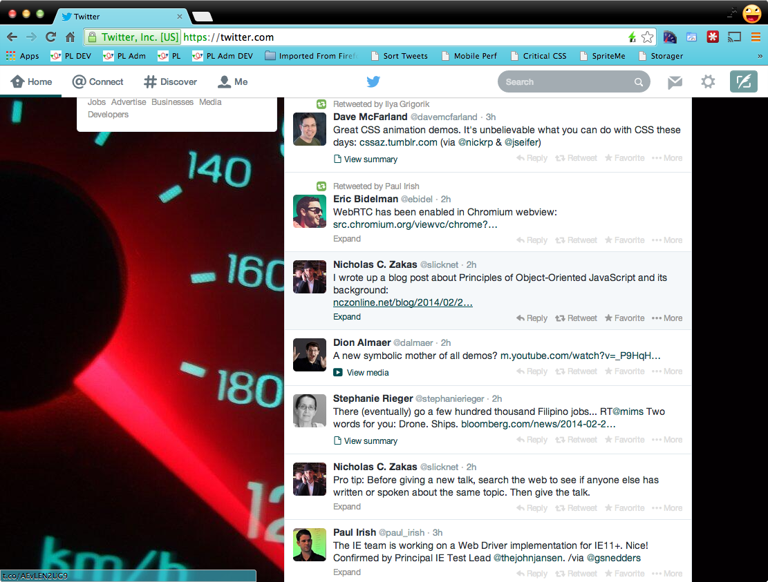

Slide 34

why should opening a new tab be a harsh transition?

Slide 35
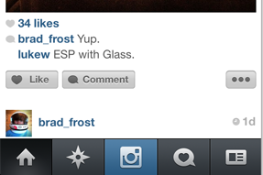
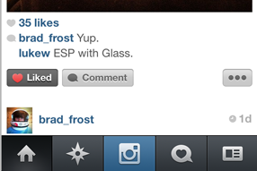
optimistic actions
Instagram
“Like” button changes immediately
server update happens in background
lukew.com/ff/entry.asp?1759
Notes:
Instragram co-founder Mike Krieger calls this technique “performing actions optimistically”.

Slide 36

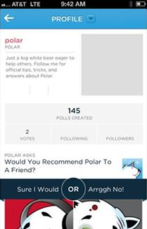
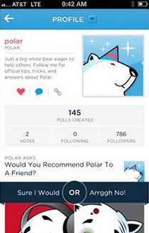
skeleton screens
blank page that is gradually filled
lukew.com/ff/entry.asp?1797
Notes:
From Luke's app "Polar".

Slide 37


Slide 38
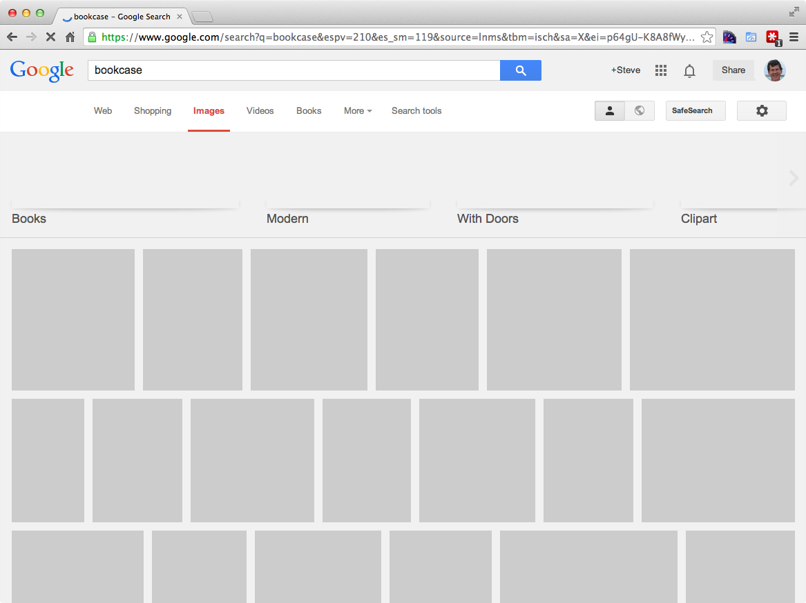

Slide 39
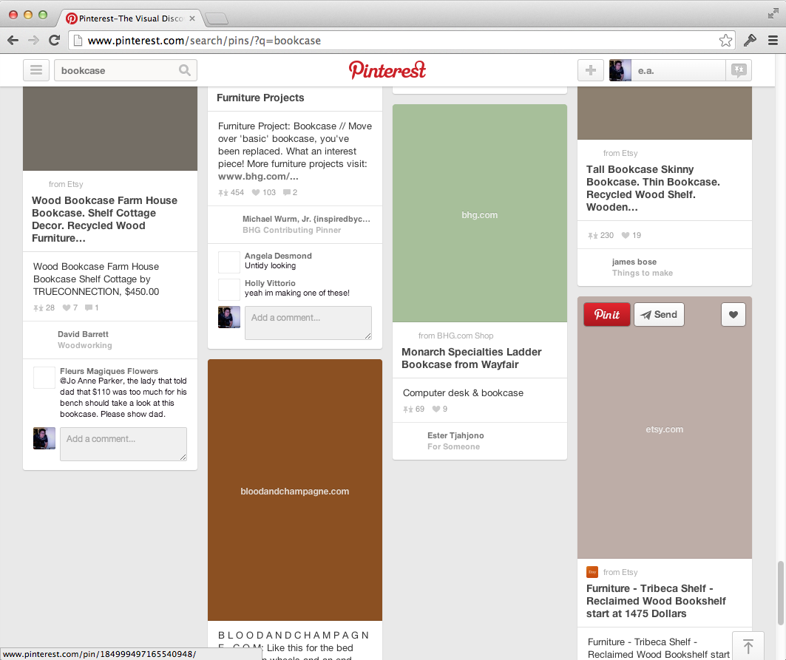
Notes:
Thanks to Emily Nakashima for this example.

Slide 40
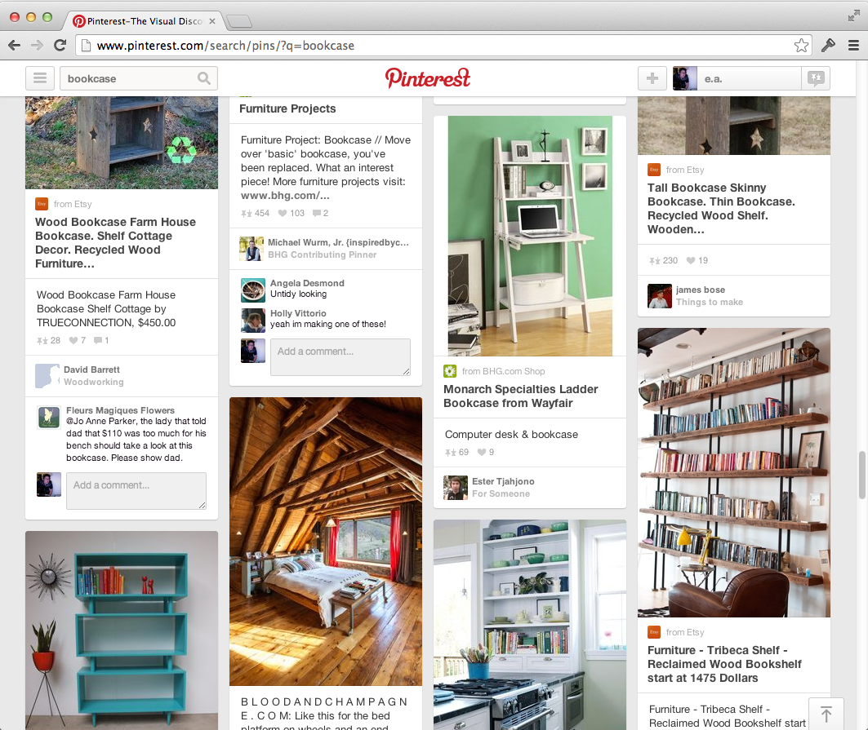

Slide 41
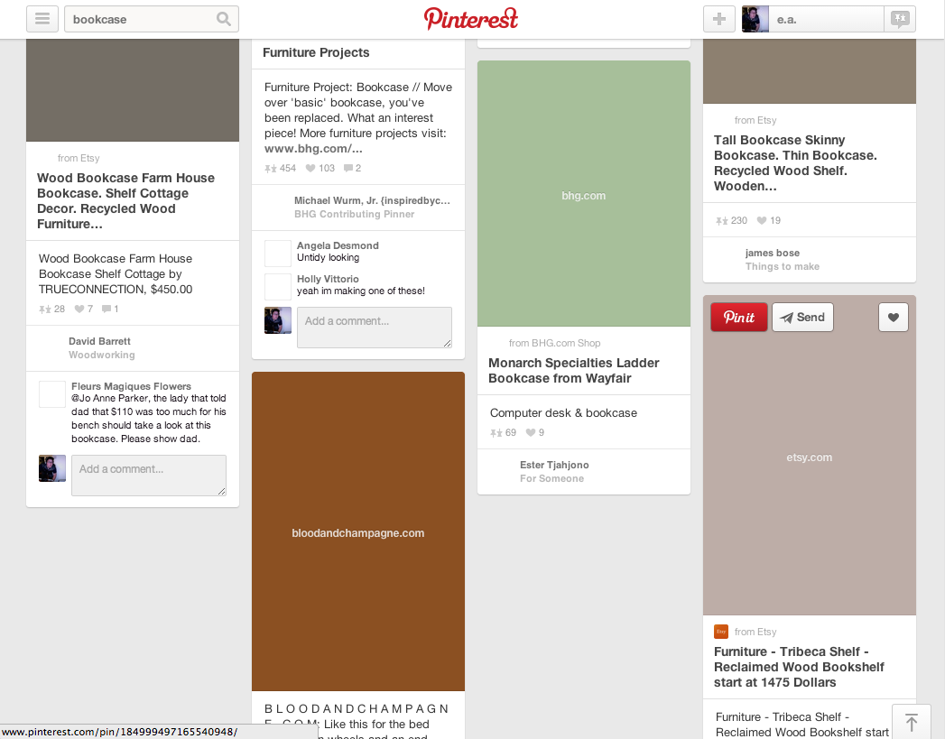

Slide 42
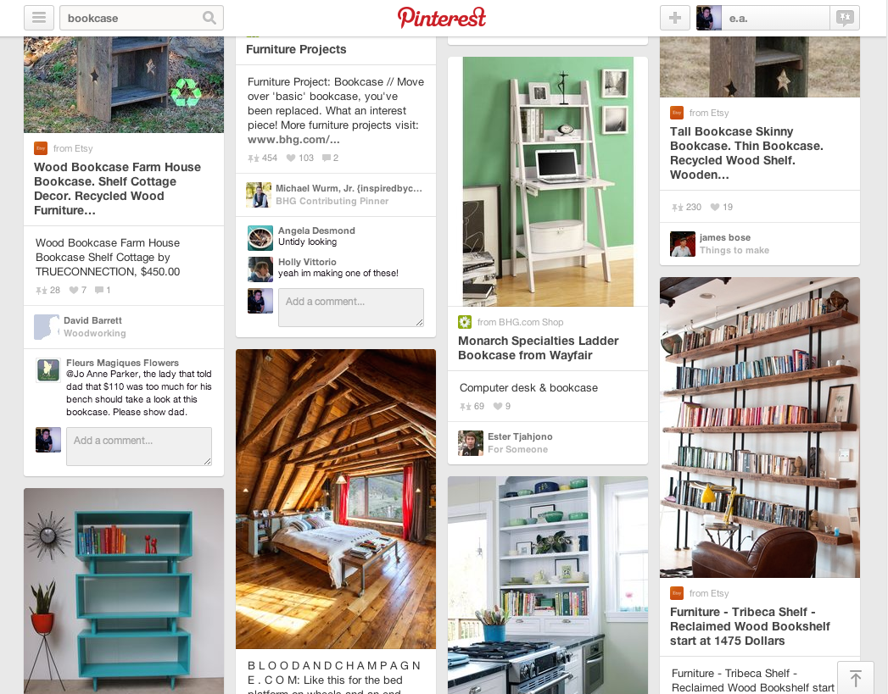

Slide 43
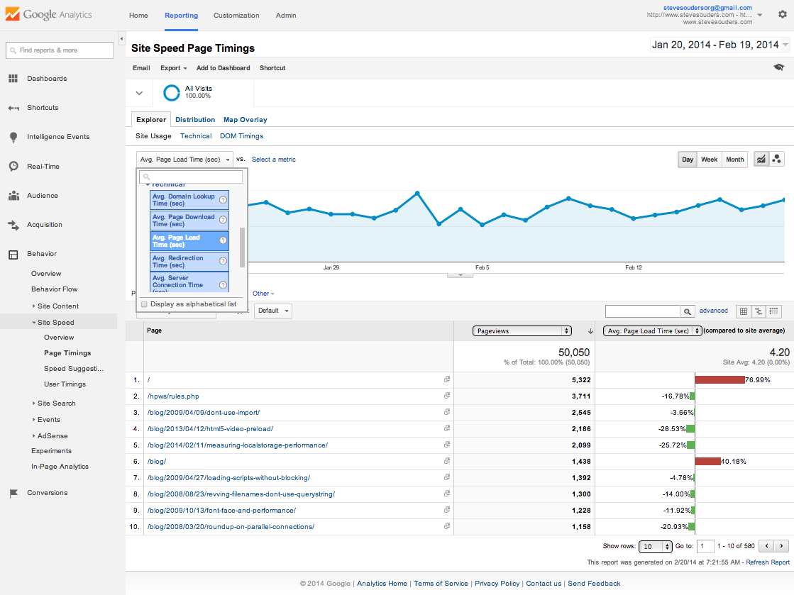
Notes:
https://www.google.com/analytics/web/?et=reset#report/content-site-speed-overview/a15026169w31046415p30049615/

Slide 44
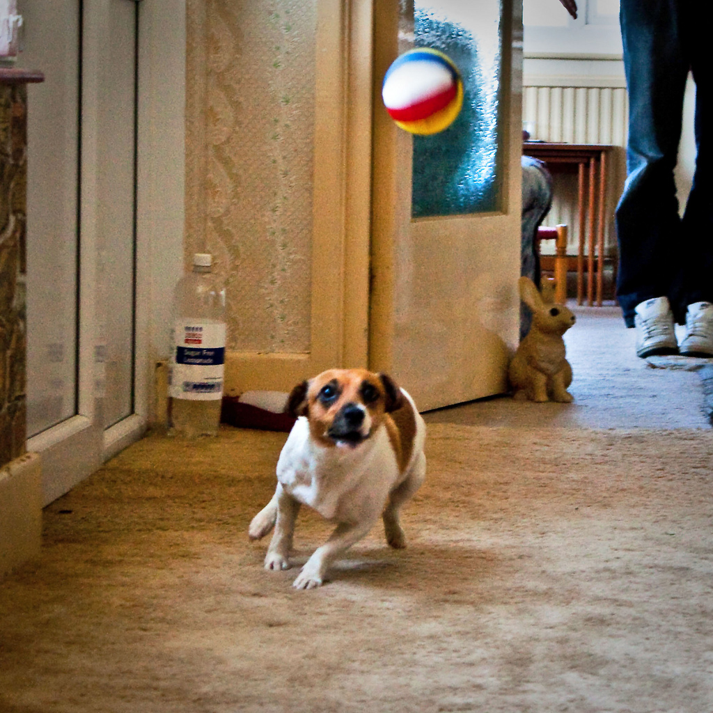
Notes:
flickr.com/photos/66176388@N00/3804806568/
Other ideas:
- clicked link feedback
- clear page on paint (NOT body created)
- JS API to get percentage of resources downloaded for better progress bars

Slide 45
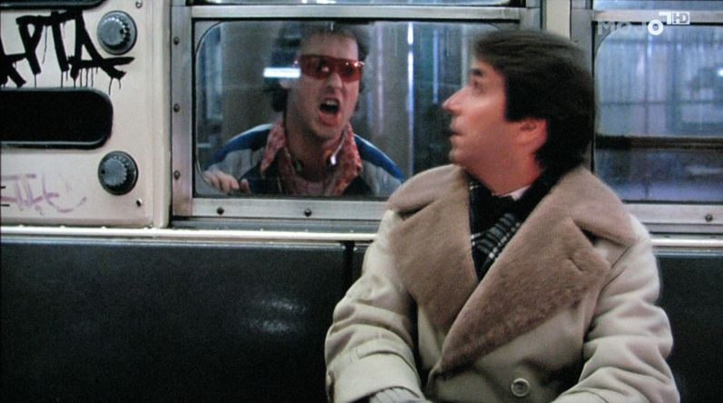
“Perception
Brokers!”
Notes:
http://thomaspluck.com/2008/07/24/80s-trash-of-the-week-night-shift-2/

Slide 46
Steve Souders
@souders
Notes:
"thank you" by nj dodge: http://flickr.com/photos/nj_dodge/187190601/
Verrazano-Narrows Bridge

Slide 47
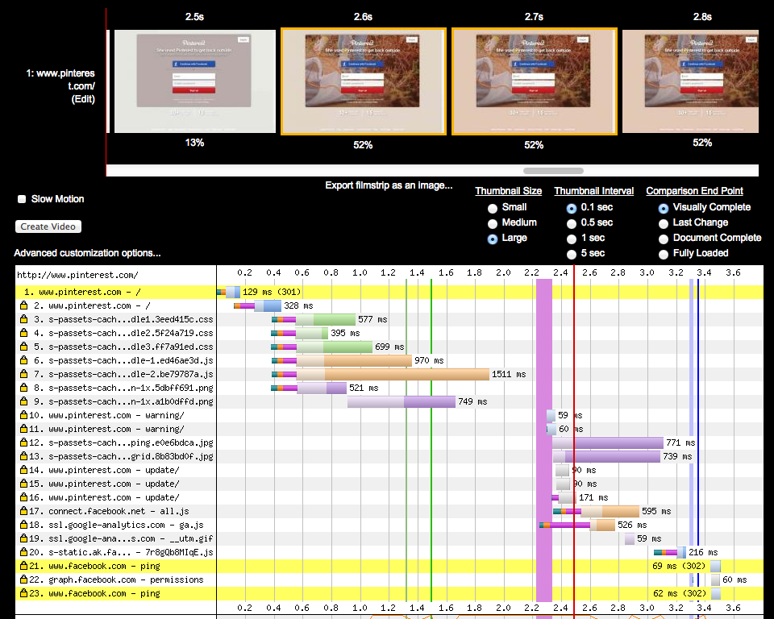
Why so late?!
Notes:
Chrome: http://www.webpagetest.org/result/141205_7Y_AA4/
IE9: http://www.webpagetest.org/result/141205_09_A9K/

Slide 48
FP
  login: main images are blocked by preloader
  loggedin: _30.jpg images steal connections
all:
  CPU is high, blocks rendering, JS?
  inline CSS? dynamic inlining?

