Slide 1
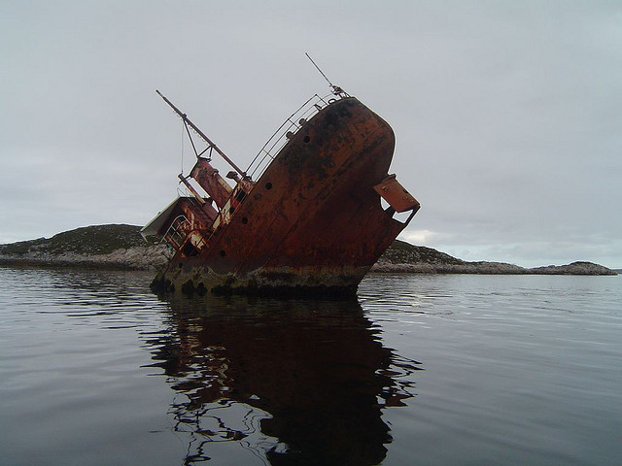
Your script just killed my site
stevesouders.com/docs/paypal-spof-20121115.pptx
Disclaimer: This content does not necessarily reflect the opinions of my employer.
Notes:
http://www.flickr.com/photos/jocelynaubert/3100384270/

Slide 2
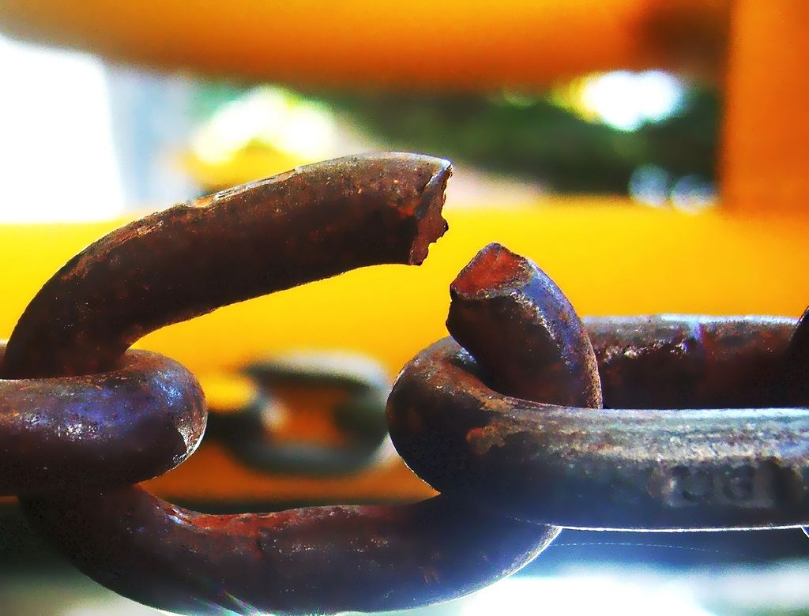
SPOF
Notes:
http://www.flickr.com/photos/darwinbell/465459020/

Slide 3
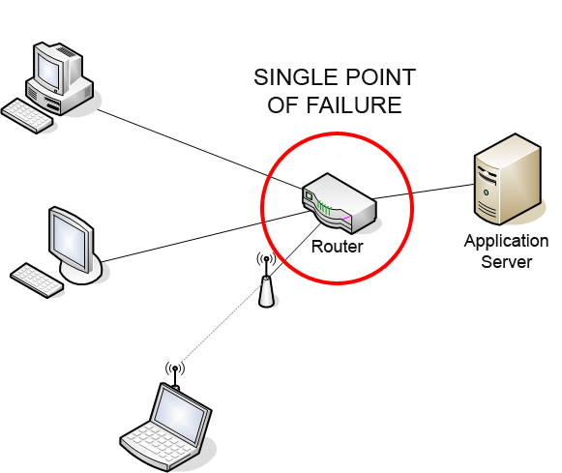
Notes:
http://en.wikipedia.org/wiki/Single_point_of_failure

Slide 4
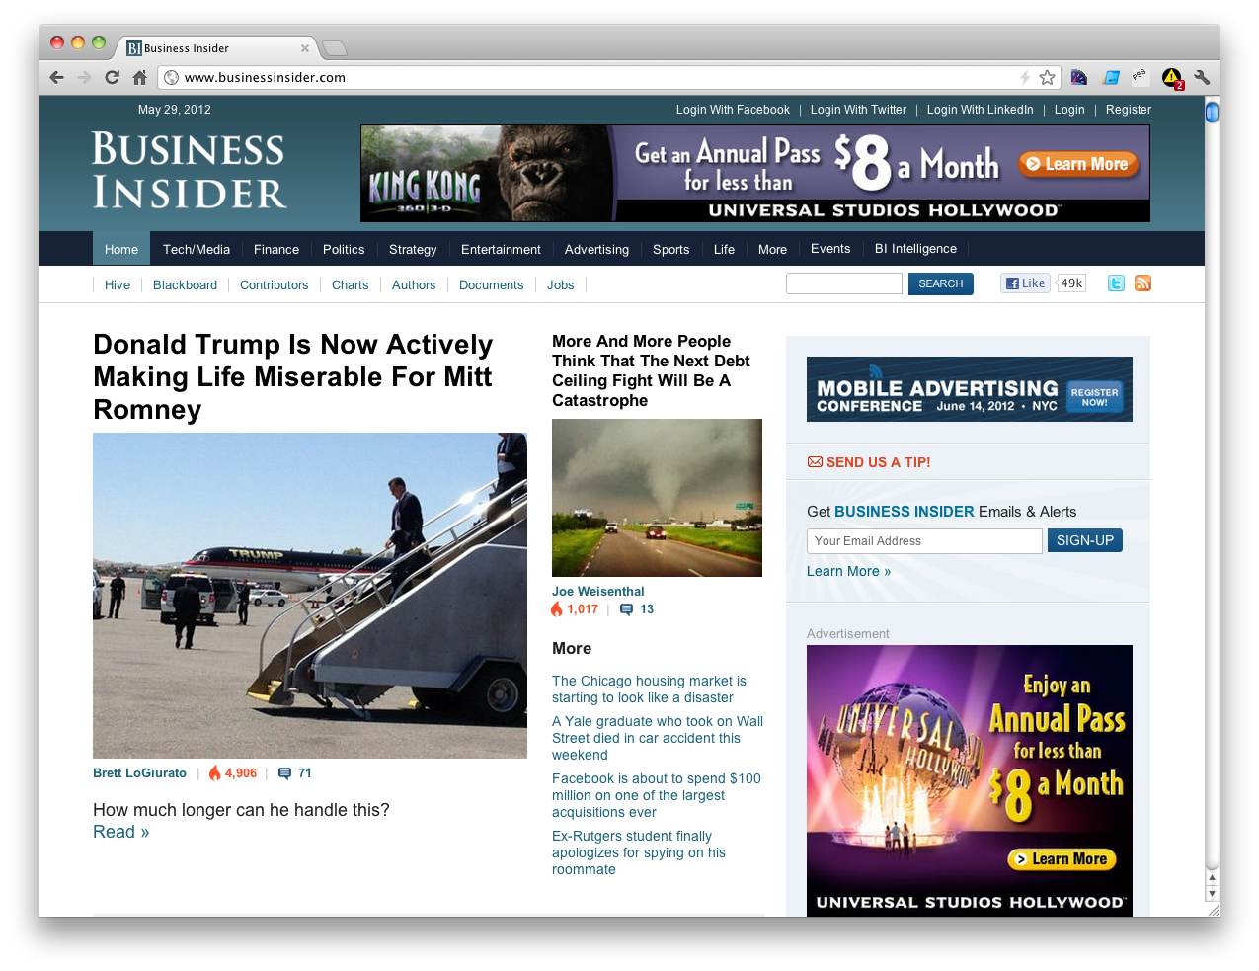
Notes:
Widgets
Ads
Analytics

Slide 5
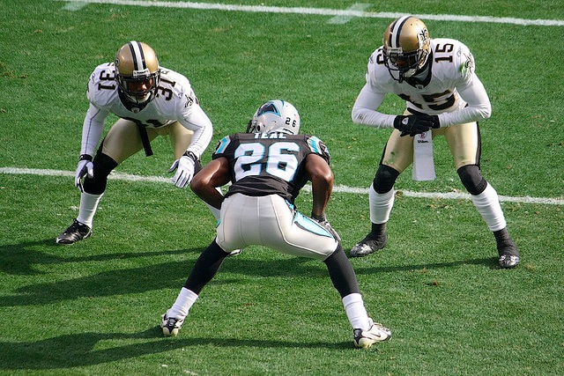
synchronous scripts block all following elements from rendering
in all browsers

Slide 6
#fail
Notes:
----- Meeting Notes (11/15/12 16:02) -----
If the backend server took 20-120 seconds to finish pagers would be going off.

Slide 7
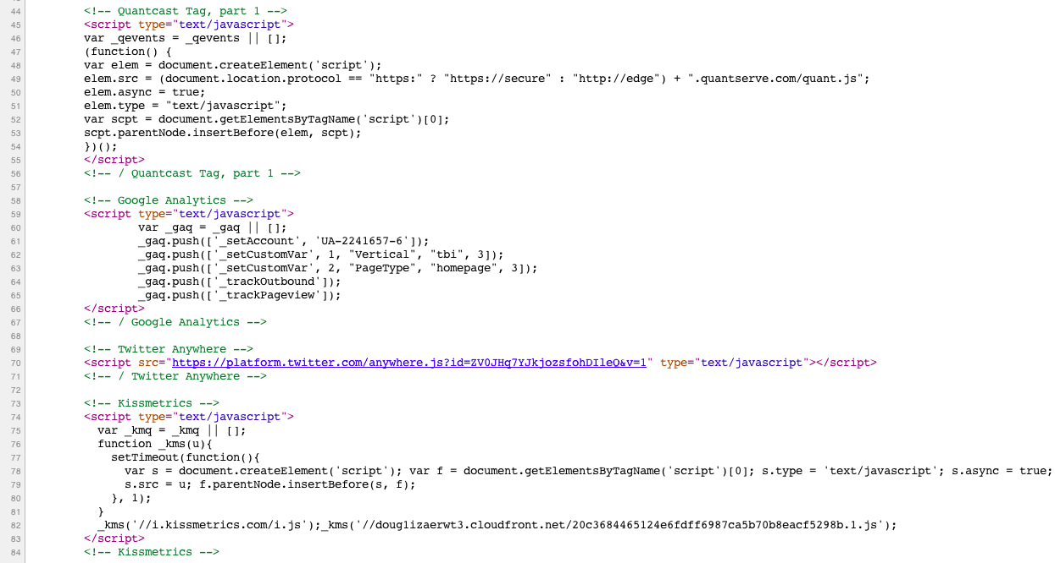
async
#fail
async
sync
async

Slide 8
Frontend SPOF

Slide 9
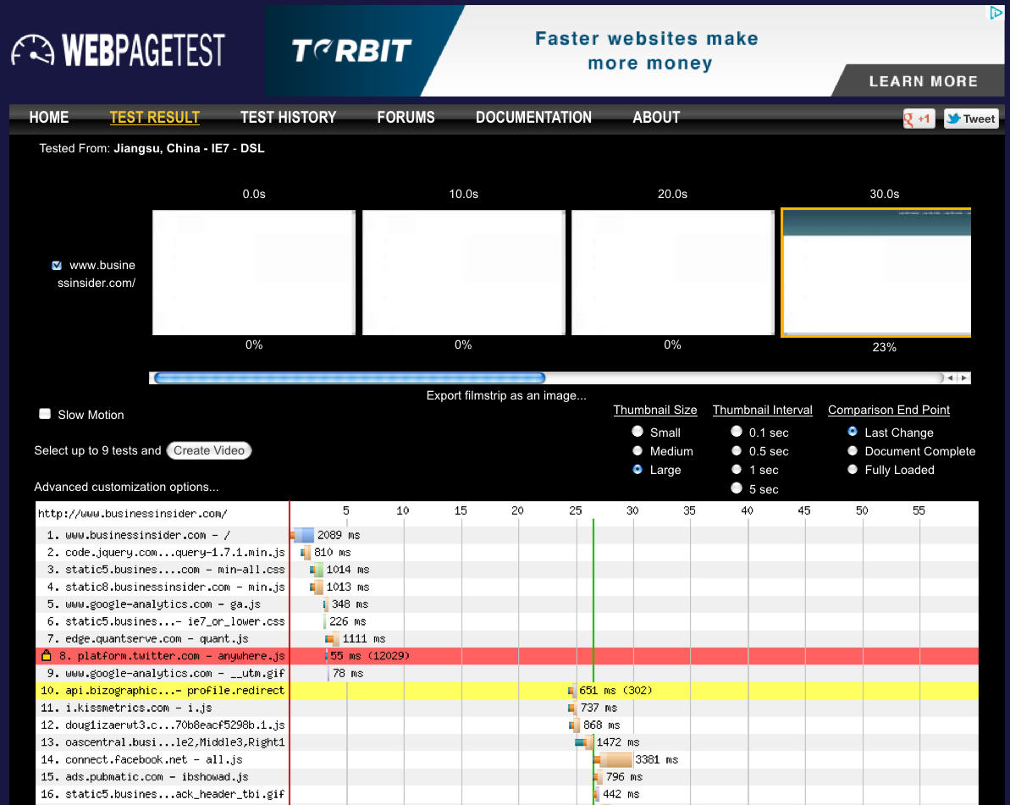
http://www.webpagetest.org/result/120529_41_HWV/

Slide 10
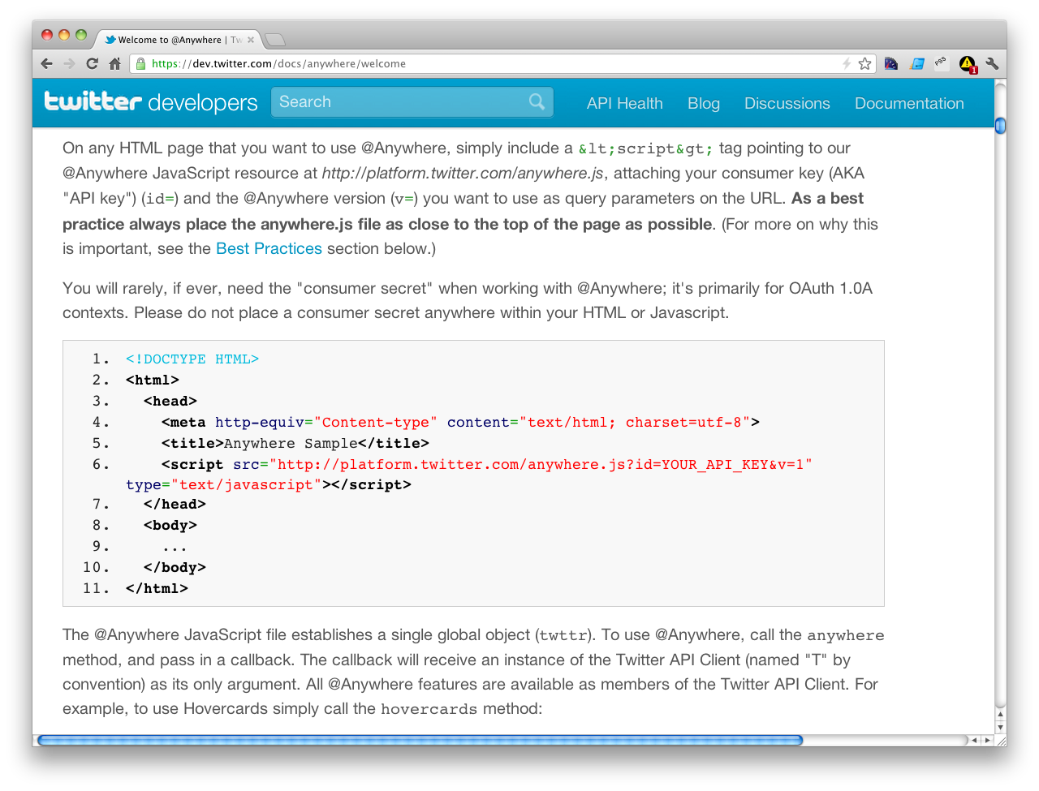

Slide 11
entire BODY blocked from rendering
Notes:
Later in the docs they talk about how the LATER resources are loaded async, but not this bootstrap script.
All it takes is one.

Slide 12
http://www.webpagetest.org/result/120529_41_HWV/

Slide 13
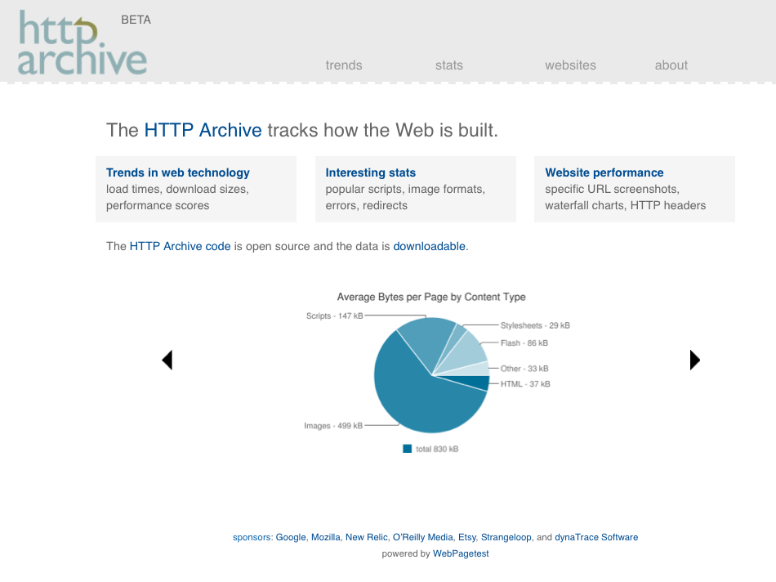

Slide 14
mysql>

Slide 15
select p.url, wptid
mysql>

Slide 16
select p.url, wptid
from pages as p, requests as r
mysql>

Slide 17
select p.url, wptid
from pages as p, requests as r
where p.pageid >= 844954 and
p.pageid <= 1564447 and
p.pageid = r.pageid and
mysql>

Slide 18
select p.url, wptid
from pages as p, requests as r
where p.pageid >= 844954 and
p.pageid <= 1564447 and
p.pageid = r.pageid and
rank < 20000 and
mysql>

Slide 19
select p.url, wptid
from pages as p, requests as r
where p.pageid >= 844954 and
p.pageid <= 1564447 and
p.pageid = r.pageid and
rank < 20000 and
resp_content_type like “%script%” and
mysql>

Slide 20
select p.url, wptid
from pages as p, requests as r
where p.pageid >= 844954 and
p.pageid <= 1564447 and
p.pageid = r.pageid and
rank < 20000 and
resp_content_type like “%script%” and
time > 10000 and
mysql>

Slide 21
select p.url, wptid
from pages as p, requests as r
where p.pageid >= 844954 and
p.pageid <= 1564447 and
p.pageid = r.pageid and
rank < 20000 and
resp_content_type like “%script%” and
time > 10000 and
renderStart > 10000
mysql>

Slide 22
select p.url, wptid
from pages as p, requests as r
where p.pageid >= 844954 and
p.pageid <= 1564447 and
p.pageid = r.pageid and
rank < 20000 and
resp_content_type like “%script%” and
time > 10000 and
renderStart > 10000
group by p.pageid;
mysql>

Slide 23
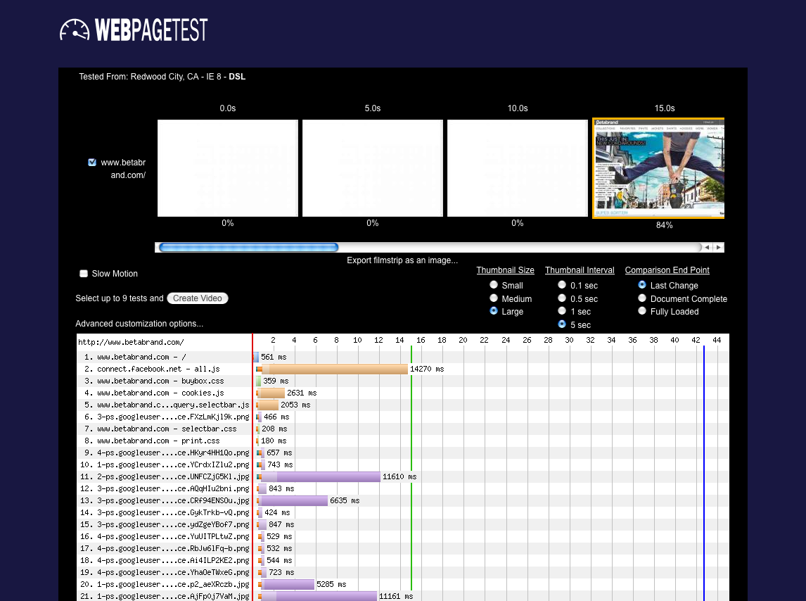
Notes:
http://httparchive.webpagetest.org/result/120401_40_WFQG/

Slide 24
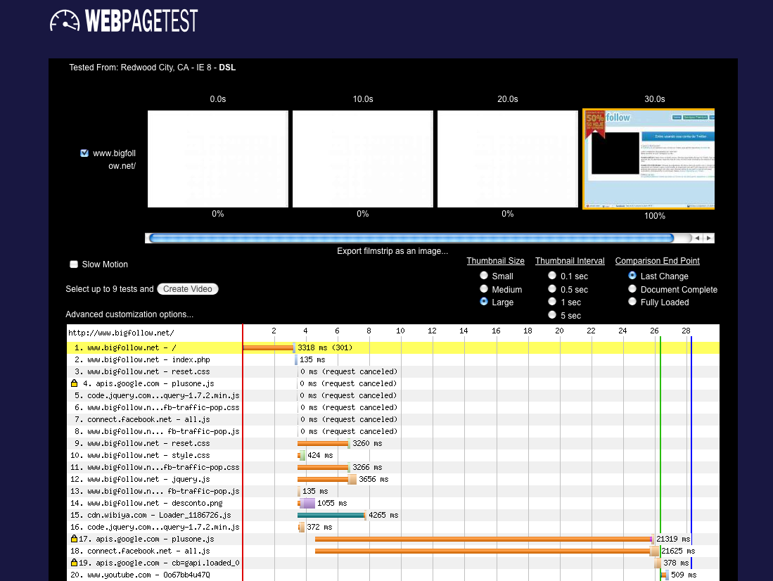
Notes:
http://httparchive.webpagetest.org/result/120515_5_4S4C/
plusone.js and all.js are synchronous

Slide 25
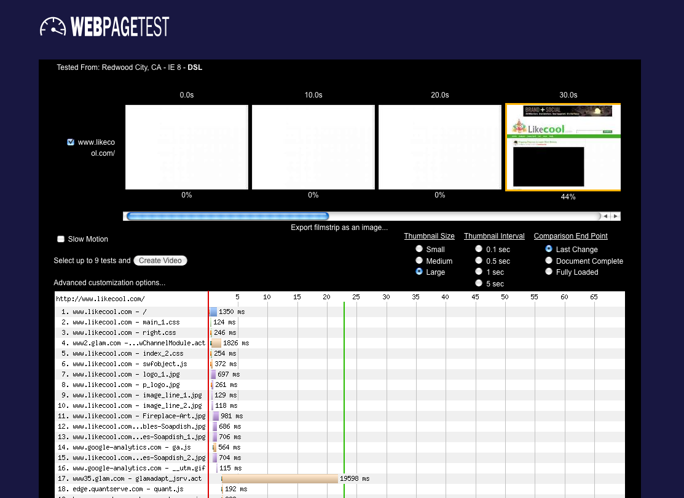
Notes:
http://httparchive.webpagetest.org/result/120515_0_DNT/
glamadapt_jsrv.act is inserted by wChannelModule.act using document.write
likecool is ranked 11K
Glam Media is “the leader in curated social media content”

Slide 26
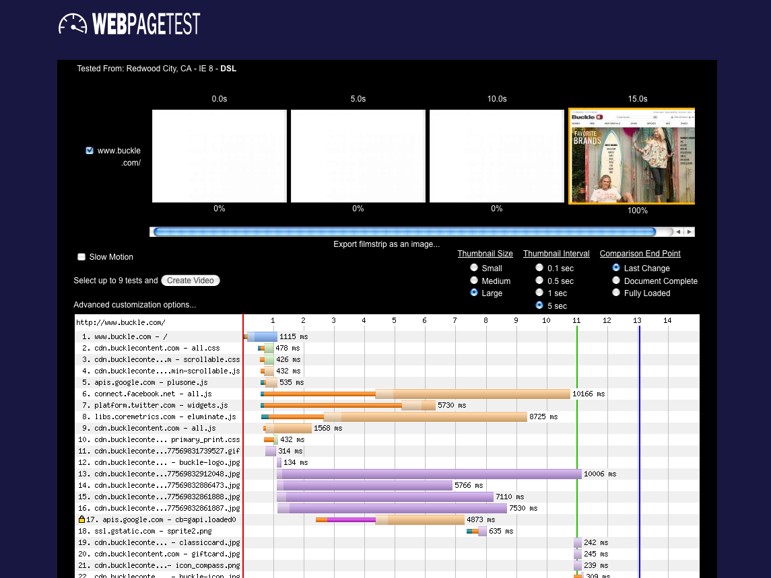
Notes:
http://httparchive.webpagetest.org/result/120301_AP_P4W3/
rank #19K
all.js, widgets.js, eluminate.js all loaded sync

Slide 27
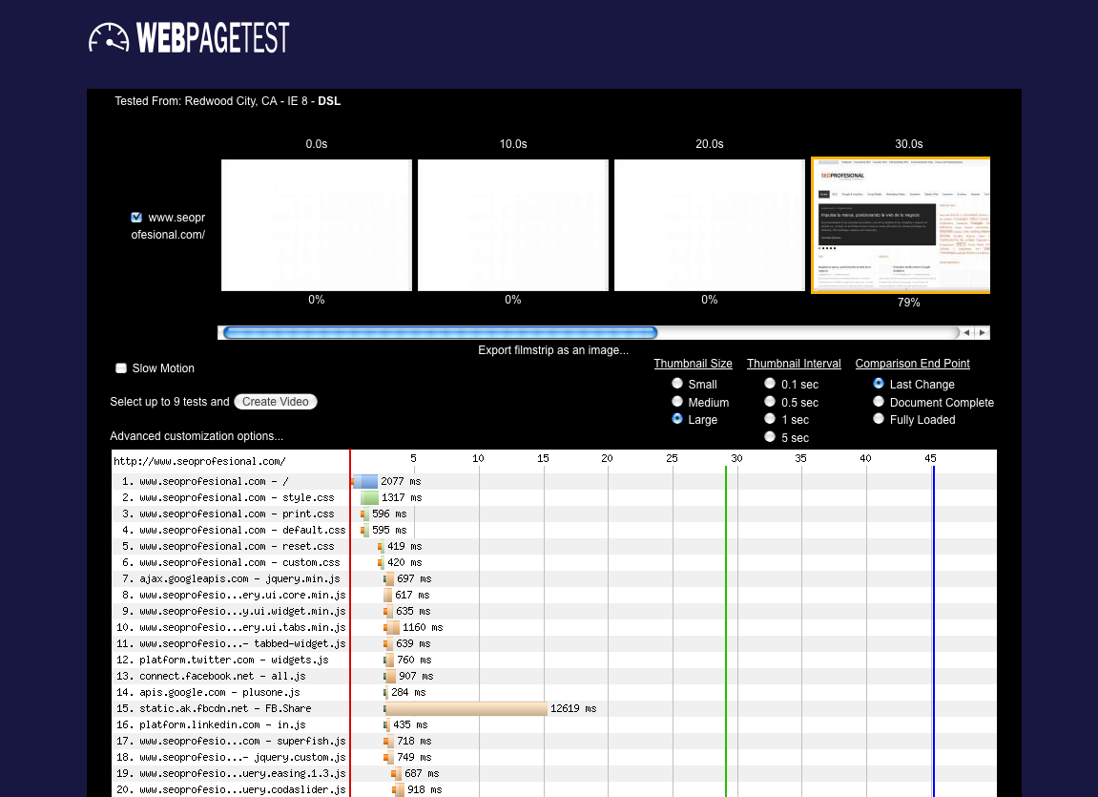
Notes:
http://httparchive.webpagetest.org/result/120401_8H_VTA3/

Slide 28
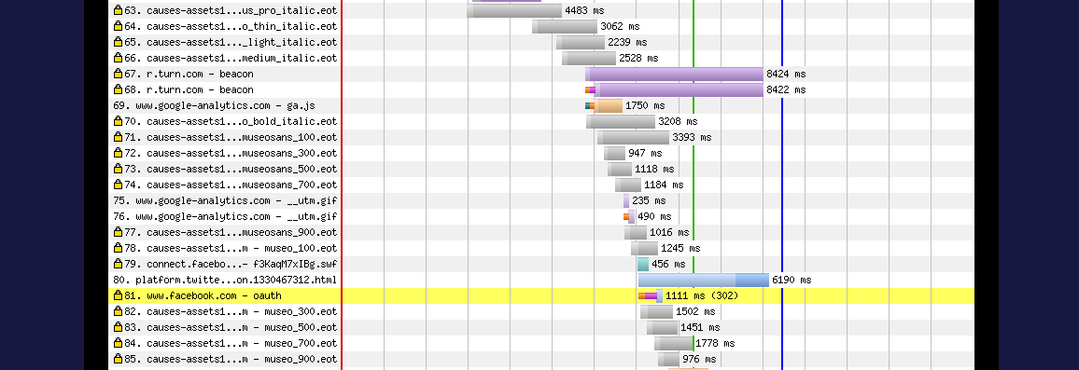
Notes:
http://httparchive.webpagetest.org/result/120315_VQ_QCZP/
fonts

Slide 29
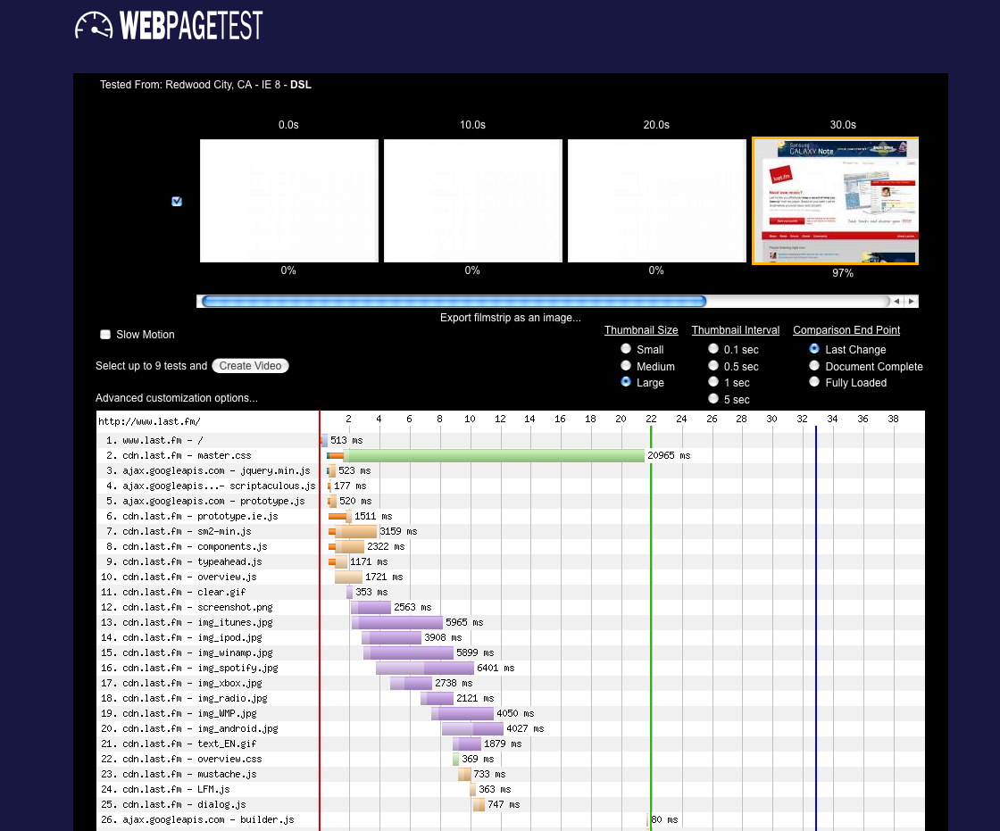
Notes:
http://httparchive.webpagetest.org/result/120515_0_35V/
Their own CSS file

Slide 30
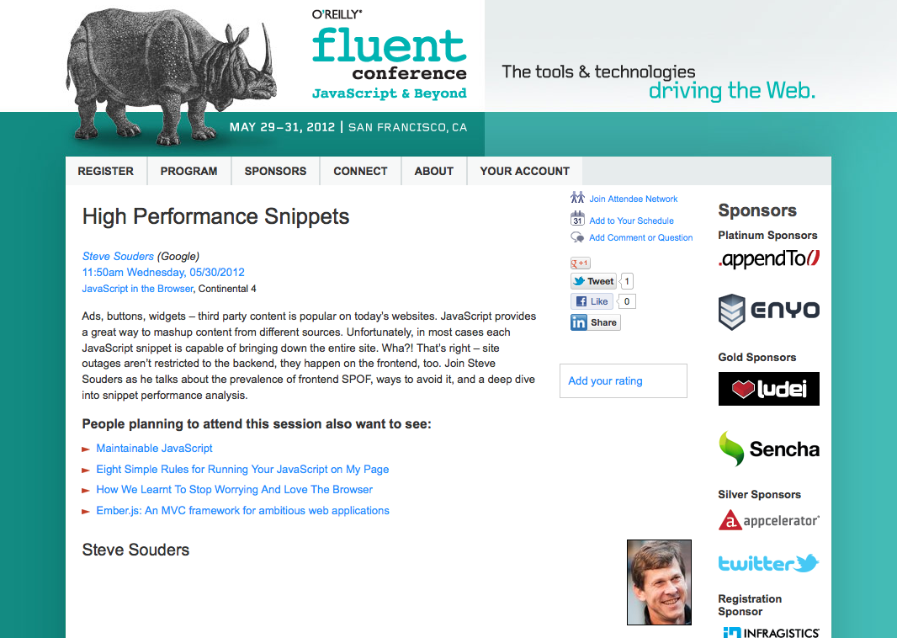

Slide 31
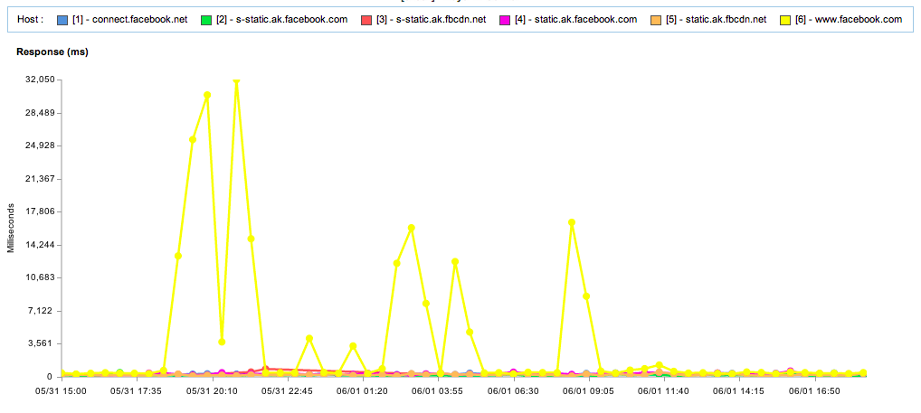
blog.catchpoint.com/2012/06/01/facebook-outage-wake-up-call-for-websites/

Slide 32
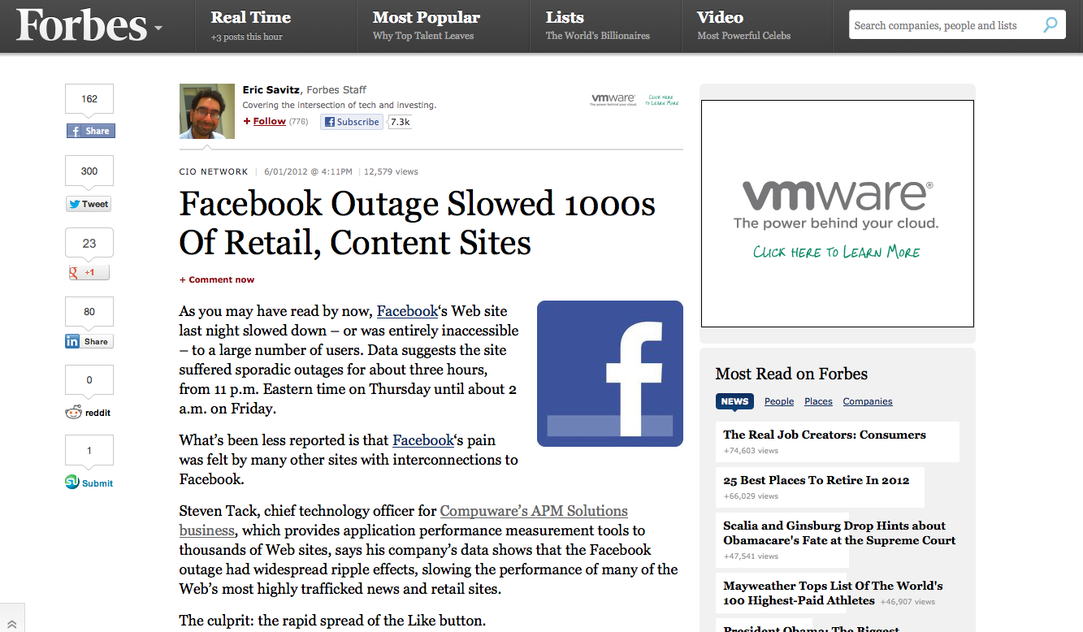

Slide 33
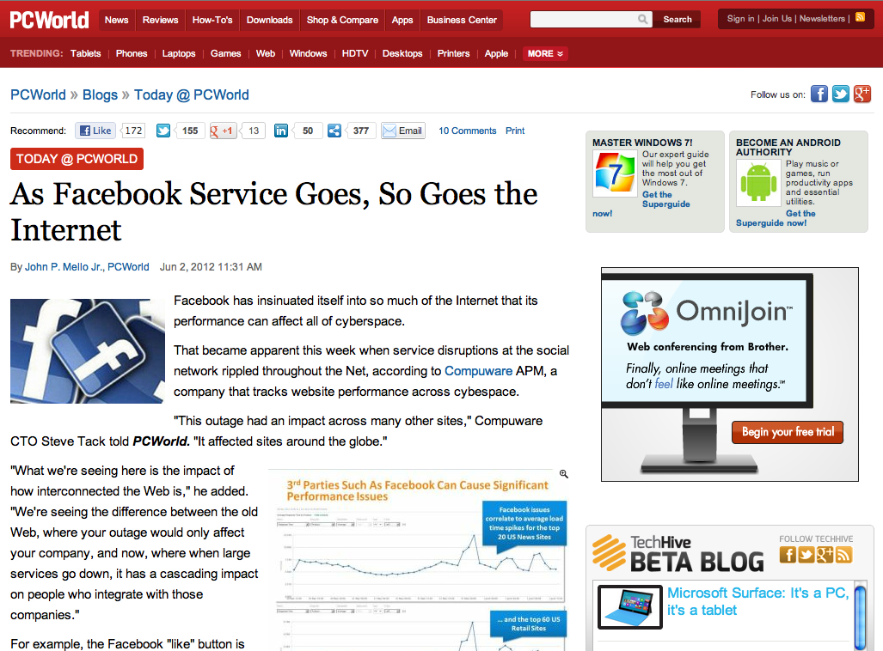

Slide 34
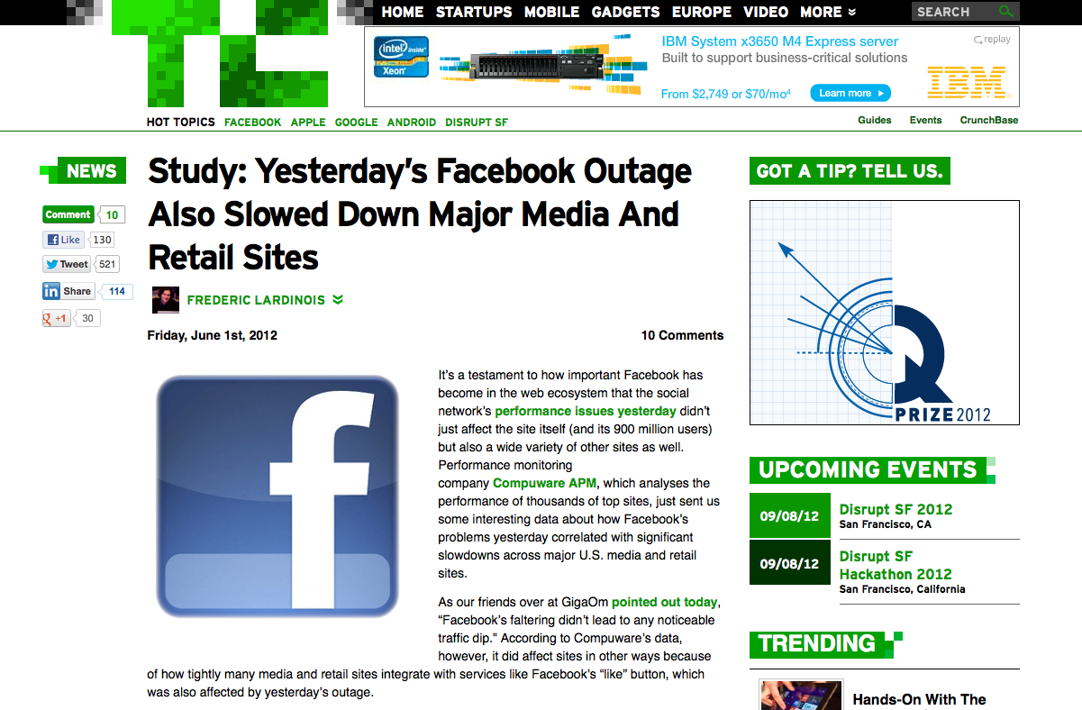

Slide 36
blog.catchpoint.com/2012/06/01/facebook-outage-wake-up-call-for-websites/

Slide 37
Notes:
http://www.flickr.com/photos/rusty-projector/225212919/
Thanks for listening to my cautionary tale of woe and foreboding.
But it’s not all doom and gloom.

Slide 38
Notes:
There is a brighter future where snippets aren’t a frontend SPOF.

Slide 39
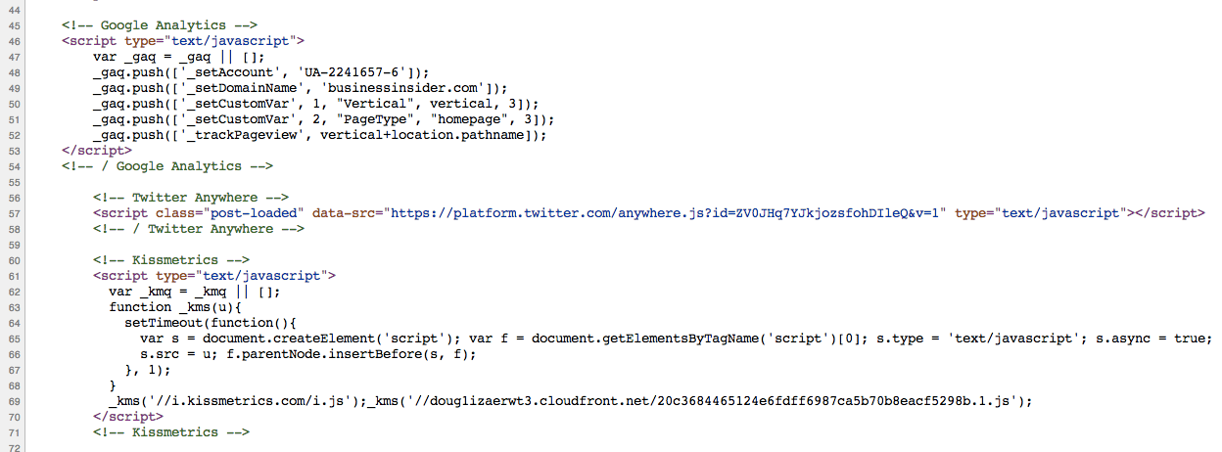
async!

Slide 41
async!
#fail
sync

Slide 42
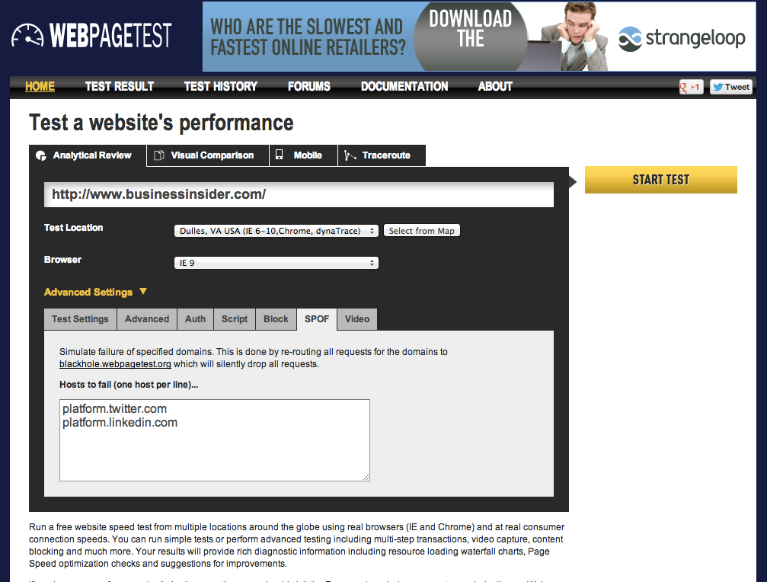

Slide 43
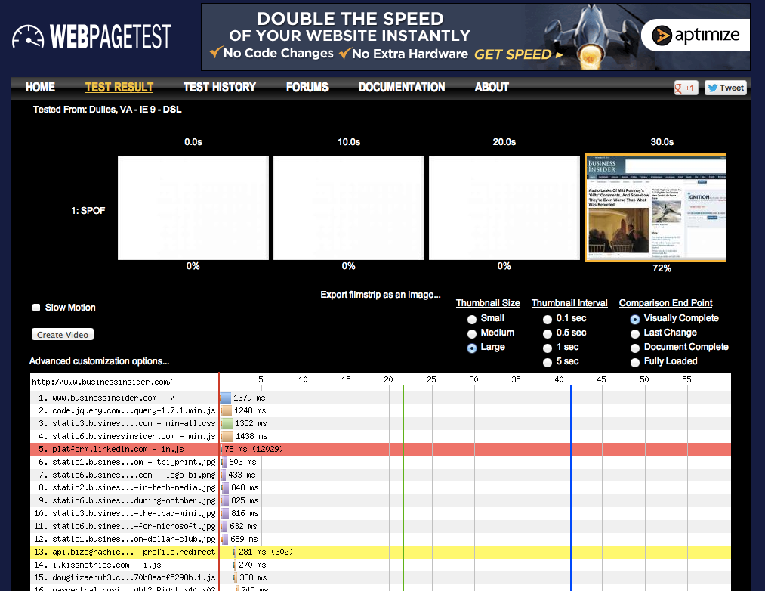
Notes:
http://www.webpagetest.org/result/121115_B2_XM6/

Slide 44
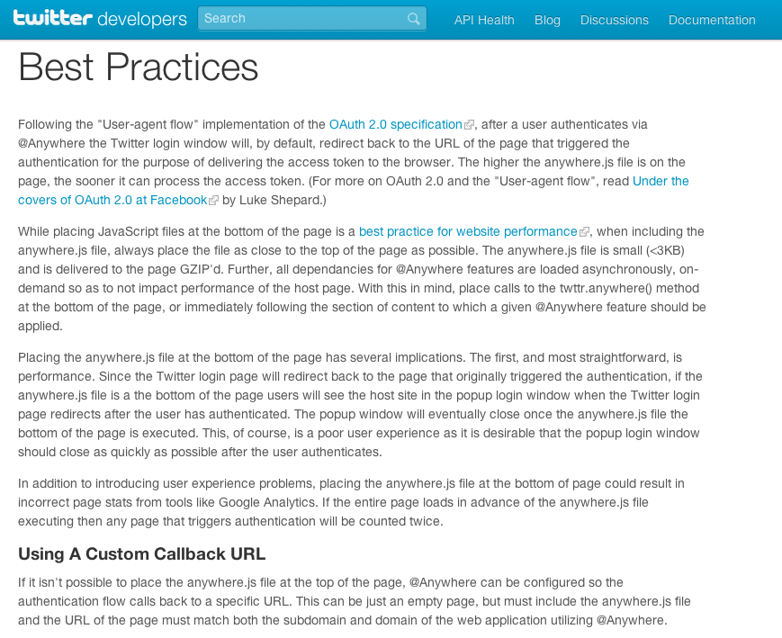
While placing JavaScript files at the bottom of the page is a best practice for website performance, when including the anywhere.js file, always place the file as close to the top of the page as possible.
The anywhere.js file is small (<3KB) and is delivered to the page GZIP'd.
Further, all dependancies for @Anywhere features are loaded asynchronously, on-demand so as to not impact performance of the host page.

Slide 45
three facts:
failures happen
304 & 200 both produce frontend SPOF
anywhere.js expires after 15 minutes

Slide 46
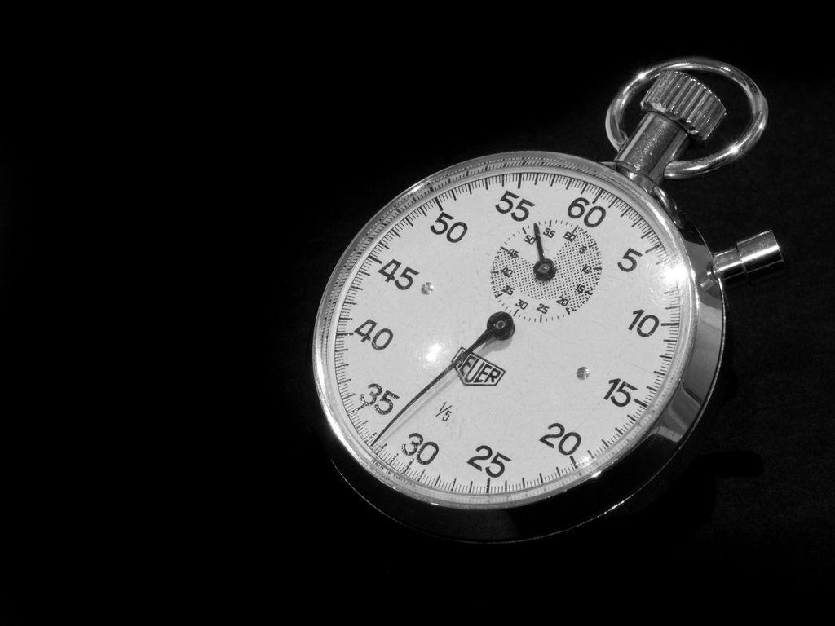
snippet cache times
http://platform.twitter.com/widgets.js - 30 mins
http://connect.facebook.net/en_US/all.js - 15 mins
http://www.google-analytics.com/ga.js - 120 mins
Notes:
flickr.com/photos/wwarby/3296379139/

Slide 47
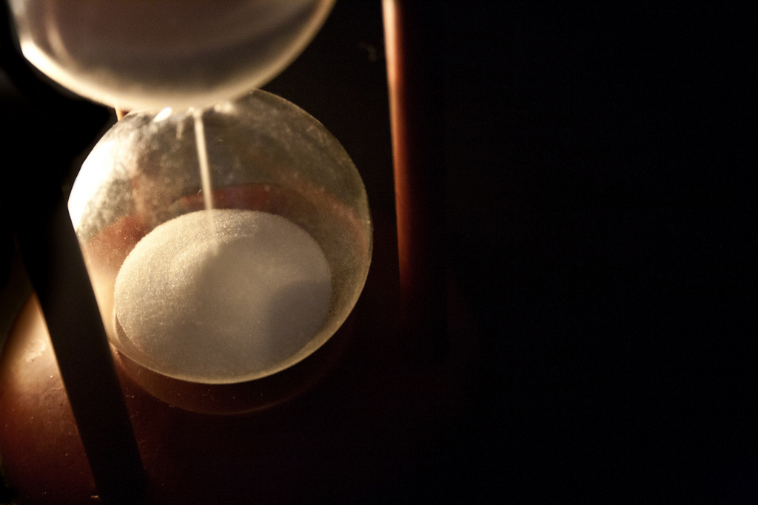
“bootstrap scripts” often have short cache times
more frequent Conditional GET requests means frontend SPOF is more likely
but short cache times is the only way snippet owners can push updates
or is it?
Notes:
flickr.com/photos/juditk/5024772809/
whether it’s 1 or 5 requests, frontend SPOF will still happen

Slide 48
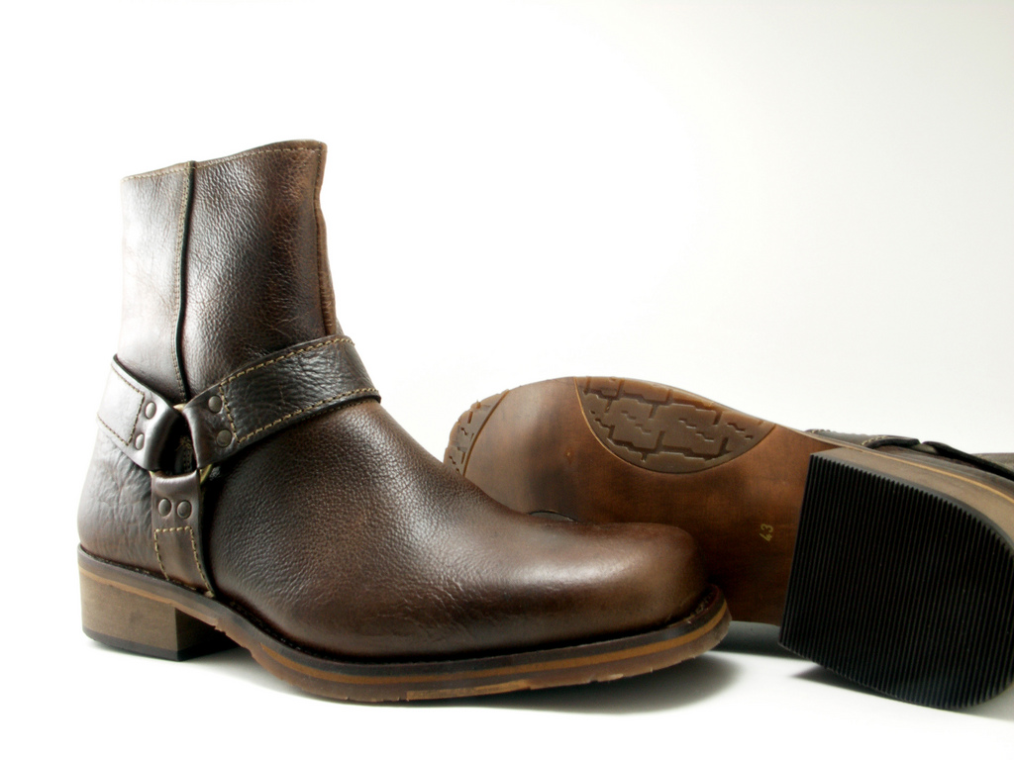
self-updating bootstrap scripts
with Stoyan Stefanov
stevesouders.com/blog/2012/05/22/self-updating-scripts/

Slide 49
client
server
bootstrap.js:
var v=“1.7”;
scriptelem.src = “beacon.js?v=”+v;
current version is 1.7
200
maxage=604800
beacon.js:
?v=1.7&log...
204

Slide 50
client
server
next day…
bootstrap.js:
bootstrap.js updated to 1.8
read from cache
beacon.js:
?v=1.7&log...
200
var iframe1 = document.createElement("iframe");
iframe1.style.display = "none”;
iframe1.src = ”update.php";
document.body.appendChild(iframe1);

Slide 51
client
server
update.php
200
bootstrap.js is still read from cache
<script src=“bootstrap.js">
</script>
<script>
if (location.hash === '') {
location.hash = "check”;
location.reload(true);
}
</script>
on reload bootstrap.js is re-requested and overwrites cache
200

Slide 52
part 1: update notification
piggyback on dynamic request
pass cached version # to server: ?v=127
server returns:
204 – no update
JS – new version available

Slide 53
part 2: overwrite cache
re-request dynamically
rev the URL (querystring)
XHR w/ setRequestHeader
reload iframe containing bootstrap script

Slide 54
example
load bootstrap script:
var s1=document.createElement('script');
s1.async=true;
s1.src='http://souders.org/tests/selfupdating/bootstrap.js’;
var s0=document.getElementsByTagName('script’)[0];
s0.parentNode.insertBefore(s1, s0);
stevesouders.com/tests/selfupdating/

Slide 55
send beacon:
http://souders.org/tests/selfupdating/beacon.js?v=02:29:53
beacon response triggers update:
var iframe1 = document.createElement("iframe");
iframe1.style.display = "none”;
iframe1.src = "http://souders.org/tests/selfupdating/update.php?v=02:29:53";
document.body.appendChild(iframe1);
stevesouders.com/tests/selfupdating/

Slide 56
iframe reloads itself:
<script src="http://souders.org/tests/selfupdating/bootstrap.js">
</script>
<script>
if (location.hash === '') {
location.hash = "check”;
location.reload(true);
}
</script>
reload triggers (un)Conditional GET
cached script is updated
stevesouders.com/tests/selfupdating/

Slide 57
voilà
bootstrap scripts can have long cache times
AND
get updated when necessary

Slide 58
caveat
the update is used on the next page view (like app cache)

Slide 59
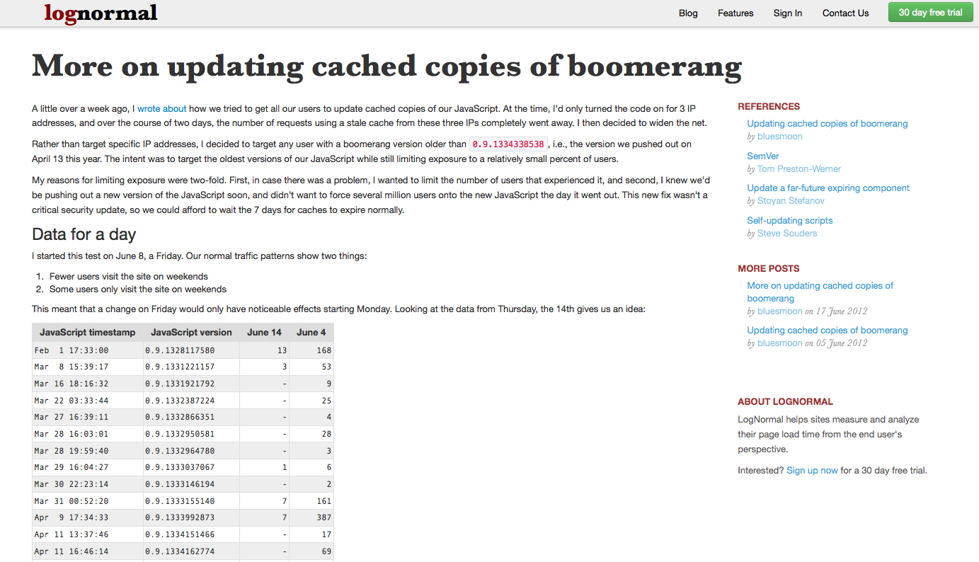
lognormal.com/blog/2012/06/05/updating-cached-boomerang/

Slide 60
lognormal.com/blog/2012/06/05/updating-cached-boomerang/

Slide 61
dynamic symbol loading: C
void *handle;
double (*cosine)(double);
handle = dlopen("/lib/libm.so.6", RTLD_LAZY);
if ( !handle ) {
exit(1);
}
cosine = dlsym(handle, "cos");
if ( dlerror() != NULL ) {
exit(1);
}
Notes:
http://tldp.org/HOWTO/Program-Library-HOWTO/dl-libraries.html

Slide 62
dynamic symbol loading: JavaScript
<script src='mycombo.js'></script>
<script>
$('.content a, .huffpo-wide-container a').mousedown(function() {...
</script>
Wha?!
Notes:
http://tldp.org/HOWTO/Program-Library-HOWTO/dl-libraries.html

Slide 63
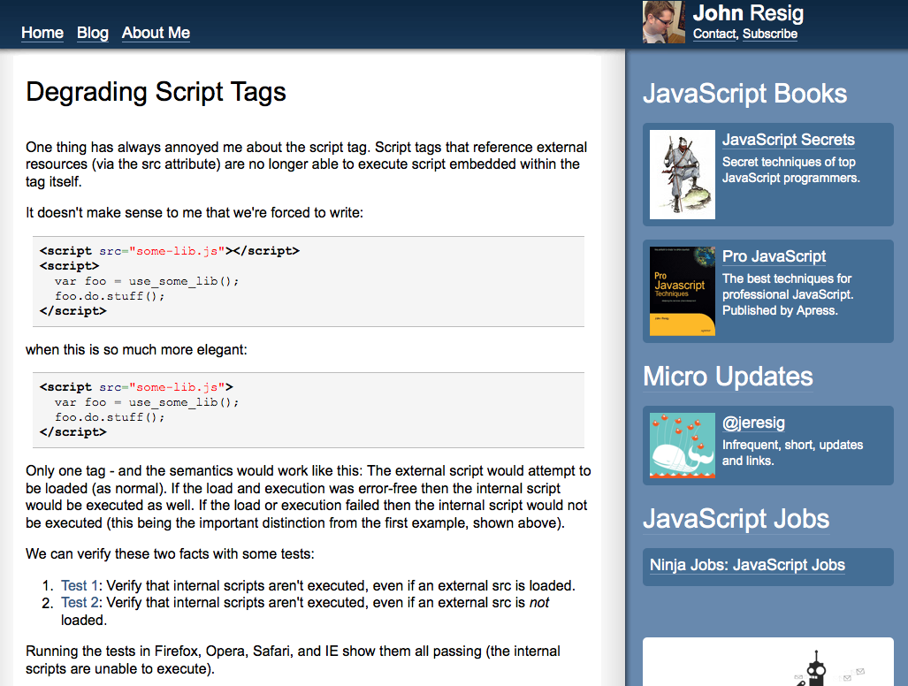
ejohn.org/blog/degrading-script-tags/

Slide 64
dynamic symbol loading: JavaScript
<script src='mycombo.js'></script>
<script>
$('.content a, .huffpo-wide-container a').mousedown(function() {...
</script>
<script src='mycombo.js'>
$('.content a, .huffpo-wide-container a').mousedown(function() {...
</script>
at the end of mycombo.js:
var scripts = document.getElementsByTagName("script");
for ( var cntr = scripts.length; cntr > 0; cntr-- ) {
var curScript = scripts[cntr-1];
if (curScript.src.indexOf('mycombo.js') != -1) {
eval( curScript.innerHTML );
break;
}
}
Notes:
http://tldp.org/HOWTO/Program-Library-HOWTO/dl-libraries.html

Slide 65
we’re JavaScript
& we mean business
Notes:
http://www.flickr.com/photos/jpellgen/3345383578/

Slide 66
takeaways
load 3rd party scripts async
test with WebPagetest SPOF
have RUM timeout
self-update bootstrap scripts & increase cache times
harden JS loading
Notes:
flickr.com/photos/myklroventine/4062102754/

Slide 67
what’s your website’s weakest link?
Notes:
http://www.flickr.com/photos/darwinbell/465459020/

Slide 68
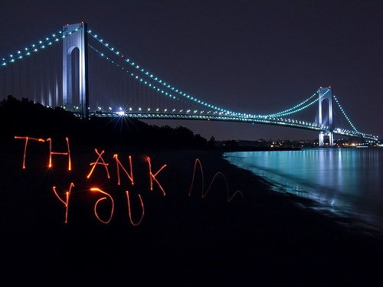
Steve Souders
@souders
stevesouders.com/docs/paypal-spof-20121115.pptx
Notes:
"thank you" by nj dodge: http://flickr.com/photos/nj_dodge/187190601/
I’m pretty sure this is the Verrazano-Narrows Bridge.

Slide 69
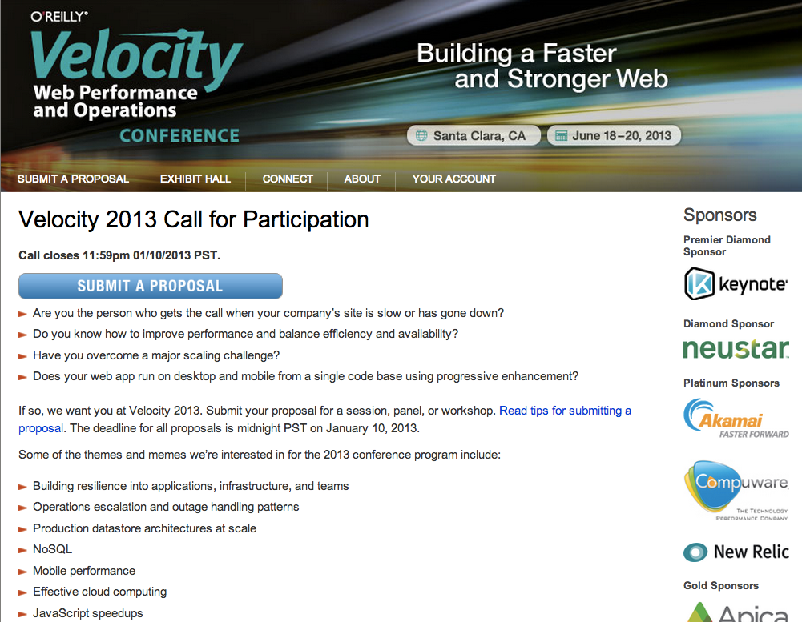

Slide 70
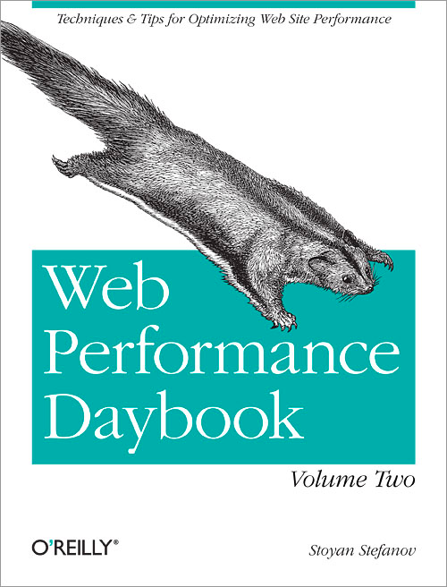
Patrick Meenan
Nicholas Zakas
Guy Podjarny
Stoyan Stefanov
Tim Kadlec
Brian Pane
Josh Fraser
Steve Souders
Betty Tso
Israel Nir
Marcel Duran
Éric Daspet
Alois Reitbauer
Matthew Prince
Buddy Brewer
Alexander Podelko
Estelle Weyl
Aaron Peters
Tony Gentilcore
Matthew Steele
Bryan McQuade
Tobie LangelBilly Hoffman
Joshua Bixby
Sergey Chernyshev
JP Castro
Pavel Paulau
David Calhoun
Nicole Sullivan
James Pearce
Tom Hughes-Croucher

