Slide 1
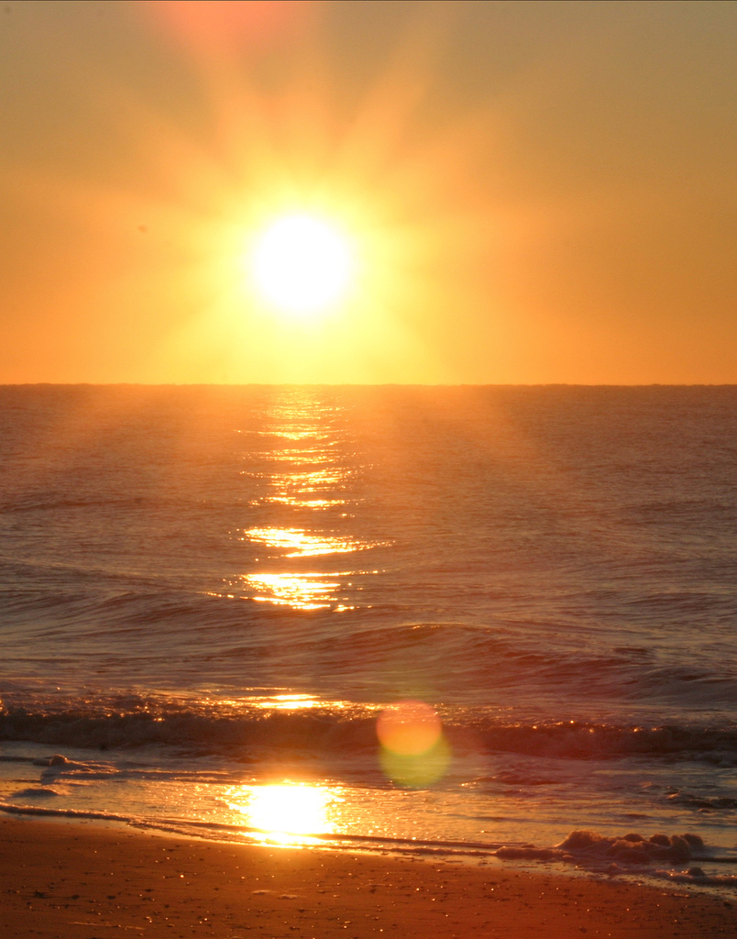
High Performance HTML5
stevesouders.com/docs/onekingslane-html5-20130301.pptx
Disclaimer: This content does not necessarily reflect the opinions of my employer.
Notes:
flickr.com/photos/djbiesack/85833076/

Slide 2
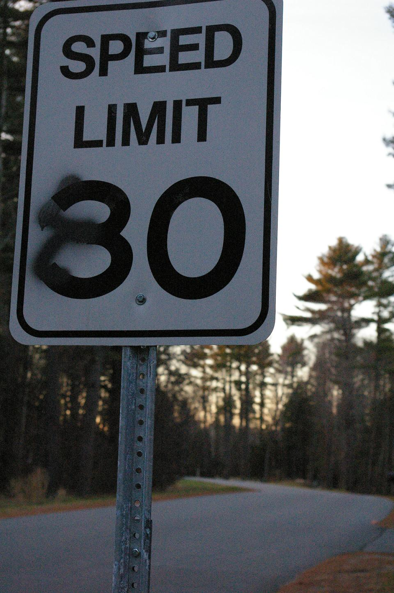
YSlow
Cuzillion
SpriteMe
Hammerhead
Notes:
flickr.com/photos/bekahstargazing/318930460/

Slide 3
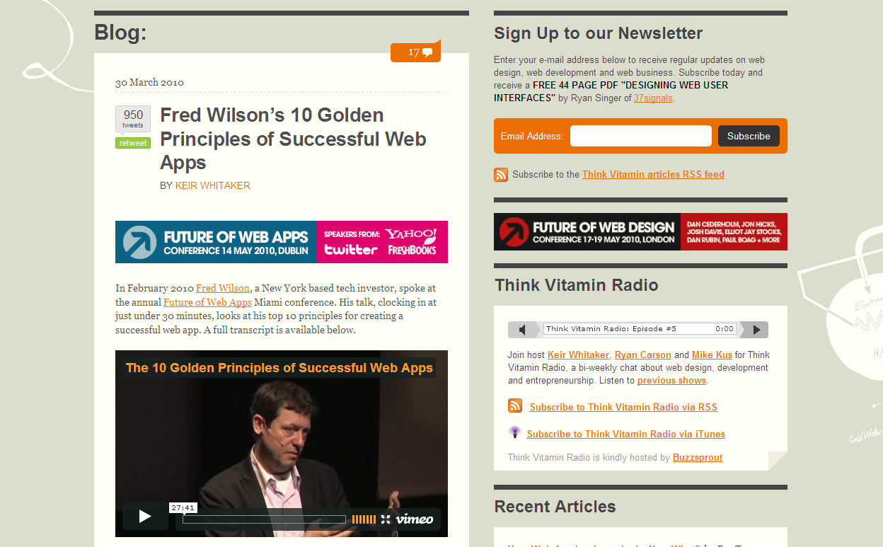
carsonified.com/blog/business/fred-wilsons-10-golden-principles-of-successful-web-apps/
#1. Speed: “First and foremost, we believe that speed is more than a feature. Speed is the most important feature.”
Notes:
Fred Wilson is Managing Partner of two venture capital firms, Flatiron Partners (Yoyodyne, Geocities) and Union Square Ventures (Twitter, delicious, Etsy, Feedburner).
Speed
Instant utility
Software is media
Less is more
Make it programmable
Make it personal
RESTful
Discoverability
Clean
Playful

Slide 4
en.oreilly.com/velocity2009/public/schedule/detail/8523

Slide 5
en.oreilly.com/velocity2009/public/schedule/detail/8523

Slide 6
Yahoo!
0.4 sec slower
traffic ⬇ 5-9%
slideshare.net/stoyan/dont-make-me-wait-or-building-highperformance-web-applications
slideshare.net/stoyan/yslow-20-presentation

Slide 7
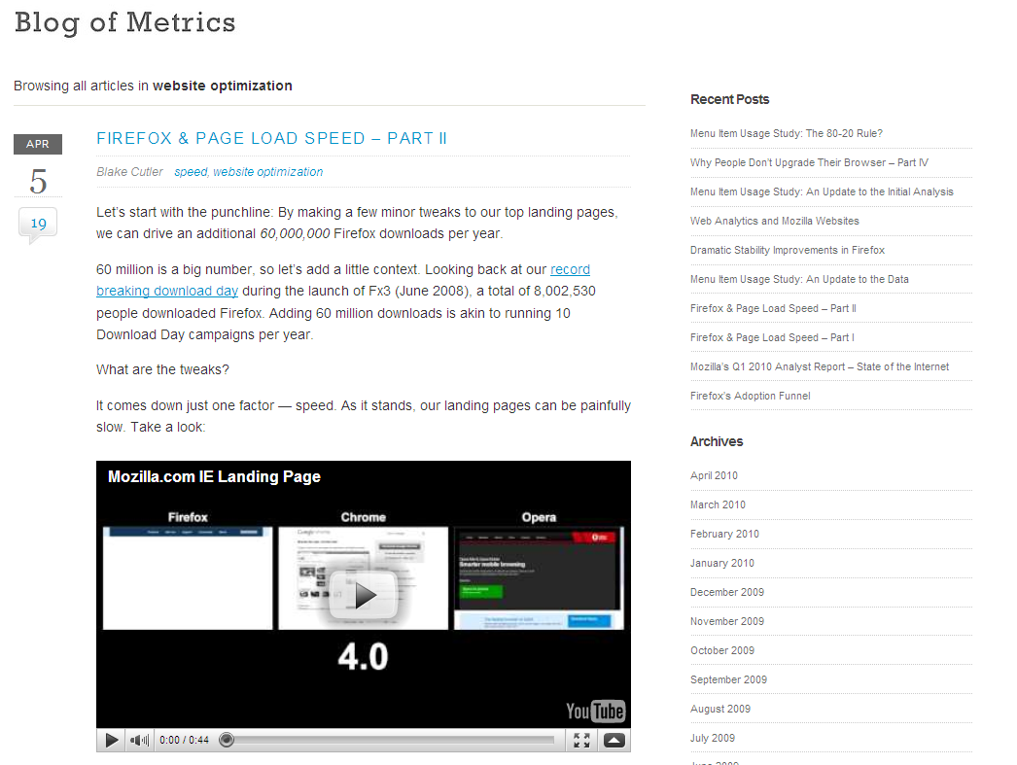
blog.mozilla.com/metrics/category/website-optimization/
…shaved 2.2 seconds off the average page load time and increased download conversions by 15.4%!
Notes:
“if we’re able to achieve a similar performance boost across our other top landing pages, we’ll drive in excess of 60 million yearly Firefox downloads.”

Slide 8
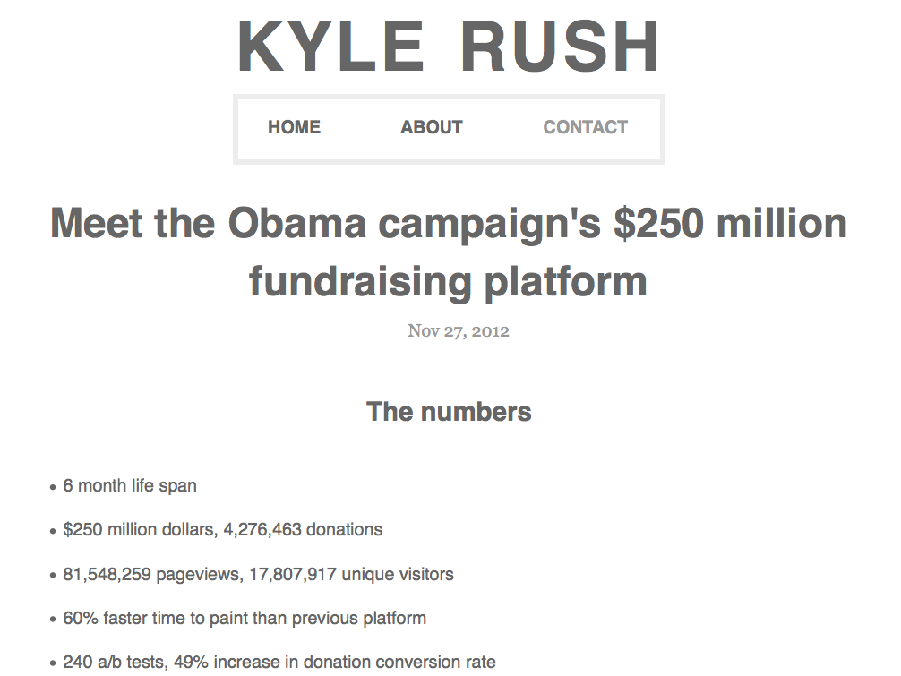
We made the new platform 60% faster and this resulted in a 14% increase in donation conversions.

Slide 9
en.oreilly.com/velocity2009/public/schedule/detail/7709
blog.mozilla.com/metrics/category/website-optimization/
…shaved 2.2 seconds off the average page load time and increased download conversions by 15.4%!
Notes:
This was a ~5 second speed up.

Slide 10
en.oreilly.com/velocity2008/public/schedule/detail/3632

Slide 11
slideshare.net/EdmundsLabs/how-edmunds-got-in-the-fast-lane-80-reduction-in-page-load-time-in-3-simple-steps-6593377

Slide 12
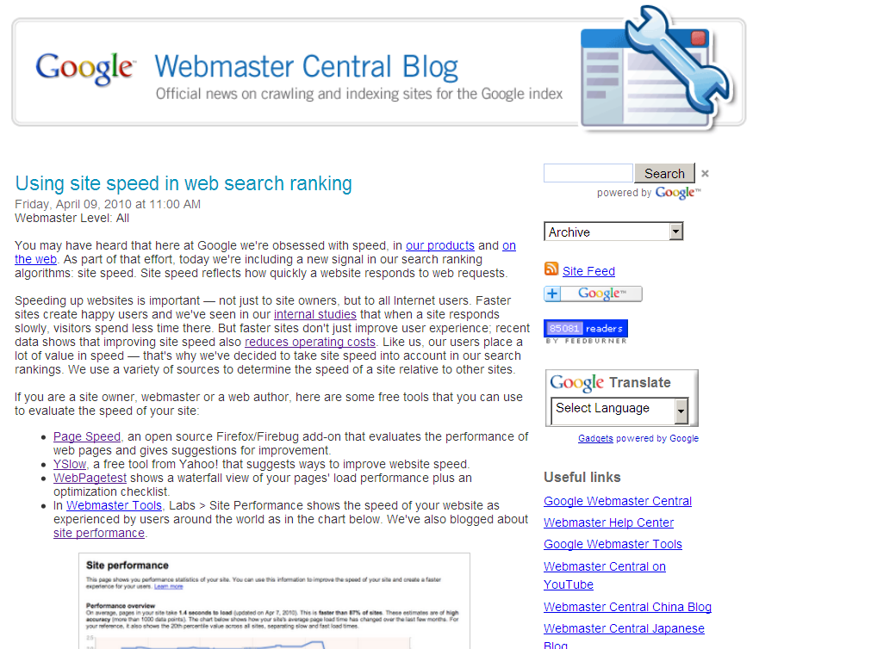
Site speed in search rank
…we've decided to take site speed into account in our search rankings.
Screen shot of blog post
googlewebmastercentral.blogspot.com/2010/04/using-site-speed-in-web-search-ranking.html
Notes:
Time measurements from real users.

Slide 13
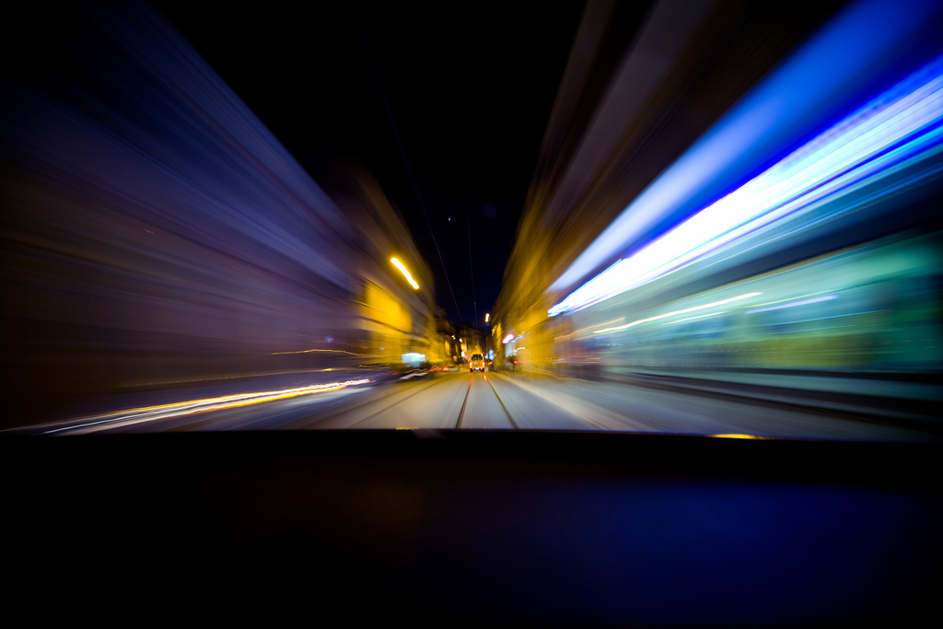
Web
Performance
Optimization
WPO
drives traffic
improves UX
increases revenue
reduces costs
Notes:
flickr.com/photos/pedromourapinheiro/3123885534/

Slide 14
High Performance HTML5
http://www.w3.org/TR/html5/
Notes:
flickr.com/photos/djbiesack/85833076/

Slide 15
Web Performance Working Group
chartered June 2010
web timing
Navigation Timing
User Timing
Resource Timing
page visibility
script-based animations
efficient script yielding
high resolution timer
HAR file format
http://www.w3.org/2010/webperf/

Slide 16
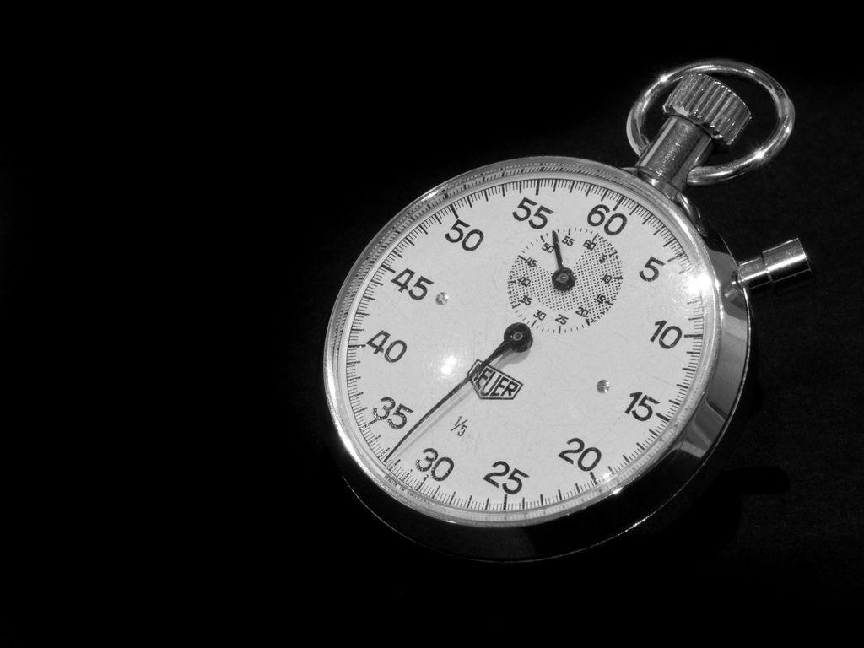
Navigation Timing
var timing = performance.timing;
var loadtime =
timing.loadEventEnd –
timing.navigationStart;
Chrome 10, IE9, Firefox 7, Android 4, BB 10, Chrome Mobile 16, IE Mobile 9
http://blog.chromium.org/2010/07/do-you-know-how-slow-your-web-page-is.html
Notes:
flickr.com/photos/wwarby/3296379139/

Slide 17
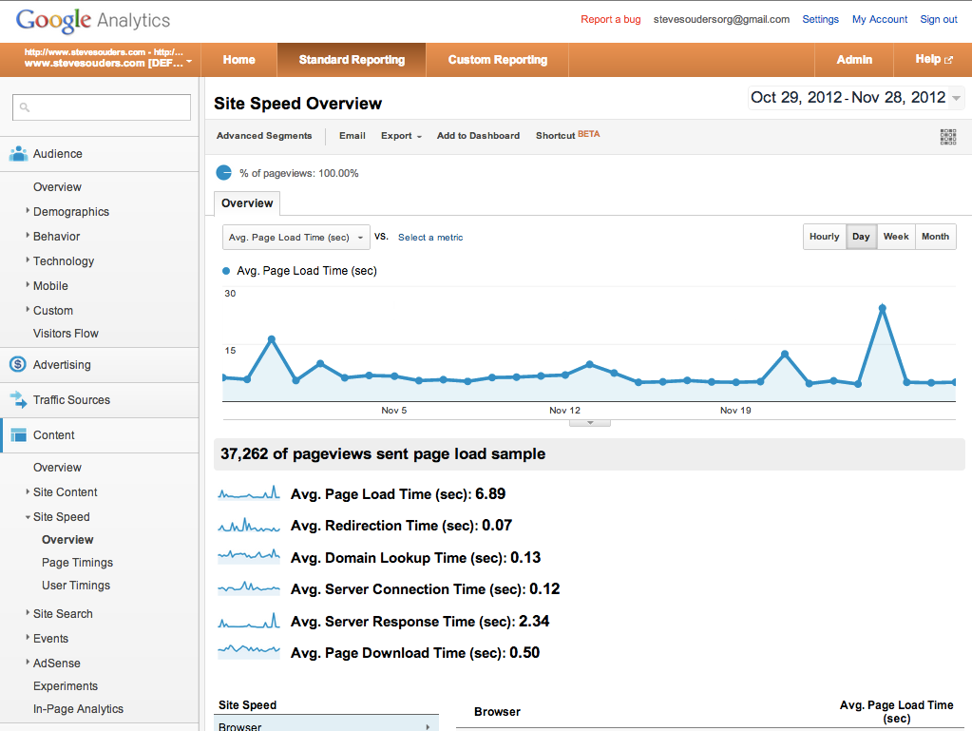
Notes:
https://www.google.com/analytics/web/?et=reset#report/content-site-speed-overview/a15026169w31046415p30049615/

Slide 18
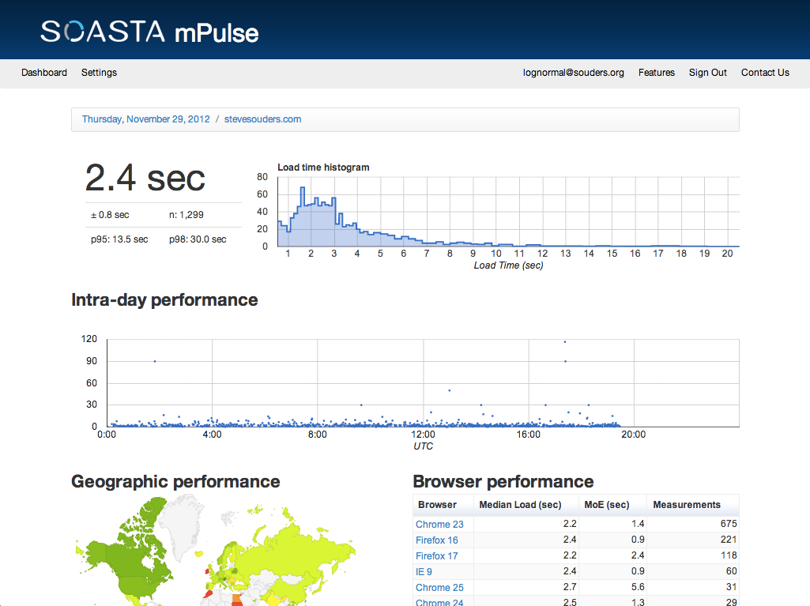
Notes:
https://app.lognormal.com/dashboard

Slide 19
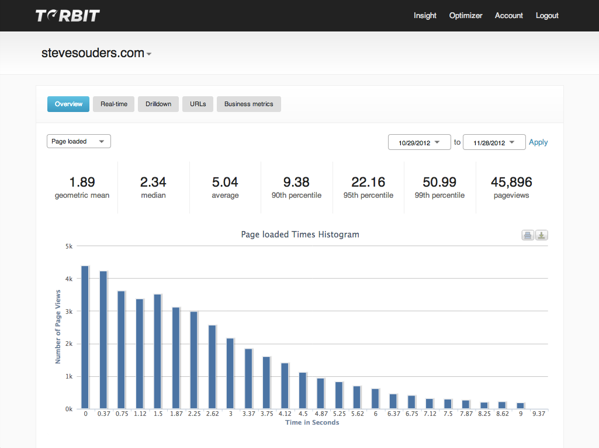
Notes:
https://secure.torbit.com/b171af3295de06f3/insight-dashboard?site=stevesouders.com#

Slide 20
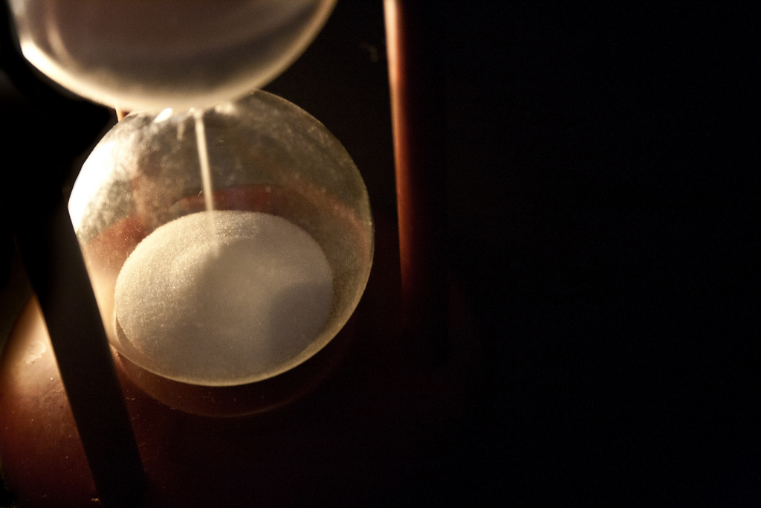
Resource Timing
DNS, redirects, etc.
security safeguards
Chrome 25+, IE10
User Timing
for web apps
mark, measure
Notes:
flickr.com/photos/juditk/5024772809/

Slide 21
Page Visibility
detect when page is visible
stats
video & audio
polling, DHTML
performance: prefetching, prerendering
Chrome 13:
document.webkitHidden
webkitvisibilitychange
code.google.com/chrome/whitepapers/pagevisibility.html
Notes:
flickr.com/photos/96221617@N00/51603550/

Slide 22
script async & defer
script src
halts parsing, blocks rendering
async
execute when script is downloaded, async
defer
execute after page is parsed, in order
missing
download & execute last
download last, execute on demand
Notes:
Generally async & defer scripts start downloading immediately. I wish they’d wait, esp. defer scripts, so they don’t hog connections from the limited pool.
flickr.com/photos/gevertulley/4771808965/

Slide 23
GMail Mobile
<script type="text/javascript">
/*
var ...
*/
</script>
get script DOM element's text
remove comment delimiters
eval() when invoked
awesome for prefetching JS that might (not) be needed
http://goo.gl/l5ZLQ
Notes:
GMail Mobile: http://googlecode.blogspot.com/2009/09/gmail-for-mobile-html5-series-reducing.html
SproutCore: http://blog.sproutcore.com/post/225219087/faster-loading-through-eval

Slide 24
ControlJS a JavaScript module for making scripts load faster
just change HTML
inline & external scripts
<script type=‘text/cjs’
data-cjssrc=‘main.js’>
</script>
<script type=‘text/cjs’>
var name = getName();
</script>
http://controljs.org/

Slide 25
ControlJS a JavaScript module for making scripts load faster
download without executing
<script type=‘text/cjs’
data-cjssrc=‘main.js’
data-cjsexec=false>
<script>
Later if/when needed:
CJS.execScript(src);

Slide 26
ControlJS a JavaScript module for making scripts load faster
control.js loads async
var cjsscript = document.createElement('script');
cjsscript.src = "control.js";
var cjssib = document.getElementsByTagName('script')[0];
cjssib.parentNode.insertBefore(cjsscript, cjssib);

Slide 27
app cache
offline apps, longer cache
Notes:
flickr.com/photos/india-nepal-iran/203982474/

Slide 28
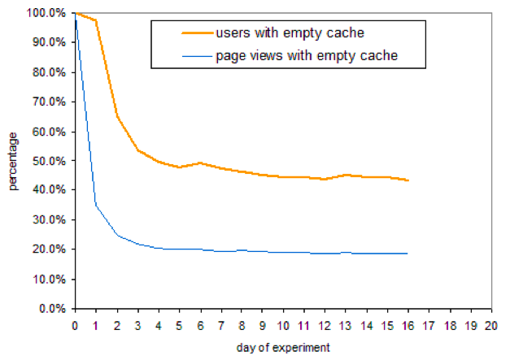
yuiblog.com/blog/2007/01/04/performance-research-part-2/

Slide 29
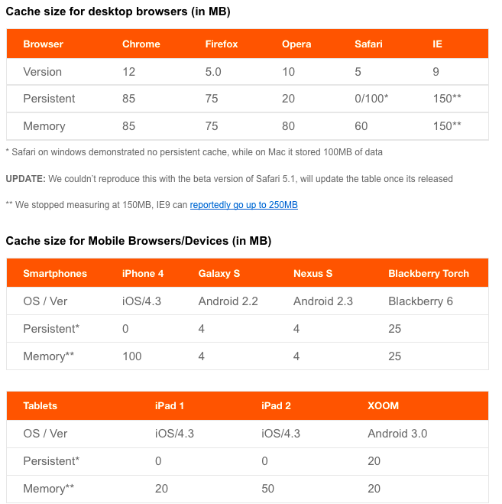
blaze.io/mobile/understanding-mobile-cache-sizes/

Slide 30
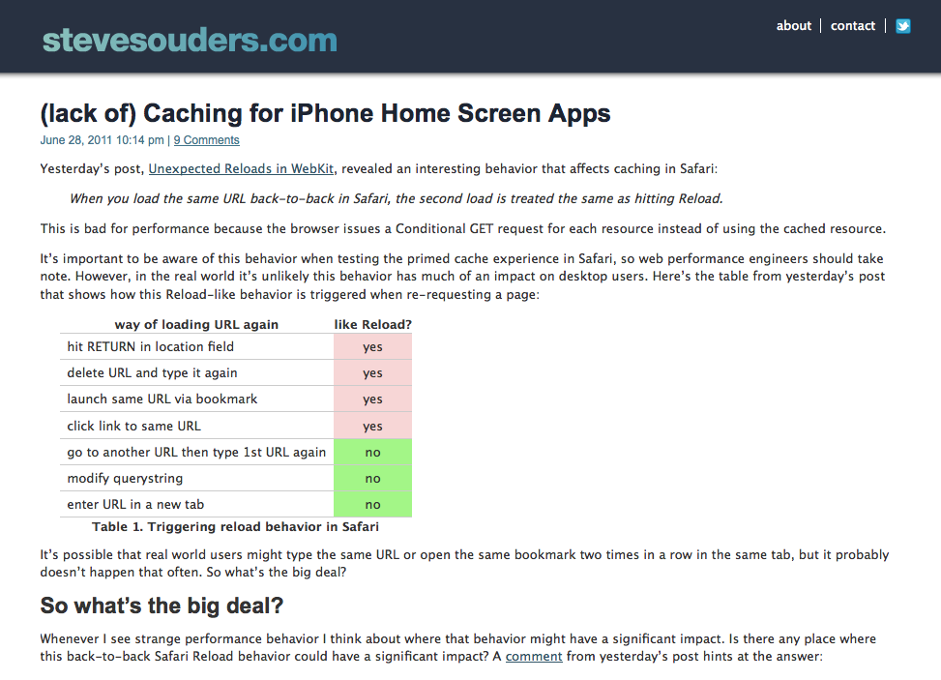
Home screen apps on iPhone are slower because resources are re-requested even though they should be read from cache.

Slide 31
app cache
offline apps, longer cache
<!doctype html>
<html manifest=“myapp.appcache”>
myapp.appcache:
CACHE MANIFEST
# Revision: 1.28
CACHE:
/images/logo.gif
NETWORK:
/login.html
FALLBACK:
/index.html /offline.html
Content-Type: text/cache-manifest
Notes:
flickr.com/photos/india-nepal-iran/203982474/

Slide 32
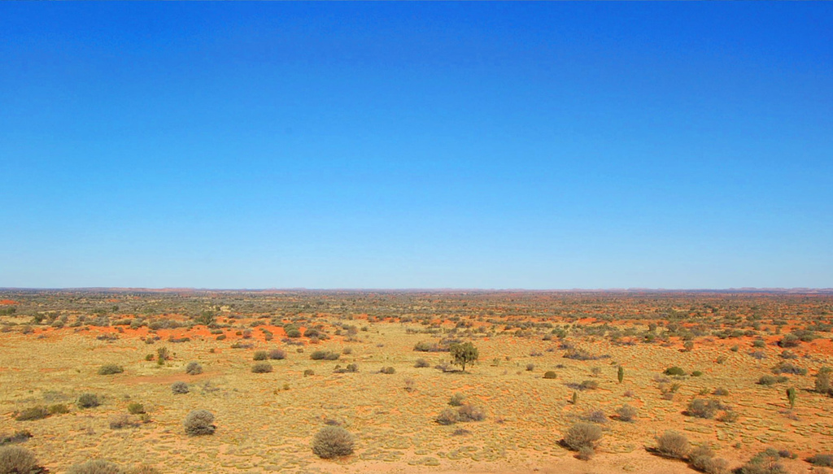
app cache gotchas
html docs w/ manifest are cached
404 => nothing is cached
size: 5MB+
must rev manifest to update resources
update is served on 2nd reload (?!?!)
Notes:
flickr.com/photos/97657657@N00/1918688483/

Slide 33
1
2
app cache
reload
push app
logo.gif =
user loads app
app cache is empty
fetch manifest
fetch logo.gif
app cache =
user sees
3
4
5
push app
logo.gif =
rev manifest
user loads app
app cache =
user sees
fetch manifest
fetch logo.gif
app cache =
user loads app again
app cache =
user sees
fetch manifest (304)

Slide 34
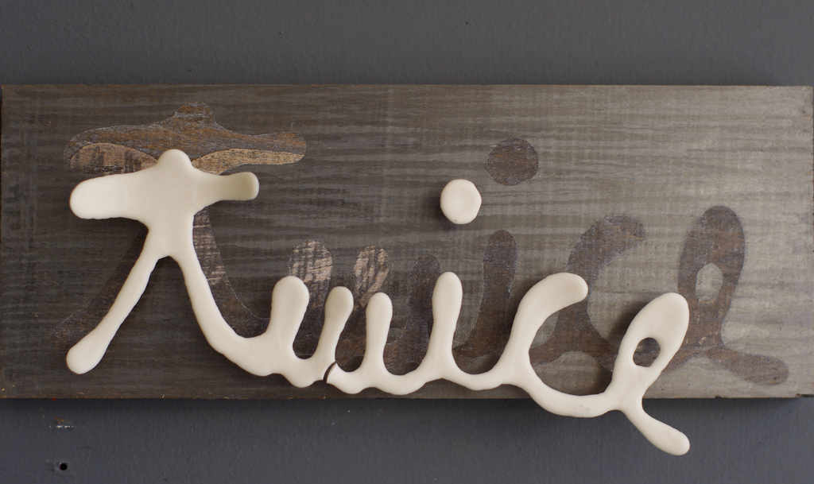
load twice workaround
window.applicationCache.addEventListener('updateready',
function(e) { if ( window.applicationCache.status ==
window.applicationCache.UPDATEREADY) {
if ( confirm(“Load new content?”) ) {
...
http://www.webdirections.org/blog/get-offline/
http://www.html5rocks.com/en/tutorials/appcache/beginner/
Notes:
flickr.com/photos/presley_m/5152304885/

Slide 35
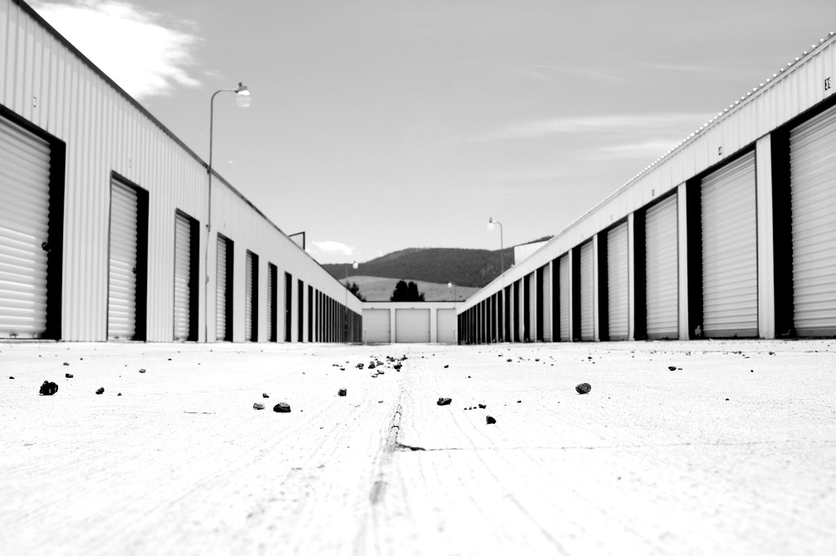
localStorage
window.localStorage:
setItem()
getItem()
removeItem()
clear()
also sessionStorage
all popular browsers, 5MB max
warning: it’s synchronous
http://dev.w3.org/html5/webstorage/
http://diveintohtml5.org/storage.html
Notes:
flickr.com/photos/bryanpearson/564703455/

Slide 36
localStorage as cache
1st doc: write JS & CSS blocks to localStorage
mres.-0yDUQJ03U8Hjija: <script>(function(){...
set cookie with entries & version
MRES=-0yDUQJ03U8Hjija:-4EaJoFuDoX0iloI:...
later docs: read JS & CSS from localStorage
document.write( localStorage.getItem(mres.-0yDUQJ03U8Hjija) );
http://stevesouders.com/blog/2011/03/28/storager-case-study-bing-google/
Notes:
flickr.com/photos/nelsoncruz/431244400/

Slide 37
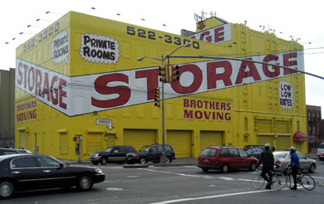
localStorage issues
security
attacker could modify JS in localStorage
transient ability results in persistent attack
use checksum to validate integrity of JS
http://www.w2spconf.com/2012/papers/w2sp12-final8.pdf
performance
< 100K is fast - ~100 ms
> 1M is slow - ~1000 ms
https://insouciant.org/tech/localstorage-load-times-redux/
Notes:
flickr.com/photos/bryanpearson/564703455/

Slide 38
localStorage survey
 | Desktop | Mobile
Google | *185K | 70K
Facebook | - | 171K
YouTube | 4K | 8K
Yahoo! | - | -
Baidu | - | 86K
Wikipedia | - | -
MS Live | - | -
QQ | - | -
Amazon | - | -
Twitter | 600K | -
* sessionStorage
Notes:
flickr.com/photos/bryanpearson/564703455/

Slide 39
stevesouders.com/mobileperf/mobileperfbkm.php

Slide 40
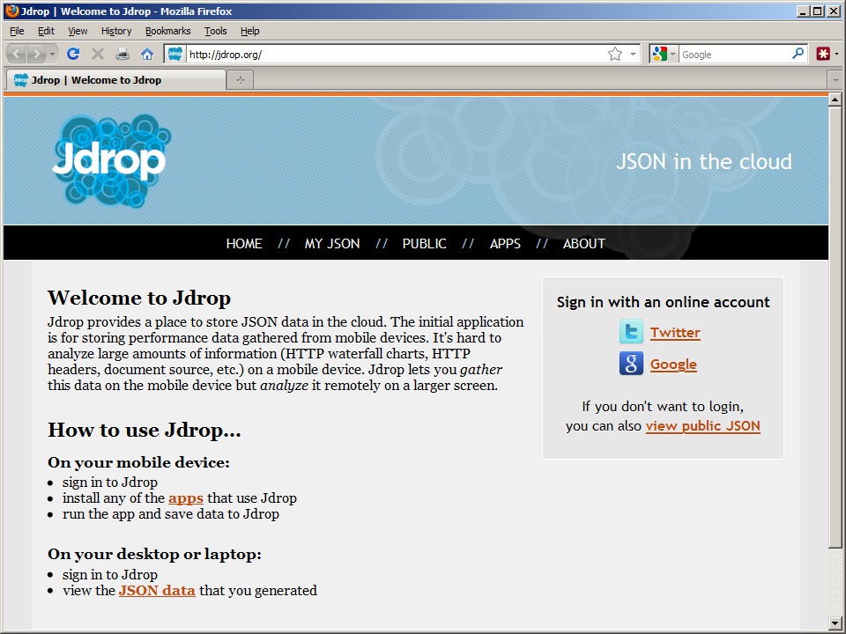

Slide 41
@font-face
* IE9 does not display a blank page, but does “flash” the element.
stevesouders.com/blog/2010/06/01/frontend-spof/
Worth delaying most important design elements? Or entire page?
Notes:
flickr.com/photos/typoatelier/4261455105/

Slide 42
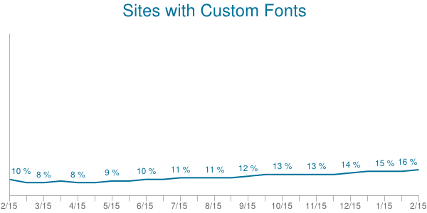
httparchive.org/trends.php#perFonts
flickr.com/photos/imbrettjackson/520656349/

Slide 43
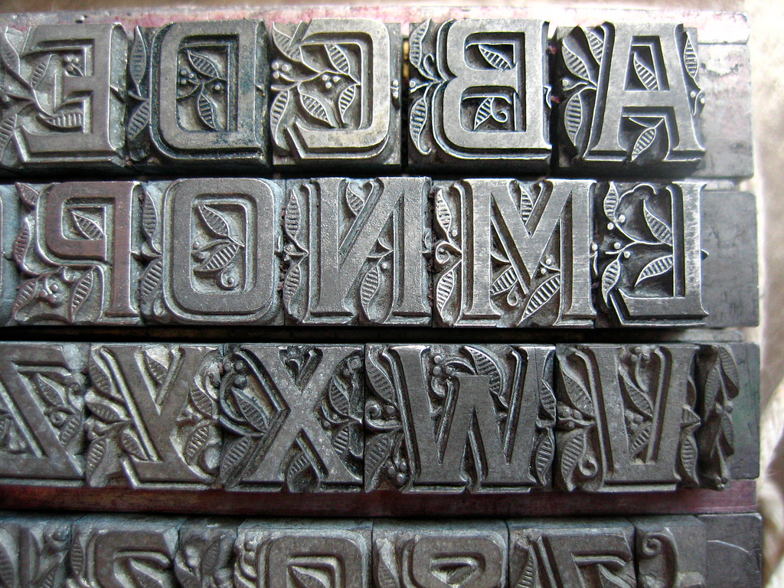
improving @font-face
smaller, custom font files
avoid FOUT, impatient fallback
n milliseconds
DOM loaded, window onload
user interaction
higher priority caching
aggressively use expired fonts
today: localStorage
Notes:
flickr.com/photos/firebrat/2711165108/

Slide 44
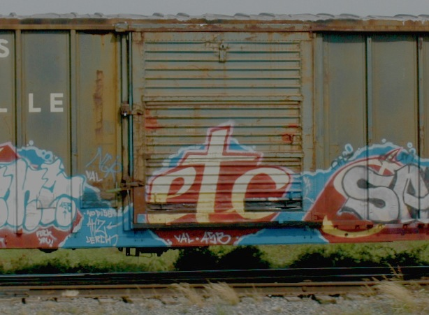
there’s more
CSS instead of images: border radius, linear & radial gradients, drop shadow
SVG, inline SVG, and canvas
video tag
WebSockets
web workers
builtin controls: progress, datetime
Notes:
flickr.com/photos/dualphoto/2609096047/

Slide 45
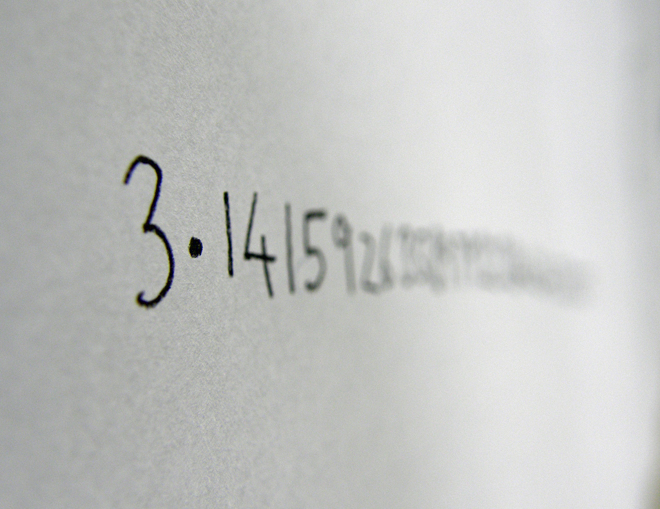
and more
history – http://www.kylescholz.com/blog/2010/04/html5_history_is_the_future.html
<a ping
requestAnimationFrame – not timers
native JSON parse/stringify
http://bit.ly/browserscope-modernizr
http://www.html5rocks.com/
Notes:
flickr.com/photos/kaptainkobold/5741327207/

Slide 46
takeaways
speed matters
WPWG
window.performance
async & defer
app cache, localStorage
Notes:
flickr.com/photos/myklroventine/4062102754/

Slide 47
Patrick Meenan
Nicholas Zakas
Guy Podjarny
Stoyan Stefanov
Tim Kadlec
Brian Pane
Josh Fraser
Steve Souders
Betty Tso
Israel Nir
Marcel Duran
Éric Daspet
Alois Reitbauer
Matthew Prince
Buddy Brewer
Alexander Podelko
Estelle Weyl
Aaron Peters
Tony Gentilcore
Matthew Steele
Bryan McQuade
Tobie LangelBilly Hoffman
Joshua Bixby
Sergey Chernyshev
JP Castro
Pavel Paulau
David Calhoun
Nicole Sullivan
James Pearce
Tom Hughes-Croucher

Slide 49
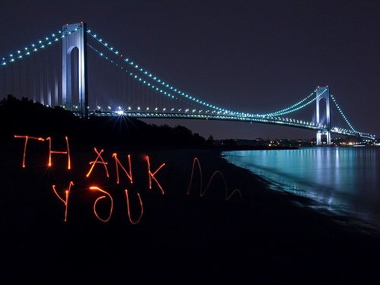
Steve Souders
@souders
stevesouders.com/docs/onekingslane-html5-20130301.pptx
Notes:
"thank you" by nj dodge: http://flickr.com/photos/nj_dodge/187190601/
I’m pretty sure this is the Verrazano-Narrows Bridge.

Slide 50
Performance Analysis
URL | onload (secs) | Page Speed | Reqs | Size MB
One Kings Lane | 13.6 | 85 | 69 | 1.8
Fab | 43.4 | 94 | 186 | 7.2
Gilt | 12.9 | 91 | 58 | 2.1
Twitter | 4.7 | 96 | 15 | 0.4
Yammer | 7.9 | 85 | 32 | 0.8
Stack Overflow | 1.5 | 93 | 13 | 0.2
Chrome: webpagetest.org/result/130228_G7_105R/
IE9: webpagetest.org/result/130228_PP_1055/
Notes:
video: http://www.webpagetest.org/video/view.php?id=130228_f552a46320bb1eb1458530e582ad5b5f0eb20b5a

