Slide 1
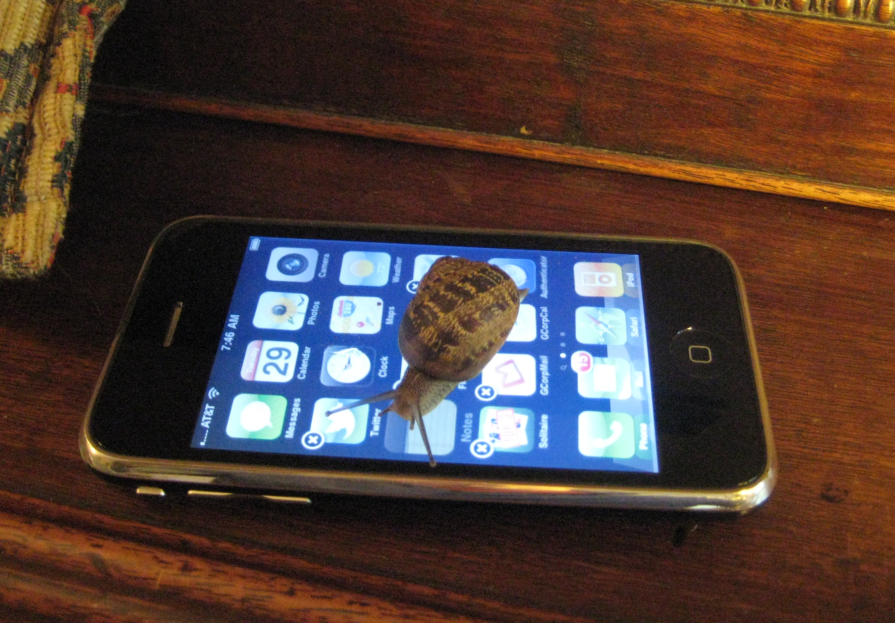
High Performance Mobile
stevesouders.com/docs/linkedin-20110427.pptx
Disclaimer: This content does not necessarily reflect the opinions of my employer.

Slide 2

14 Rules
Make fewer HTTP requests
Use a CDN
Add an Expires header
Gzip components
Put stylesheets at the top
Put scripts at the bottom
Avoid CSS expressions
Make JS and CSS external
Reduce DNS lookups
Minify JS
Avoid redirects
Remove duplicate scripts
Configure ETags
Make AJAX cacheable
Notes:
photo courtesy of Vicki & Chuck Rogers: http://www.flickr.com/photos/two-wrongs/205467442/

Slide 3

Splitting the initial payload
Loading scripts without blocking
Coupling asynchronous scripts
Positioning inline scripts
Sharding dominant domains
Flushing the document early
Using iframes sparingly
Simplifying CSS Selectors
Understanding Ajax performance Doug Crockford
Creating responsive web apps Ben Galbraith, Dion Almaer
Writing efficient JavaScript Nicholas Zakas
Scaling with Comet Dylan Schiemann
Going beyond gzipping Tony Gentilcore
Optimizing images Stoyan Stefanov, Nicole Sullivan

Slide 4
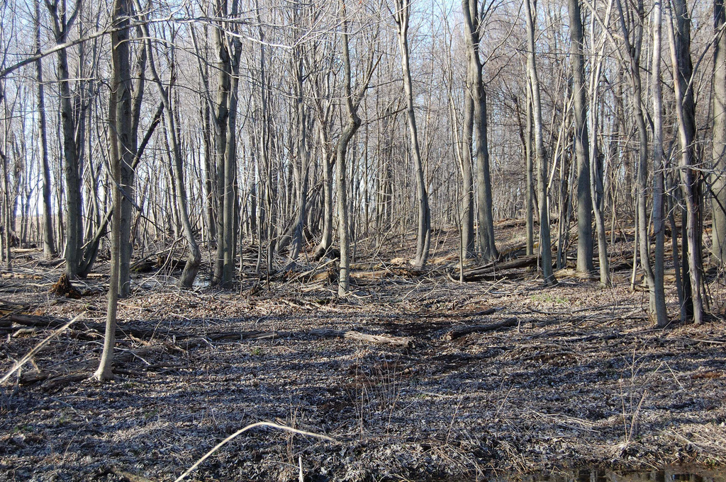

2004

Slide 5
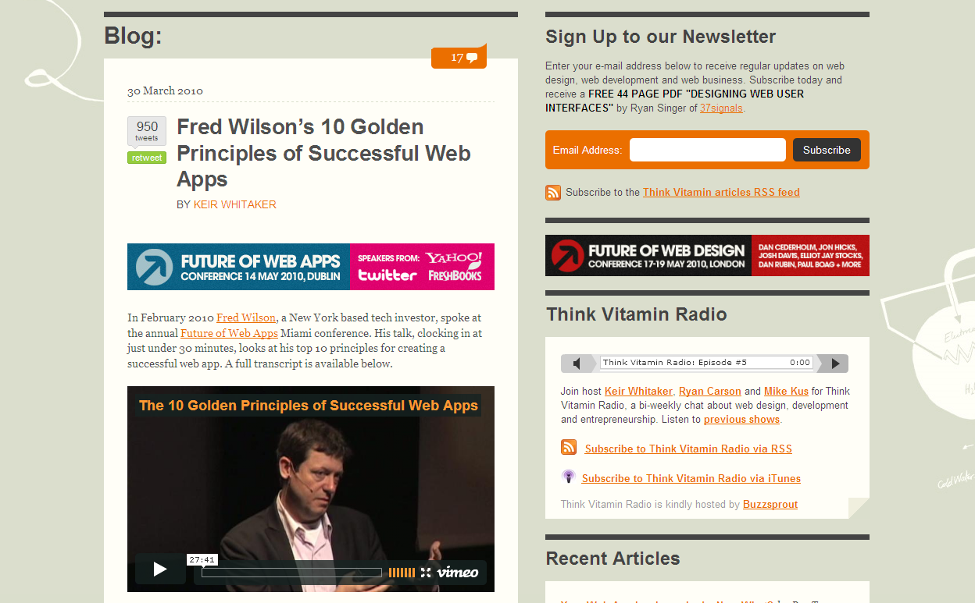
carsonified.com/blog/business/fred-wilsons-10-golden-principles-of-successful-web-apps/
#1. Speed: “First and foremost, we believe that speed is more than a feature. Speed is the most important feature.”
Notes:
Fred Wilson is Managing Partner of two venture capital firms, Flatiron Partners (Yoyodyne, Geocities) and Union Square Ventures (Twitter, delicious, Etsy, Feedburner).
Speed
Instant utility
Software is media
Less is more
Make it programmable
Make it personal
RESTful
Discoverability
Clean
Playful

Slide 6
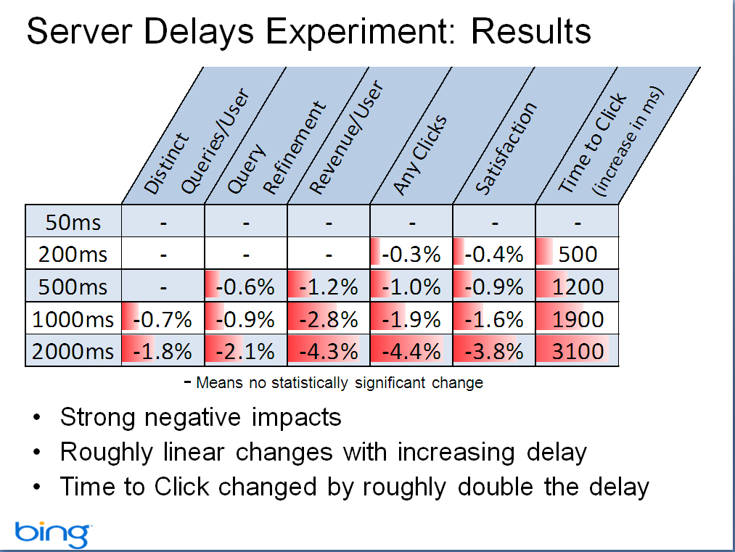
en.oreilly.com/velocity2009/public/schedule/detail/8523

Slide 7
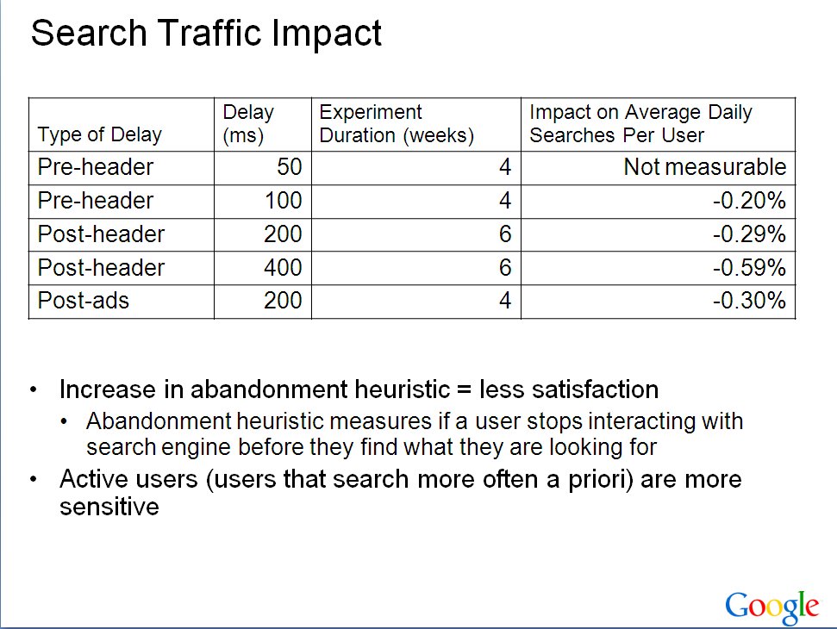
en.oreilly.com/velocity2009/public/schedule/detail/8523

Slide 8
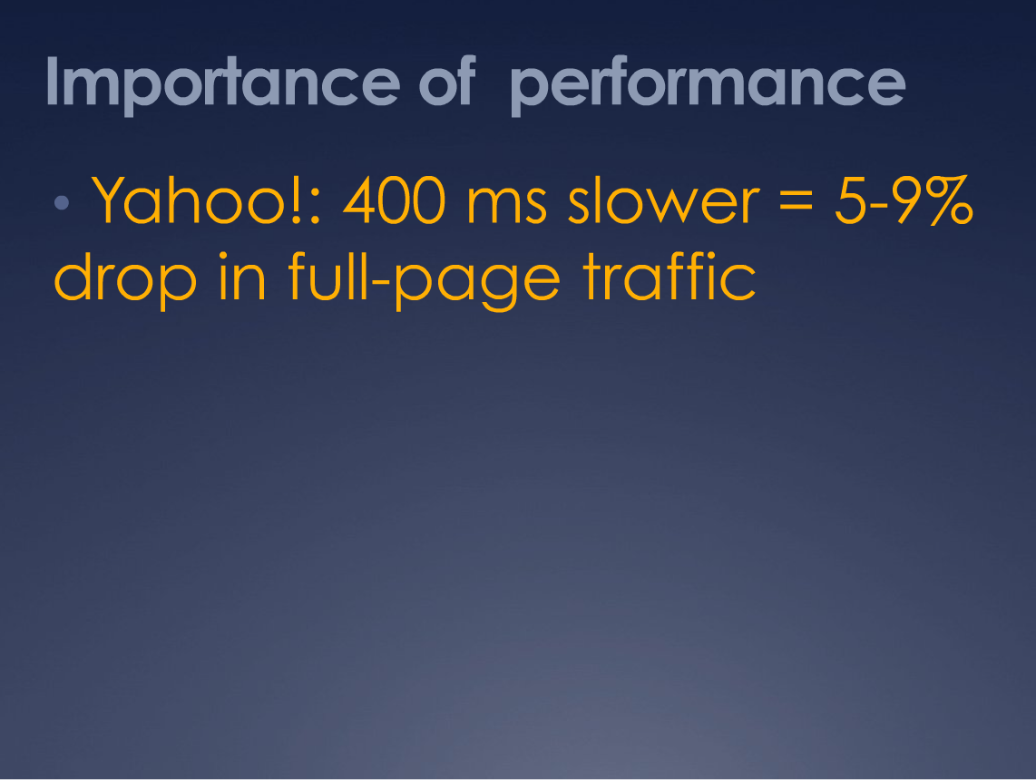
Yahoo!
0.4 sec slower
traffic ⬇ 5-9%
slideshare.net/stoyan/dont-make-me-wait-or-building-highperformance-web-applications
slideshare.net/stoyan/yslow-20-presentation

Slide 9
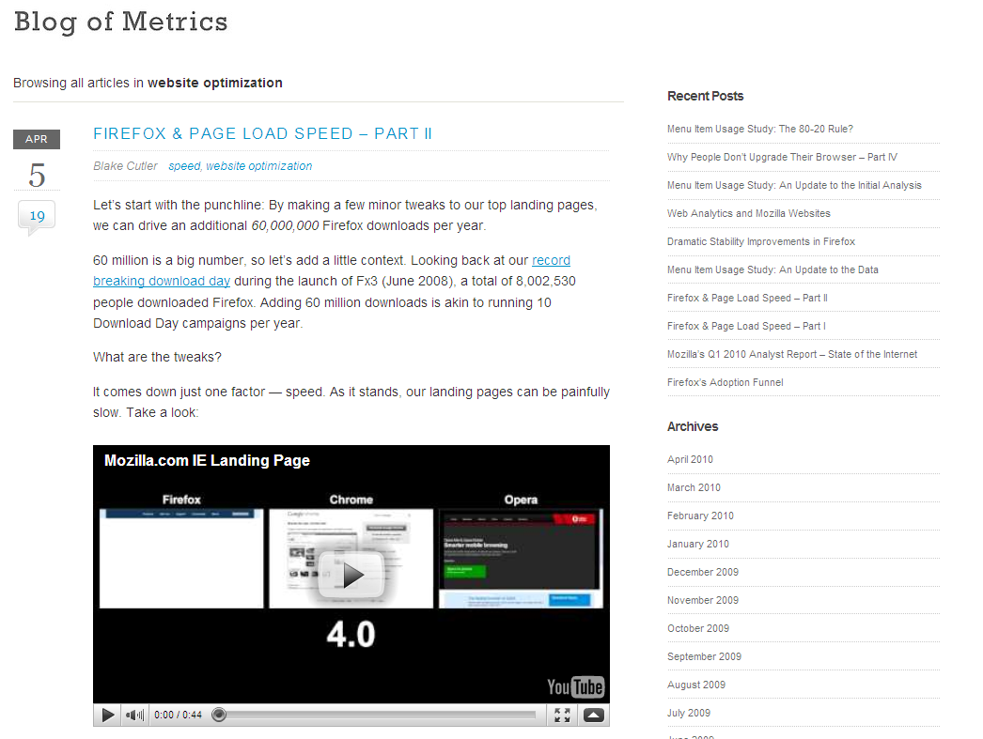
blog.mozilla.com/metrics/category/website-optimization/
…shaved 2.2 seconds off the average page load time and increased download conversions by 15.4%!
Notes:
“if we’re able to achieve a similar performance boost across our other top landing pages, we’ll drive in excess of 60 million yearly Firefox downloads.”

Slide 10
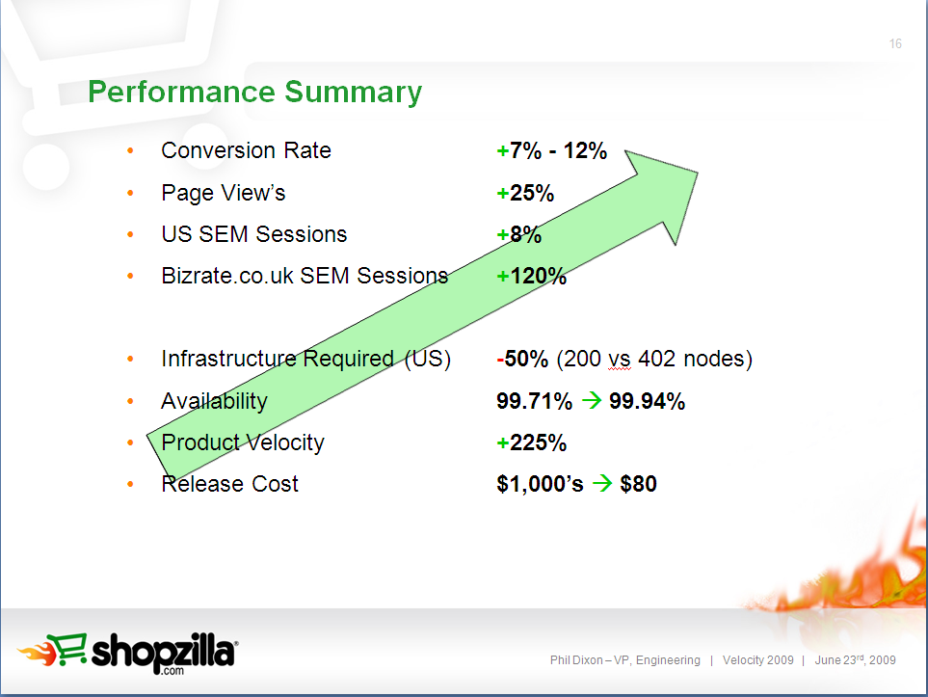
en.oreilly.com/velocity2009/public/schedule/detail/7709
blog.mozilla.com/metrics/category/website-optimization/
…shaved 2.2 seconds off the average page load time and increased download conversions by 15.4%!
Notes:
This was a ~5 second speed up.

Slide 11
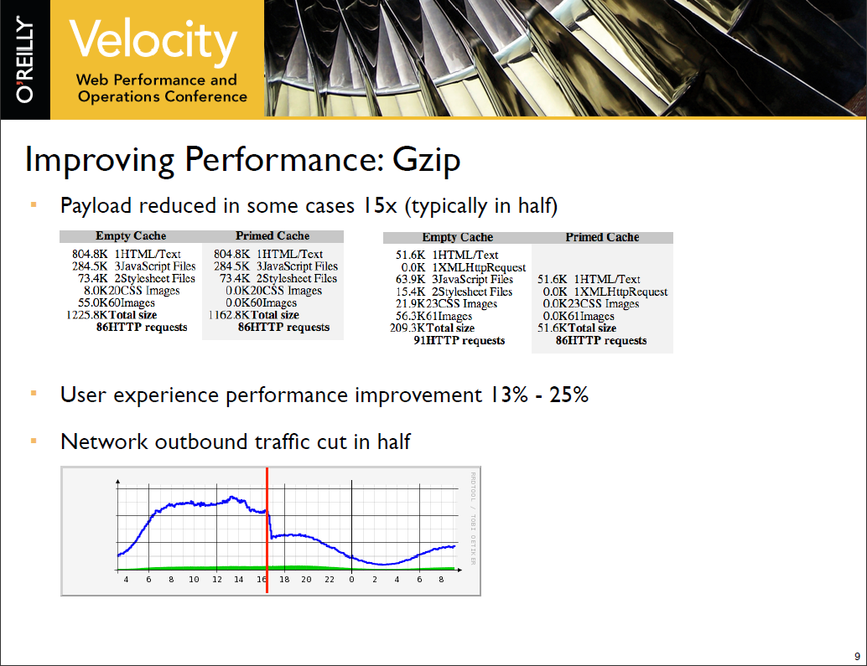

en.oreilly.com/velocity2008/public/schedule/detail/3632

Slide 12
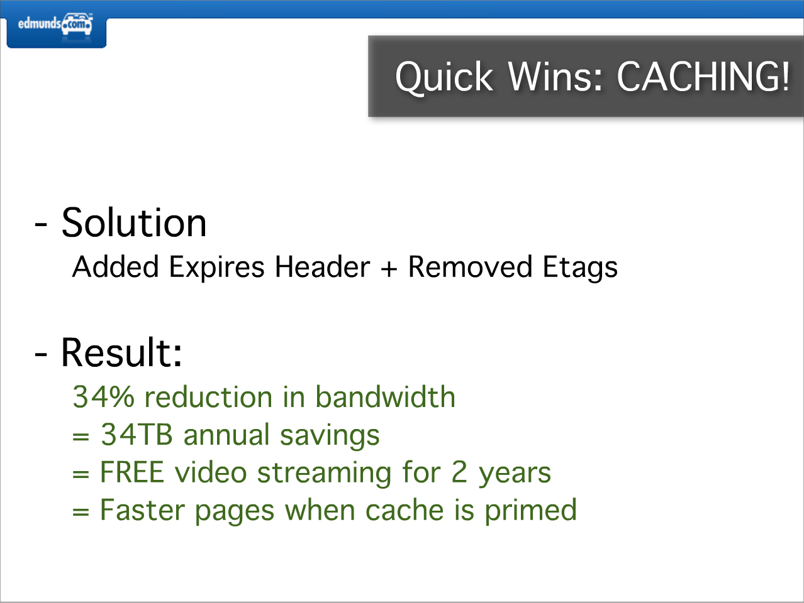
slideshare.net/EdmundsLabs/how-edmunds-got-in-the-fast-lane-80-reduction-in-page-load-time-in-3-simple-steps-6593377

Slide 13
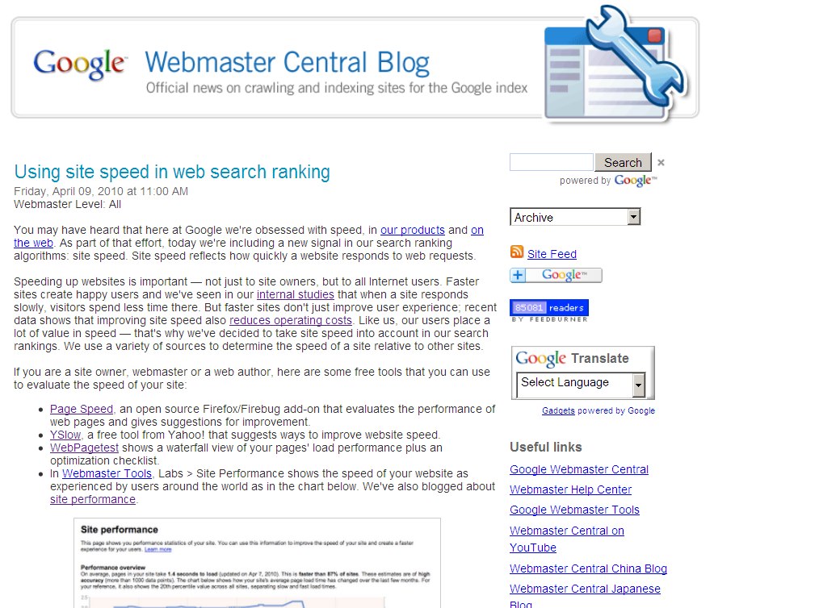
Site speed in search rank
…we've decided to take site speed into account in our search rankings.
Screen shot of blog post
googlewebmastercentral.blogspot.com/2010/04/using-site-speed-in-web-search-ranking.html
Notes:
Time measurements from real users.

Slide 14

Web
Performance
Optimization
WPO
  drives traffic
  improves UX
  increases revenue
  reduces costs
flickr.com/photos/pedromourapinheiro/3123885534/

Slide 15
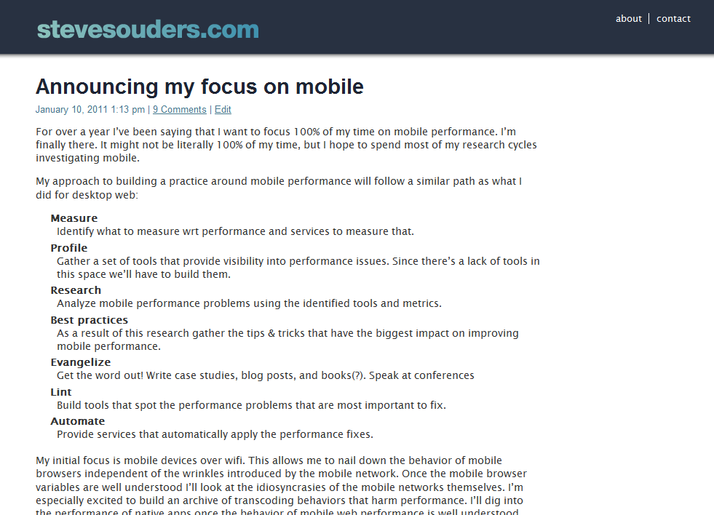

Slide 16
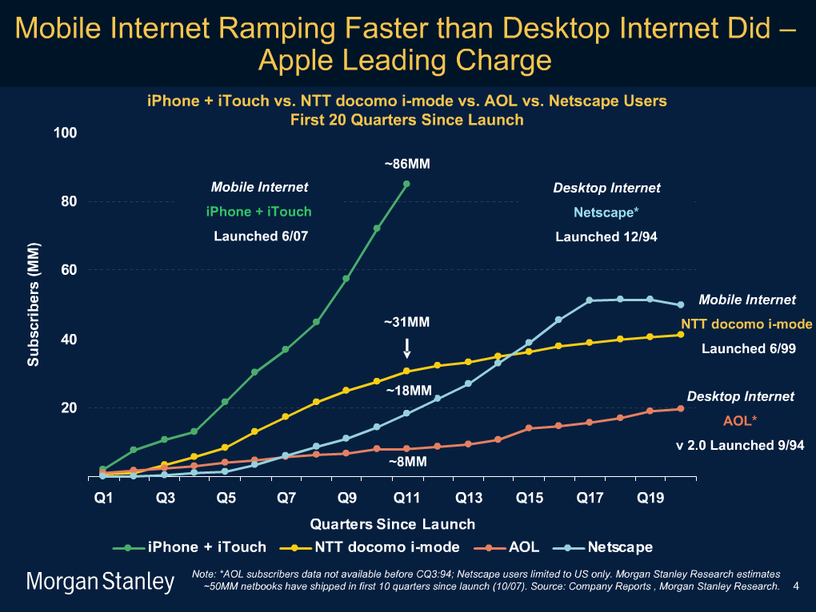
slideshare.net/CMSummit/ms-internet-trends060710final

Slide 17
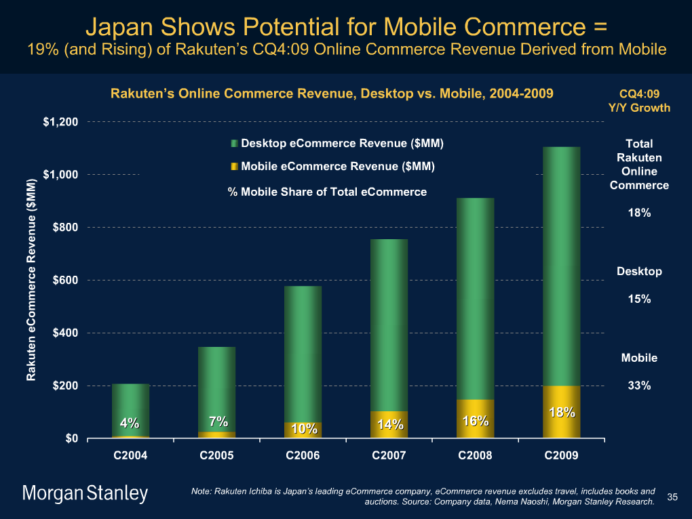
slideshare.net/CMSummit/ms-internet-trends060710final

Slide 18
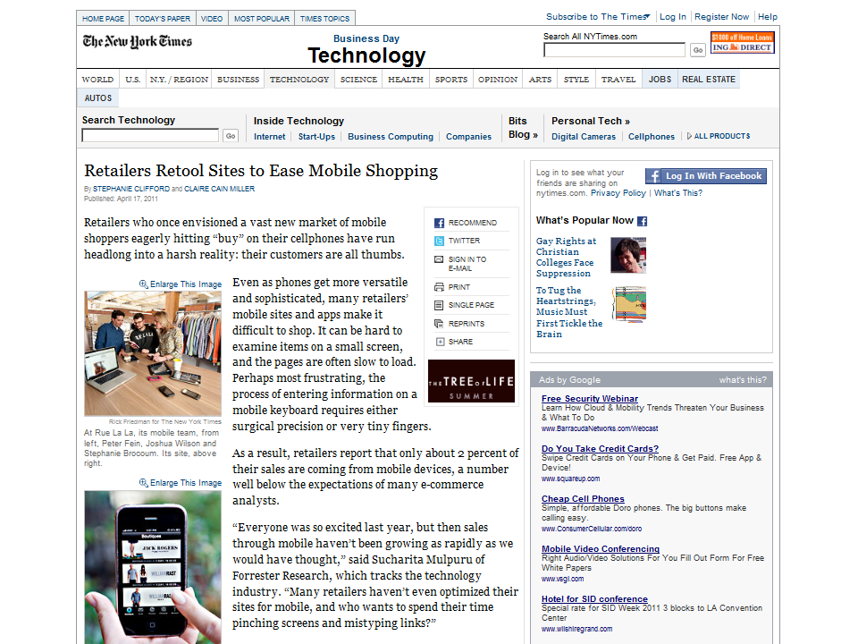
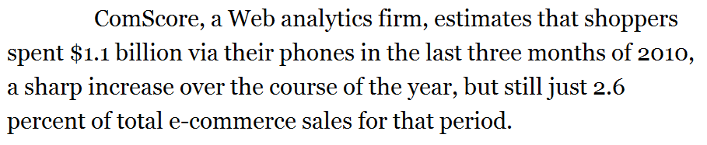
nytimes.com/2011/04/18/technology/18mobile.html
Notes:
http://www.nytimes.com/2011/04/18/technology/18mobile.html

Slide 19
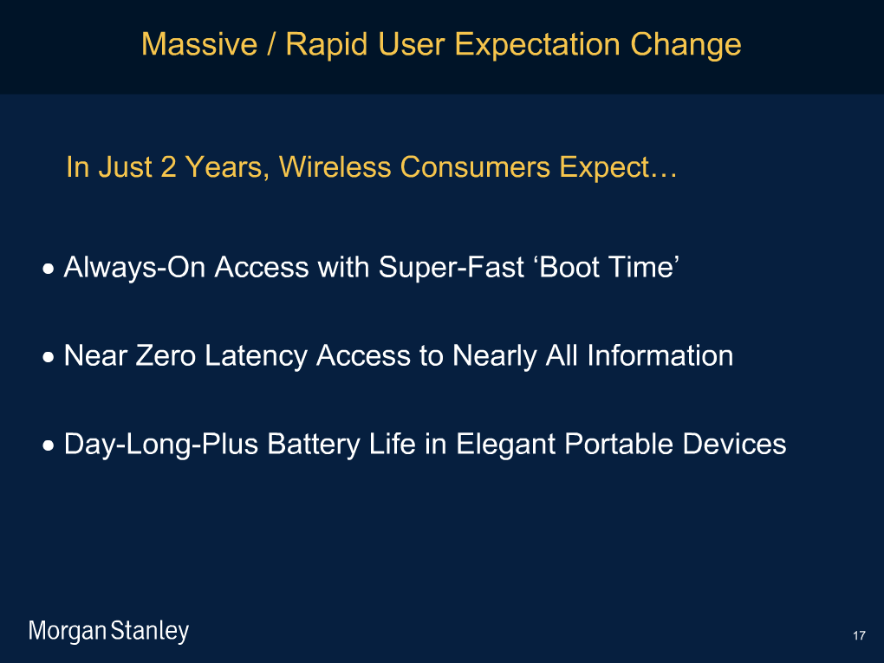
slideshare.net/CMSummit/ms-internet-trends060710final

Slide 20
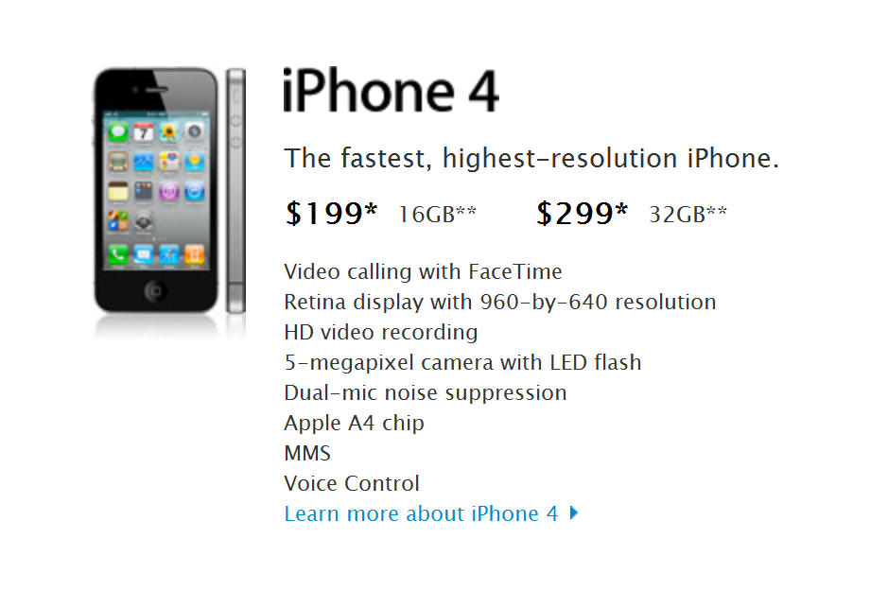


Slide 21
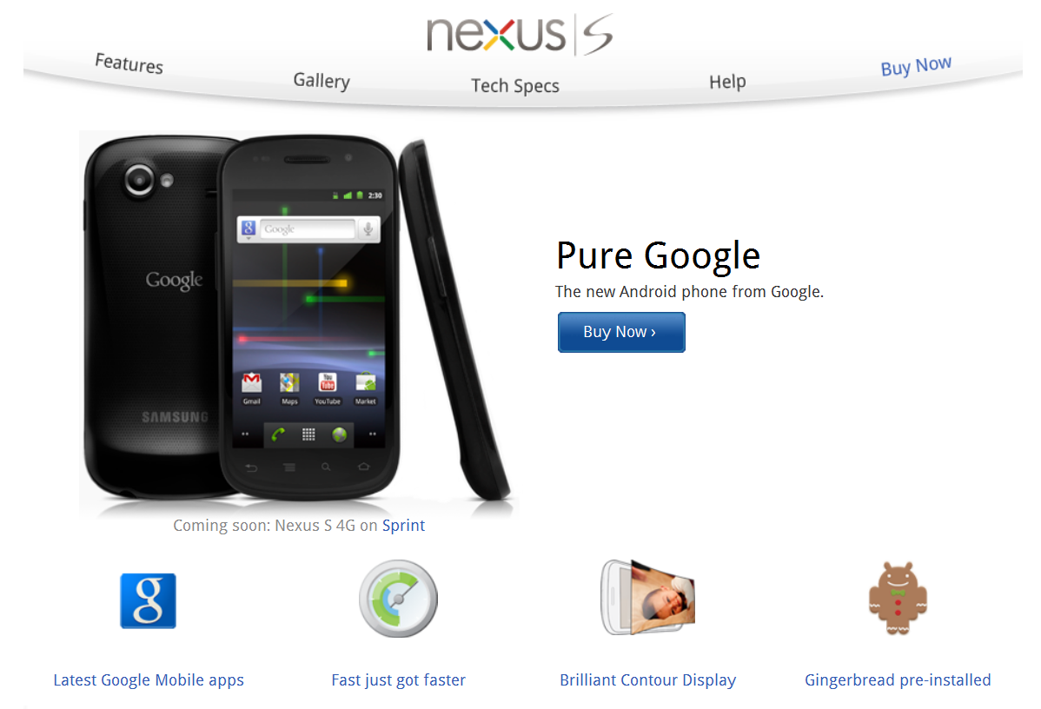


Slide 22


Slide 23


Slide 24









Slide 26
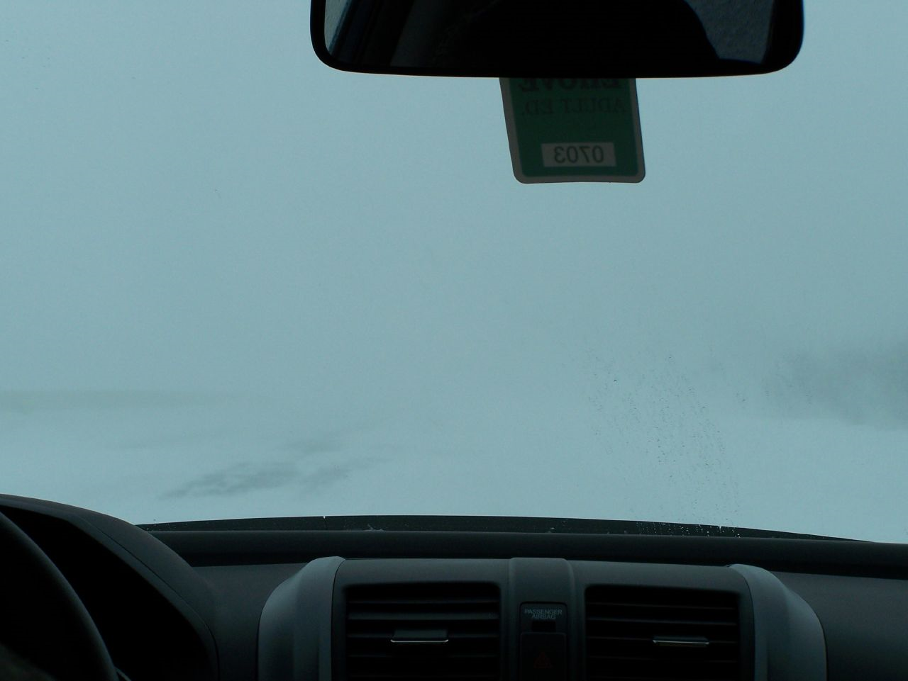
zero visibility
flickr.com/photos/davidandheidi/2320489837/

Slide 27
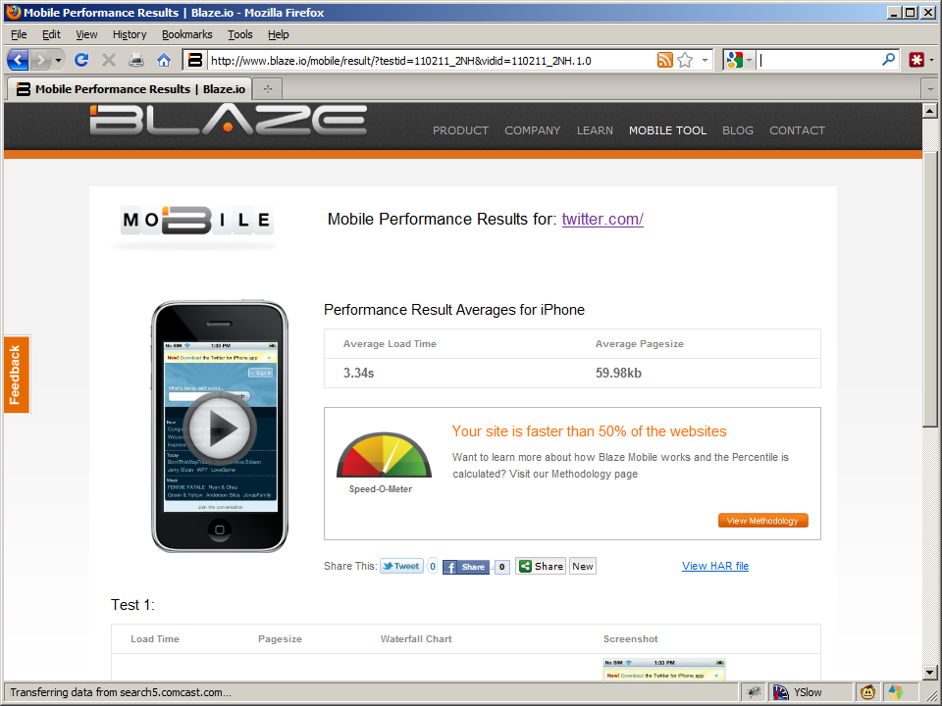
1

Slide 28
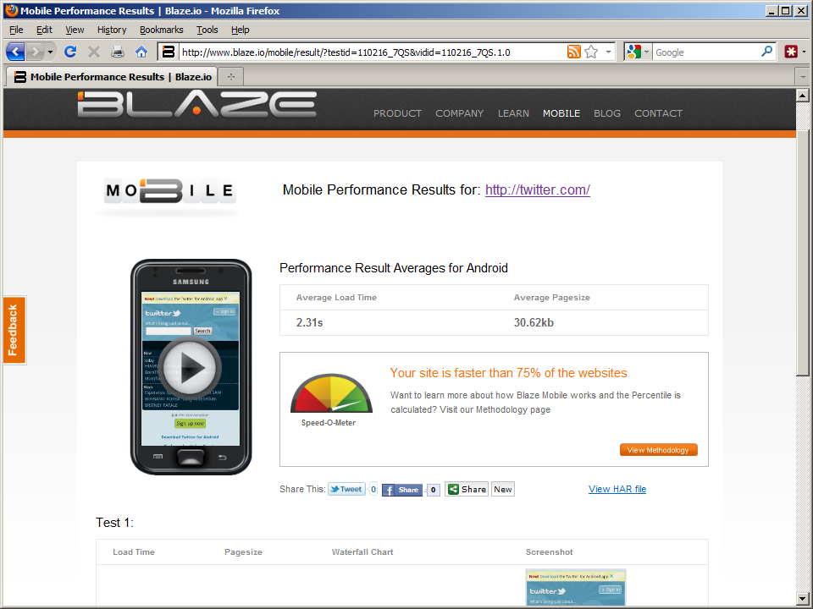

Slide 29
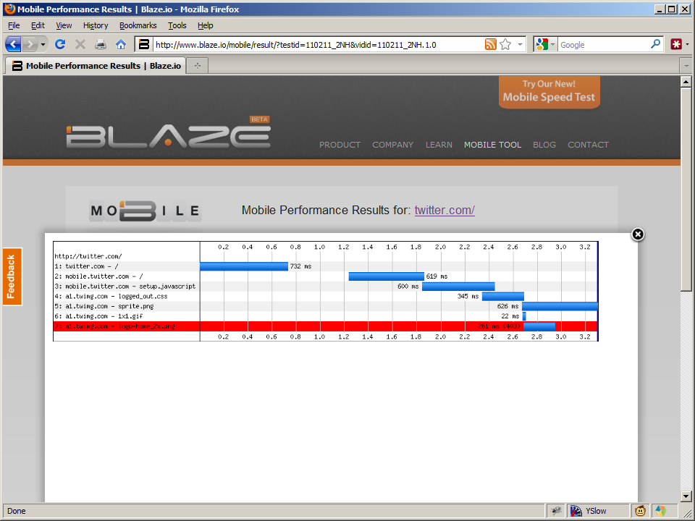

Slide 30
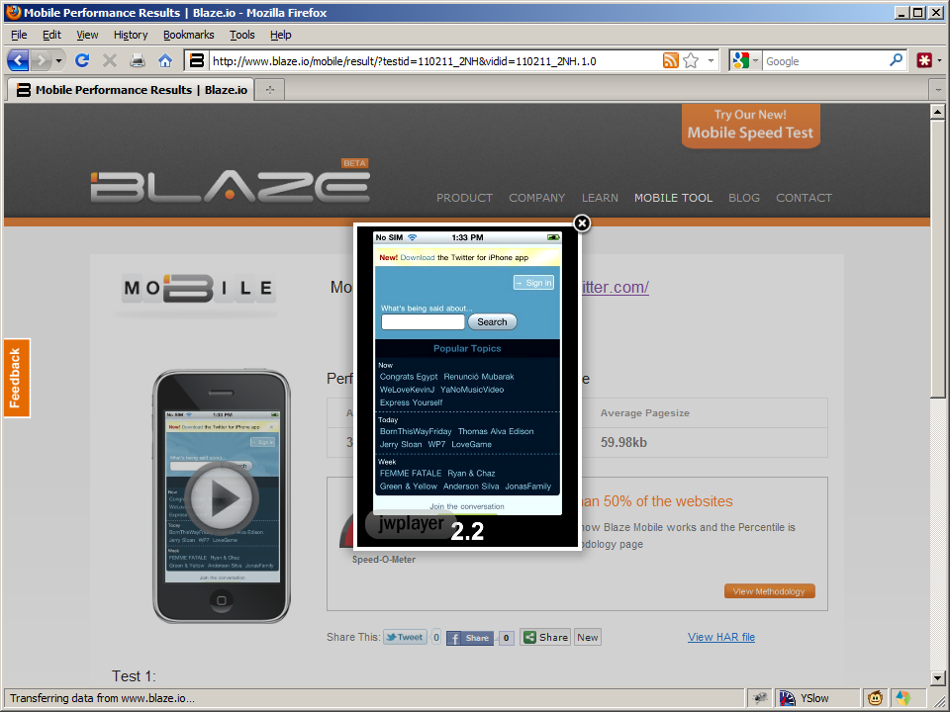

Slide 31
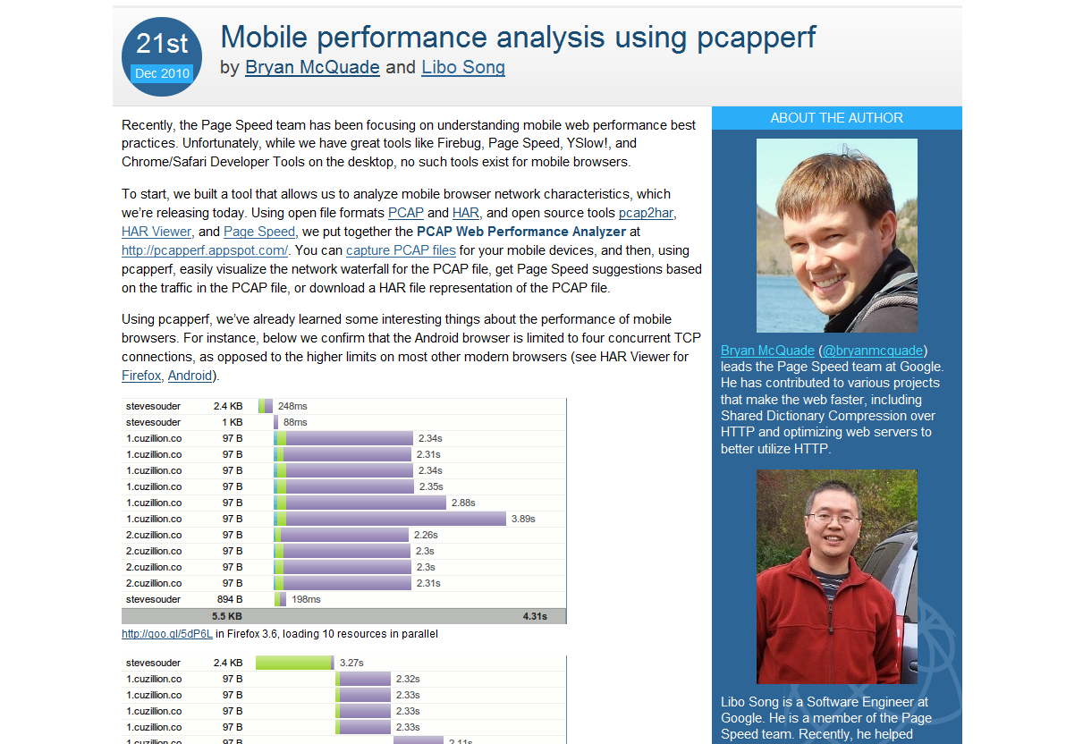
2

Slide 32
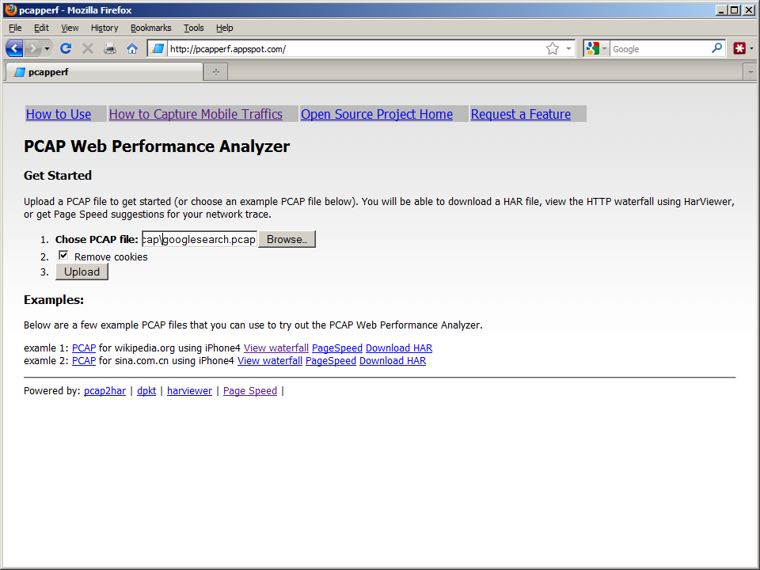

Slide 33
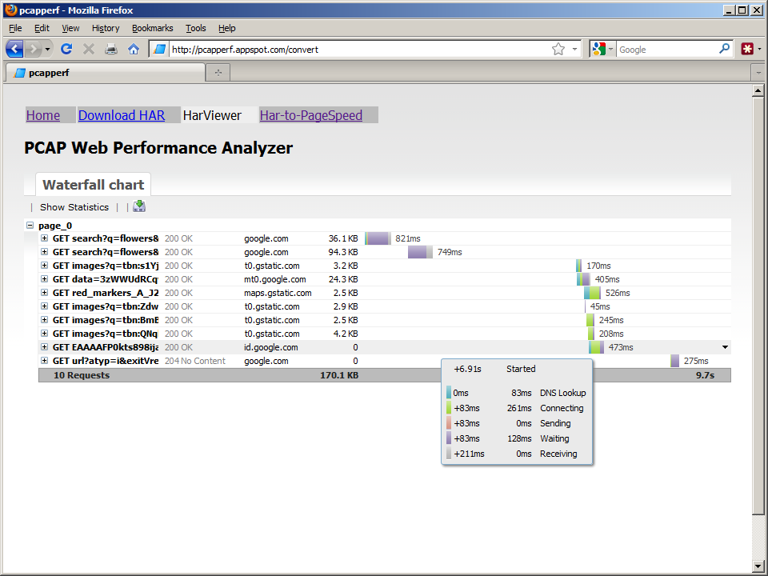
to intr
to intr

Slide 34
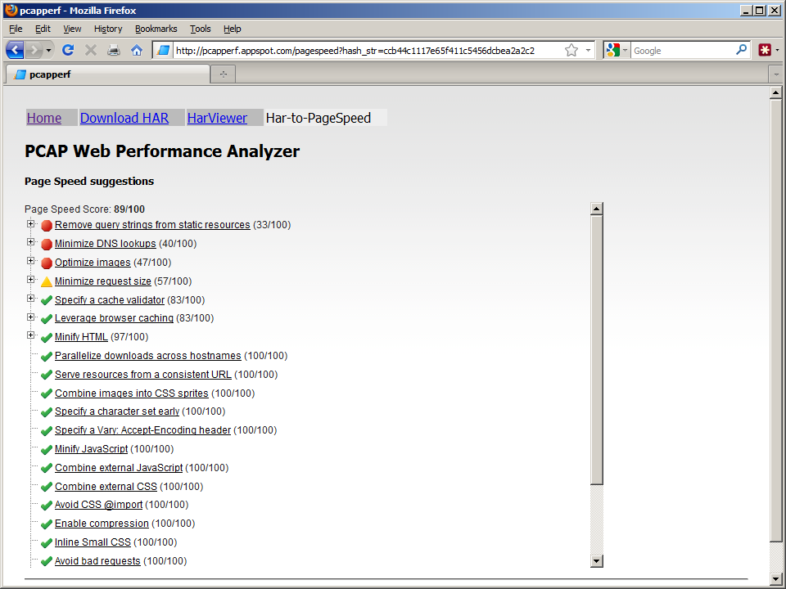

Slide 35
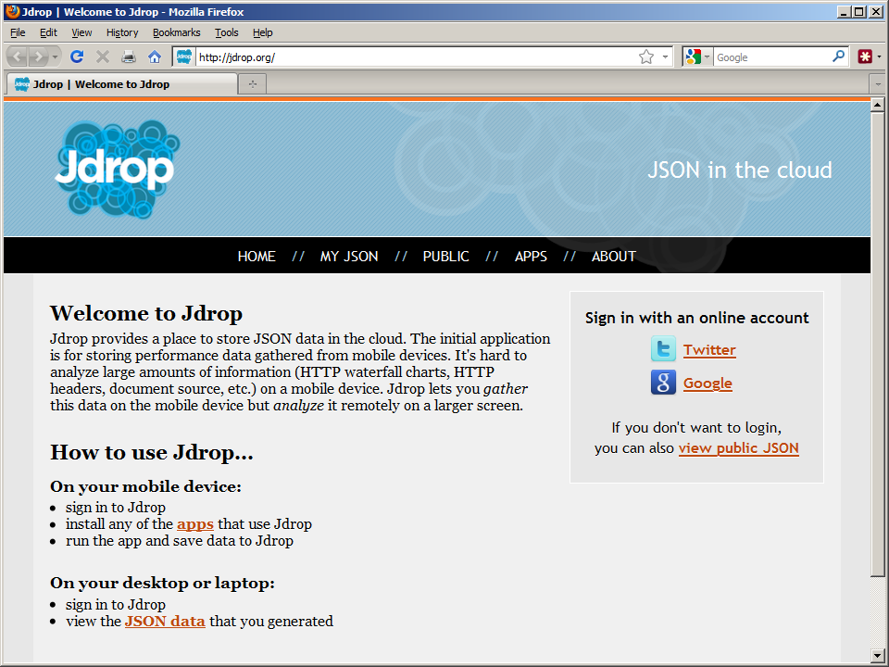
3

Slide 36
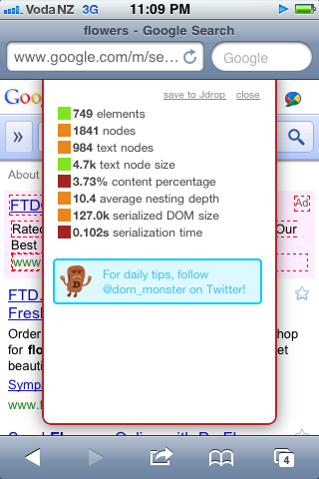

Slide 37
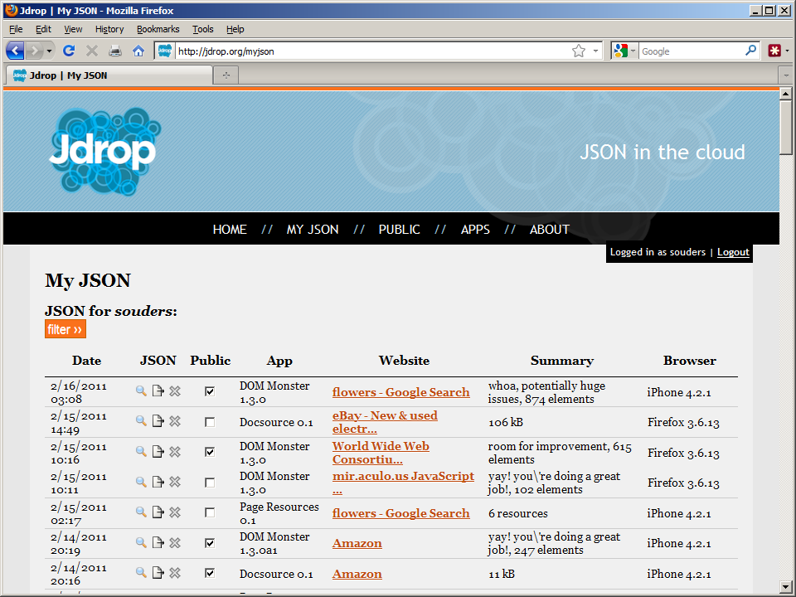

Slide 38
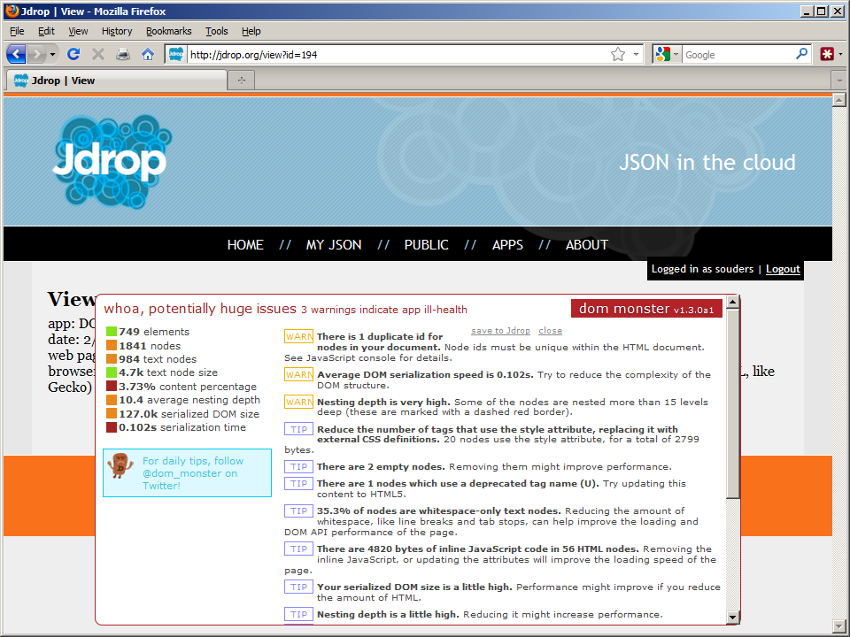

Slide 39
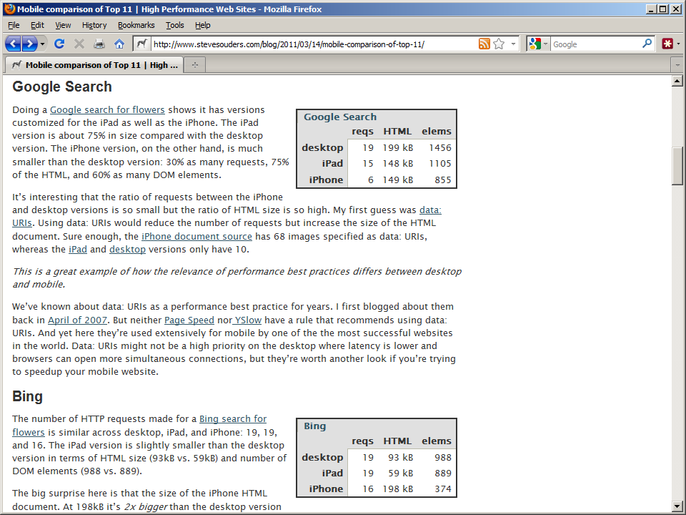


Slide 40
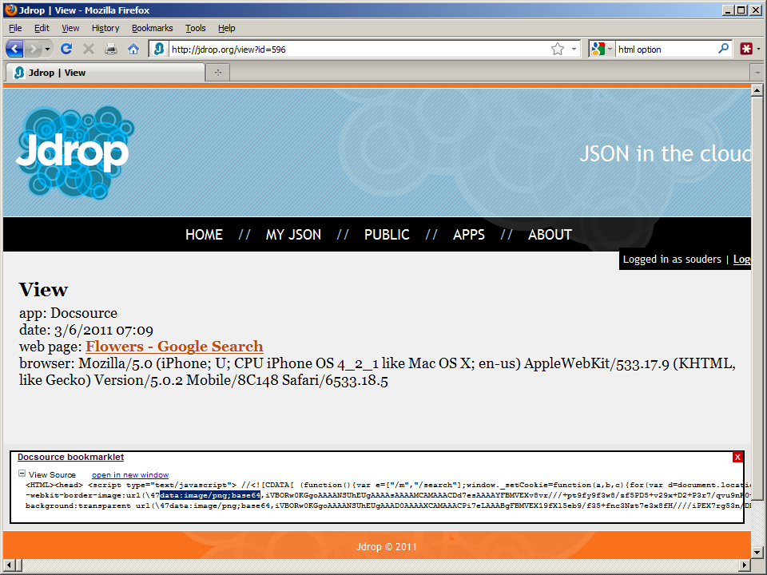

Slide 41


Slide 42
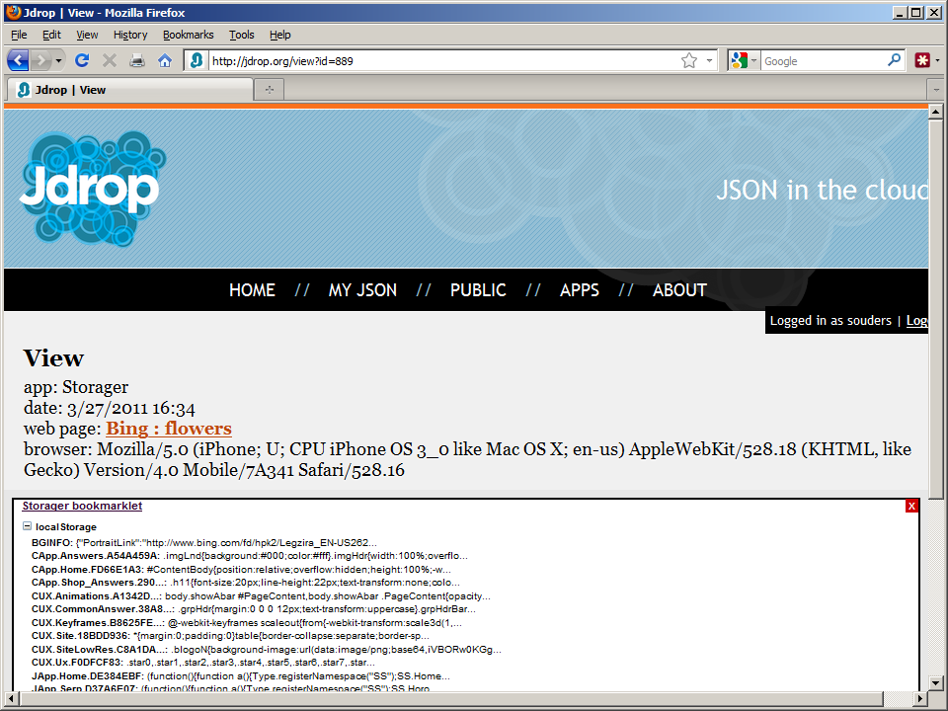

Slide 43
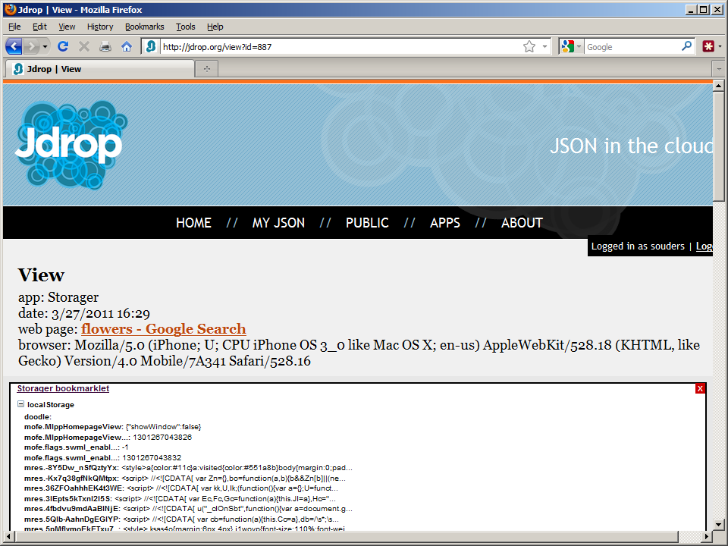

Slide 44
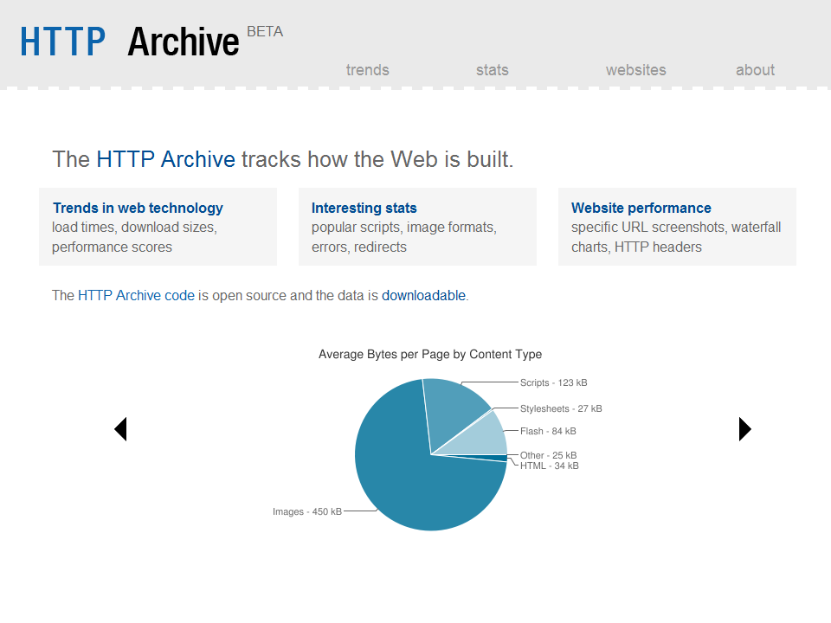

Slide 45
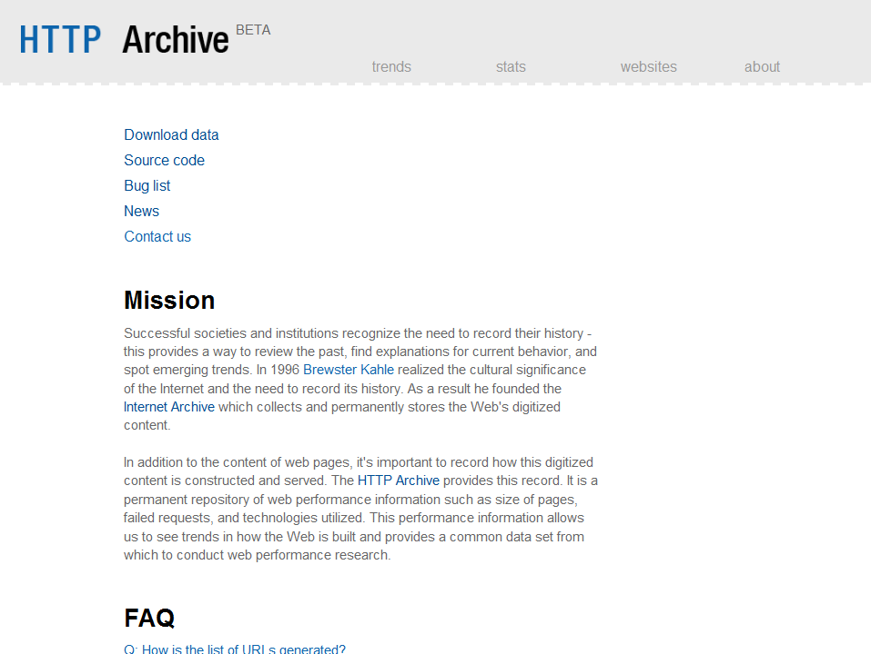
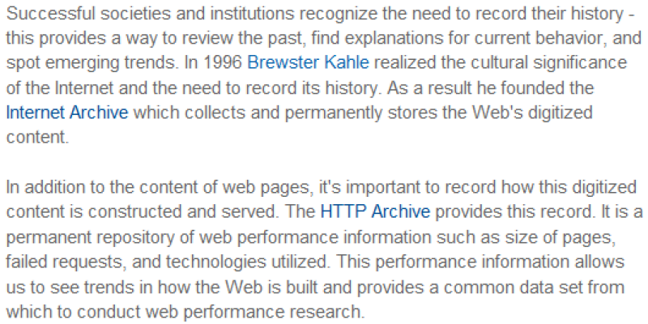

Slide 46
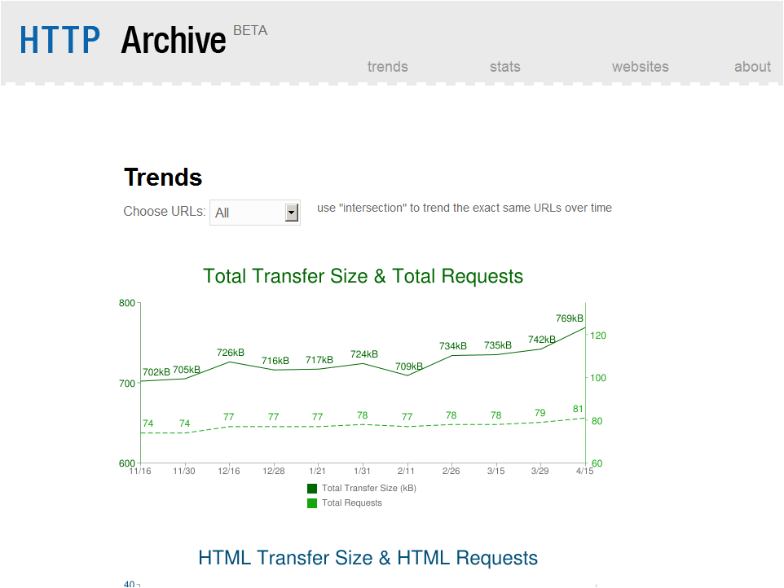
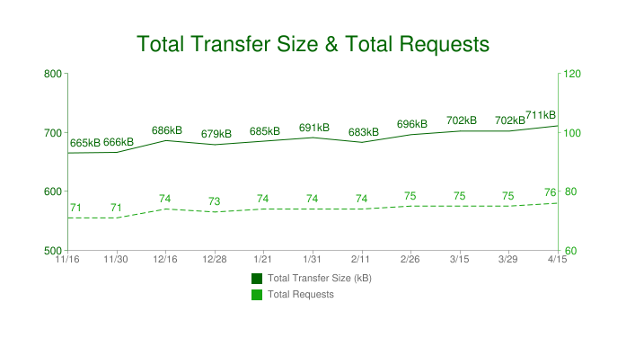

Slide 47
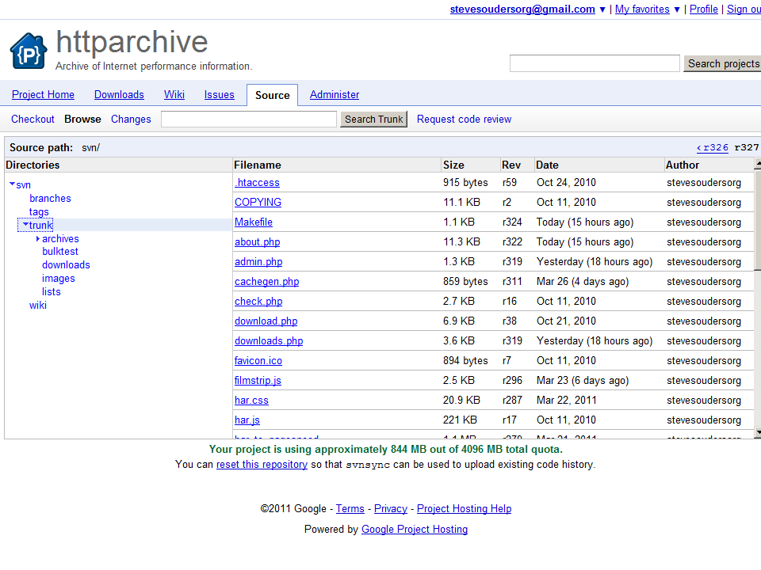

Slide 48
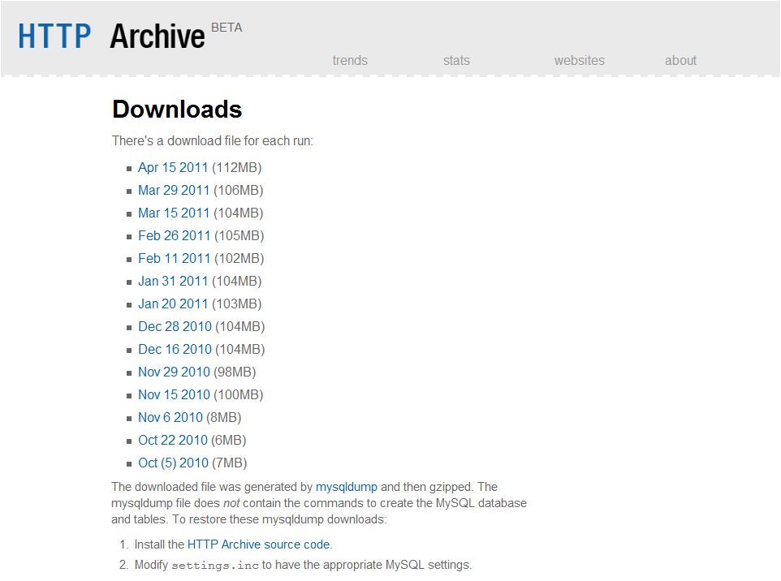

Slide 49
takeaways
speed matters
WPO
  traffic↑, UX↑, revenue↑, costs↓
faster mobile
  biz opp, differentiator, shared pain
visibility into mobile
  Blaze.io, pcapperf, Jdrop

Slide 50

Steve Souders
@souders
stevesouders.com/docs/linkedin-20110427.pptx
flickr.com/photos/myklroventine/4062102754/
Notes:
http://www.flickr.com/photos/myklroventine/4062102754/

