Slide 1
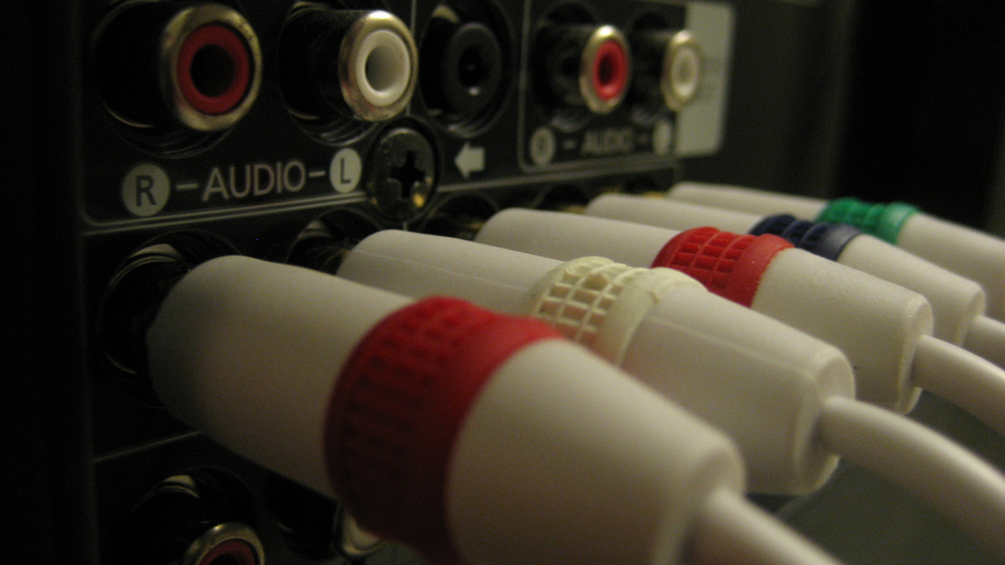
High Performance Web Components
@souders
stevesouders.com/docs/html5devconf-webcomp-20140522.pptx
flickr.com/photos/brenderous/4255550788
Notes:
https://www.flickr.com/photos/brenderous/4255550788

Slide 2

Web Components
souders@google.com
stevesouders.com/docs/sap-hpws-20140424.pptx
Notes:
https://www.flickr.com/photos/oskay/437341128

Slide 3
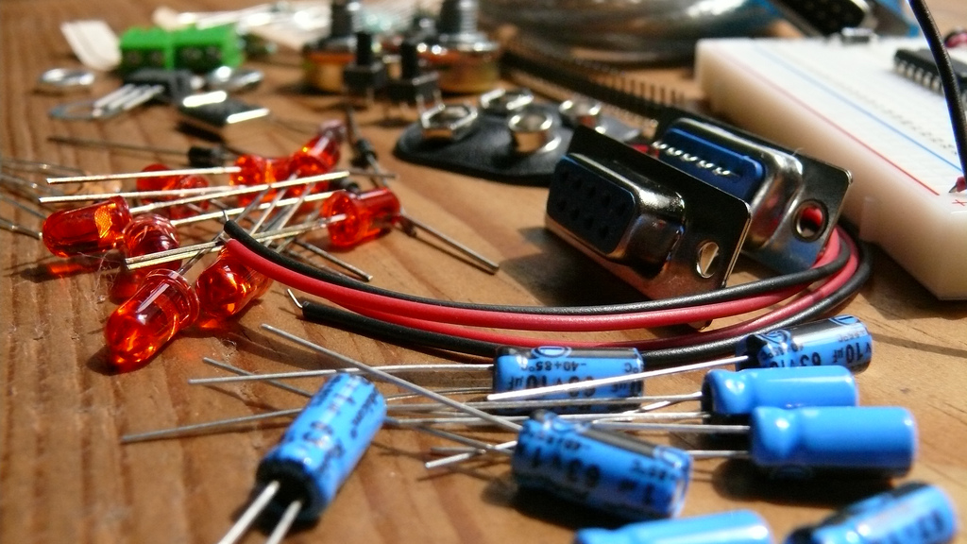
Web Components
souders@google.com
stevesouders.com/docs/sap-hpws-20140424.pptx
Notes:
https://www.flickr.com/photos/tiemposdelruido/4051085295
also:
https://www.flickr.com/photos/tiemposdelruido/4051083769
https://www.flickr.com/photos/tiemposdelruido/4051086973
https://www.flickr.com/photos/tiemposdelruido/4051826452
https://www.flickr.com/photos/tiemposdelruido/4051078871

Slide 4
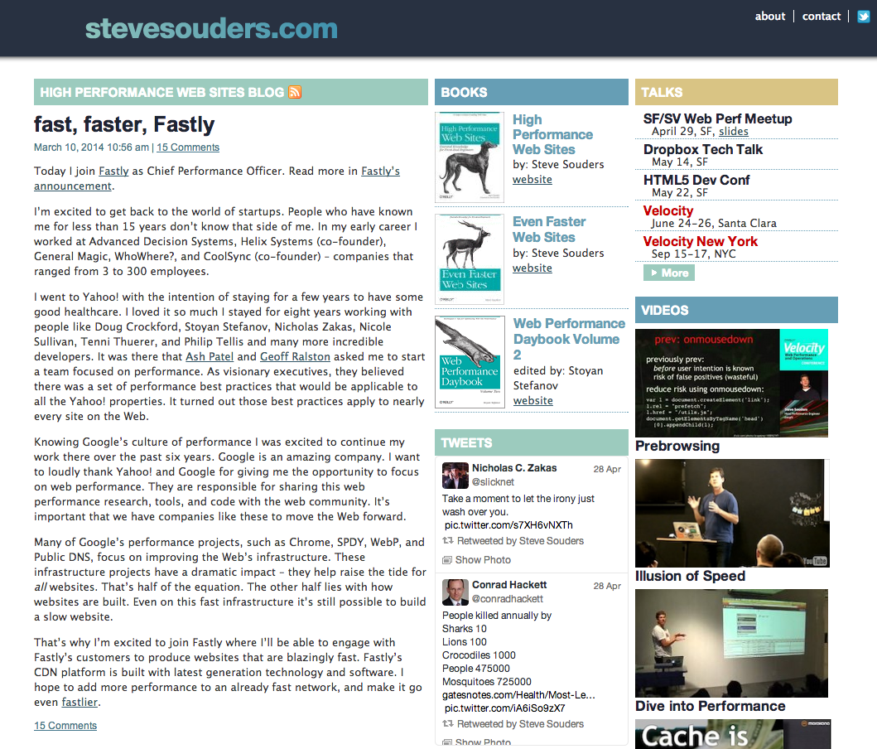

Slide 5
flickr.com/photos/brenderous/4255550788
Notes:
https://www.flickr.com/photos/brenderous/4255550788

Slide 6
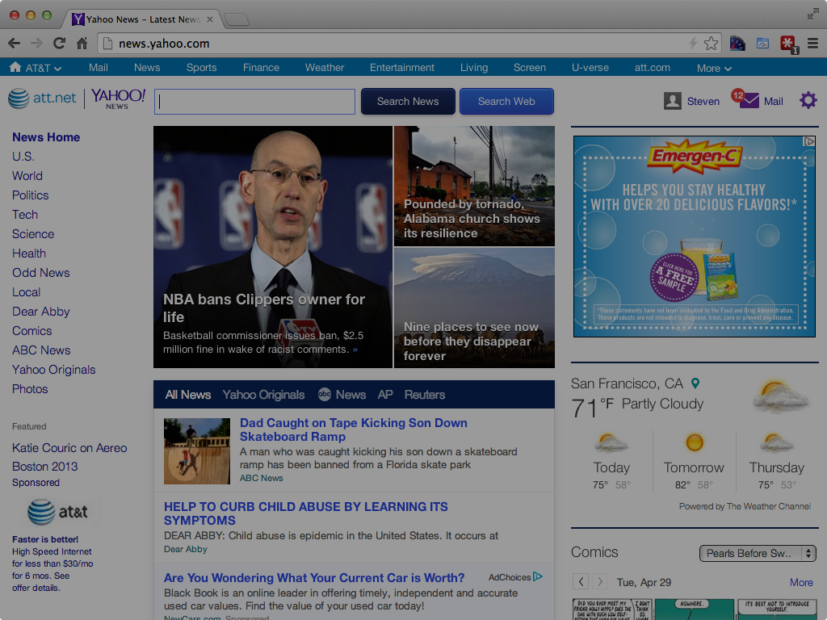
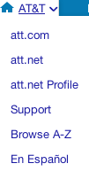


Slide 7
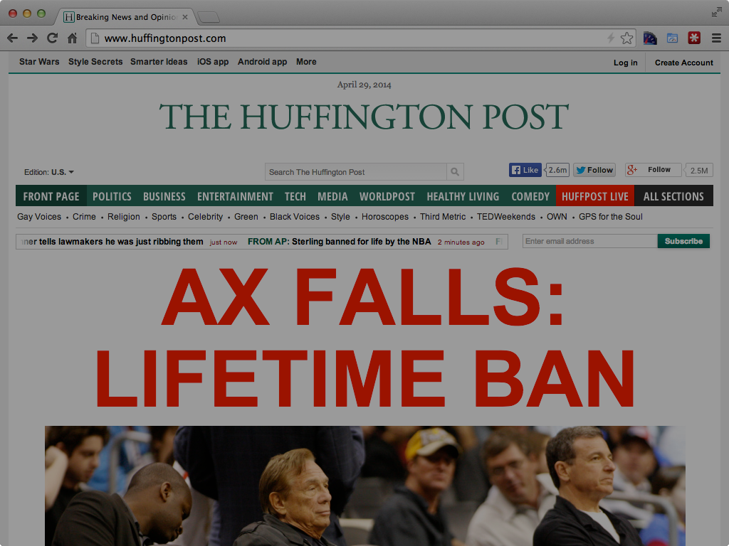

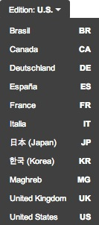

Slide 8

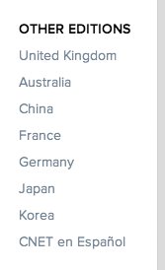

Slide 9



Slide 10



Slide 11



Slide 12














Slide 13
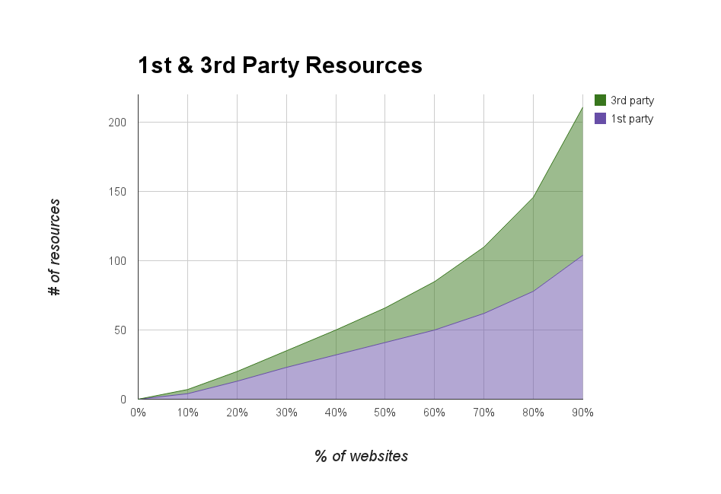
bigqueri.es/t/what-is-the-distribution-of-1st-party-vs-3rd-party-resources/100
Notes:
50th: 25 3rd party, 41 1st party
90th: 107 3rd party, 104 1st party
SELECT party,
NTH(10, quantiles(cnt)) p10,
NTH(20, quantiles(cnt)) p20,
NTH(30, quantiles(cnt)) p30,
NTH(40, quantiles(cnt)) p40,
NTH(50, quantiles(cnt)) p50,
NTH(60, quantiles(cnt)) p60,
NTH(70, quantiles(cnt)) p70,
NTH(80, quantiles(cnt)) p80,
NTH(90, quantiles(cnt)) p90,
NTH(99, quantiles(cnt)) p99
FROM (
SELECT
origin,
IF (req_host CONTAINS REGEXP_EXTRACT(origin, r'([\w-]+)'), INTEGER(1), INTEGER(3)) AS party,
COUNT(*) as cnt
FROM [httparchive:runs.2014_04_15_requests] requests JOIN EACH (
SELECT pageid, DOMAIN(url) as origin
FROM [httparchive:runs.2014_04_15_pages]
) pages ON pages.pageid = requests.pageid
GROUP BY origin, party
)
GROUP by party;

Slide 14
flickr.com/photos/brenderous/4255550788
Notes:
https://www.flickr.com/photos/brenderous/4255550788

Slide 15
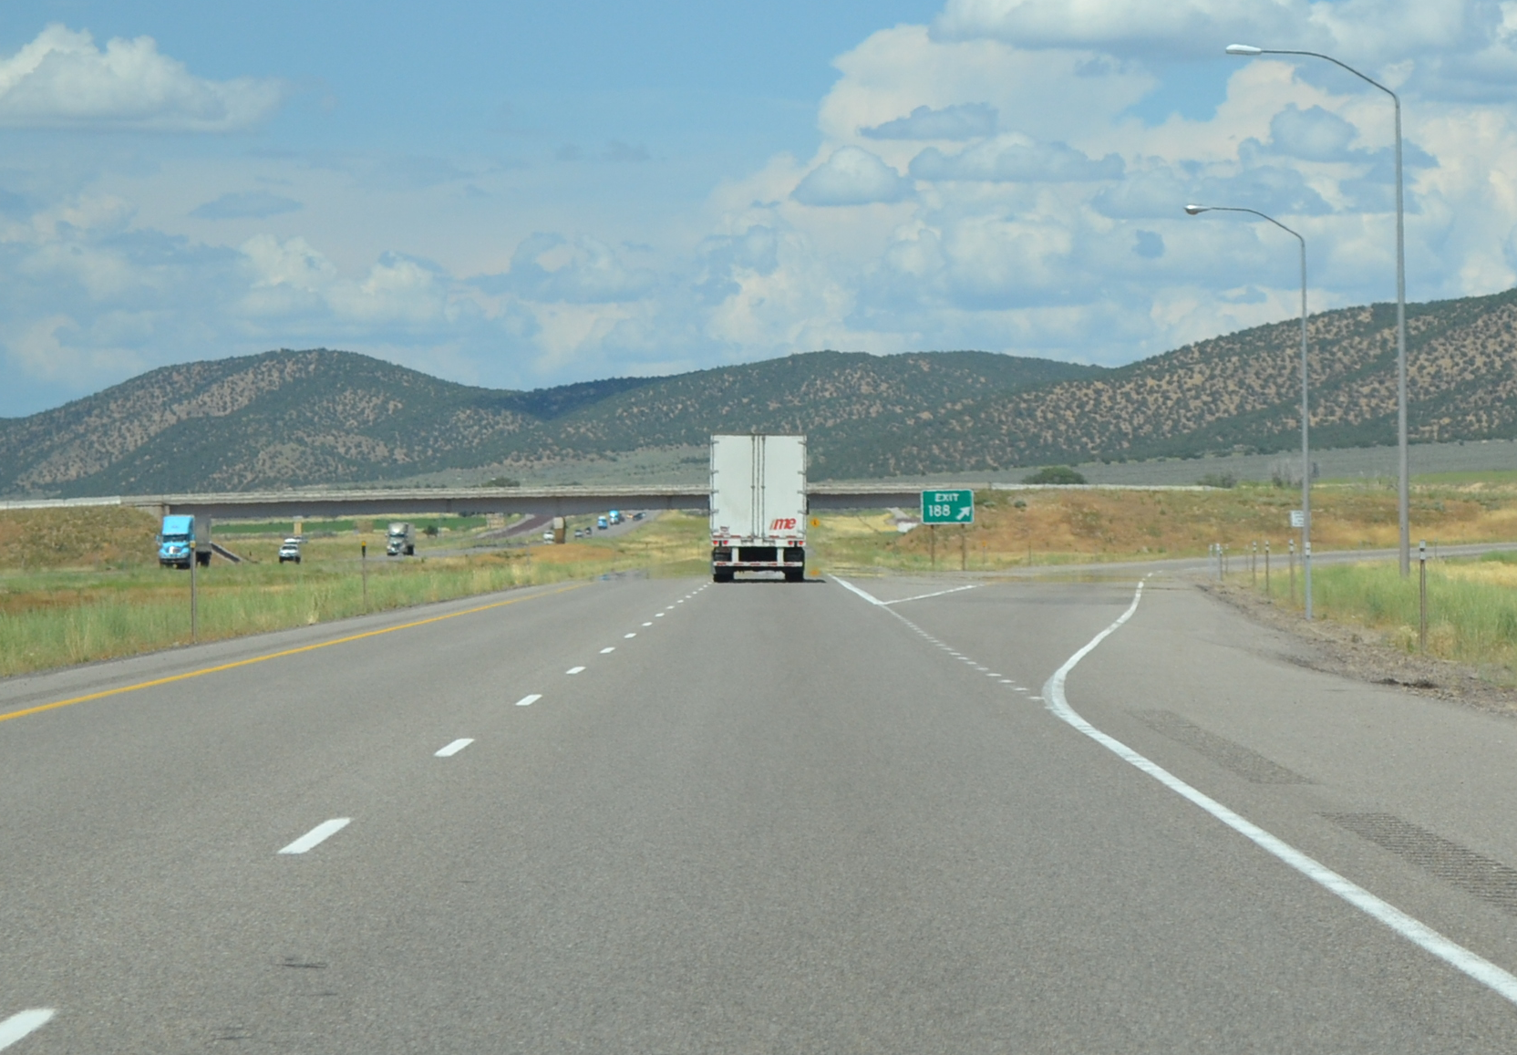
flickr.com/photos/countylemonade/5940567593

Slide 16
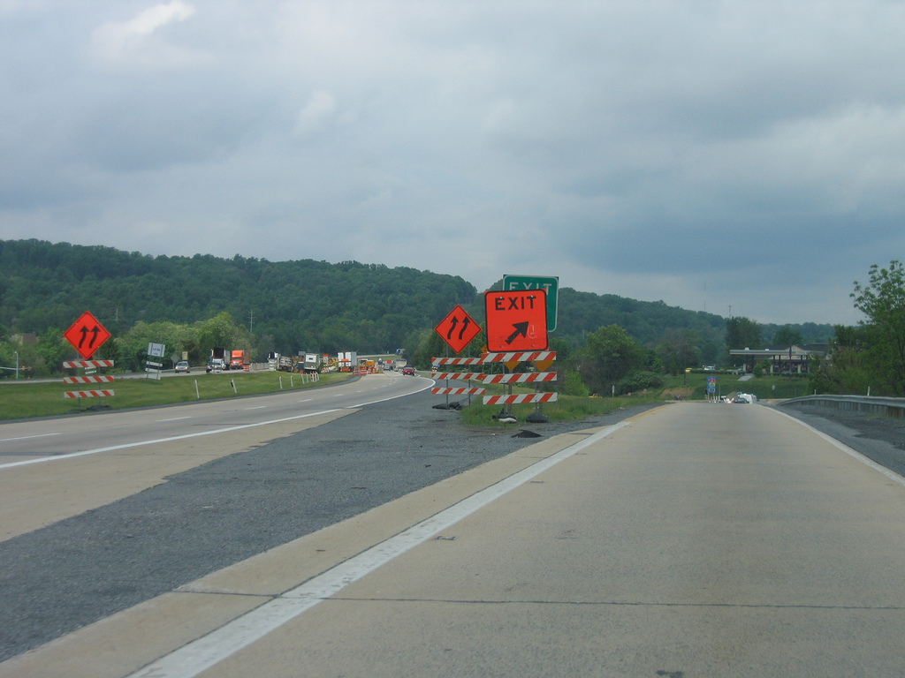
flickr.com/photos/thisisbossi/3069180895

Slide 17
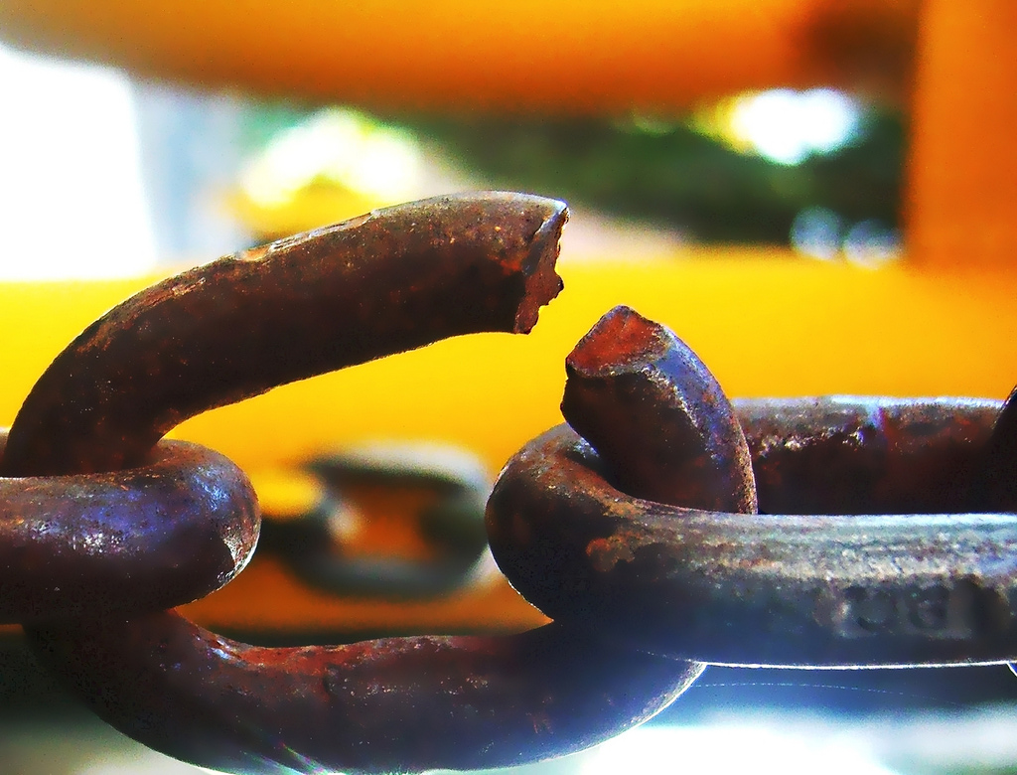
SPOF
flickr.com/photos/darwinbell/465459020/
Notes:
http://www.flickr.com/photos/darwinbell/465459020/

Slide 18
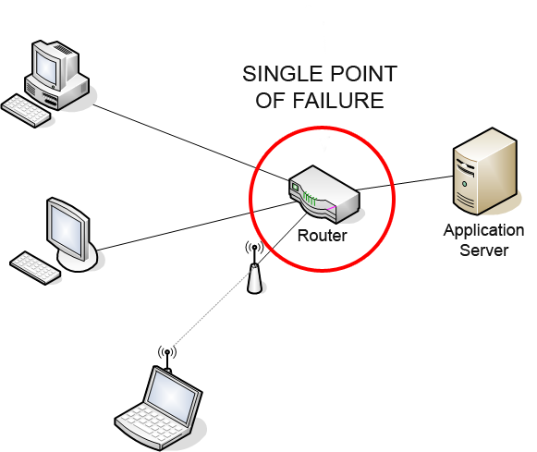
en.wikipedia.org/wiki/Single_point_of_failure
Notes:
http://en.wikipedia.org/wiki/Single_point_of_failure

Slide 19
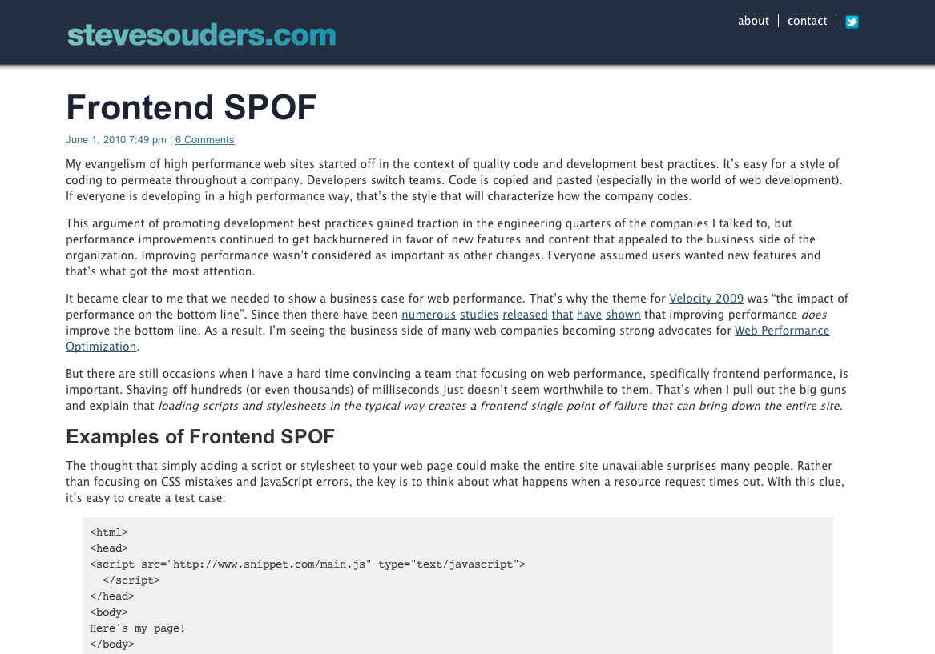
Frontend SPOF

Slide 20
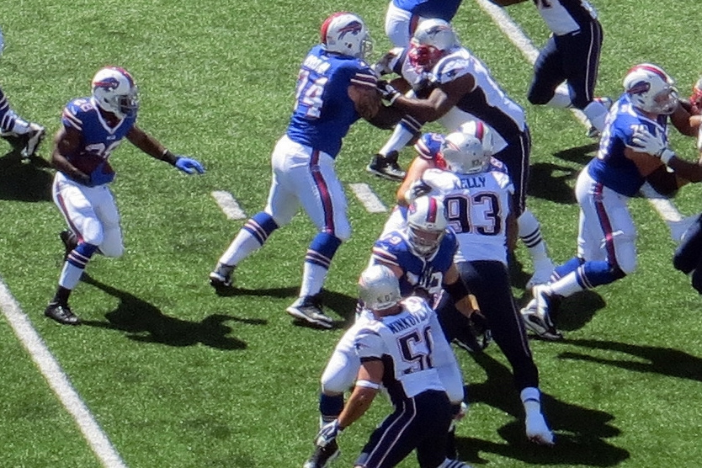
scripts
stylesheets
fonts
flickr.com/photos/runneralan/9741423581

Slide 21
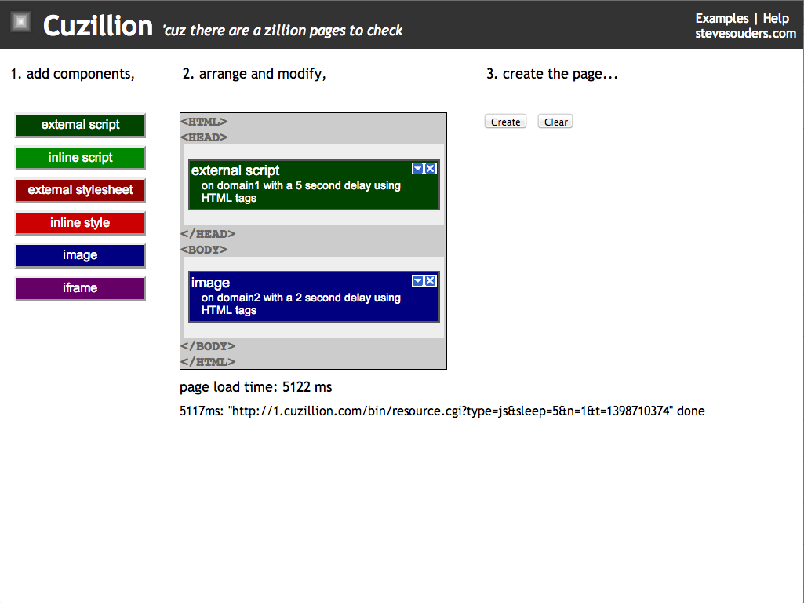

Slide 22
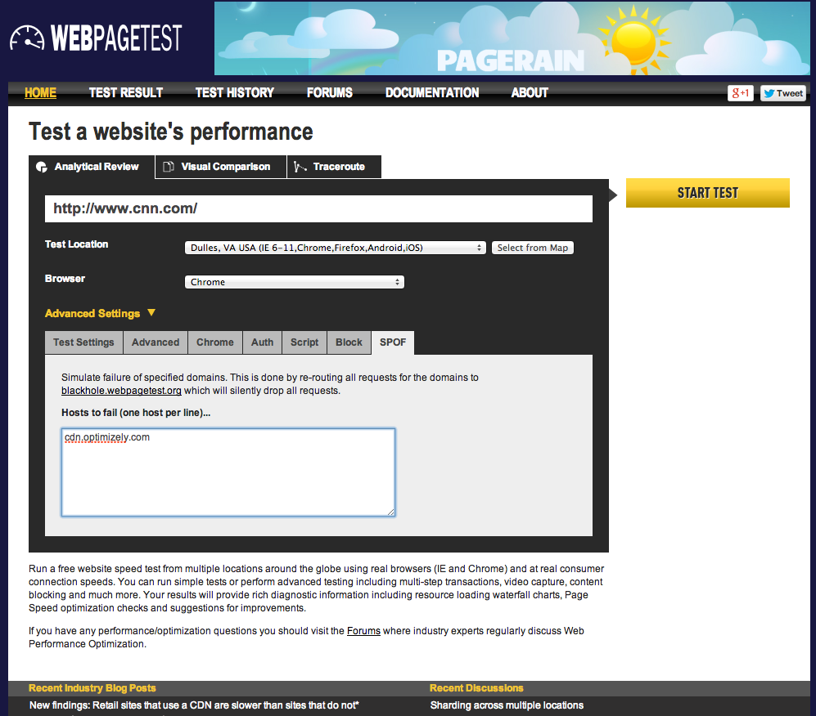
Notes:
http://www.webpagetest.org/video/compare.php?tests=140429_9G_5QD,140429_M5_5QE

Slide 23
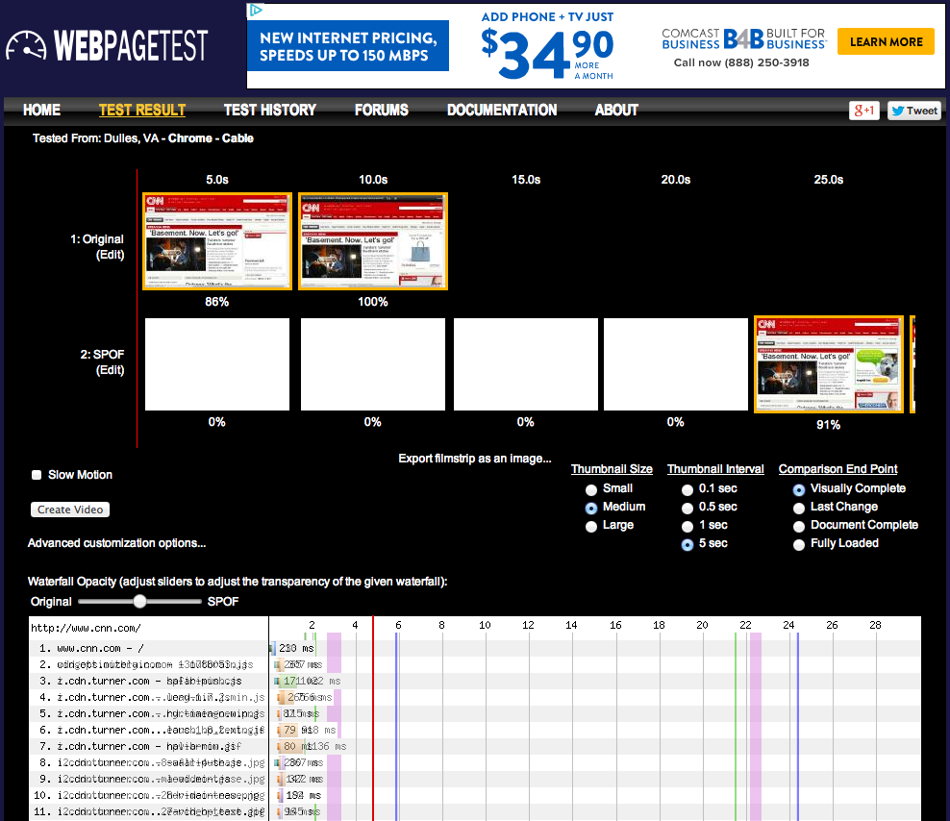

Slide 24

p(frontend SPOF)
= p(at least one 3rd party down)
= 1 – p(all 3rd party up)
= 1 – p(3rd party up)^{n}
where
n = # of 3rd party JS, CSS, & fonts on the page
flickr.com/photos/mkamp/2478311790
Notes:
https://www.khanacademy.org/math/probability/independent-dependent-probability/independent_events/v/getting-at-least-one-heads
SLAs:
99.95% - Amazon EC2, http://aws.amazon.com/ec2/sla/
99.95% - Google App Engine, https://developers.google.com/appengine/sla
99.9% - Google Apps, https://www.google.com/apps/intl/en/terms/sla.html
99.9% - Google Analytics, http://static.googleusercontent.com/media/www.google.com/en/us/intl/en_ALL/analytics/premium/premium_fact_sheet.pdf
10 of 28 cloud services from this study had availability below 99.9%
http://iwgcr.org/wp-content/uploads/2013/06/IWGCR-Paris.Ranking-003.2-en.pdf
Availability 2007-2012
Tumblr 99.977
Facebook 99.966
GoDaddy 99.932
GitHub 99.863
Twitter 99.852
Netflix 99.772
Google Apps 99.67
Apple iCloud Mail 99.658
SalesForce 99.608
Microsoft Xbox Live 99.304
Microsoft Windows Azure 98.727
Amazon Web Services 97.435

Slide 25
p(frontend SPOF)
example:
p(3rd party up) = 0.998 (17 hr/yr)
n = 10
p(frontend SPOF)
= 1 - p(3rd party up)^{n}
= 1 - (0.998)¹⁰
= 1 – (0.98)
= 0.02 (7.2 days/yr)
flickr.com/photos/mkamp/2478311790

Slide 26
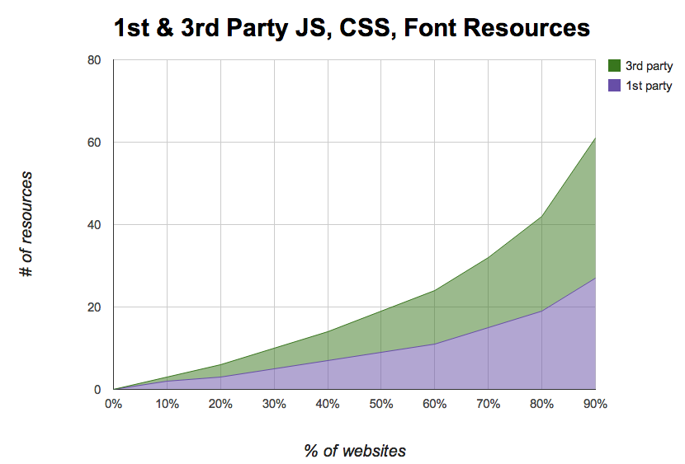
bigqueri.es/t/what-is-the-distribution-of-1st-party-vs-3rd-party-resources/100
Notes:
median: 10 3rd party scripts, stylesheets, and fonts
80th: 23
90th: 34
SELECT party,
NTH(10, quantiles(cnt)) p10,
NTH(20, quantiles(cnt)) p20,
NTH(30, quantiles(cnt)) p30,
NTH(40, quantiles(cnt)) p40,
NTH(50, quantiles(cnt)) p50,
NTH(60, quantiles(cnt)) p60,
NTH(70, quantiles(cnt)) p70,
NTH(80, quantiles(cnt)) p80,
NTH(90, quantiles(cnt)) p90,
NTH(99, quantiles(cnt)) p99
FROM (
SELECT
origin,
IF (req_host CONTAINS REGEXP_EXTRACT(origin, r'([\w-]+)'), INTEGER(1), INTEGER(3)) AS party,
COUNT(*) as cnt
FROM [httparchive:runs.2014_04_15_requests] as requests JOIN EACH (
SELECT pageid, DOMAIN(url) as origin
FROM [httparchive:runs.2014_04_15_pages]
) pages ON pages.pageid = requests.pageid
where (resp_content_type like "%css%" OR resp_content_type like "%script%" OR resp_content_type like "%font%")
GROUP BY origin, party
)
GROUP by party

Slide 27
p(3rd party up)?
SLAs
  99.9% - GA, Google Apps
  99.95% - GAE, Amazon EC2
Uptime 2007-2012
  99.93% - GoDaddy
  99.86% - GitHub
  99.67% - Google Apps
  97.43% - AWS
iwgcr.org/wp-content/uploads/2013/06/IWGCR-Paris.Ranking-003.2-en.pdf
flickr.com/photos/mkamp/2478311790
Notes:
SLAs:
99.95% - Amazon EC2, http://aws.amazon.com/ec2/sla/
99.95% - Google App Engine, https://developers.google.com/appengine/sla
99.9% - Google Apps, https://www.google.com/apps/intl/en/terms/sla.html
99.9% - Google Analytics, http://static.googleusercontent.com/media/www.google.com/en/us/intl/en_ALL/analytics/premium/premium_fact_sheet.pdf
10 of 28 cloud services from this study had availability below 99.9%
http://iwgcr.org/wp-content/uploads/2013/06/IWGCR-Paris.Ranking-003.2-en.pdf
Availability 2007-2012
BASED ON PRESS RELEASES
Tumblr 99.977
Facebook 99.966
GoDaddy 99.932
GitHub 99.863
Twitter 99.852
Netflix 99.772
Google Apps 99.67
Apple iCloud Mail 99.658
SalesForce 99.608
Microsoft Xbox Live 99.304
Microsoft Windows Azure 98.727
Amazon Web Services 97.435

Slide 28
p(frontend SPOF)
p(3rd party up)
 | 0.999 | 0.998 | 0.997
10 (50th) | 0.010 (3.6) | 0.020 (7.2) | 0.030 (10.8)
23 (80th) | 0.023 (8.3) | 0.045 (16.4) | 0.067 (24.4)
34 (90th) | 0.033 (12.2) | 0.066 (24.0) | 0.097 (35.4)
n
(days/year)
p(frontend SPOF)
flickr.com/photos/mkamp/2478311790
Notes:
In reality it's not this bad because:
- Fonts are less SPOFish. Fonts are 2 at 50th and 7 at 90th.
- 3rd party resources from same domain count as a single event (probably).
- ASYNC

Slide 29
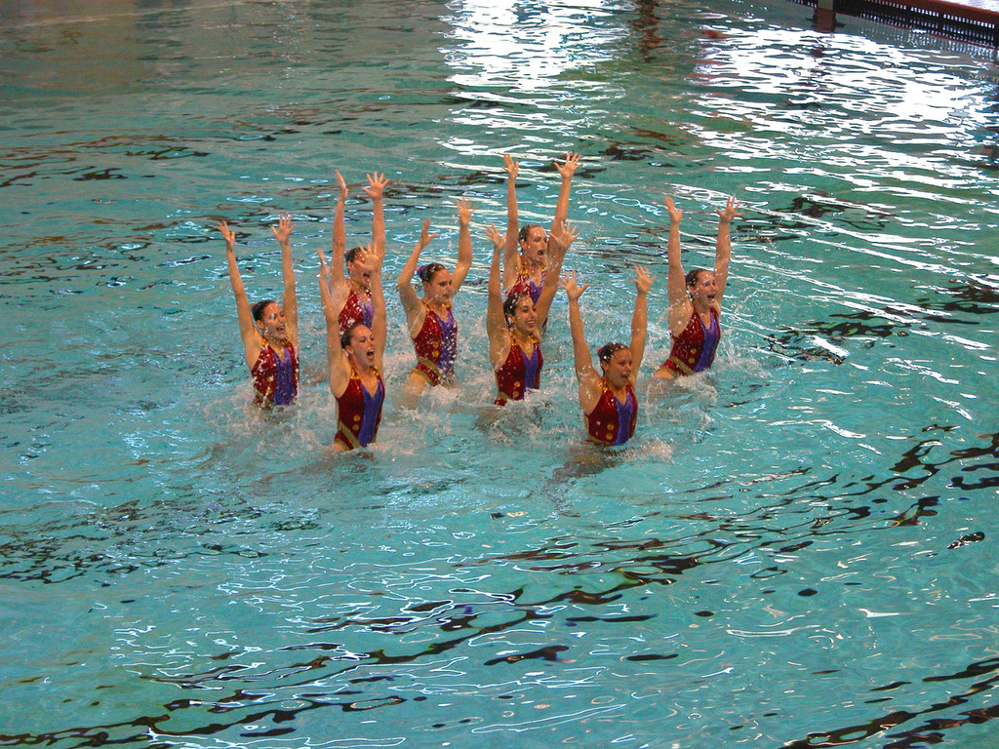
sync
flickr.com/photos/krhamm/171302038

Slide 30
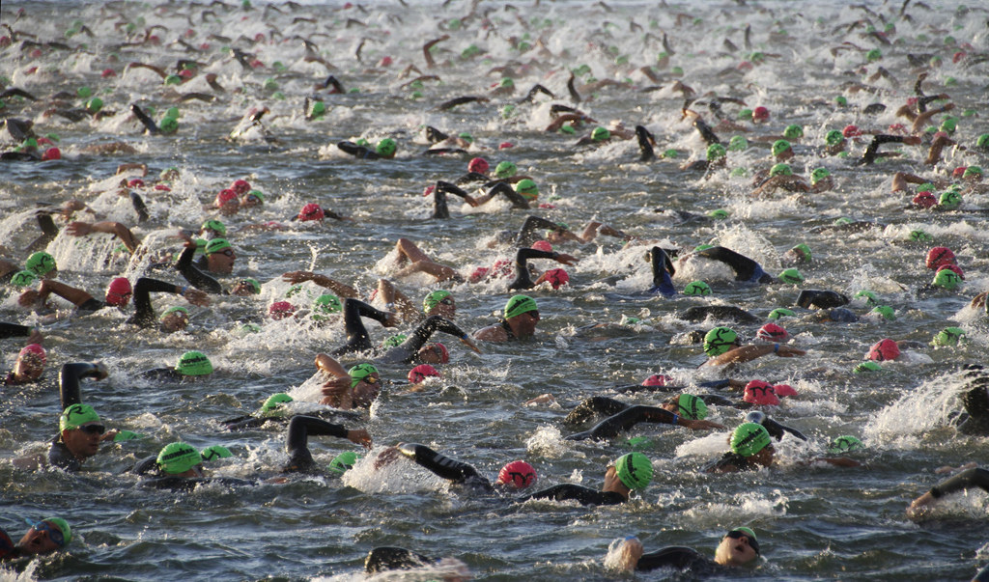
async
flickr.com/photos/8229345@N02/7980116331

Slide 31
load scripts async
var s0 = document. getElementsByTagName('script')[0];
var s1 = document. createElement('script');
s1.async = true;
s1.src = 'common.js';
s0.parentNode.insertBefore(s1, s0);

Slide 32
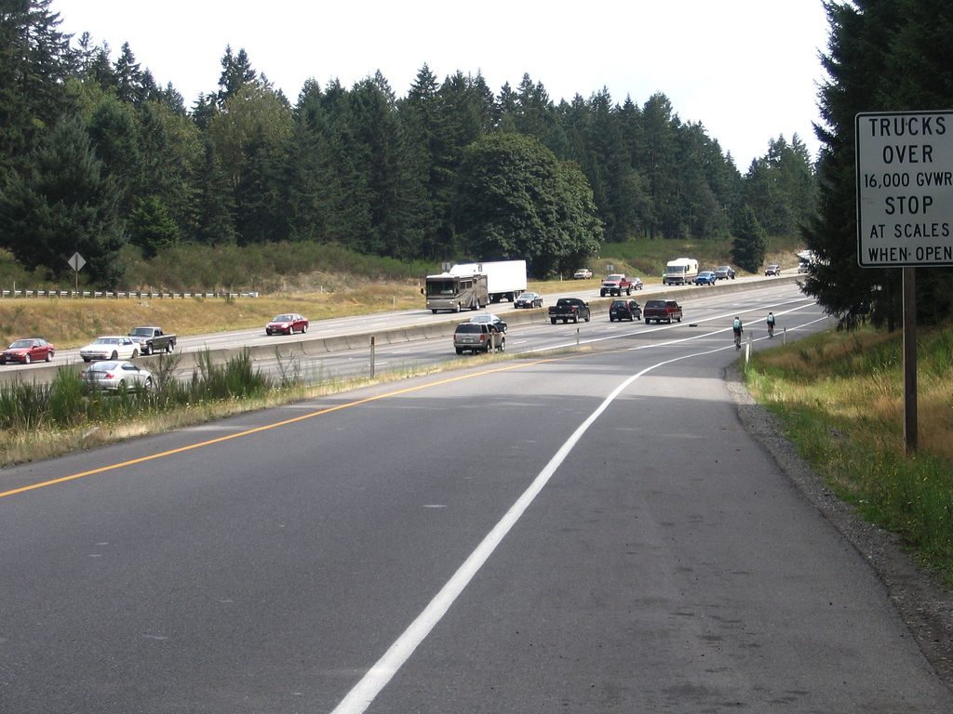
https://www.flickr.com/photos/thisisbossi/3069180895

Slide 33


Slide 34


Slide 35
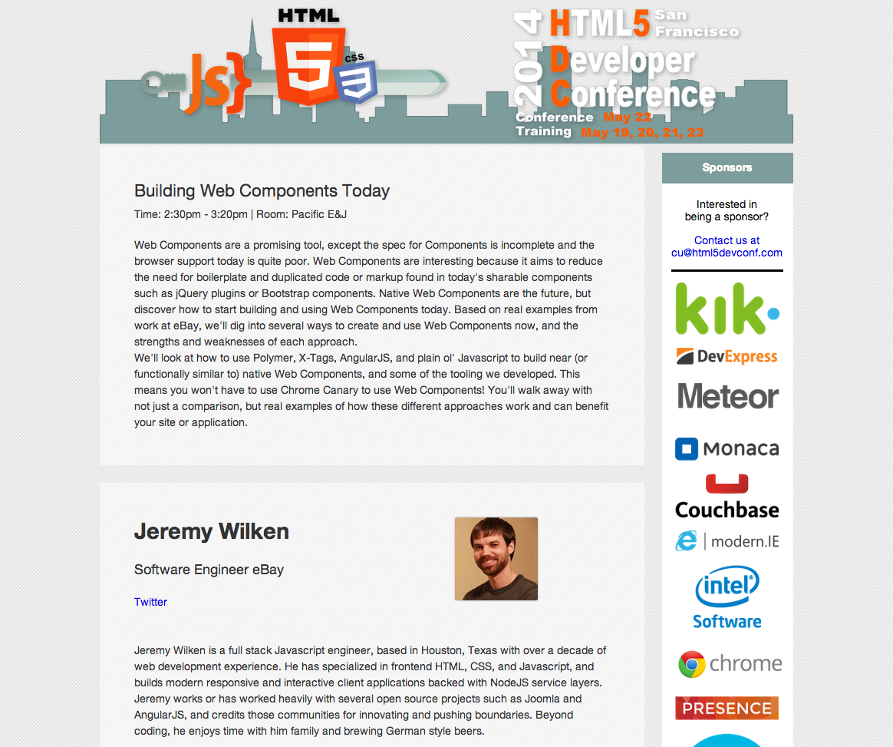

Slide 36
HTML Templates
Shadow DOM
HTML Imports
Custom Elements

Slide 37
HTML Templates
Shadow DOM
HTML Imports
Custom Elements
Notes:
HTML Templates – download & parse HTML but DON'T render
Shadow DOM – markup encapsulation, style boundaries,
HTML IMPORTS ARE INTEGRAL TO WEB COMPONENTS for reuse argument

Slide 38
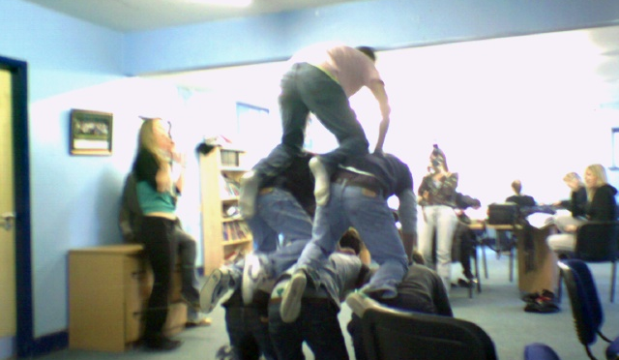
Support
Chrome 33-34 with chrome://flags/
  experimental Web Platform features
  Experimental JavaScript
  HTML Imports
Chrome 36+: no flags
Polymer: http://www.polymer-project.org/
flickr.com/photos/callumscott2/167684986

Slide 39
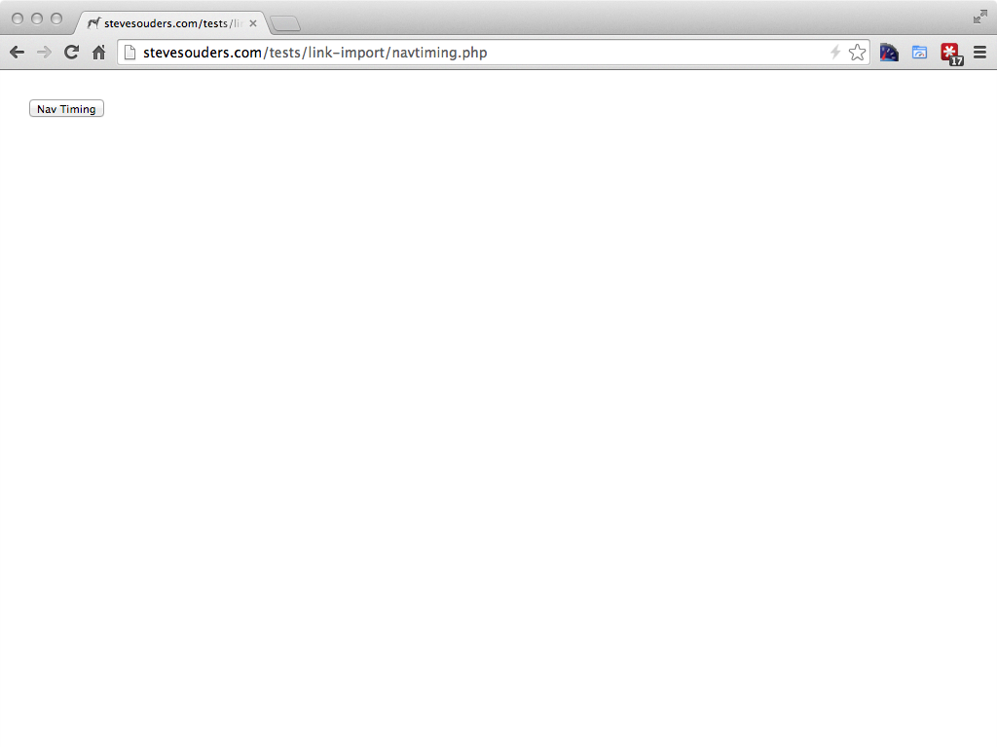
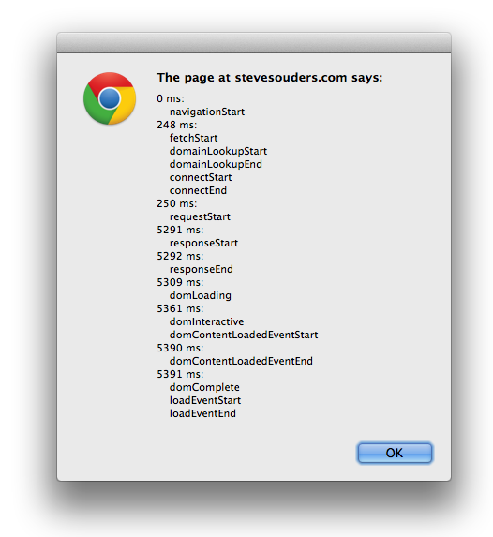

Slide 40
navtiming.php:
<div id='navtiming-content'>
<input type=button
value='Nav Timing'
onclick='doNavTiming()'>
</div>
<script>
function doNavTiming() { ... }
</script>

Slide 41
navtiming.php:
<div id='navtiming-content'>
<input type=button
value='Nav Timing'
onclick='doNavTiming()'>
</div>
<script>
function doNavTiming() { ... }
</script>

Slide 42
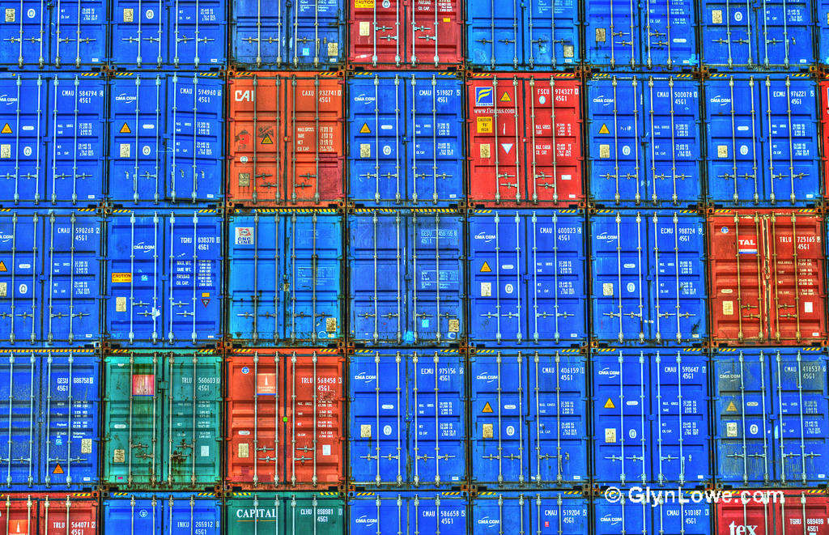
HTML Imports
<link rel="import" href="navtiming.html">
navtiming.html:
<div id="navtiming-content">
<input type=button value='Nav Timing' onclick='doNavTiming()'>
</div>
<script>
function doNavTiming() {…}
flickr.com/photos/glynlowe/10039742285

Slide 43
insert imported HTML
var link = document. querySelector('link[rel=import]');
var content = link.import. querySelector('#navtiming-content');
document.getElementById('target'). appendChild(content. cloneNode(true));

Slide 44
<html>
<head>
<link rel="import" href="navtiming.php">
</head>
<body>
<div id="target"></div>
<script>
var link = document. querySelector('link[rel=import]');
var content = link.import. querySelector('#navtiming-content');
document.getElementById('target'). appendChild(content.cloneNode(true));
</script>
</body>
</html>

Slide 45
<html>
<head>
<link rel="import" href="navtiming.php">
</head>
<body>
<div id="target"></div>
<script>
var link = document. querySelector('link[rel=import]');
var content = link.import. querySelector('#navtiming-content');
document.getElementById('target'). appendChild(content.cloneNode(true));
</script>
</body>
</html>

Slide 46
<html>
<head>
<link rel="import" href="navtiming.php">
</head>
<body>
<div id="target"></div>
<script>
var link = document. querySelector('link[rel=import]');
var content = link.import. querySelector('#navtiming-content');
document.getElementById('target'). appendChild(content.cloneNode(true));
</script>
</body>
</html>

Slide 47
<html>
<head>
<link rel="import" href="navtiming.php">
</head>
<body>
<div id="target"></div>
<script>
var link = document. querySelector('link[rel=import]');
var content = link.import. querySelector('#navtiming-content');
document.getElementById('target'). appendChild(content.cloneNode(true));
</script>
</body>
</html>

Slide 48
<html>
<head>
<link rel="import" href="navtiming.php">
</head>
<body>
<div id="target"></div>
<script>
var link = document. querySelector('link[rel=import]');
var content = link.import. querySelector('#navtiming-content');
document.getElementById('target'). appendChild(content.cloneNode(true));
</script>
</body>
</html>

Slide 49
<html>
<head>
<link rel="import" href="navtiming.php">
</head>
<body>
<div id="target"></div>
<script>
var link = document. querySelector('link[rel=import]');
var content = link.import. querySelector('#navtiming-content');
document.getElementById('target'). appendChild(content.cloneNode(true));
</script>
</body>
</html>
Race Condition?

Slide 50

<html>
<head>
<link rel="import" href="navtiming.php">
</head>
<body>
<div id="target"></div>
<script>
var link = document. querySelector('link[rel=import]');
var content = link.import. querySelector('#navtiming-content');
document.getElementById('target'). appendChild(content.cloneNode(true));
</script>
</body>
</html>
Race Condition!

Slide 51
resolution: BLOCK
Chrome 33-34:
  stop parsing at next SCRIPT tag
Chrome 36:
  stop parsing immediately – entire BODY is blocked from rendering
flickr.com/photos/runneralan/9741423581

Slide 52
scripts
stylesheets
fonts
web components (new!)
flickr.com/photos/runneralan/9741423581

Slide 53
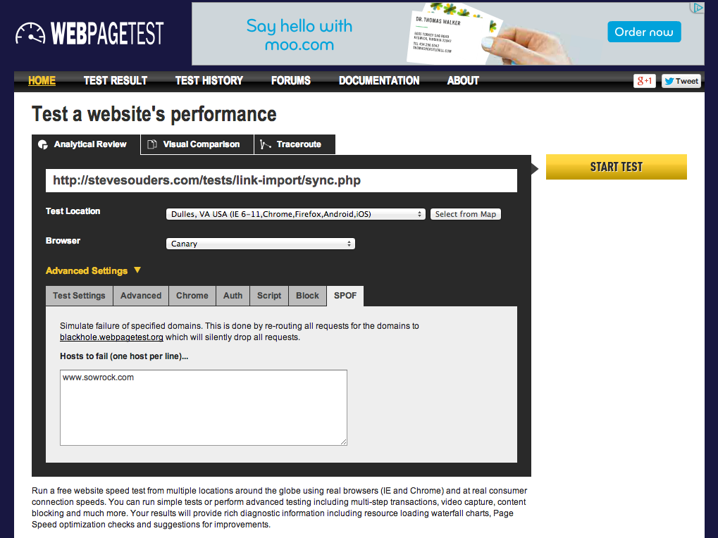
Notes:
http://www.webpagetest.org/video/compare.php?tests=140429_WZ_12SP,140429_VX_12SQ

Slide 54
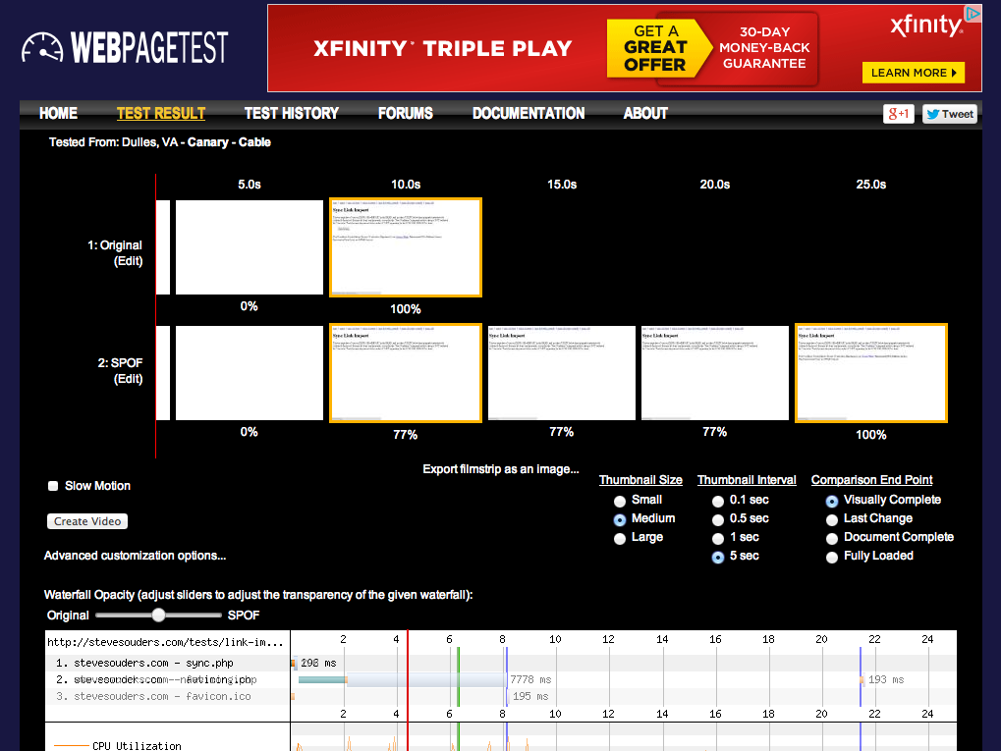
Notes:
http://www.webpagetest.org/video/compare.php?tests=140429_WZ_12SP,140429_VX_12SQ

Slide 55
load HTML Imports async
var link = document. createElement('link');
link.rel = 'import';
link.onload = function() {
var link = document.querySelector('link[rel=import]');
var content = link.import.querySelector('#navtiming-content');
document.getElementById('target').appendChild(content.cloneNode(true));
};
link.href = 'navtiming.php';
document.getElementsByTagName ('head')[0].appendChild(link);
flickr.com/photos/8229345@N02/7980116331

Slide 56
HTML Templates
Shadow DOM
HTML Imports
Custom Elements

Slide 57
Custom Elements
<link rel="import" href="navtimingce.php">
navtimingce.php:
<script>
var NavTimingProto = Object.create(HTMLElement.prototype);
NavTimingProto.createdCallback = function(){
this.innerHTML = "<input type=button…>"; };
document.registerElement('nav-timing', {prototype: NavTimingProto});
function doNavTiming() {...};
MUST have hyphen!

Slide 58
Custom Elements
<link rel="import" href="navtimingce.php">
navtimingce.php:
<script>
var NavTimingProto = Object.create(HTMLElement.prototype);
NavTimingProto.createdCallback = function(){
this.innerHTML = "<input type=button…>"; };
document.registerElement('nav-timing', {prototype: NavTimingProto});
function doNavTiming() {...};

Slide 59
Custom Elements
<link rel="import" href="navtimingce.php">
navtimingce.php:
<script>
var NavTimingProto = Object.create(HTMLElement.prototype);
NavTimingProto.createdCallback = function(){
this.innerHTML = "<input type=button…>"; };
document.registerElement('nav-timing', {prototype: NavTimingProto});
function doNavTiming() {...};

Slide 60
Custom Elements
<link rel="import" href="navtimingce.php">
navtimingce.php:
<script>
var NavTimingProto = Object.create(HTMLElement.prototype);
NavTimingProto.createdCallback = function(){
this.innerHTML = "<input type=button…>"; };
document.registerElement('nav-timing', {prototype: NavTimingProto});
function doNavTiming() {...};

Slide 61
Custom Elements
<link rel="import" href="navtimingce.php">
navtimingce.php:
<script>
var NavTimingProto = Object.create(HTMLElement.prototype);
NavTimingProto.createdCallback = function(){
this.innerHTML = "<input type=button…>"; };
document.registerElement('nav-timing', {prototype: NavTimingProto});
function doNavTiming() {...};
MUST have hyphen!

Slide 62
insert custom element
<nav-timing></nav-timing>
That's it!

Slide 63
<html>
<head>
<link rel="import" href="navtimingce.php">
</head>
<body>
<nav-timing></nav-timing>
</body>
</html>
Race Condition?

Slide 64
<html>
<head>
<link rel="import" href="navtimingce.php">
</head>
<body>
<nav-timing></nav-timing>
</body>
</html>
Race Condition!

Slide 65
solution: BLOCK
Chrome 33-34:
  stop parsing at 1st SCRIPT tag
Chrome 36:
  stop parsing immediately – entire BODY is blocked from rendering
all:
  ignore hyphenated tags if not registered
flickr.com/photos/runneralan/9741423581

Slide 66
load HTML Imports async
var link = document. createElement('link');
link.rel = 'import';
link.onload = function() {
var link = document.querySelector('link[rel=import]');
var content = link.import.querySelector('#navtiming-content');
document.getElementById('target').appendChild(content.cloneNode(true));
};
link.href = 'navtiming.php';
document.getElementsByTagName ('head')[0].appendChild(link);
blocks!
Notes:
used to work in Chrome 33-34

Slide 67
load HTML Imports async
<link rel="import"
href="navtiming.php"
async
onload="function() {
var link = document.querySelector('link[rel=import]');
var content = link.import.querySelector('#navtiming-content');
document.getElementById('target').appendChild(content.cloneNode(true));
}">

Slide 68
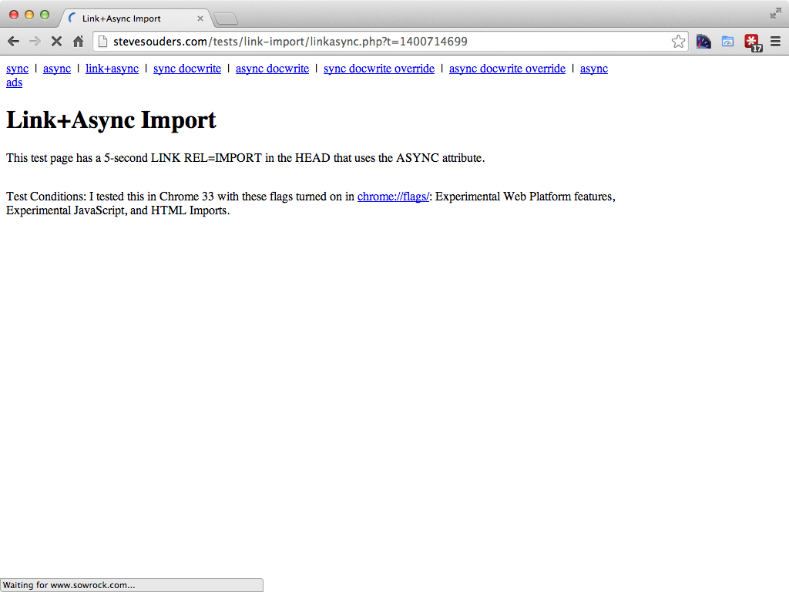

Slide 69
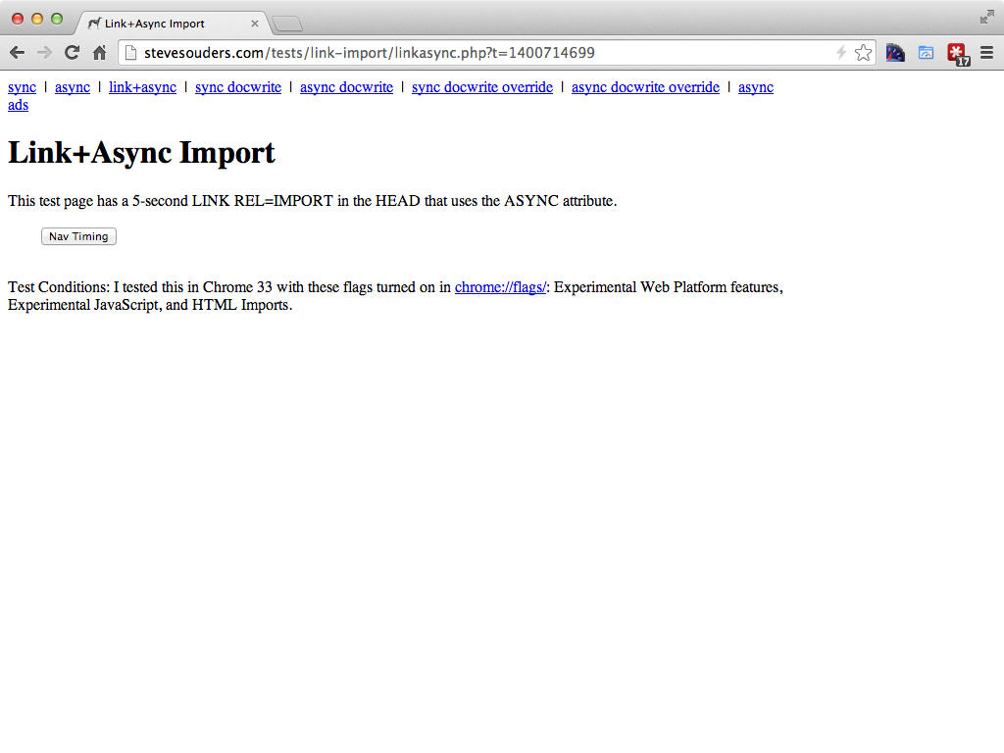

Slide 70

more granularity
load asynchronously
load synchronously for specific component(s)
flickr.com/photos/abitha_arabella/13444735444

Slide 71

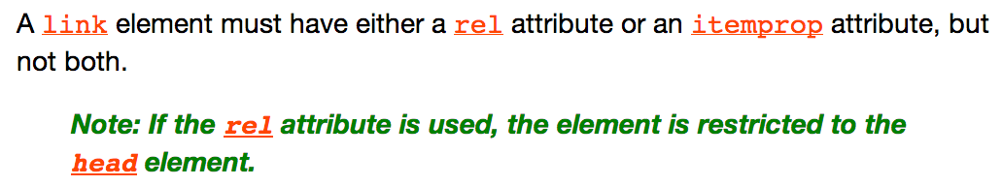
suggested fixes
"lazyload" attribute – DONE!
"elements" attribute
make LINK valid w/in BODY
stevesouders.com/blog/2013/12/02/html-imports-scope-security-and-suggestions/
flickr.com/photos/chudo1909/6979697127
Notes:
http://www.whatwg.org/specs/web-apps/current-work/multipage/semantics.html#the-link-element
other bg photo: https://www.flickr.com/photos/hanspetermeyer/9146936834

Slide 72

flickr.com/photos/chhani/8016548370

Slide 73

takeaways
HTML Imports block rendering
use link+async
spec in flux, make suggestions
check your site for Frontend SPOF
Notes:
flickr.com/photos/myklroventine/4062102754/

Slide 74
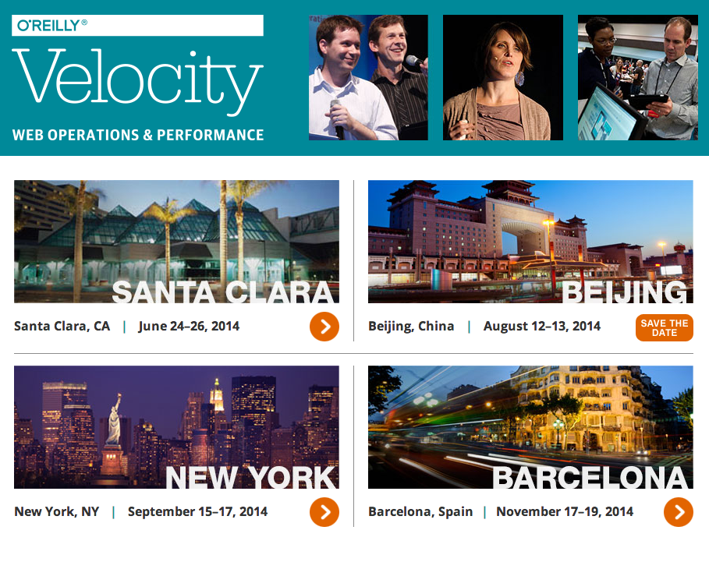

Slide 75

Steve Souders
@souders
stevesouders.com/docs/html5devconf-webcomp-20140522.pptx
Notes:
"thank you" by nj dodge: http://flickr.com/photos/nj_dodge/187190601/

