Slide 1
How fast are we going now?
@souders
stevesouders.com/docs/hamburg-howfast-20130528.pptx
Disclaimer: This content does not necessarily reflect the opinions of my employer.
Notes:
YtseJam Photography, "Going nowhere fast", http://www.flickr.com/photos/thatguyfromcchs08/2300190277/

Slide 2
Notes:
GENERALLY SLOW IS BAD
http://www.flickr.com/photos/msvg/4476789745/

Slide 3
Notes:
http://www.flickr.com/photos/silent_e/406944364/

Slide 4
Notes:
SLOW IS BAD
http://www.flickr.com/photos/iwona_kellie/4867301081/

Slide 5
Notes:
http://www.flickr.com/photos/stuant63/3159936302/

Slide 6
Notes:
http://www.flickr.com/photos/cwinters/4561002487/

Slide 7
Notes:
http://www.flickr.com/photos/bruce-camera/5244072368/

Slide 8
Notes:
http://www.flickr.com/photos/94213193@N00/324472983/

Slide 9
Notes:
http://www.flickr.com/photos/matman/661077091/

Slide 10
Notes:
http://www.flickr.com/photos/lizhaslam/6255976169/

Slide 11
Notes:
http://www.flickr.com/photos/mommypants/3189190946/

Slide 12
Notes:
NOTICE HOW THE GIRL IS GIVING THE “GO FASTER” SIGN
http://www.flickr.com/photos/blake/6062598298/

Slide 13
Notes:
FAST CAN BE A LITTLE FRIGHTENING
http://www.flickr.com/photos/45777632@N06/6340839611/

Slide 14
Notes:
http://www.flickr.com/photos/dullhunk/3930915541/

Slide 15
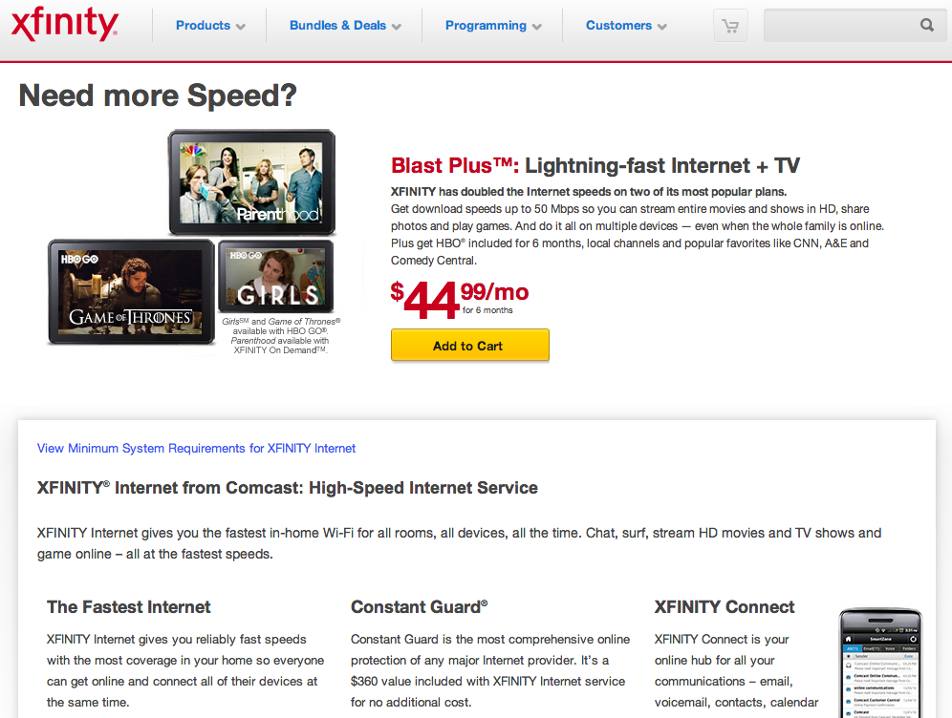

Slide 16
AT&T is the nation's fastest 4G LTE network for your iPhone 5. As explained by kids, faster is better.
Notes:
AT&T is the nation's fastest 4G LTE network for your iPhone 5. As explained by kids, faster is better.

Slide 17
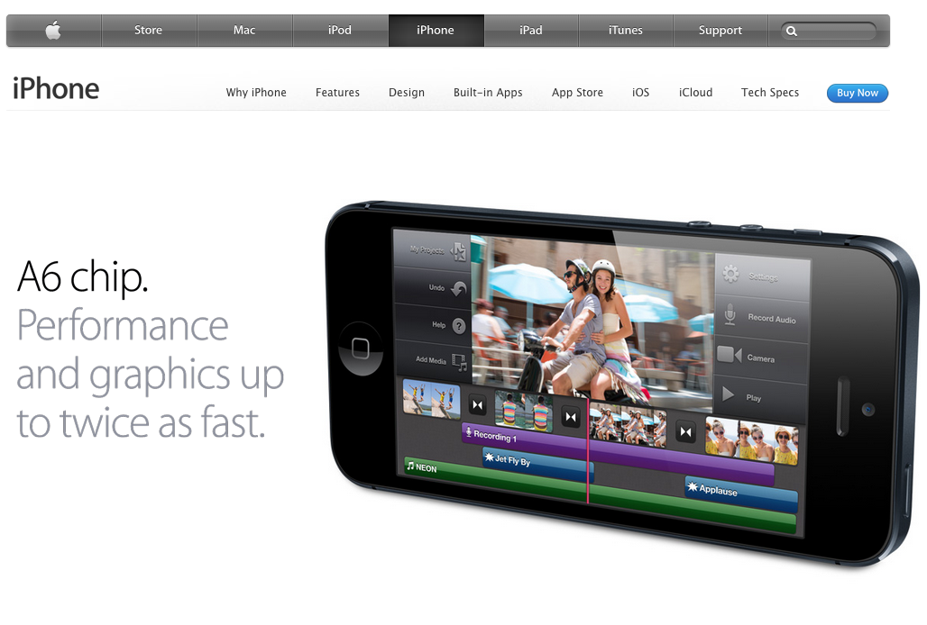

Slide 18
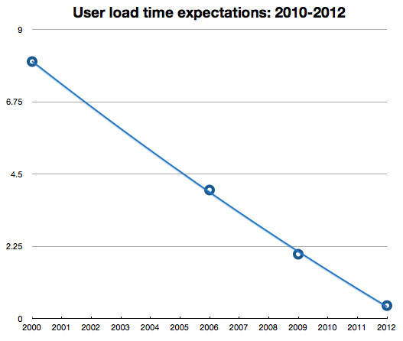
webperformancetoday.com/2013/03/27/top-ecommerce-sites-are-slower-than-they-were-last-year/
Notes:
Joshua Bixby sent me the sources for each data point:
8 seconds (Zona, 1999):http://www.websiteoptimization.com/speed/1/
4 seconds (Jupiter, 2006):http://www.akamai.com/4seconds
2 seconds (Forrester, 2009):http://www.akamai.com/html/about/press/releases/2009/press_091409.html
400ms (Google, 2012):http://www.nytimes.com/2012/03/01/technology/impatient-web-users-flee-slow-loading-sites.html?pagewanted=all&_r=0

Slide 19
en.oreilly.com/velocity2009/public/schedule/detail/8523

Slide 20
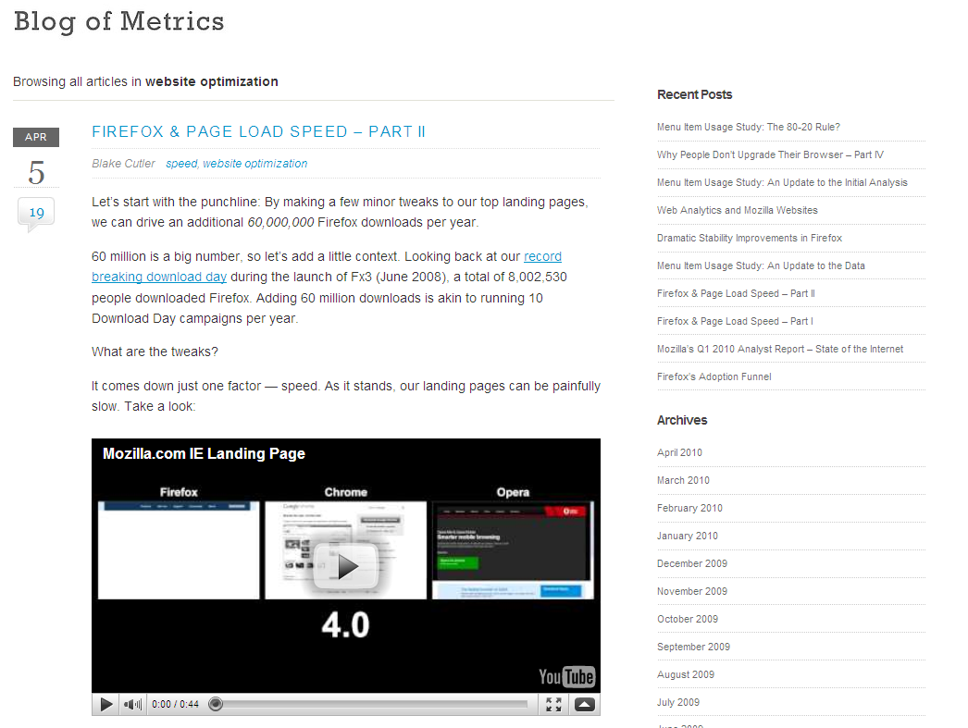
blog.mozilla.com/metrics/category/website-optimization/
…shaved 2.2 seconds off the average page load time and increased download conversions by 15.4%!
Notes:
“if we’re able to achieve a similar performance boost across our other top landing pages, we’ll drive in excess of 60 million yearly Firefox downloads.”

Slide 21
en.oreilly.com/velocity2009/public/schedule/detail/7709
blog.mozilla.com/metrics/category/website-optimization/
…shaved 2.2 seconds off the average page load time and increased download conversions by 15.4%!
Notes:
This was a ~5 second speed up.

Slide 22
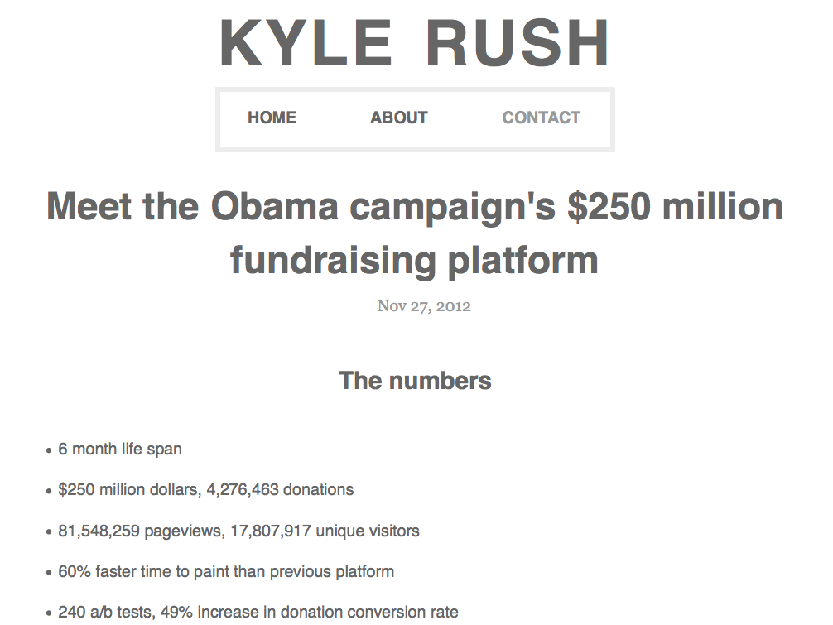
We made the new platform 60% faster and this resulted in a 14% increase in donation conversions.
kylerush.net/blog/meet-the-obama-campaigns-250-million-fundraising-platform/
Notes:
contribute.barackobama.com

Slide 23
Connection Speed
Notes:
SOMETIMES FAST IS JUST BASED ON PERCEPTIONS
http://www.flickr.com/photos/photohype/288124023/

Slide 24
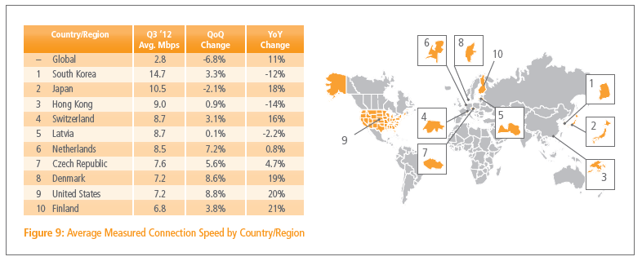
Akamai
State of the Internet
Q3 2012
akamai.com/stateoftheinternet/
Notes:
Specific to Akamai – how long it takes to download their resources. Could be affected by big clients moving on or off, causing/lessening congestion.

Slide 25
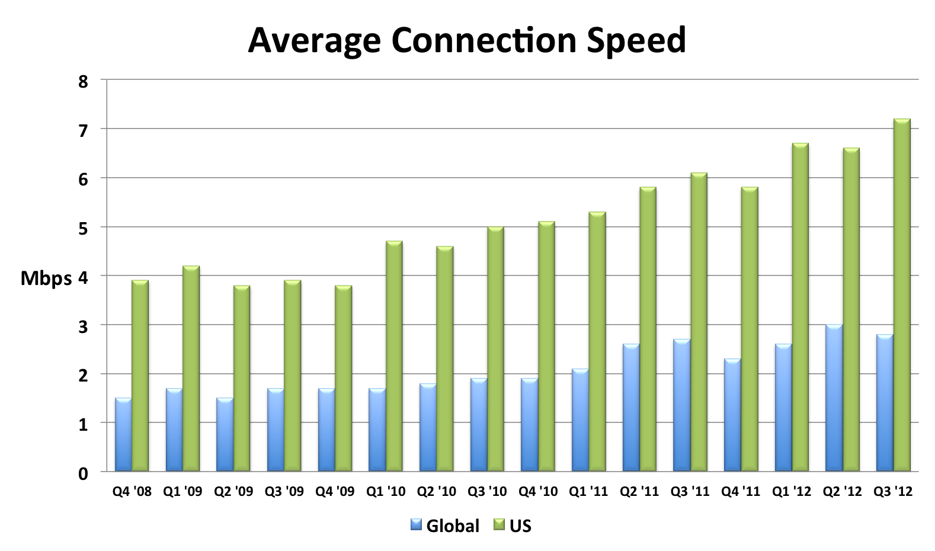
{
YoY: +4% +18%
akamai.com/stateoftheinternet/

Slide 26
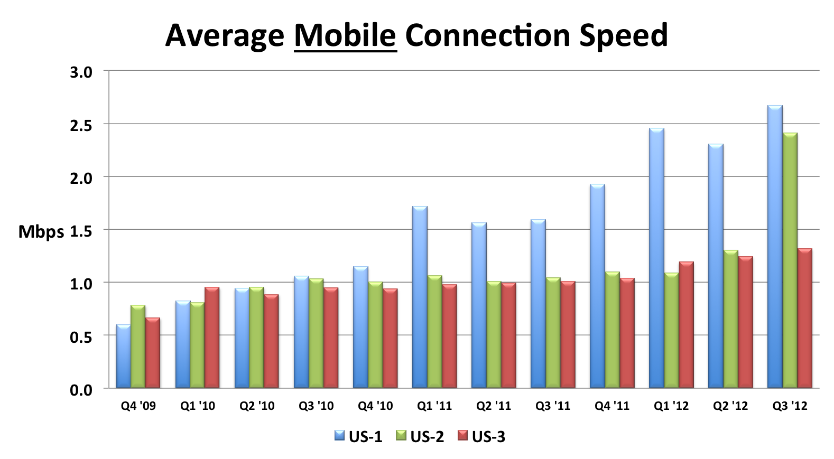
{
YoY: +68% +131% +30%
akamai.com/stateoftheinternet/
Notes:
Actual carrier is hidden behind “US-1” etc.

Slide 27
Year-over-year:
global speeds are 4% faster
US speeds are 18% faster
US mobile speeds are 30-131% faster

Slide 28
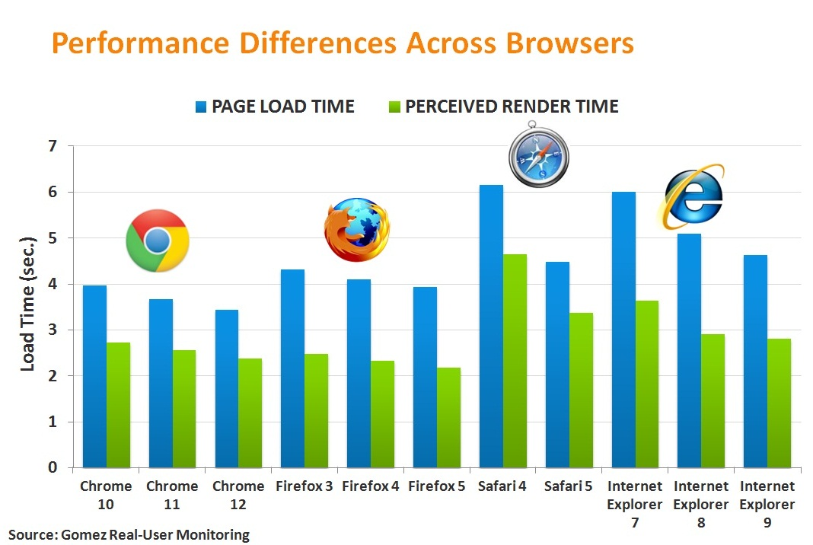
techcrunch.com/2011/08/08/whats-the-fastest-web-browser-in-the-real-world-chrome/
Notes:
based on Gomez RUM data
Not sure how they determine “perceived” render time.

Slide 29
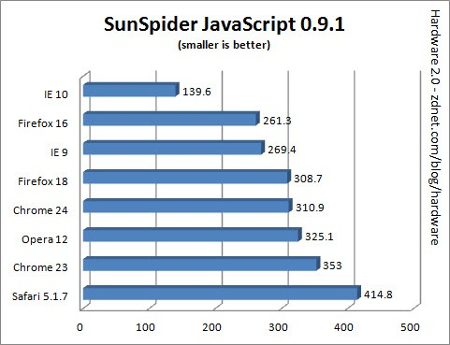
zdnet.com/the-big-browser-benchmark-january-2013-edition-7000009776/
Notes:
based on Gomez RUM data

Slide 30
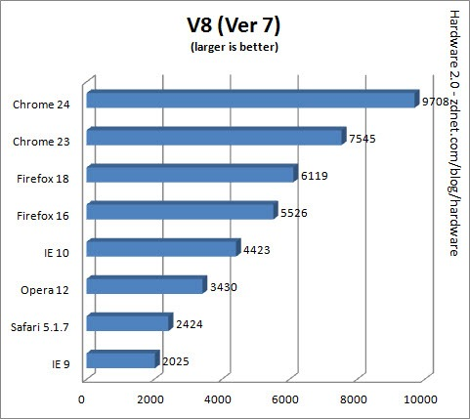
zdnet.com/the-big-browser-benchmark-january-2013-edition-7000009776/
Notes:
based on Gomez RUM data

Slide 31
Page Weight
Notes:
http://www.flickr.com/photos/bigbaddie/4907862472/

Slide 32
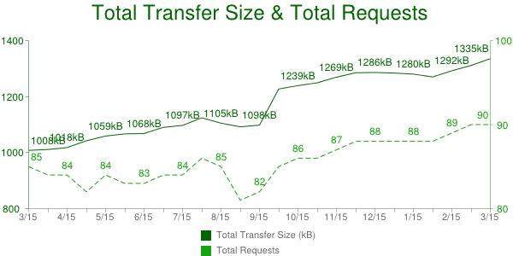
327K (32%) bigger in one year
“All” URLs (70K to 300K URLs)
sample size may affect results
httparchive.org/trends.php?s=All
Notes:
HTTP Archive: twice a month, 300K wwide top URLs from Alexa, gather info incl size.
http://chart.apis.google.com/chart?chxr=1,800,1400,200|2,80,100,10&chds=9,99,80,100,9,99,800,1400&chd=t:-1|85,84,84,82,84,83,83,84,84,86,85,81,82,85,86,86,87,88,88,88,88,88,89,90,90|-1|1008,1011,1018,1042,1059,1067,1068,1090,1097,1124,1105,1092,1098,1227,1239,1249,1269,1285,1286,1284,1280,1270,1292,1311,1335&chxl=0:|3%2F15%7C+%7C4%2F15%7C+%7C5%2F15%7C+%7C6%2F15%7C+%7C7%2F15%7C+%7C8%2F15%7C+%7C9%2F15%7C+%7C10%2F15%7C+%7C11%2F15%7C+%7C12%2F15%7C+%7C1%2F15%7C+%7C2%2F15%7C+%7C3%2F15&chxt=x,y,r&chs=600x300&cht=lxy&chco=15A50E,006600&chm=N,15A50E,0,::2,12,,h::8|N**kB,006600,1,::2,12,,h::8&chts=006600,24&chtt=Total+Transfer+Size+%26+Total+Requests&chma=5,5,5,25&chls=1,6,3|1&chxs=1,006600,11.5,-0.5,lt,006600,006600|2,15A50E,11.5,-0.5,lt,15A50E,15A50E&chxtc=0,4|1,4&chxp=0&chdl=Total+Requests|Total+Transfer+Size+(kB)&chdlp=bv|r

Slide 33
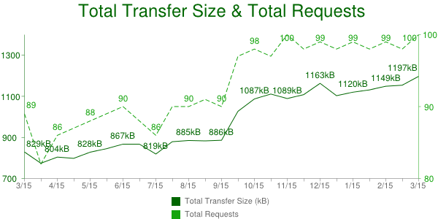
“Top 1000” URLs
10/1 spike due to testing change
not apples-to-apples
httparchive.org/trends.php?s=Top1000
Notes:
http://chart.apis.google.com/chart?chds=9,99,80,100,9,99,700,1400&chxr=1,700,1400,200|2,80,100,10&chd=t:-1|89,82,86,87,88,89,90,88,86,90,90,91,90,97,98,97,100,98,99,98,99,98,99,98,100|-1|829,774,804,798,828,845,867,867,819,879,885,883,886,1027,1087,1111,1089,1108,1163,1103,1120,1131,1149,1154,1197&chxl=0:|3%2F15%7C+%7C4%2F15%7C+%7C5%2F15%7C+%7C6%2F15%7C+%7C7%2F15%7C+%7C8%2F15%7C+%7C9%2F15%7C+%7C10%2F15%7C+%7C11%2F15%7C+%7C12%2F15%7C+%7C1%2F15%7C+%7C2%2F15%7C+%7C3%2F15&chxt=x,y,r&chs=600x300&cht=lxy&chco=15A50E,006600&chm=N,15A50E,0,::2,12,,h::8|N**kB,006600,1,::2,12,,h::8&chts=006600,24&chtt=Total+Transfer+Size+%26+Total+Requests&chma=5,5,5,25&chls=1,6,3|1&chxs=1,006600,11.5,-0.5,lt,006600,006600|2,15A50E,11.5,-0.5,lt,15A50E,15A50E&chxtc=0,4|1,4&chxp=0&chdl=Total+Requests|Total+Transfer+Size+(kB)&chdlp=bv|r

Slide 34
CORRECT data
 | Mar `12 | Mar `13 | Δ
total | 822 K | 1053 K | 231 K
images | 486 K | 600 K | 114 K
JS | 163 K | 188 K | 25 K
Flash | 84 K | 75 K | -9 K
HTML | 35 K | 42 K | 7 K
CSS | 30 K | 36 K | 6 K
font | 3 K | 11 K | 8 K
Where’s the other 80 K?
151 K
Notes:
I gathered this data by manual SQL queries looking at only the responses started before window.onload.

Slide 35
“other” resources
Content-Type | Mar `12 | Mar `13 | Δ K/ page
text/plain | 823, 8K, 7K | 778, 44K, 35K | 28K
video/mp4 | 3, 316K, 1K | 8, 2498K, 20K | 19K
video/x-flv | 7, 556K, 4K | 16, 1262K, 21K | 17K
application/octet-stream | 158, 28K, 5K | 187, 58K, 11K | 6K
70 K
how many
avg xfer size
K/page
(remember: “Top 1000”)
Notes:
text/plain: 35K per page = 31K video + 3K fonts
octet-stream: 19K per page = 15K video + 4K fonts

Slide 36
text/plain resources
URL regex | Mar `12 | Mar `13 | Δ K/ page
.flv, .f4v | 12, 146K, 2K | 18, 1674K, 31K | 29K
.ttf, .eot, .woff | 59, 54K, 3K | 75, 38K, 3K | 0K
35 K per page
= (778 reqs * 44K/req) / 975 pages
31 K – video
3 K – fonts
Notes:
text/plain: 35K per page = 31K video + 3K fonts
octet-stream: 19K per page = 15K video + 4K fonts

Slide 37
octet/stream resources
URL regex | Mar `12 | Mar `13 | Δ K/ page
.flv,.f4v,.mp4,.swf | 14, 56K, 1K | 10, 652K, 7K | 6K
.ttf, .eot, .woff | 49, 41K, 2K | 88, 42K, 4K | 2K
11 K per page
= (187 reqs * 58K/req) / 975 pages
7 K – video
4 K – fonts
Notes:
text/plain: 35K per page = 31K video + 3K fonts
octet-stream: 19K per page = 15K video + 4K fonts

Slide 38
COMPLETE data
 | Mar `12 | Mar `13 | Δ
total | 822 K | 1053 K | 231 K (28%)
images | 486 K | 600 K | 114 K (23%)
JS | 163 K | 188 K | 25 K (15%)
video | 92 K | 154 K | 62 K (67%)
HTML | 35 K | 42 K | 7 K (20%)
CSS | 30 K | 36 K | 6 K (20%)
font | 8 K | 18 K | 10 K (125%)
other | 8 K | 15 K | 7 K (88%)
Notes:
I gathered this data by manual SQL queries looking at only the responses started before window.onload.

Slide 39
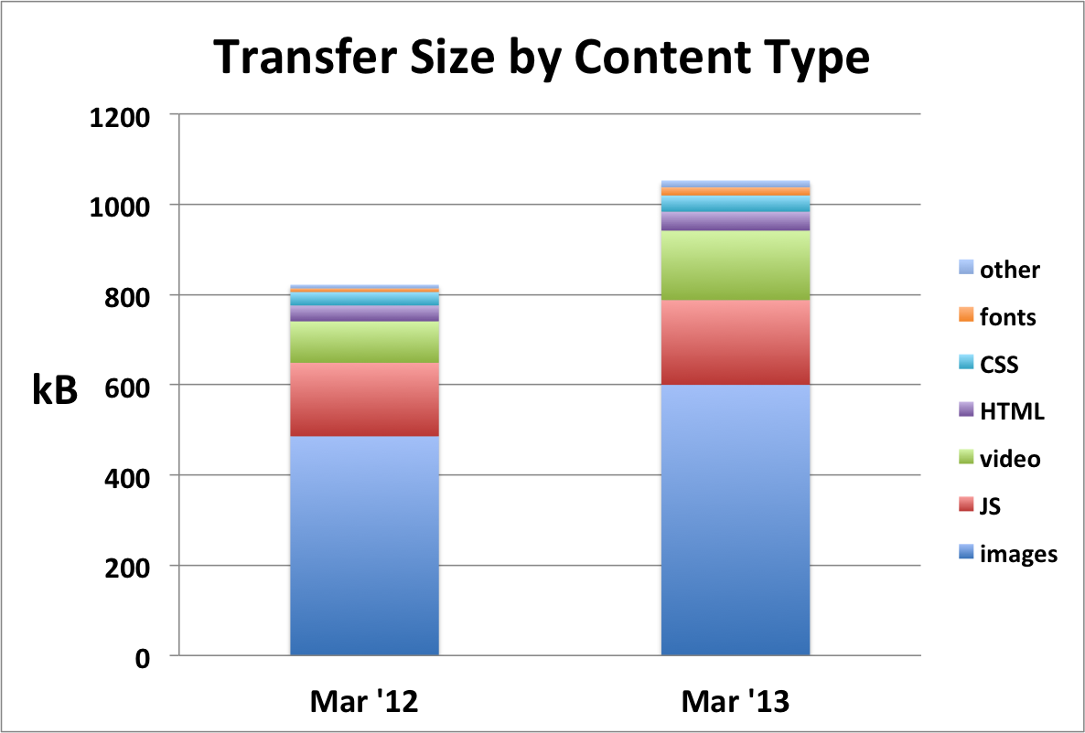
Notes:
Mar '12 Mar '13 images 489 639 31% video 93 233 151% JS 165 202 22% HTML 36 45 25% CSS 30 37 23% fonts 14 26 86% other 3 15 400%

Slide 40
Year-over-year:*
pages 231K (28%) heavier
images up 114K (23%)
video up 62K (67%)
* “Top 1000” URLs, transfer size

Slide 41
quality of craft
Notes:
http://www.flickr.com/photos/rexboggs5/7608691710/

Slide 42
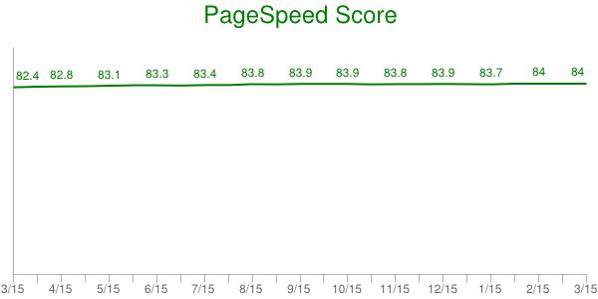
httparchive.org/trends.php?s=Top1000

Slide 43
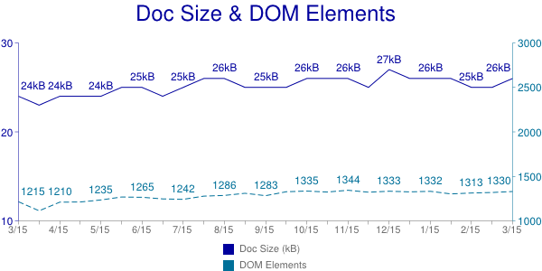
httparchive.org/trends.php?s=Top1000

Slide 44
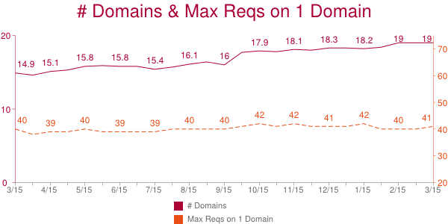
httparchive.org/trends.php?s=Top1000

Slide 45
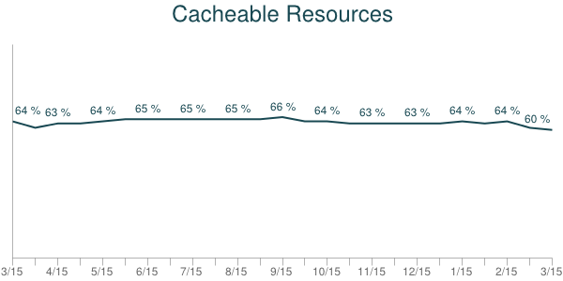
httparchive.org/trends.php?s=Top1000

Slide 46
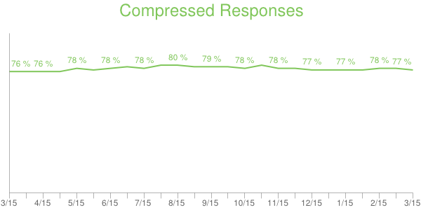
httparchive.org/trends.php?s=Top1000

Slide 47
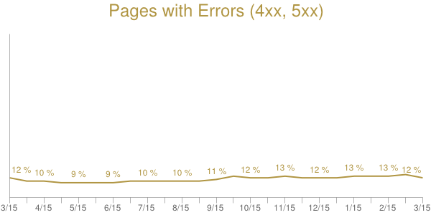
httparchive.org/trends.php?s=Top1000

Slide 48
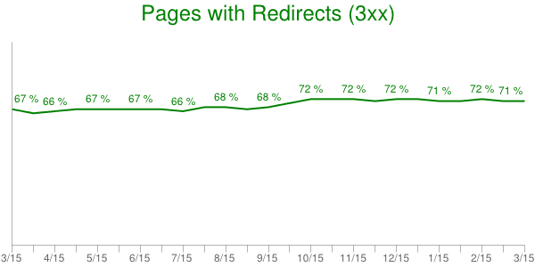
httparchive.org/trends.php?s=Top1000

Slide 49
Year-over-year:*
no significant change in adoption of best practices
* “Top 1000” URLs

Slide 50
page speed
Notes:
flickr.com/photos/wwarby/3296379139/

Slide 51
webperformancetoday.com/

Slide 52
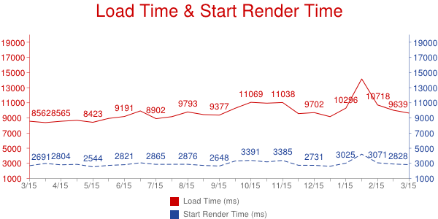
avg across ~900K measurements
synthetic: 1 browser, 1 location, 1 network connection, etc.
Notes:
http://chart.apis.google.com/chart?chds=9,99,80,100,9,99,700,1400&chxr=1,700,1400,200|2,80,100,10&chd=t:-1|89,82,86,87,88,89,90,88,86,90,90,91,90,97,98,97,100,98,99,98,99,98,99,98,100|-1|829,774,804,798,828,845,867,867,819,879,885,883,886,1027,1087,1111,1089,1108,1163,1103,1120,1131,1149,1154,1197&chxl=0:|3%2F15%7C+%7C4%2F15%7C+%7C5%2F15%7C+%7C6%2F15%7C+%7C7%2F15%7C+%7C8%2F15%7C+%7C9%2F15%7C+%7C10%2F15%7C+%7C11%2F15%7C+%7C12%2F15%7C+%7C1%2F15%7C+%7C2%2F15%7C+%7C3%2F15&chxt=x,y,r&chs=600x300&cht=lxy&chco=15A50E,006600&chm=N,15A50E,0,::2,12,,h::8|N**kB,006600,1,::2,12,,h::8&chts=006600,24&chtt=Total+Transfer+Size+%26+Total+Requests&chma=5,5,5,25&chls=1,6,3|1&chxs=1,006600,11.5,-0.5,lt,006600,006600|2,15A50E,11.5,-0.5,lt,15A50E,15A50E&chxtc=0,4|1,4&chxp=0&chdl=Total+Requests|Total+Transfer+Size+(kB)&chdlp=bv|r

Slide 53
window.onload
≠
user perception

Slide 54
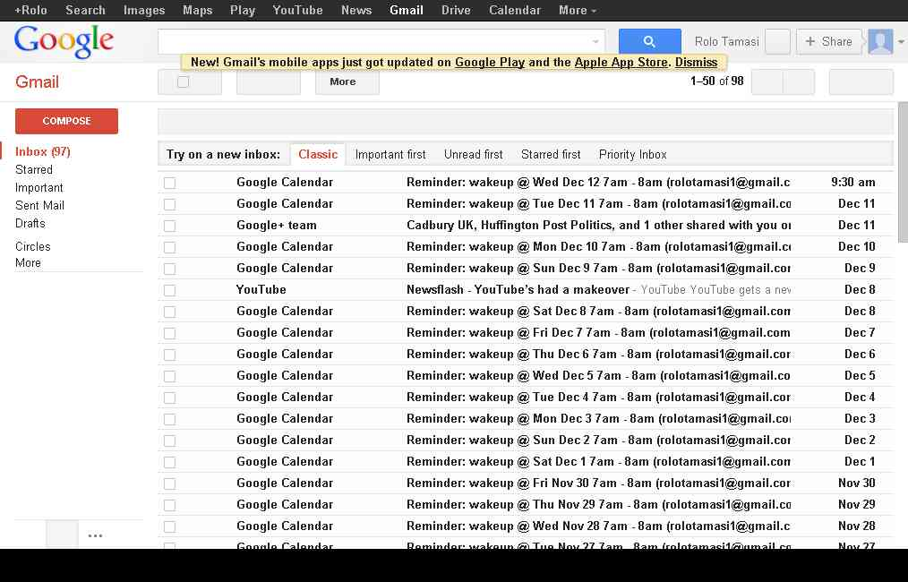
3.3 seconds
window.onload
4.8 seconds
90% rendered
Notes:
http://www.webpagetest.org/video/compare.php?tests=121212_KK_VED-r%3A2-c%3A0&thumbSize=200&ival=1000&end=visual

Slide 55
2.0 seconds
88% rendered
5.2 seconds
window.onload
Notes:
http://www.webpagetest.org/video/compare.php?tests=121212_KF_V7Y-r%3A3-c%3A0&thumbSize=200&ival=1000&end=visual

Slide 56
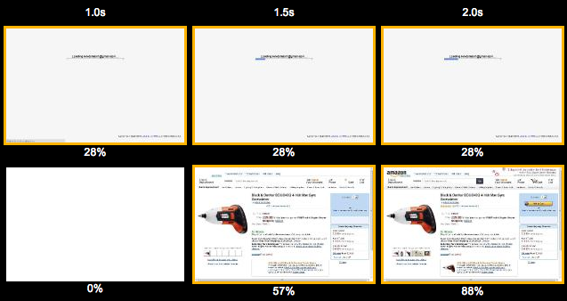
“Speed Index”
“average time at which visible parts of the page are displayed”
Notes:
The percentages indicate page rendering progress.
https://sites.google.com/a/webpagetest.org/docs/using-webpagetest/metrics/speed-index

Slide 57
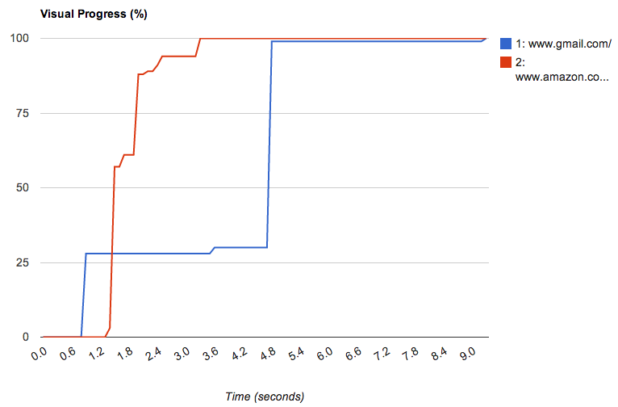
sites.google.com/a/webpagetest.org/docs/using-webpagetest/metrics/speed-index

Slide 58
Real User PLT
Page Load Time, year-over-year from real users:
desktop: 3.5% faster
mobile: 30% faster
Based on Google Analytics:
analytics.blogspot.com/2013/04/is-web-getting-faster.html
Notes:
http://analytics.blogspot.com/2013/04/is-web-getting-faster.html

Slide 59
Scorecard:
connections are faster
browsers getting faster
pages are heavier
best practices are flat
page load times are faster
Notes:
http://www.flickr.com/photos/churl/159610735/

Slide 60
takeaways
watch video growth
better performance metric
push best practices
multiple CPUs
caching
Notes:
flickr.com/photos/myklroventine/4062102754/

Slide 62
Steve Souders
@souders
stevesouders.com/docs/hamburg-howfast-20130528.pptx
Notes:
"thank you" by nj dodge: http://flickr.com/photos/nj_dodge/187190601/

