Slide 1
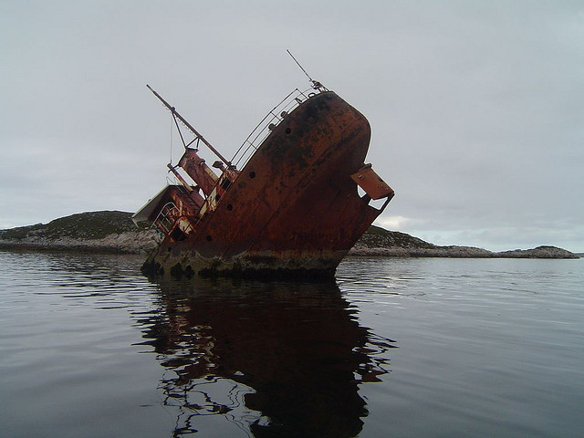
Your script just killed my site
stevesouders.com/docs/etsy-spof-20120619.pptx
Disclaimer: This content does not necessarily reflect the opinions of my employer.
Notes:
http://www.flickr.com/photos/jocelynaubert/3100384270/

Slide 2
SPOF
Notes:
http://www.flickr.com/photos/darwinbell/465459020/

Slide 3
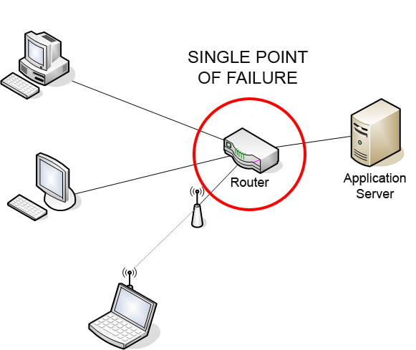
Notes:
http://en.wikipedia.org/wiki/Single_point_of_failure

Slide 4
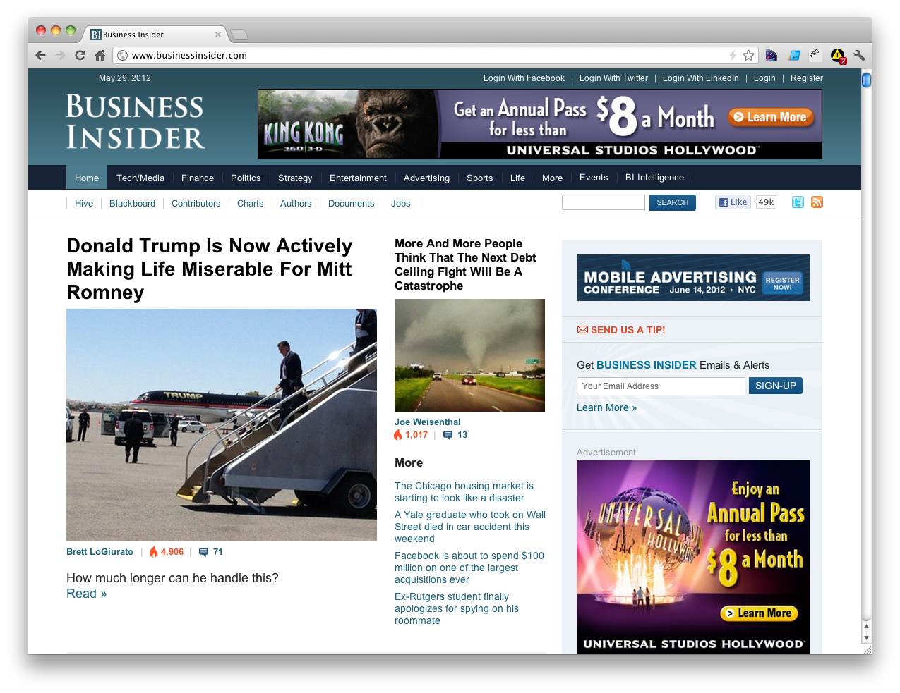
Notes:
Widgets
Ads
Analytics

Slide 5
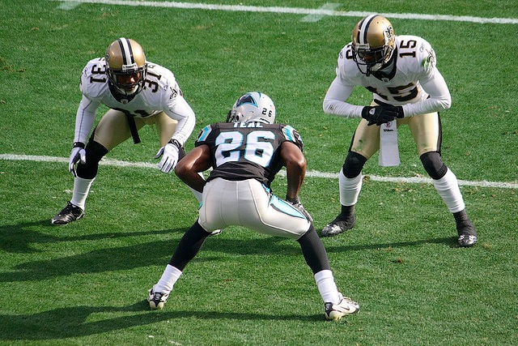
synchronous scripts block all following elements from rendering
in all browsers

Slide 6
#fail

Slide 7
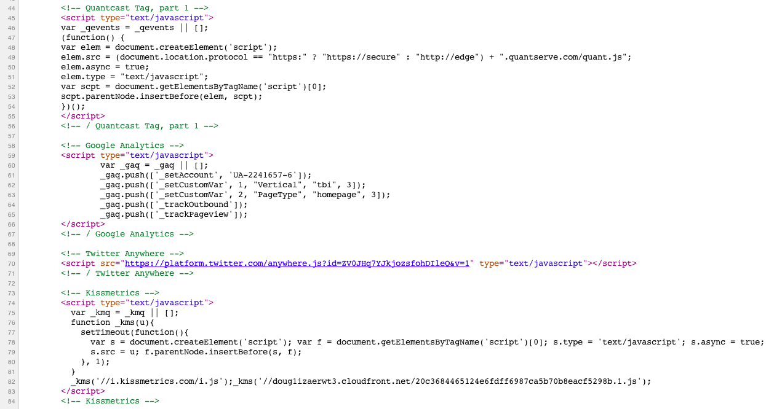
async
#fail
async
sync
async

Slide 8
Frontend SPOF

Slide 9
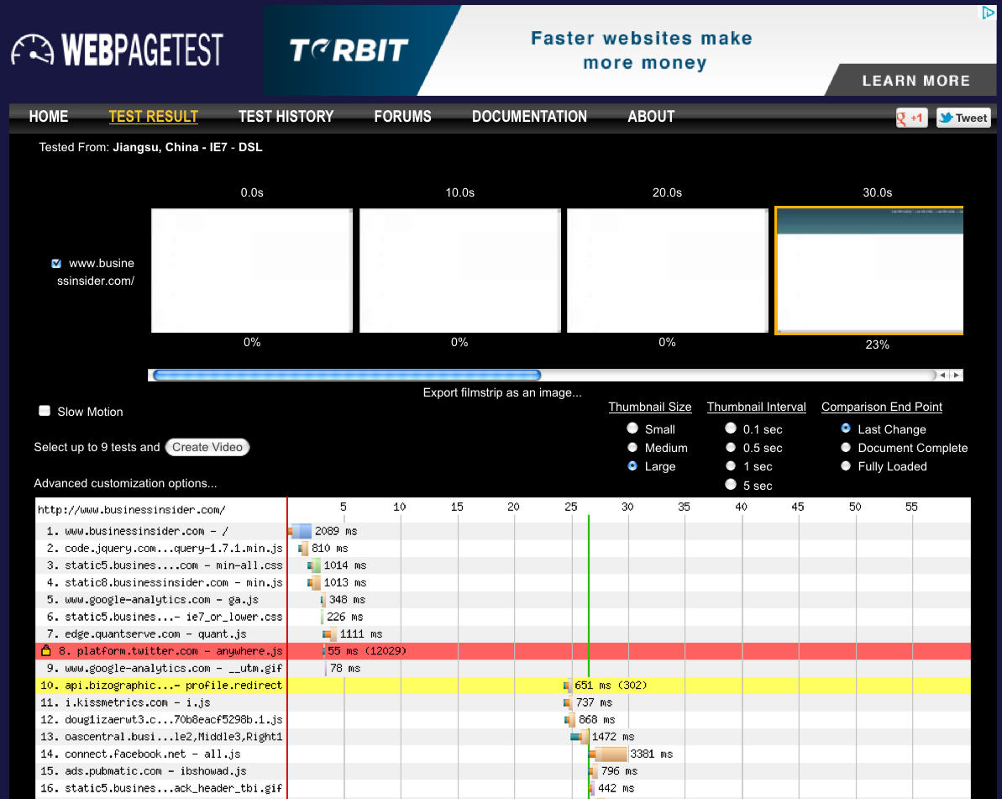
http://www.webpagetest.org/result/120529_41_HWV/

Slide 10
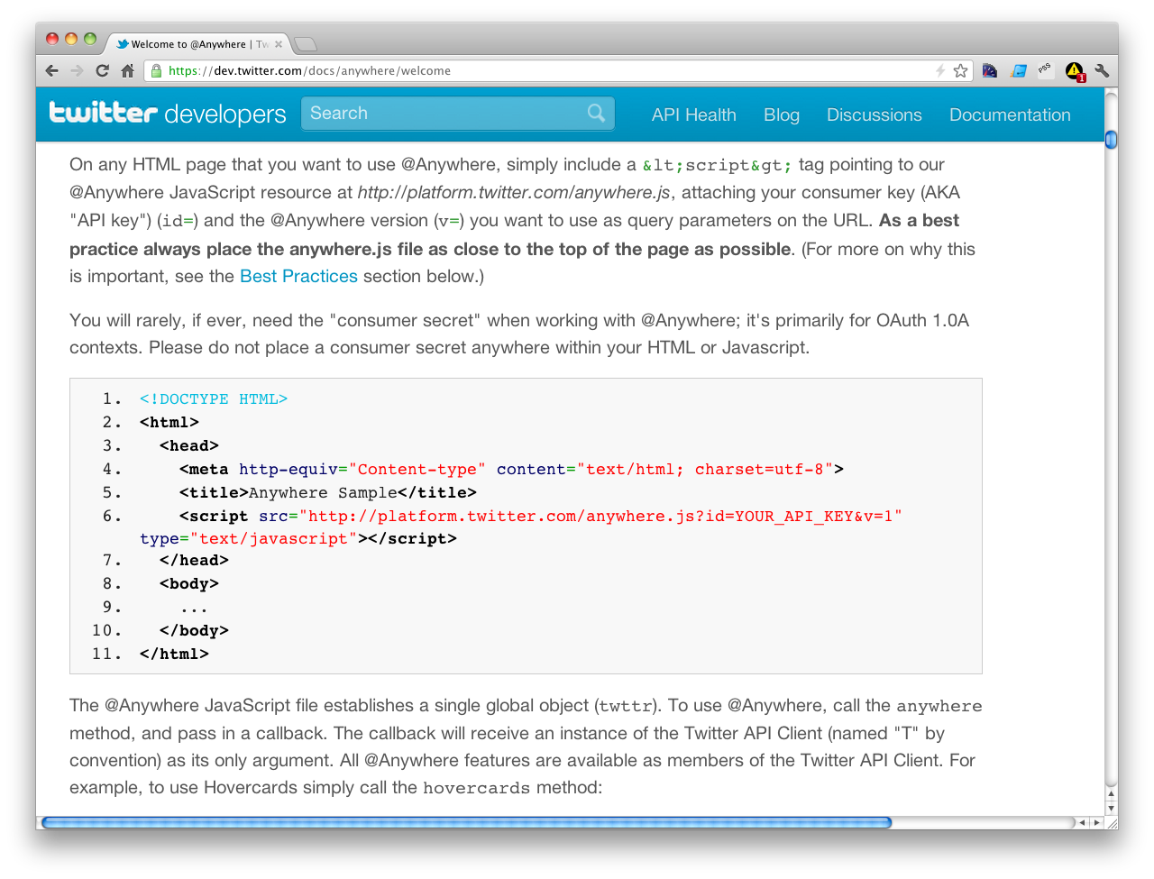

Slide 11
entire BODY blocked from rendering
Notes:
Later in the docs they talk about how the LATER resources are loaded async, but not this bootstrap script.
All it takes is one.

Slide 12
http://www.webpagetest.org/result/120529_41_HWV/

Slide 13
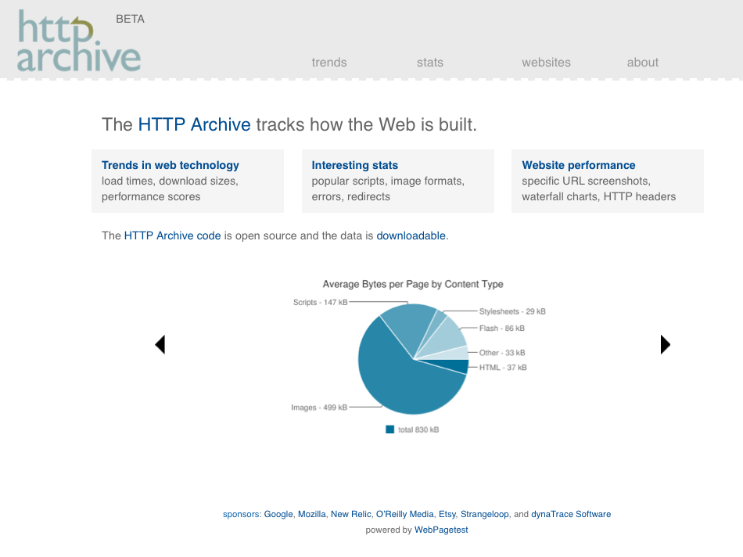

Slide 14
mysql>

Slide 15
select p.url, wptid
mysql>

Slide 16
select p.url, wptid
from pages as p, requests as r
mysql>

Slide 17
select p.url, wptid
from pages as p, requests as r
where p.pageid >= 844954 and
p.pageid <= 1564447 and
p.pageid = r.pageid and
mysql>

Slide 18
select p.url, wptid
from pages as p, requests as r
where p.pageid >= 844954 and
p.pageid <= 1564447 and
p.pageid = r.pageid and
rank < 20000 and
mysql>

Slide 19
select p.url, wptid
from pages as p, requests as r
where p.pageid >= 844954 and
p.pageid <= 1564447 and
p.pageid = r.pageid and
rank < 20000 and
resp_content_type like “%script%” and
mysql>

Slide 20
select p.url, wptid
from pages as p, requests as r
where p.pageid >= 844954 and
p.pageid <= 1564447 and
p.pageid = r.pageid and
rank < 20000 and
resp_content_type like “%script%” and
time > 10000 and
mysql>

Slide 21
select p.url, wptid
from pages as p, requests as r
where p.pageid >= 844954 and
p.pageid <= 1564447 and
p.pageid = r.pageid and
rank < 20000 and
resp_content_type like “%script%” and
time > 10000 and
renderStart > 10000
mysql>

Slide 22
select p.url, wptid
from pages as p, requests as r
where p.pageid >= 844954 and
p.pageid <= 1564447 and
p.pageid = r.pageid and
rank < 20000 and
resp_content_type like “%script%” and
time > 10000 and
renderStart > 10000
group by p.pageid;
mysql>

Slide 23
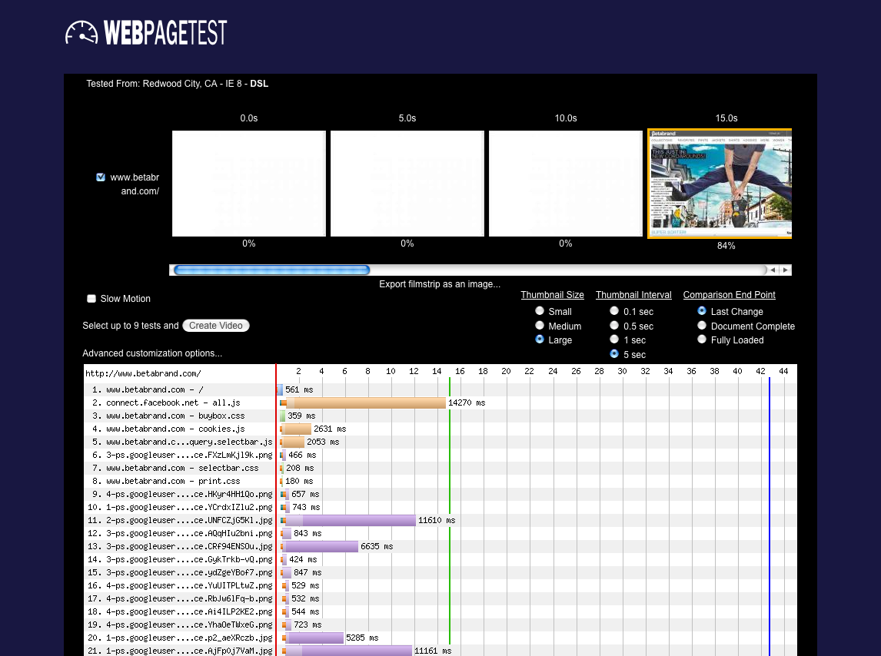
Notes:
http://httparchive.webpagetest.org/result/120401_40_WFQG/

Slide 24
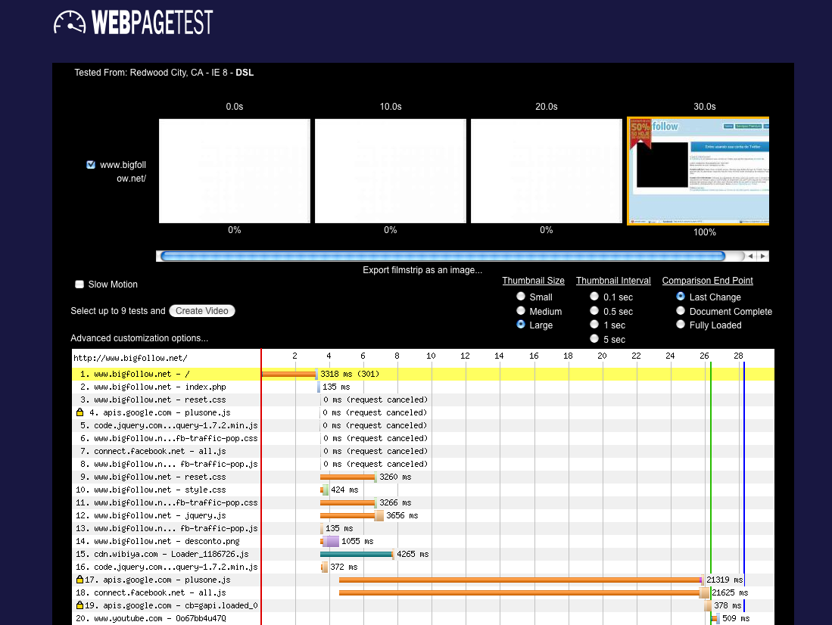
Notes:
http://httparchive.webpagetest.org/result/120515_5_4S4C/
plusone.js and all.js are synchronous

Slide 25
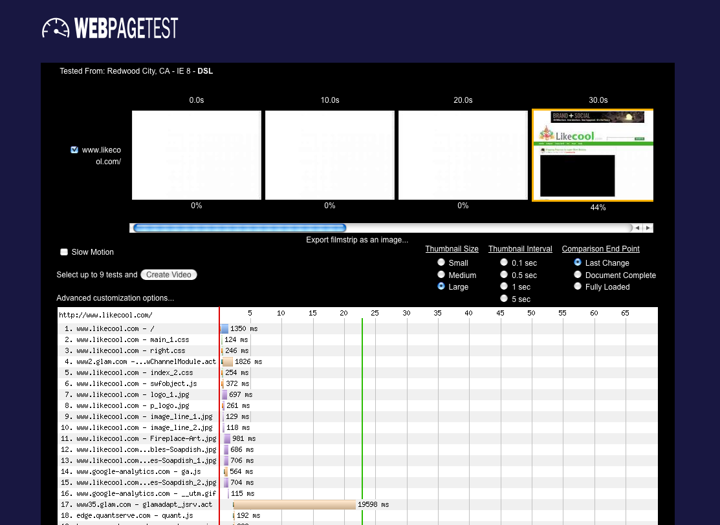
Notes:
http://httparchive.webpagetest.org/result/120515_0_DNT/
glamadapt_jsrv.act is inserted by wChannelModule.act using document.write
likecool is ranked 11K
Glam Media is “the leader in curated social media content”

Slide 26
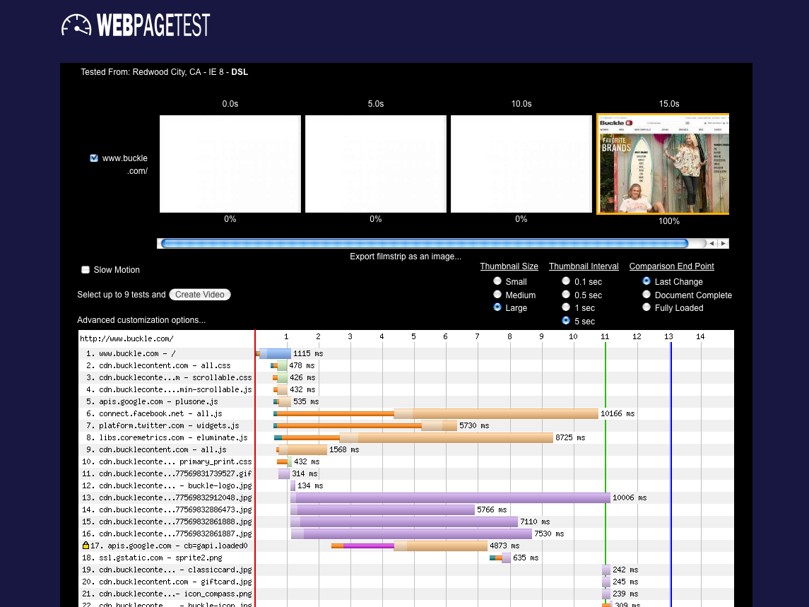
Notes:
http://httparchive.webpagetest.org/result/120301_AP_P4W3/
rank #19K
all.js, widgets.js, eluminate.js all loaded sync

Slide 27
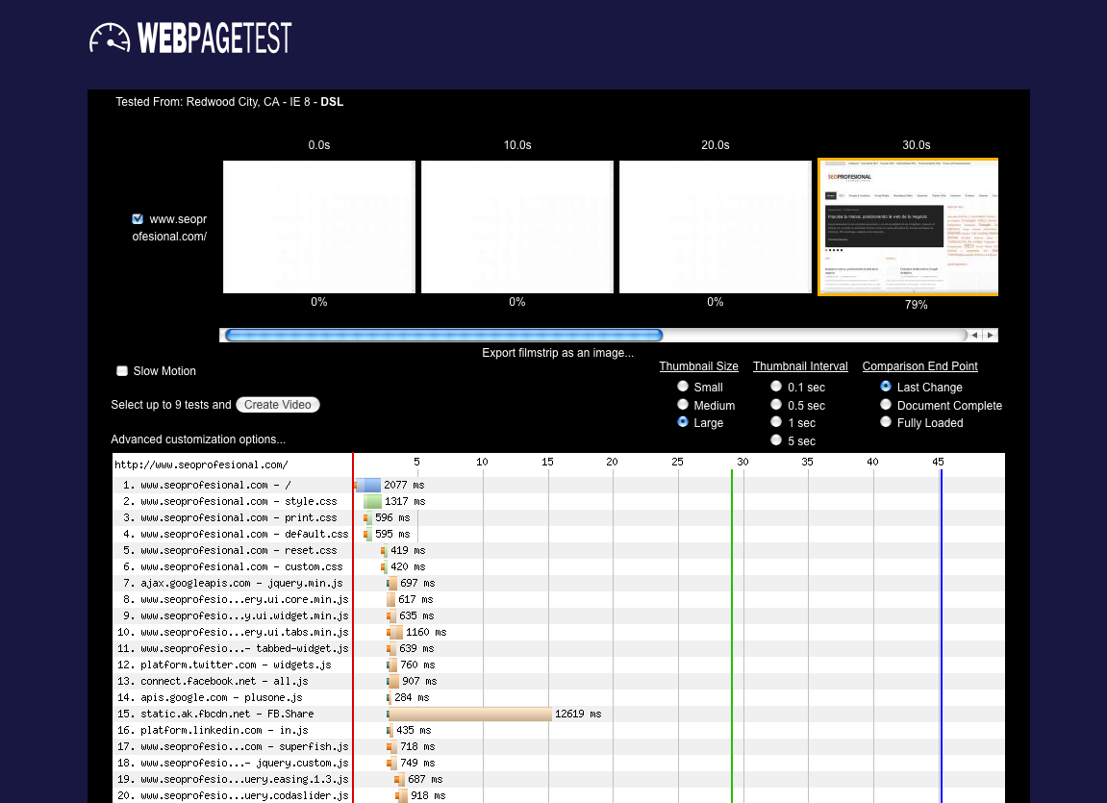
Notes:
http://httparchive.webpagetest.org/result/120401_8H_VTA3/

Slide 28
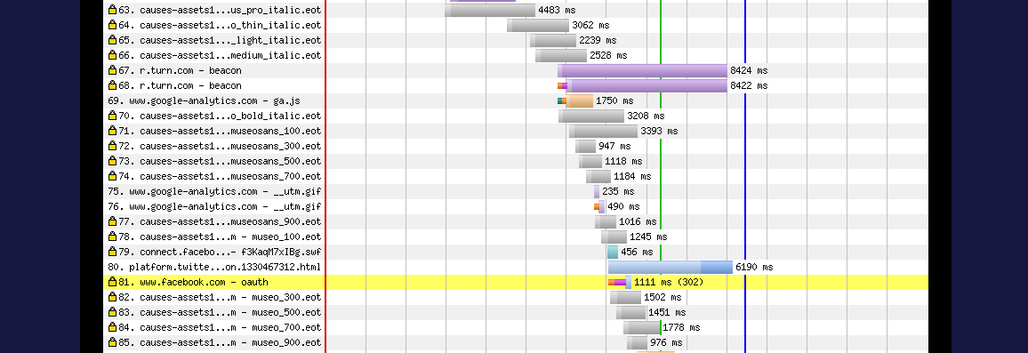
Notes:
http://httparchive.webpagetest.org/result/120315_VQ_QCZP/
fonts

Slide 29
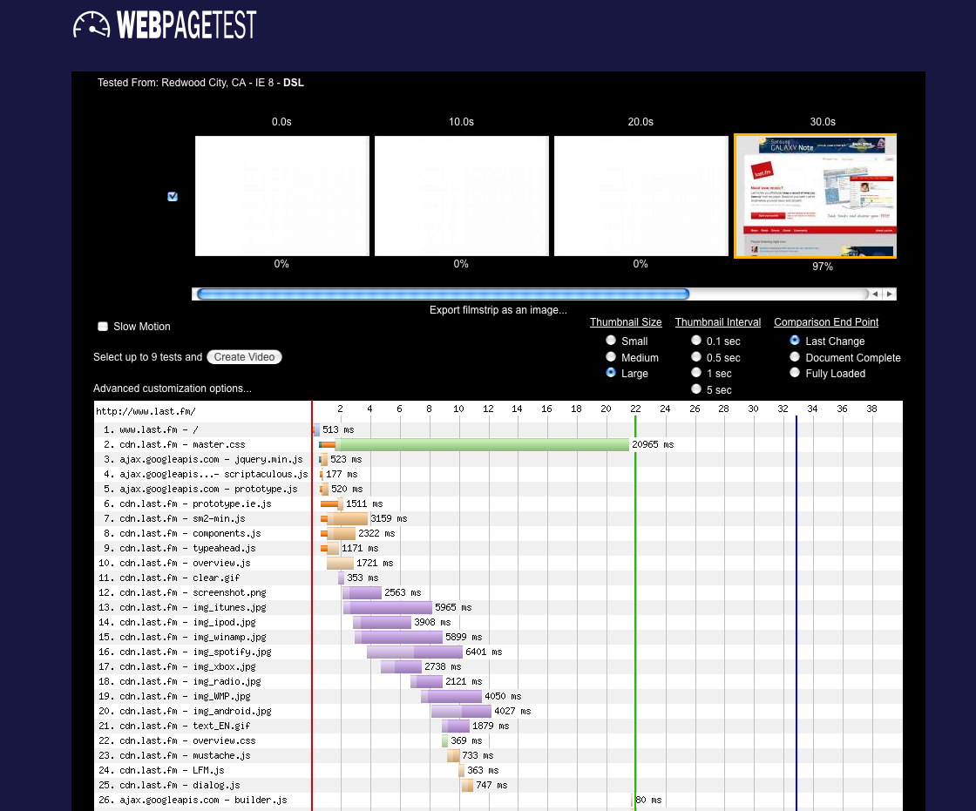
Notes:
http://httparchive.webpagetest.org/result/120515_0_35V/
Their own CSS file

Slide 30
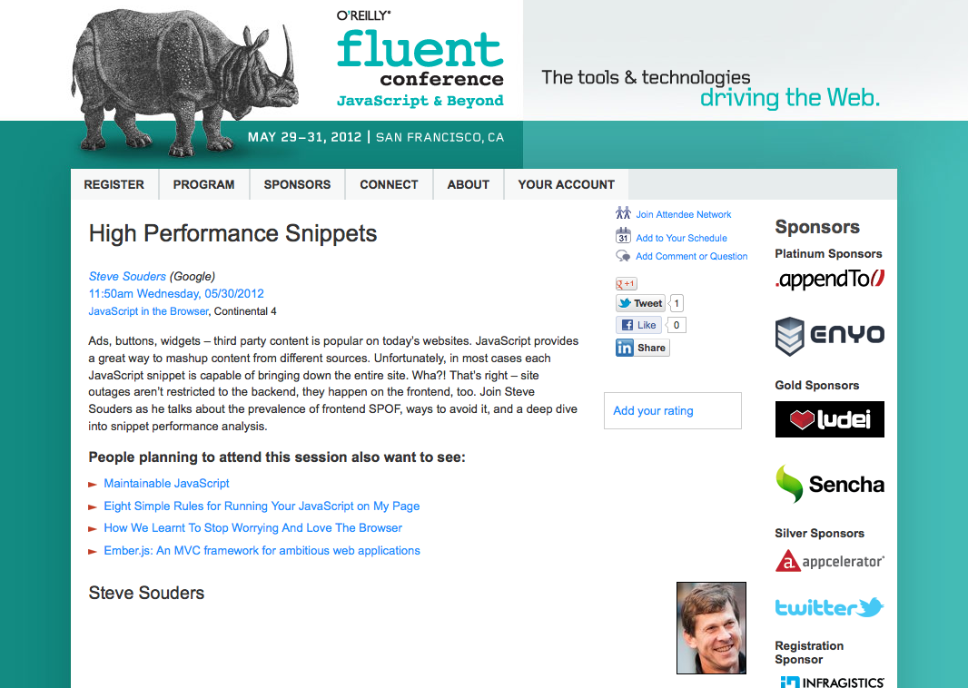

Slide 31
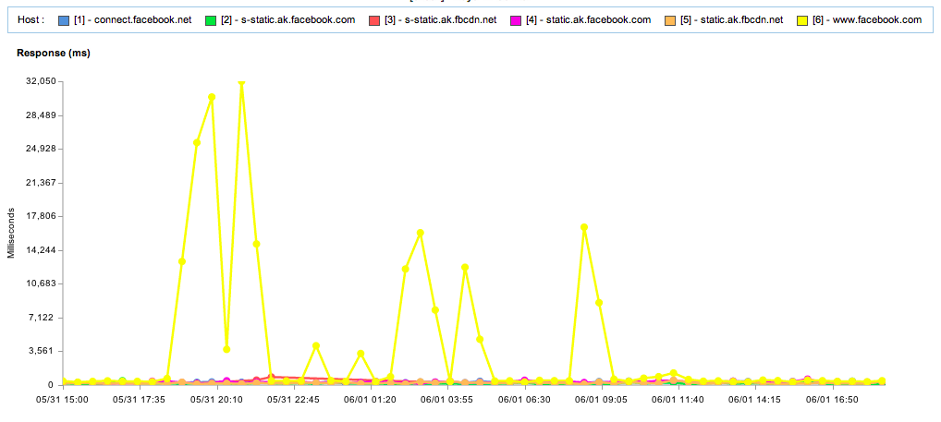
blog.catchpoint.com/2012/06/01/facebook-outage-wake-up-call-for-websites/

Slide 32
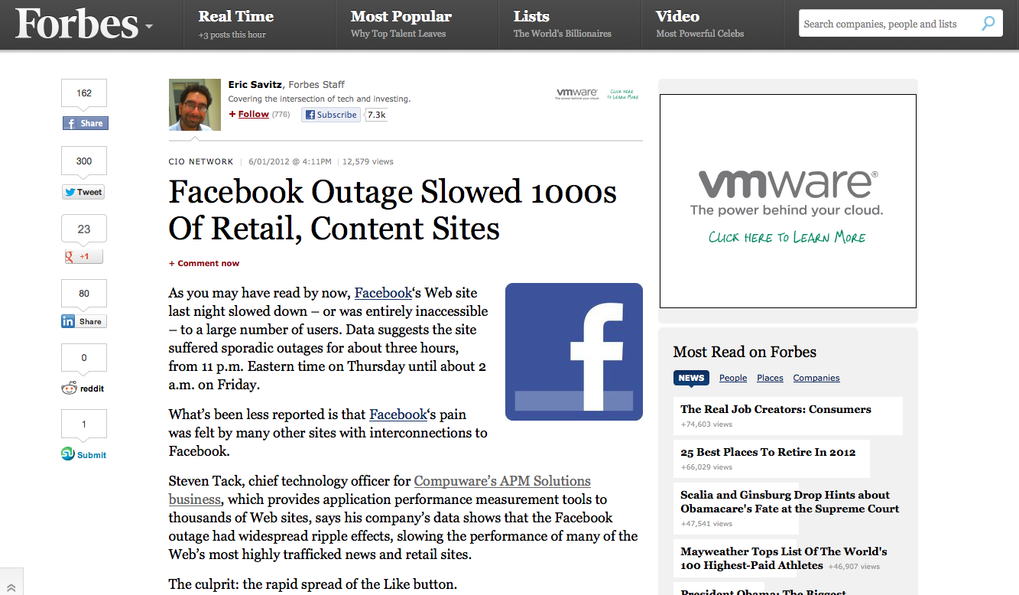

Slide 33
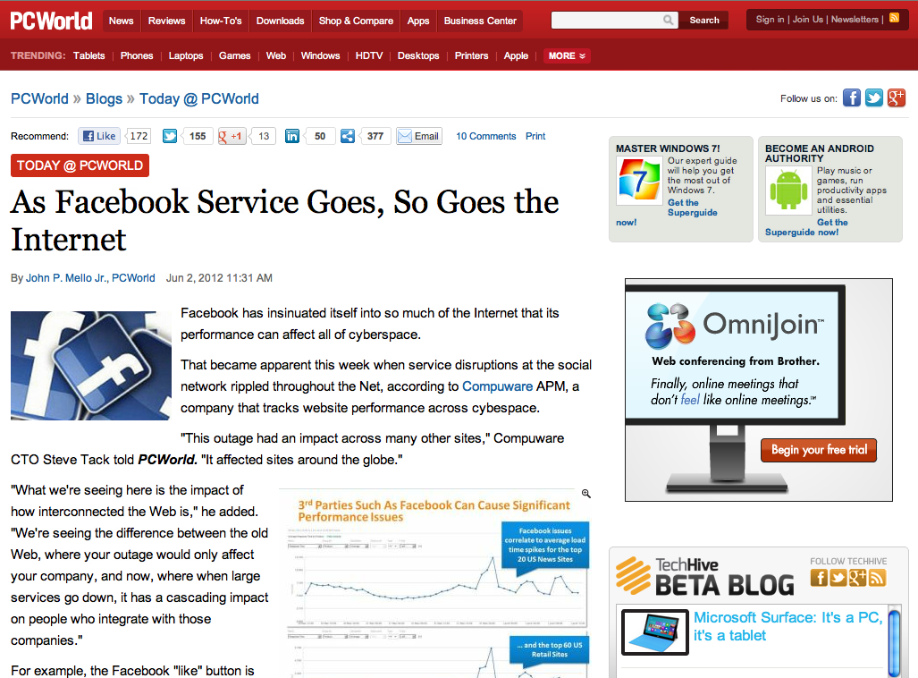

Slide 34
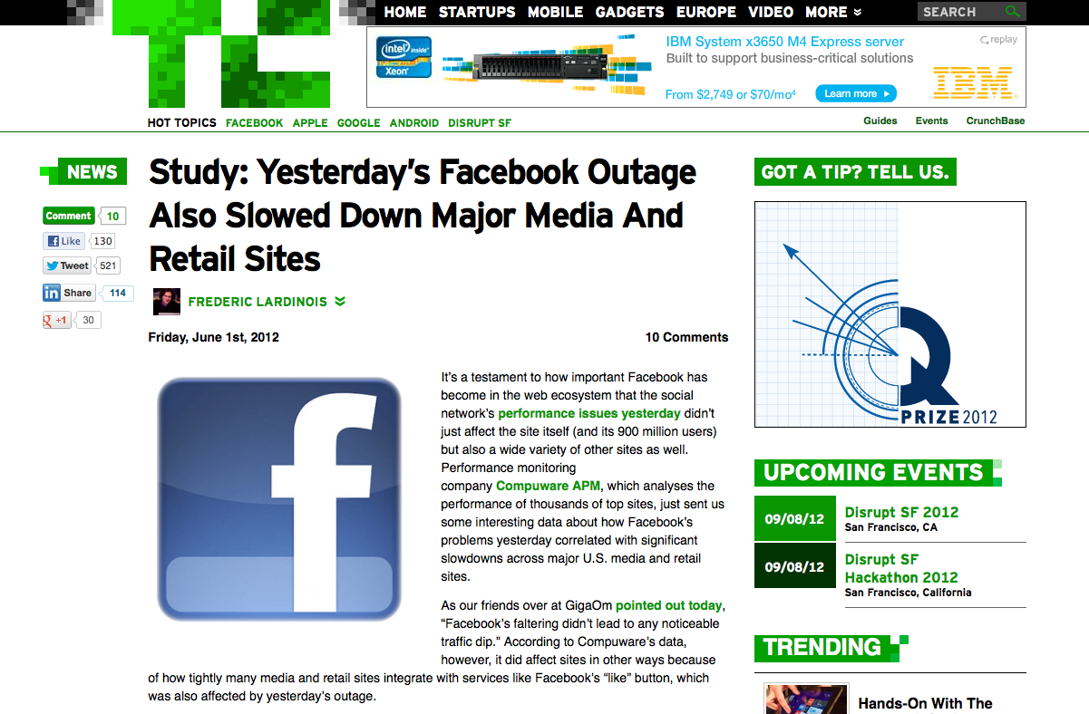

Slide 36
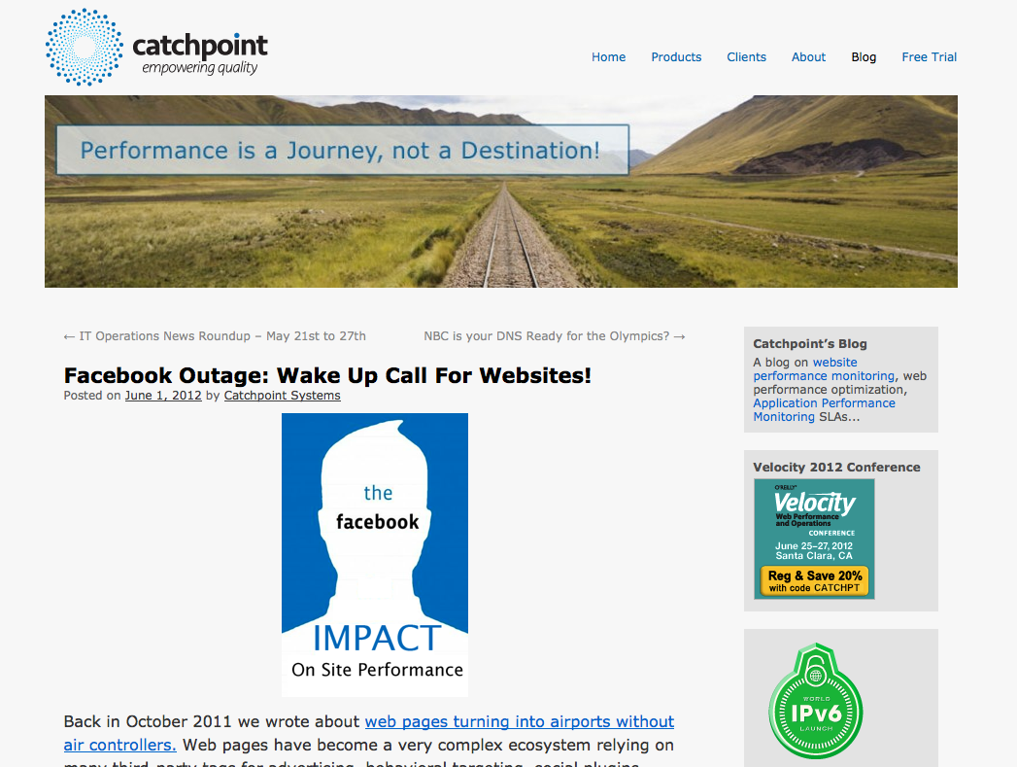
blog.catchpoint.com/2012/06/01/facebook-outage-wake-up-call-for-websites/

Slide 37
Notes:
http://www.flickr.com/photos/rusty-projector/225212919/
Thanks for listening to my cautionary tale of dread and foreboding.
But it’s not all doom and gloom.

Slide 38
Notes:
There is a brighter future where snippets aren’t a frontend SPOF.

Slide 39
http://www.webpagetest.org/result/120529_41_HWV/

Slide 40
http://blog.patrickmeenan.com/2011/10/testing-for-frontend-spof.html

Slide 41
/etc/hosts:
72.66.115.13 apis.google.com
72.66.115.13 www.google-analytics.com
72.66.115.13 static.ak.fbcdn.net
72.66.115.13 connect.facebook.net
72.66.115.13 platform.twitter.com
72.66.115.13 widgets.twimg.com
WebPagetest:
setDnsName apis.google.com blackhole.webpagetest.org
setDnsName www.google-analytics.com blackhole.webpagetest.org
setDnsName static.ak.fbcdn.net blackhole.webpagetest.org
setDnsName connect.facebook.net blackhole.webpagetest.org
setDnsName platform.twitter.com blackhole.webpagetest.org
setDnsName widgets.twimg.com blackhole.webpagetest.org
navigate http://www.businessinsider.com/

Slide 42
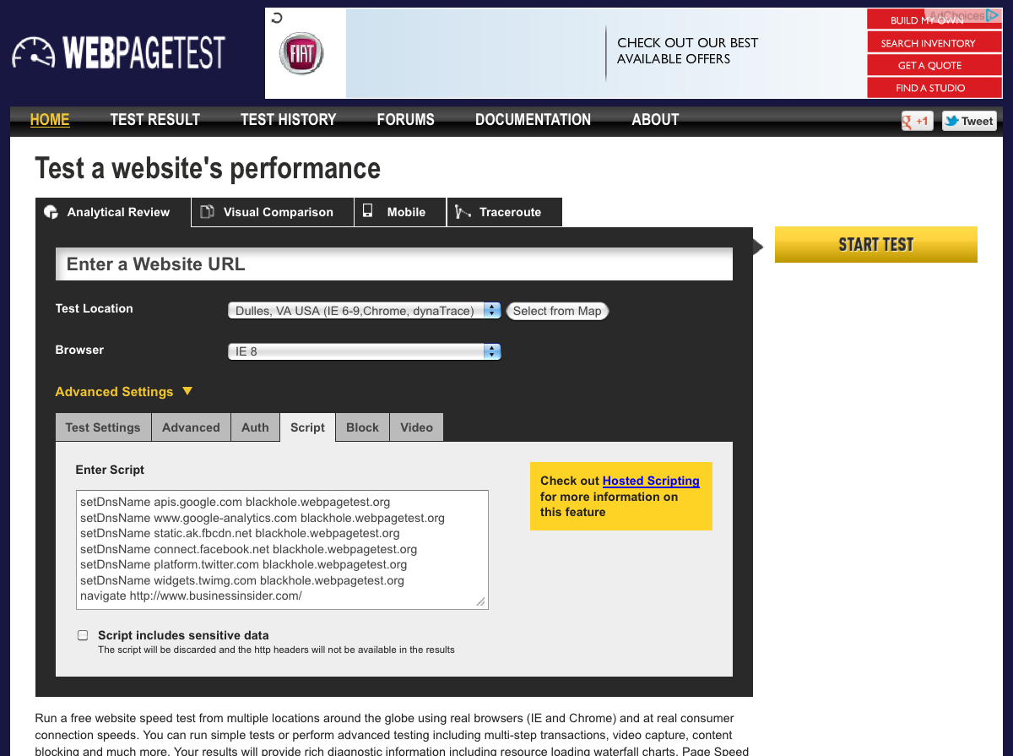
Notes:
http://www.webpagetest.org/result/120530_HS_4BA/

Slide 43
Facebook example
Benefits of async iframe
Fluent speaker screenshot – next day was outage

Slide 44
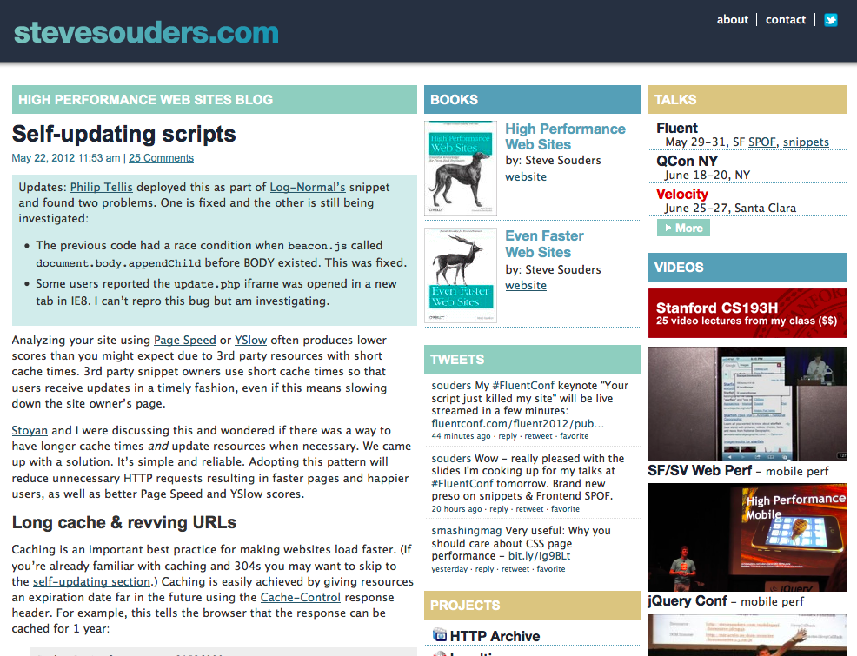

Slide 45
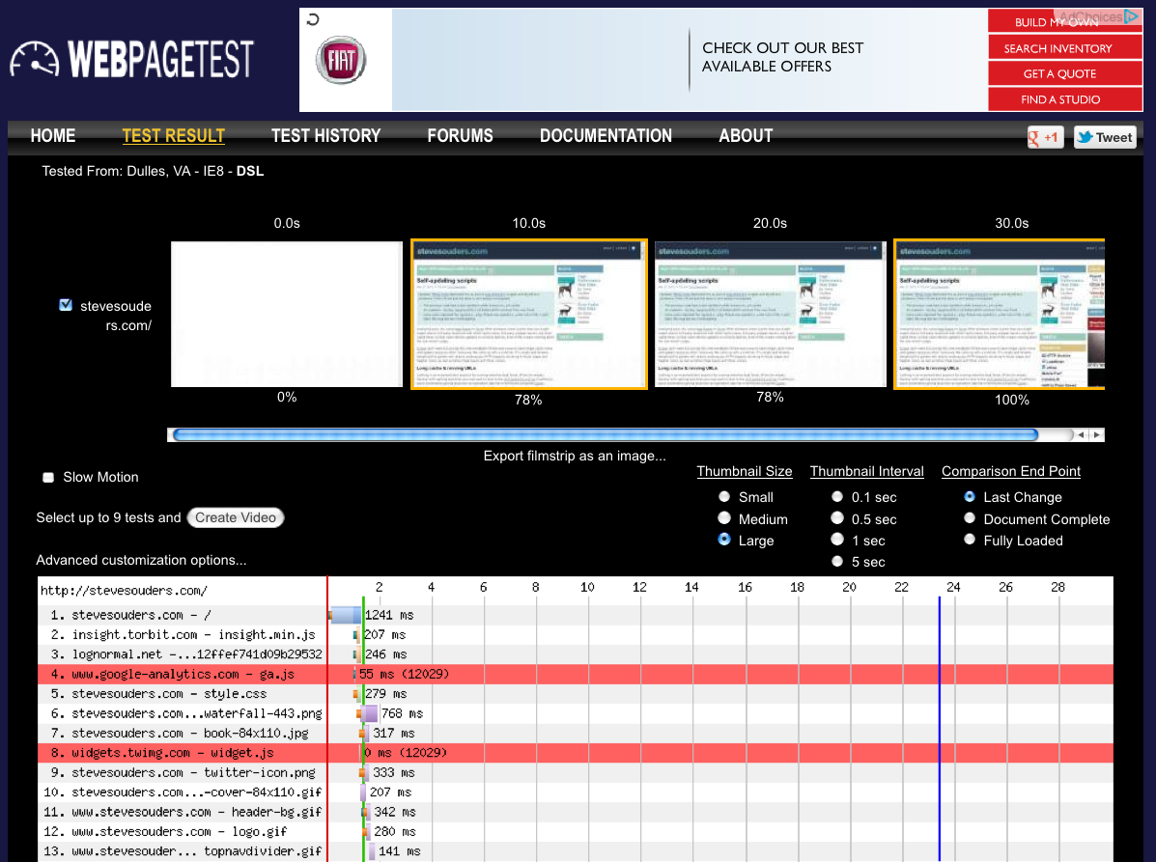
Notes:
http://www.webpagetest.org/result/120530_7R_4BJ/

Slide 46
original snippet
<script src="http://widgets.twimg.com/j/2/widget.js">
</script>
<script>
new TWTR.Widget({
version: 2,
type: 'profile',
...
}).render().setUser('souders').start();
</script>

Slide 47
asyncified snippet
<script>
var ts = document.createElement("script");
ts.async = true;
ts.src = "http://widgets.twimg.com/j/2/widget.js";
var s0 = document.getElementsByTagName('script')[0];
s0.parentNode.insertBefore(ts, s0);
new TWTR.Widget({
version: 2,
type: 'profile',
...
}).render().setUser('souders').start();
</script>
ERROR: undefined symbol TWTR

Slide 48
asyncified snippet
<script>
var ts = document.createElement("script");
ts.async = true;
ts.onload = ts.onreadystatechange = doTwitter;
ts.src = "http://widgets.twimg.com/j/2/widget.js";
var s0 = document.getElementsByTagName('script')[0];
s0.parentNode.insertBefore(ts, s0);
function doTwitter() {
if ( this.readyState && this.readyState != "complete"
&& this.readyState != "loaded" ) {
return; }
this.onload = this.onreadystatechange = null;
new TWTR.Widget({
version: 2,
type: 'profile',
...
}).render().setUser('souders').start();
}
</script>

Slide 49
asyncified snippet
<script>
function doTwitter() {
if ( this.readyState && this.readyState != "complete"
&& this.readyState != "loaded" ) {
return;
}
this.onload = this.onreadystatechange = null;
new TWTR.Widget({
version: 2,
type: 'profile',
...
}).render().setUser('souders').start();
}
var ts = document.createElement("script");
ts.async = true;
ts.onload = ts.onreadystatechange = doTwitter;
ts.src = "http://widgets.twimg.com/j/2/widget.js";
var s0 = document.getElementsByTagName('script')[0];
s0.parentNode.insertBefore(ts, s0);
</script>

Slide 50
But... you can’t make a script async if it does document.write
widget.js does document.write:
init: function(x) {
...
this.id = x.id || "twtr-widget-" + this._widgetNumber;
if (!x.id) {
document.write('<div class="twtr-widget" id="' +
this.id + '"></div>')
}
}
What if we create the DIV and specify the id?

Slide 51
asyncified snippet plus DIV
<div class=‘twtr-widget’ id=‘souderstwitter’></div>
<script>
var ts = document.createElement("script");
ts.async = true;
...
function doTwitter() {
if ( this.readyState && this.readyState != "complete"
&& this.readyState != "loaded" ) {
return;
}
this.onload = this.onreadystatechange = null;
new TWTR.Widget({
id: ‘souderstwitter’,
version: 2,
type: 'profile',
...
}).render().setUser('souders').start();
}

Slide 52
before
Notes:
http://www.webpagetest.org/result/120530_7R_4BJ/

Slide 53
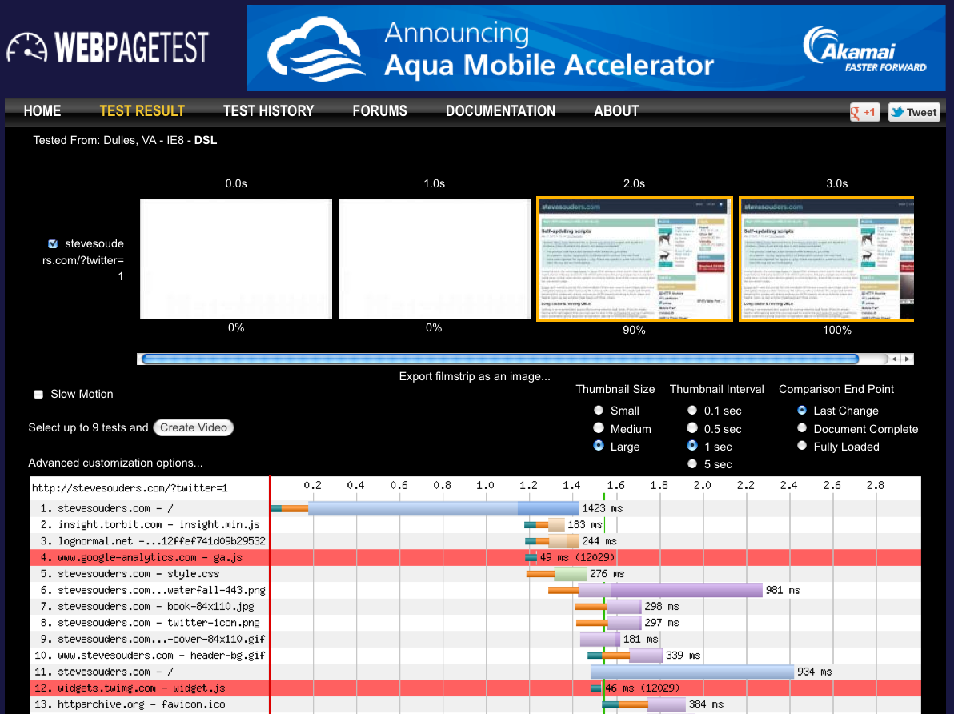
after
Notes:
http://www.webpagetest.org/result/120530_8D_4BQ/

Slide 54
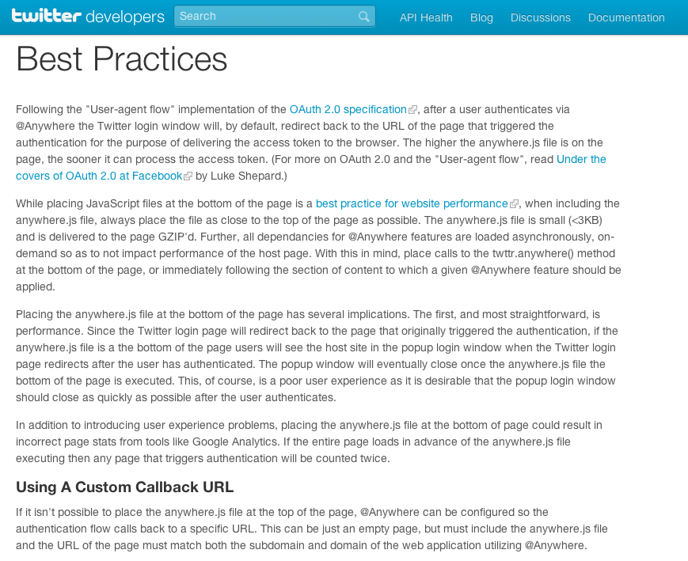
While placing JavaScript files at the bottom of the page is a best practice for website performance, when including the anywhere.js file, always place the file as close to the top of the page as possible.
The anywhere.js file is small (<3KB) and is delivered to the page GZIP'd.
Further, all dependancies for @Anywhere features are loaded asynchronously, on-demand so as to not impact performance of the host page.

Slide 55
three facts:
failures happen
304 & 200 both produce frontend SPOF
anywhere.js expires after 15 minutes

Slide 56
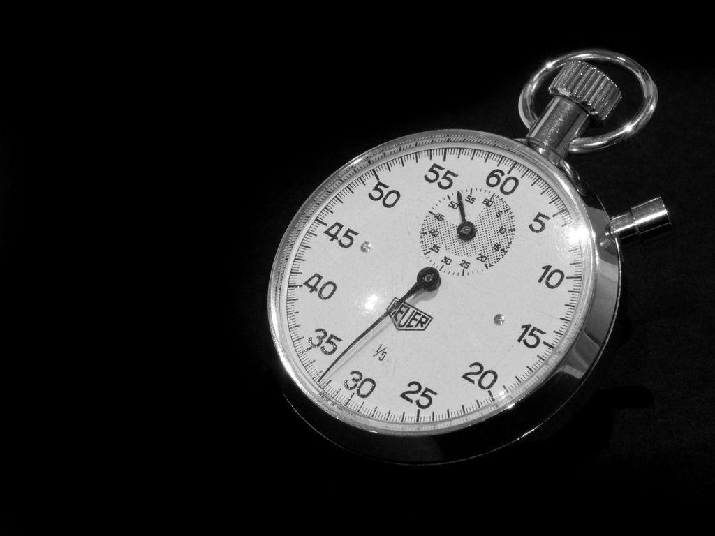
snippet cache times
http://platform.twitter.com/widgets.js - 30 mins
http://connect.facebook.net/en_US/all.js - 15 mins
http://www.google-analytics.com/ga.js - 120 mins
Notes:
flickr.com/photos/wwarby/3296379139/

Slide 57
“bootstrap scripts” often have short cache times
more frequent Conditional GET requests means frontend SPOF is more likely
but short cache times is the only way snippet owners can push updates
or is it?
Notes:
flickr.com/photos/juditk/5024772809/
whether it’s 1 or 5 requests, frontend SPOF will still happen

Slide 58
self-updating bootstrap scripts
with Stoyan Stefanov
stevesouders.com/blog/2012/05/22/self-updating-scripts/

Slide 59
client
server
bootstrap.js:
var v=“1.7”;
scriptelem.src = “beacon.js?v=”+v;
current version is 1.7
200
maxage=604800
beacon.js:
?v=1.7&log...
204

Slide 60
client
server
next day…
bootstrap.js:
bootstrap.js updated to 1.8
read from cache
beacon.js:
?v=1.7&log...
200
var iframe1 = document.createElement("iframe");
iframe1.style.display = "none”;
iframe1.src = ”update.php";
document.body.appendChild(iframe1);

Slide 61
client
server
update.php
200
bootstrap.js is still read from cache
<script src=“bootstrap.js">
</script>
<script>
if (location.hash === '') {
location.hash = "check”;
location.reload(true);
}
</script>
on reload bootstrap.js is re-requested and overwrites cache
200

Slide 62
part 1: update notification
piggyback on dynamic request
pass cached version # to server: ?v=127
server returns:
204 – no update
JS – new version available

Slide 63
part 2: overwrite cache
re-request dynamically
rev the URL (querystring)
XHR w/ setRequestHeader
reload iframe containing bootstrap script

Slide 64
example
load bootstrap script:
var s1=document.createElement('script');
s1.async=true;
s1.src='http://souders.org/tests/selfupdating/bootstrap.js’;
var s0=document.getElementsByTagName('script’)[0];
s0.parentNode.insertBefore(s1, s0);
stevesouders.com/tests/selfupdating/

Slide 65
send beacon:
http://souders.org/tests/selfupdating/beacon.js?v=02:29:53
beacon response triggers update:
var iframe1 = document.createElement("iframe");
iframe1.style.display = "none”;
iframe1.src = "http://souders.org/tests/selfupdating/update.php?v=02:29:53";
document.body.appendChild(iframe1);
stevesouders.com/tests/selfupdating/

Slide 66
iframe reloads itself:
<script src="http://souders.org/tests/selfupdating/bootstrap.js">
</script>
<script>
if (location.hash === '') {
location.hash = "check”;
location.reload(true);
}
</script>
reload triggers Conditional GET
cached script is updated
stevesouders.com/tests/selfupdating/

Slide 67
voilà
bootstrap scripts can have long cache times
AND
get updated when necessary

Slide 68
caveats
the update is used on the next page view (like app cache)
1 reported IE8 issue

Slide 69
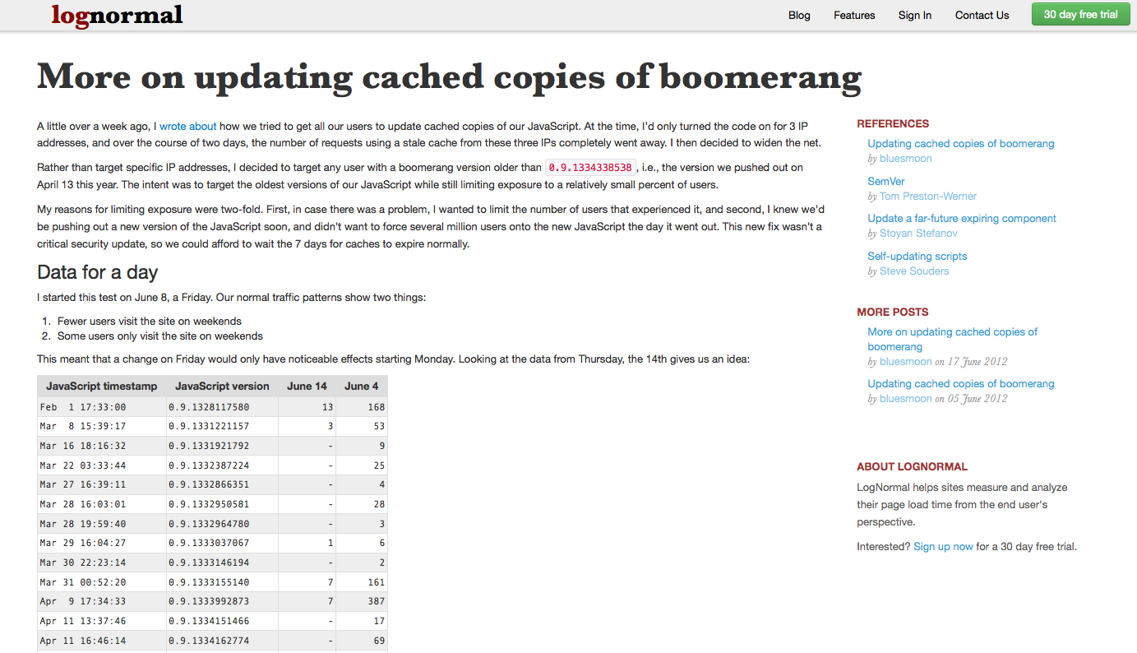

Slide 71
takeaways
load 3rd party scripts async
test your site with blackhole.webpagetest.org
have RUM timeout
make bootstrap scripts self-updating & increase cache times
Notes:
flickr.com/photos/myklroventine/4062102754/

Slide 72
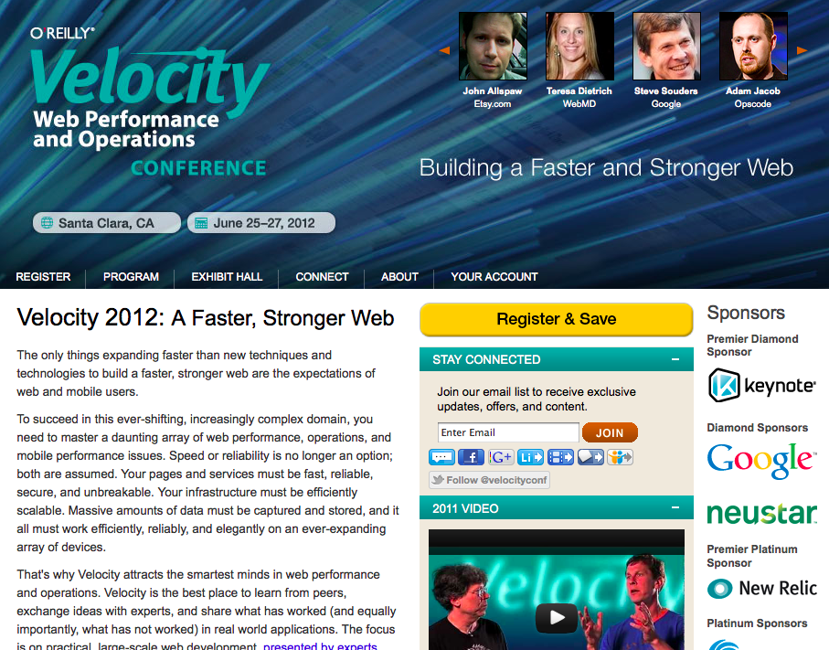

Slide 73
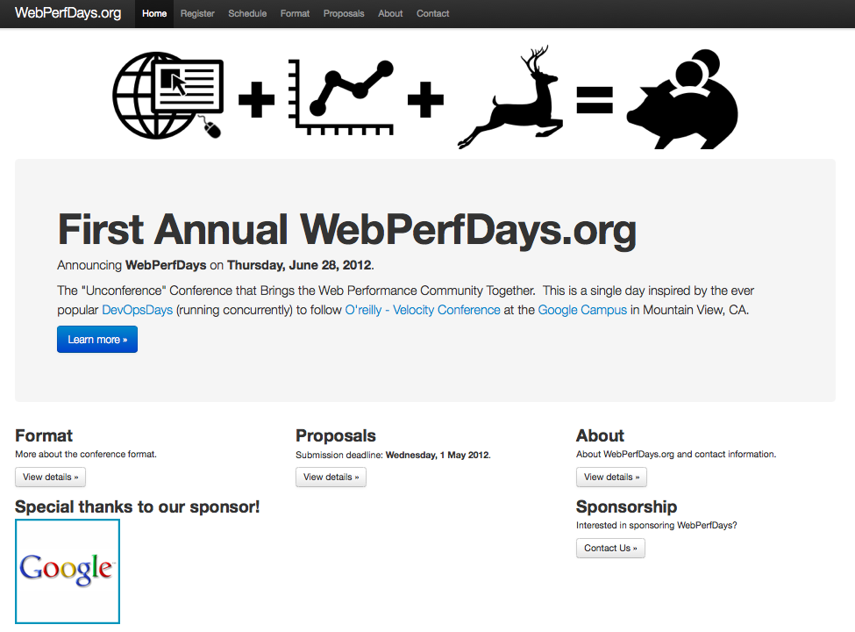

Slide 75
what’s your website’s weakest link?
Notes:
http://www.flickr.com/photos/darwinbell/465459020/

Slide 76
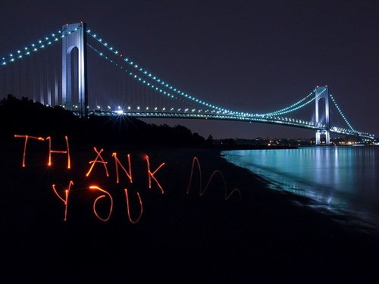
Steve Souders
@souders
stevesouders.com/docs/etsy-spof-20120619.pptx
Notes:
"thank you" by nj dodge: http://flickr.com/photos/nj_dodge/187190601/
I’m pretty sure this is the Verrazano-Narrows Bridge.

