Slide 1

Web Performance Optimization
stevesouders.com/docs/amsterdam-meetup-20120509.pptx
Disclaimer: This content does not necessarily reflect the opinions of my employer.

Slide 2

Web
Performance
Optimization
WPO
  drives traffic
  improves UX
  increases revenue
  reduces costs
Notes:
flickr.com/photos/pedromourapinheiro/3123885534/

Slide 3
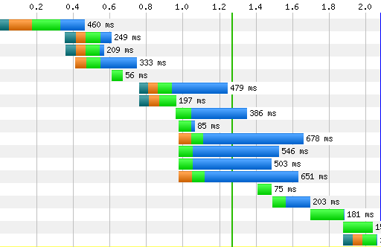
backend
frontend
“waterfall chart”

Slide 4
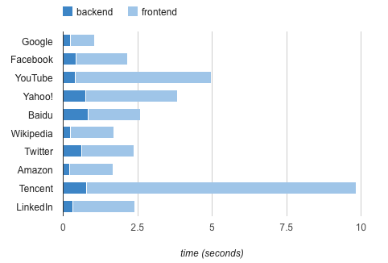
Top 10
24% - backend
76% - frontend
Notes:
Top10: http://www.webpagetest.org/result/120208_Z1_35P7S/
LinkedIn & QQ (11 & 12): http://www.webpagetest.org/result/120208_4M_35PBQ/
Amazon (avoid promo): http://www.webpagetest.org/result/120206_QM_34CFW/
10K: http://www.webpagetest.org/result/120208_FZ_35PDK/
startupu: http://www.webpagetest.org/result/120208_ZN_35PQ4/

Slide 5
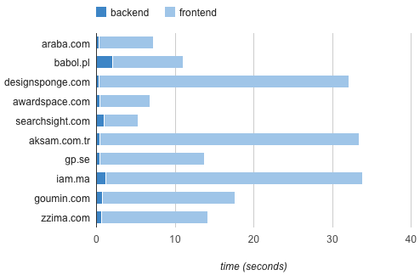
10,000+
8% - backend
92% - frontend
Notes:
Top10: http://www.webpagetest.org/result/120208_Z1_35P7S/
LinkedIn & QQ (11 & 12): http://www.webpagetest.org/result/120208_4M_35PBQ/
Amazon (avoid promo): http://www.webpagetest.org/result/120206_QM_34CFW/
10K: http://www.webpagetest.org/result/120208_FZ_35PDK/
startupu: http://www.webpagetest.org/result/120208_ZN_35PQ4/

Slide 6

www2012.wwwconference.org/proceedings/proceedings/p41.pdf

Slide 7
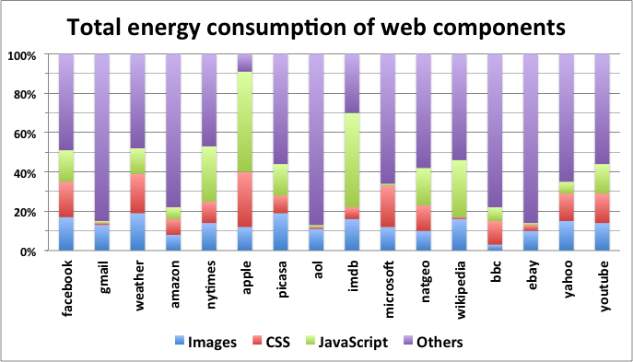

Slide 8

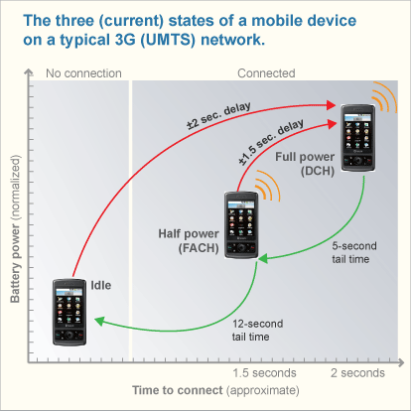
research.att.com/articles/featured_stories/2011_03/201102_Energy_efficient

Slide 9
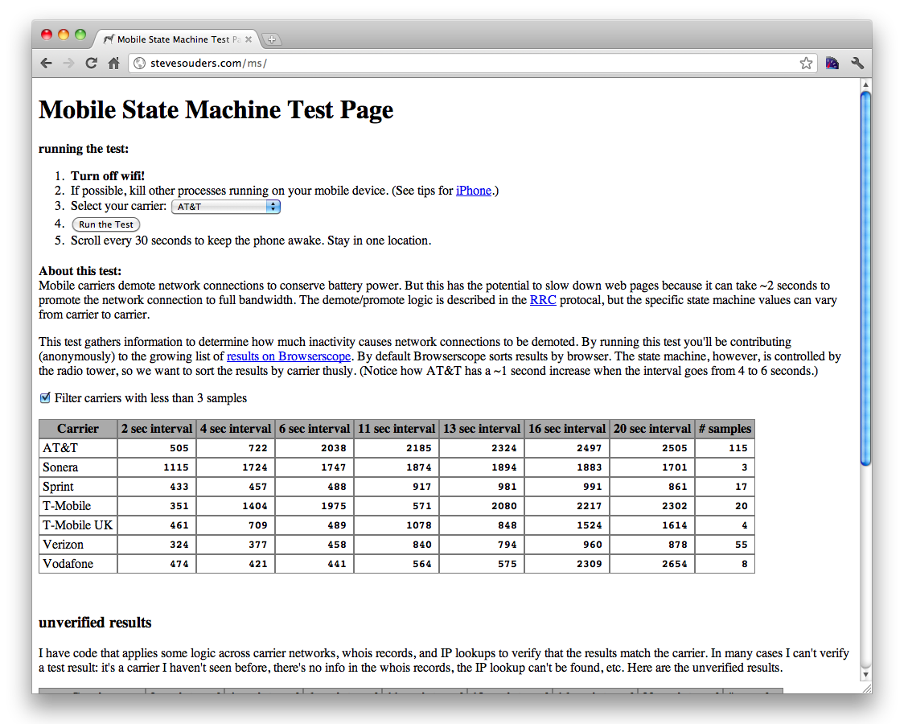

Slide 10
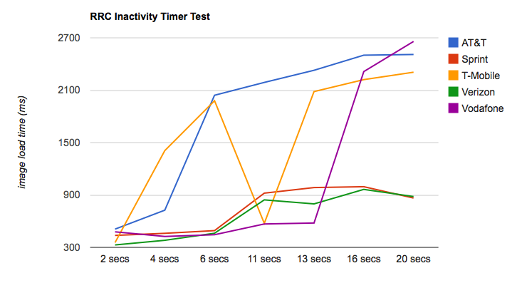
Mobile State Machine
?

Slide 11

Notes:
hrblock.com - http://www.webpagetest.org/result/120503_5E_46T9J/
hrblock tax sw - http://www.webpagetest.org/result/120503_BH_46T9K/
peachtree - http://www.webpagetest.org/result/120503_JN_46TBM/
filmstrip comparison of all 6 - http://www.webpagetest.org/video/compare.php?tests=120503_RC_46SJA%2C120503_5E_46T9J%2C120503_B9_46SJB%2C120503_JN_46TBM%2C120503_ZV_46SJC%2C120503_BH_46T9K&thumbSize=150&ival=1000&end=all

Slide 12
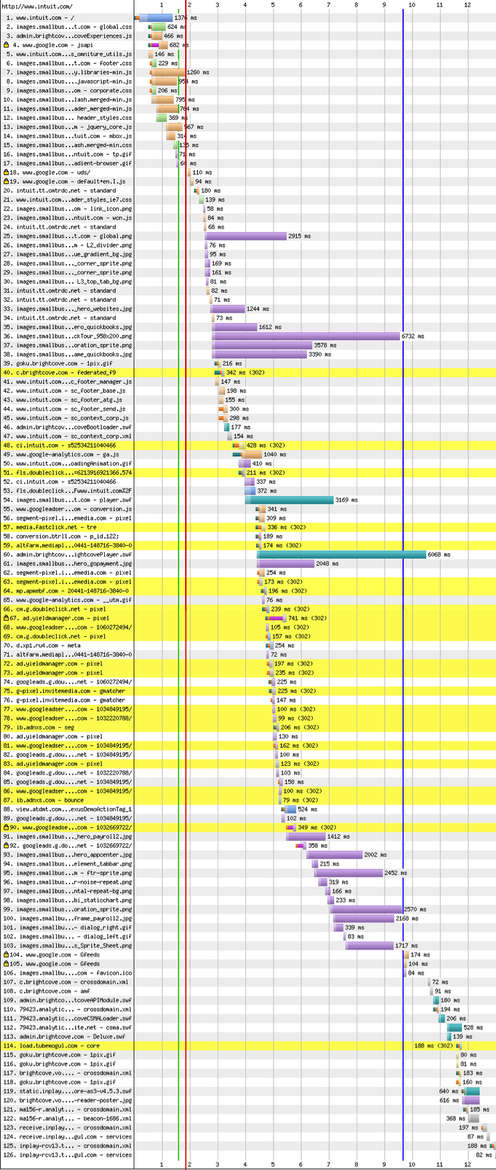
www.intuit.com
125
1,847
1.587
9.651
requests
kB
seconds start render
seconds PLT
mbox.js docwrites /mbox/standard blocks ie7.css blocks rendering
don’t docwrite scripts
domain sharding
PNGs take 3-6 seconds to download
www.webpagetest.org/result/120503_RC_46SJA/

Slide 13
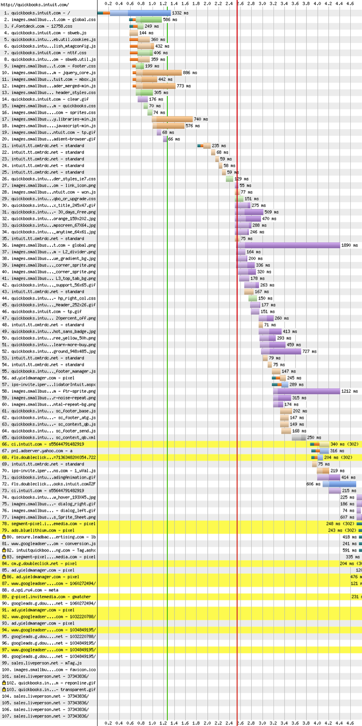
quickbooks.intuit.com
106
632
1.265
5.740
requests
kB
seconds start render
seconds PLT
mbox.js docwrites /mbox/standard blocks ie7.css blocks rendering
don’t docwrite scripts
domain sharding
add caching headers
www.webpagetest.org/result/120503_B9_46SJB/

Slide 14
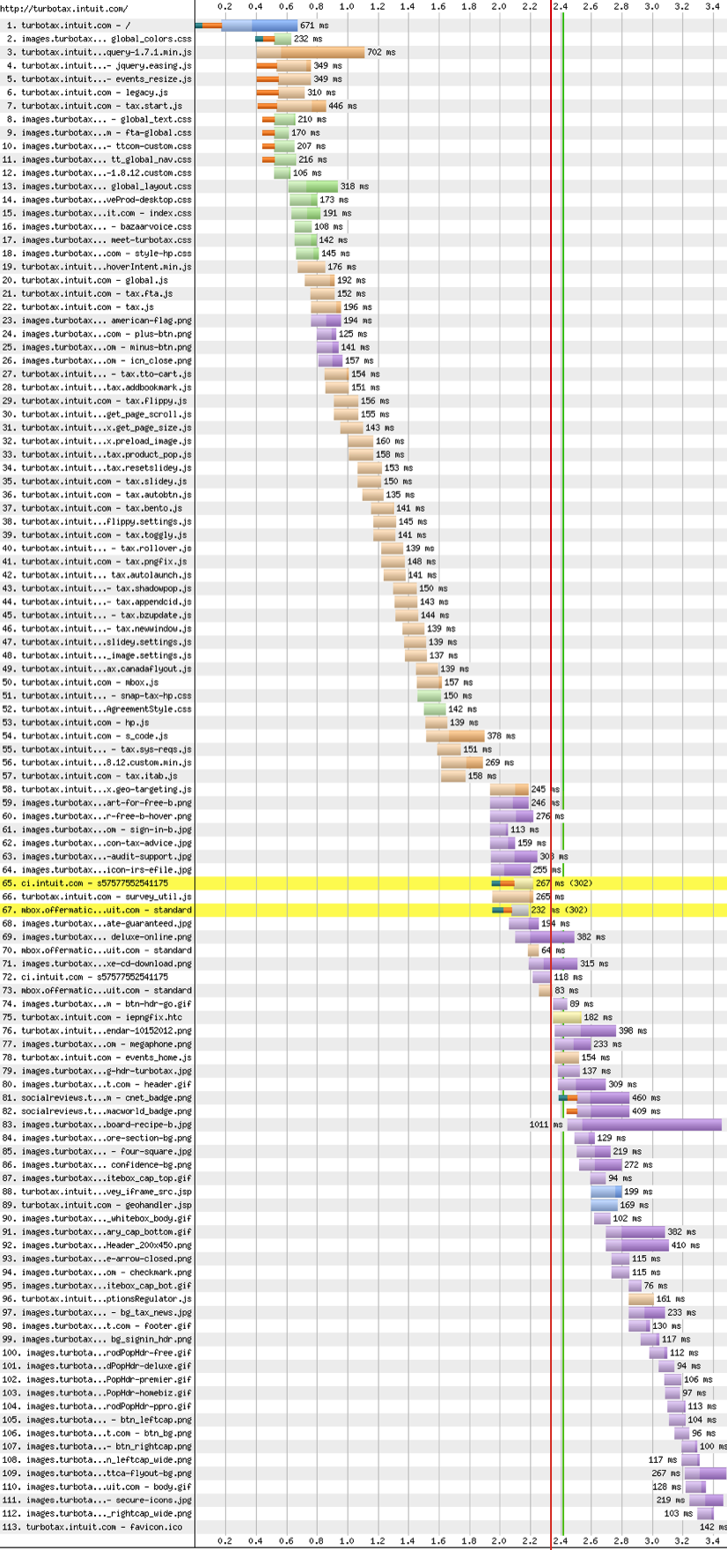
turbotax.intuit.com
112
438
2.412
3.523
requests
kB
seconds start render
seconds PLT
rendering extremely blocked
concat scripts, concat stylesheets
don’t mix inline & external scripts
don’t docwrite scripts
domain sharding
add caching headers
sprites
www.webpagetest.org/result/120503_ZV_46SJC/

Slide 15
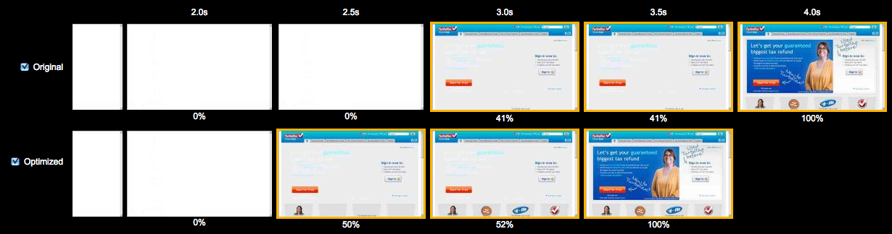
turbotax.intuit.com
this is turbotax
this is turbotax on Page Speed
www.webpagetest.org/compare
Notes:
http://www.webpagetest.org/video/compare.php?bare=1&tests=120503_07_78e0c4927d9cdd6dd223f470e1740718,120503_3V_e00c7f769c4281be9074cf96a639650d

Slide 16


Slide 17


Slide 18

Caching
Notes:
http://www.flickr.com/photos/aubra/5684588796/

Slide 19
HTTP Archive: 54K URLs, 4.6M resources
55% - NO caching headers
18% - cacheable < 1 day
} 73%
http://httparchive.org/interesting.php#max-age

Slide 20
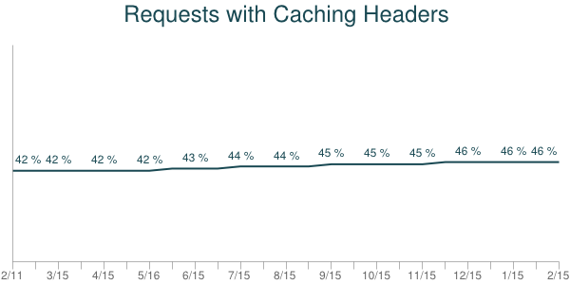
adoption is slow
http://httparchive.org/trends.php?s=intersection

Slide 21
Why so few caching headers?
  resources are dynamic
  lack of awareness

Slide 22
55% uncacheable
46%
46%
same as Jan 15
38%
same as Jan 15
Jan 15
Feb 1
Feb 15
“uncacheable” resources aren’t very dynamic
2 weeks is a long gap - daily would be higher
http://www.stevesouders.com/blog/2012/03/22/cache-them-if-you-can/

Slide 23
all resources
46%
44%
35%
same as Jan 15
same as Jan 15
Jan 15
Feb 1
Feb 15
“uncacheable” resources are LESS dynamic
    2 weeks: 46% (uncacheable) vs. 44% (all)
    4 weeks: 38% (uncacheable) vs. 35% (all)
who votes for “lack of awareness”?

Slide 24
36% of resources unchanged after 1 month
only 11% of resources cacheable for > 1 month
http://www.stevesouders.com/blog/2012/03/22/cache-them-if-you-can/

Slide 25
44% vs. 46%
35% vs. 38%
“uncacheable” resources are LESS dynamic!
who votes for “lack of awareness”?
http://www.stevesouders.com/blog/2012/03/22/cache-them-if-you-can/

Slide 26
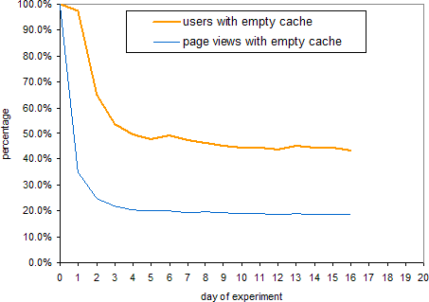
40-60% of users missing cacheable resources
  20% of page views
http://www.yuiblog.com/blog/2007/01/04/performance-research-part-2/

Slide 27
(my) browser cache sizes:
Chrome: 320 MB (cap)*
IE 9: 250 MB
IE 7-8: 50 MB
Firefox 11: 830 MB*
Opera 11: 20 MB
iPhone 4: 30-35 MB
Galaxy Nexus: 18 MB
* Based on available disk space – I had 50 GB free.

Slide 28
Chrome for Windows stats:
30% (48%?) of users have a full cache
full cache users reach that point after 4 hours of active browsing (20 clock hours)
7% of users clear their cache 1+ per week
19% of users experience “fatal cache corruption” 1+ per week
https://plus.google.com/103382935642834907366/posts/XRekvZgdnBb

Slide 29
recap:
resource owners underutilize max-age
users are often missing cacheable resources
cache sizes are small; caches fill quickly
https://plus.google.com/103382935642834907366/posts/XRekvZgdnBb

Slide 30
what can we do?
gather more/better stats
make caches bigger (and fix corruption)
improve purging logic (mime type, etc.)
more intelligent, personalized browsers

Slide 31
cache compressed or uncompressed?
Browser | Compressed responses cached compressed?
Chrome 17 | yes
Firefox 11 | yes
IE 8 | no
IE 9 | no
Safari 5 | no
Opera 11 | yes
http://www.stevesouders.com/blog/2012/03/27/cache-compressed-or-uncompressed/

