Slide 1
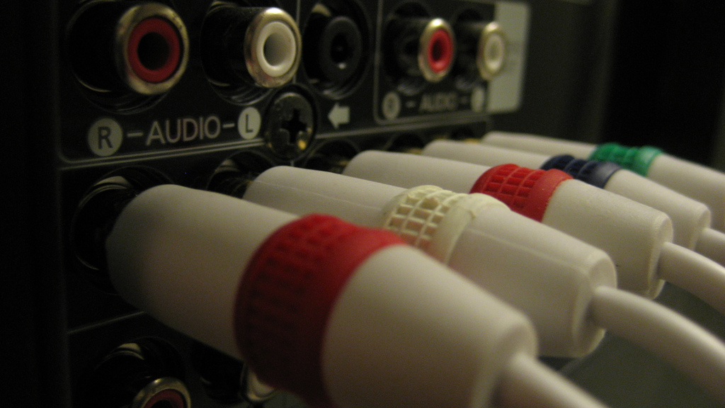
Web Components
@souders
stevesouders.com/docs/sfwebperf-20140429.pptx
flickr.com/photos/brenderous/4255550788
Notes:
https://www.flickr.com/photos/brenderous/4255550788

Slide 2
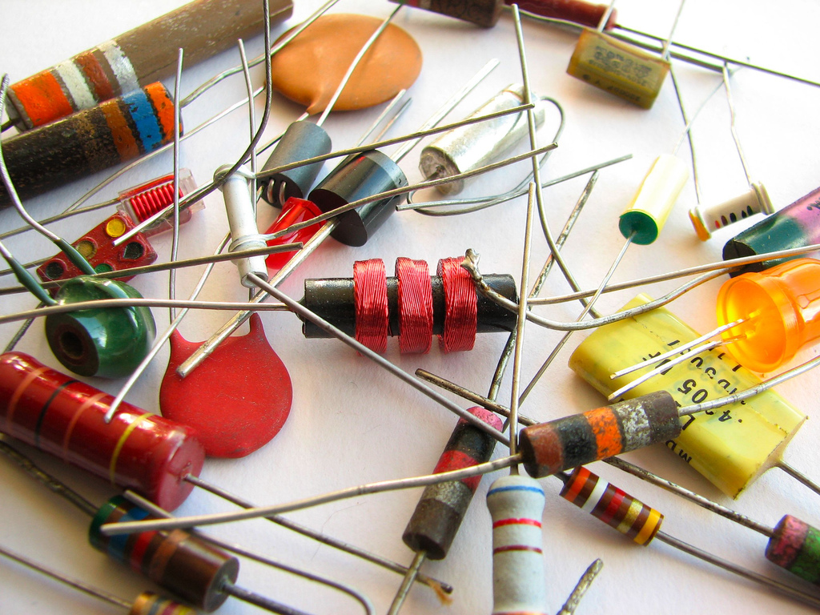
Web Components
souders@google.com
stevesouders.com/docs/sap-hpws-20140424.pptx
Notes:
https://www.flickr.com/photos/oskay/437341128

Slide 3
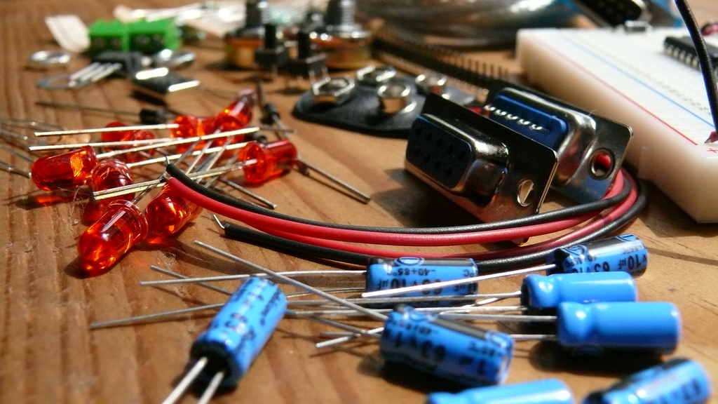
Web Components
souders@google.com
stevesouders.com/docs/sap-hpws-20140424.pptx
Notes:
https://www.flickr.com/photos/tiemposdelruido/4051085295
also:
https://www.flickr.com/photos/tiemposdelruido/4051083769
https://www.flickr.com/photos/tiemposdelruido/4051086973
https://www.flickr.com/photos/tiemposdelruido/4051826452
https://www.flickr.com/photos/tiemposdelruido/4051078871

Slide 4
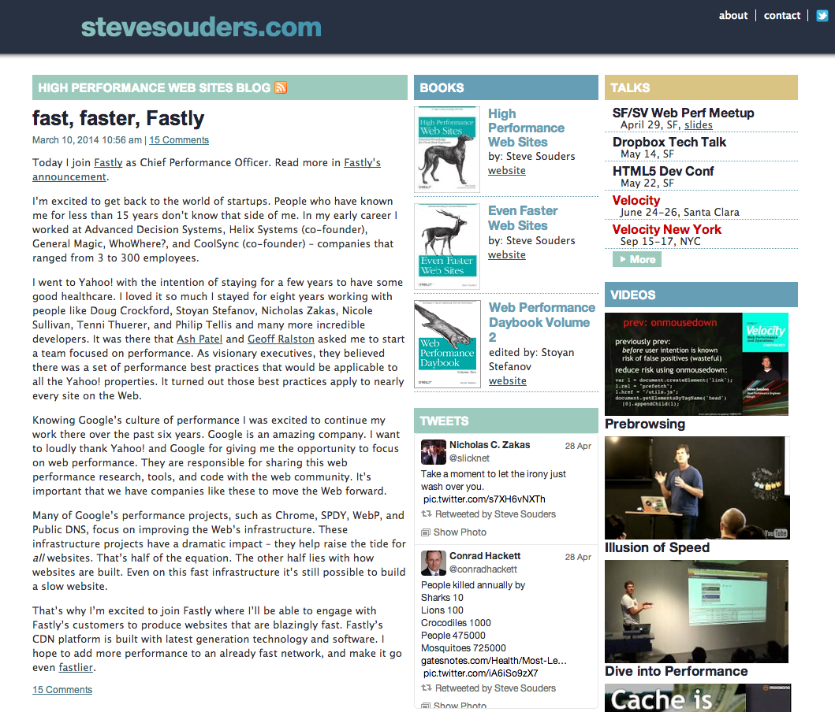

Slide 5
flickr.com/photos/brenderous/4255550788
Notes:
https://www.flickr.com/photos/brenderous/4255550788

Slide 6
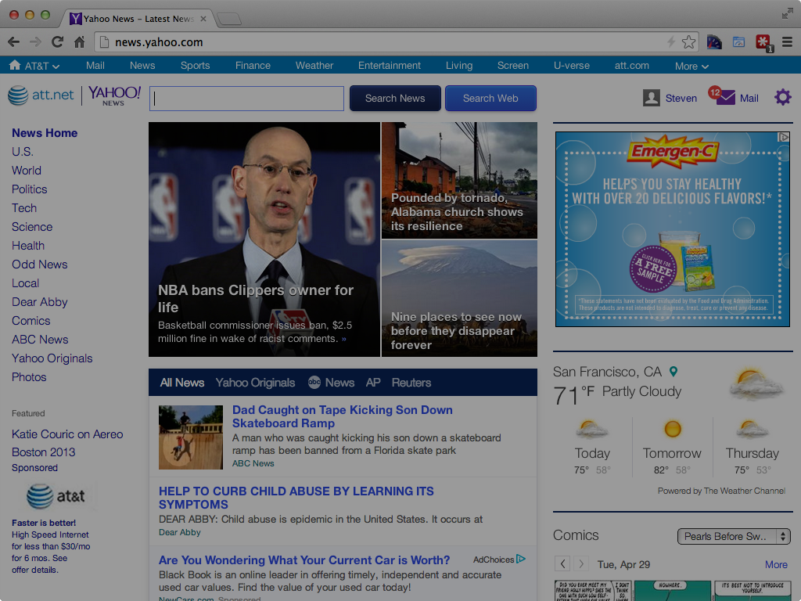
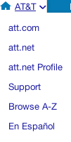

Slide 7
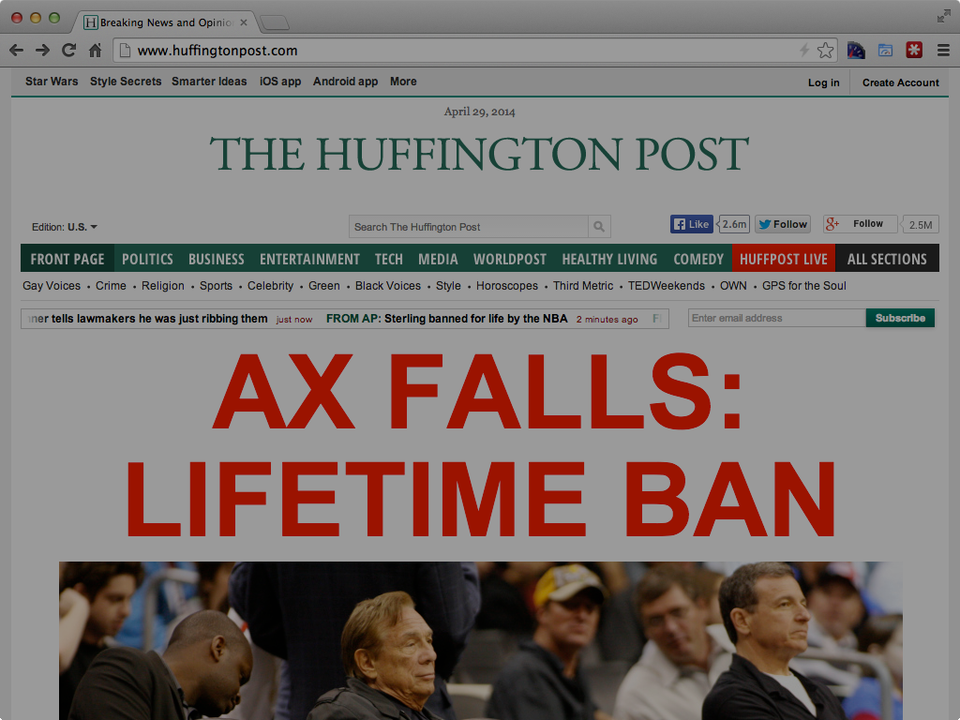
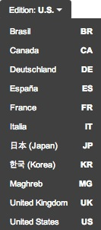

Slide 13
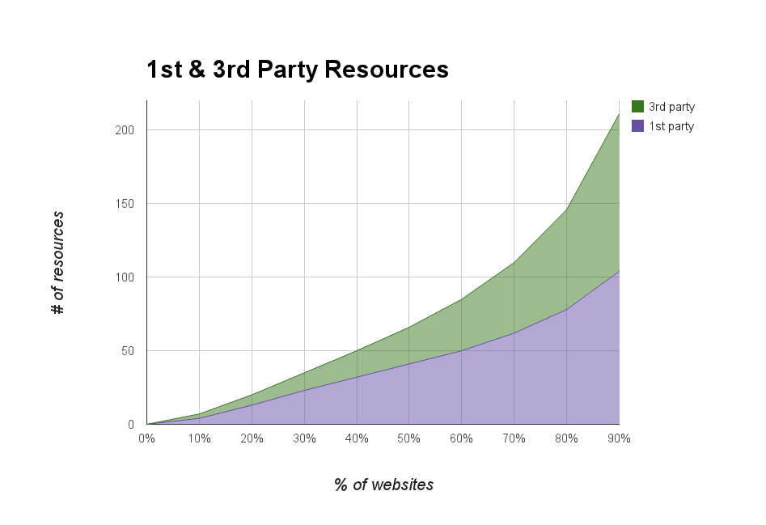
bigqueri.es/t/what-is-the-distribution-of-1st-party-vs-3rd-party-resources/100
Notes:
50th: 25 3rd party, 41 1st party
90th: 107 3rd party, 104 1st party
SELECT party,
NTH(10, quantiles(cnt)) p10,
NTH(20, quantiles(cnt)) p20,
NTH(30, quantiles(cnt)) p30,
NTH(40, quantiles(cnt)) p40,
NTH(50, quantiles(cnt)) p50,
NTH(60, quantiles(cnt)) p60,
NTH(70, quantiles(cnt)) p70,
NTH(80, quantiles(cnt)) p80,
NTH(90, quantiles(cnt)) p90,
NTH(99, quantiles(cnt)) p99
FROM (
SELECT
origin,
IF (req_host CONTAINS REGEXP_EXTRACT(origin, r'([\w-]+)'), INTEGER(1), INTEGER(3)) AS party,
COUNT(*) as cnt
FROM [httparchive:runs.2014_04_15_requests] requests JOIN EACH (
SELECT pageid, DOMAIN(url) as origin
FROM [httparchive:runs.2014_04_15_pages]
) pages ON pages.pageid = requests.pageid
GROUP BY origin, party
)
GROUP by party;

Slide 14
flickr.com/photos/brenderous/4255550788
Notes:
https://www.flickr.com/photos/brenderous/4255550788

Slide 15
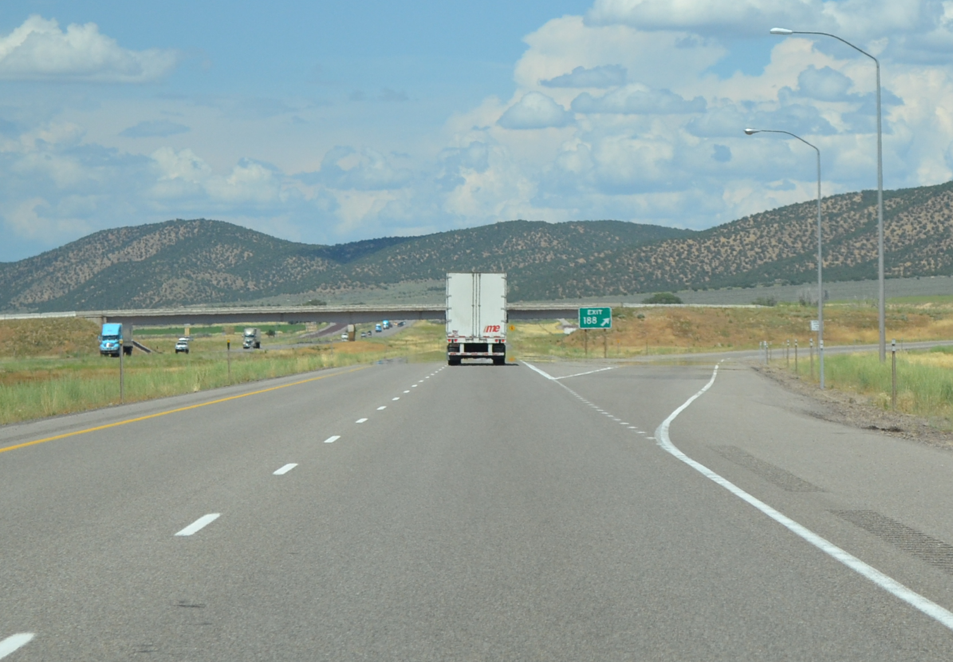
flickr.com/photos/countylemonade/5940567593

Slide 16
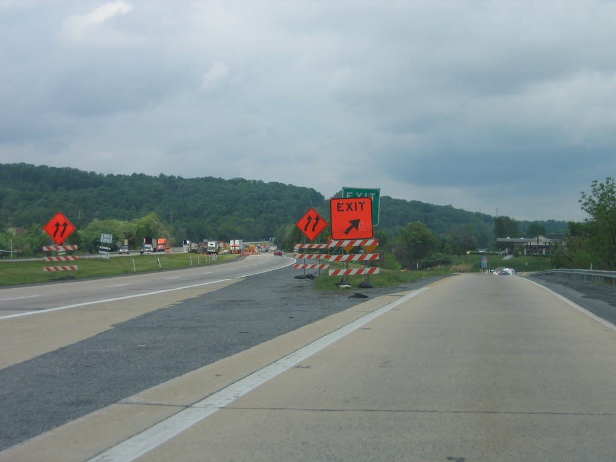
flickr.com/photos/thisisbossi/3069180895

Slide 17
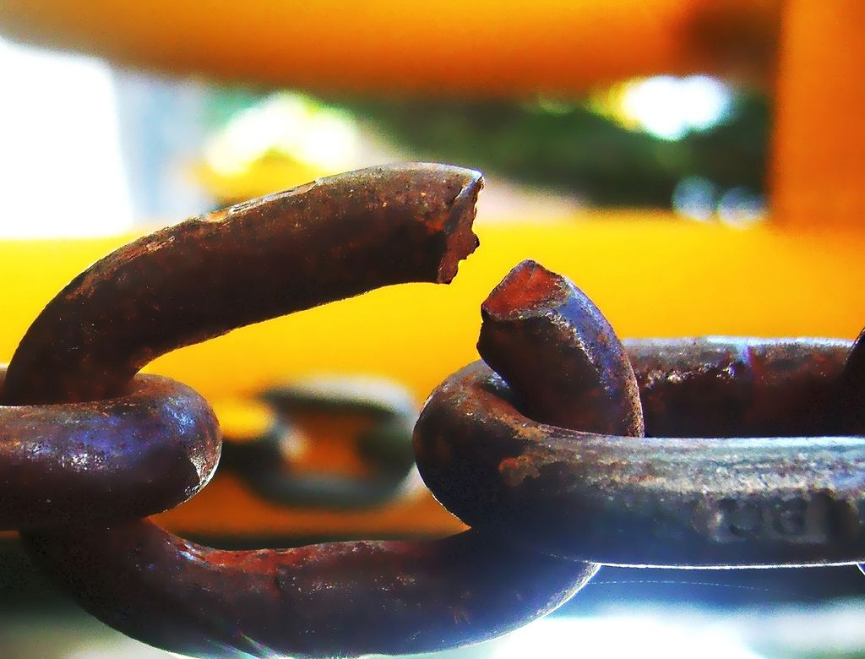
SPOF
flickr.com/photos/darwinbell/465459020/
Notes:
http://www.flickr.com/photos/darwinbell/465459020/

Slide 18
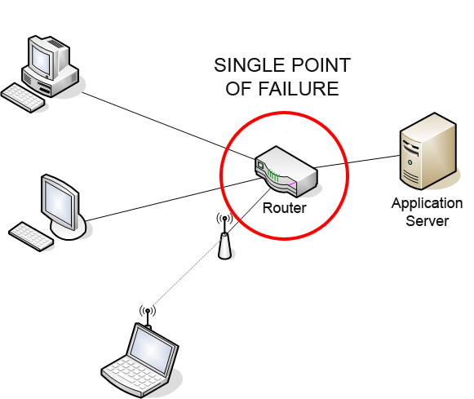
en.wikipedia.org/wiki/Single_point_of_failure
Notes:
http://en.wikipedia.org/wiki/Single_point_of_failure

Slide 19
Frontend SPOF

Slide 20
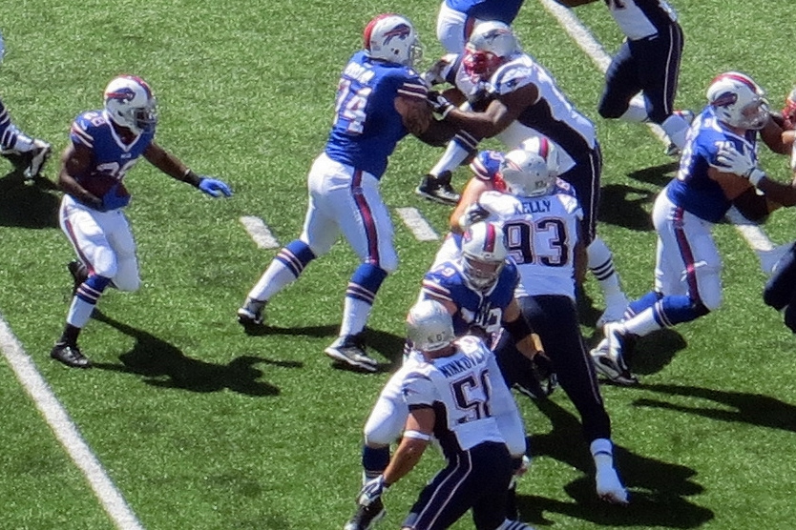
scripts
stylesheets
fonts
flickr.com/photos/runneralan/9741423581

Slide 21
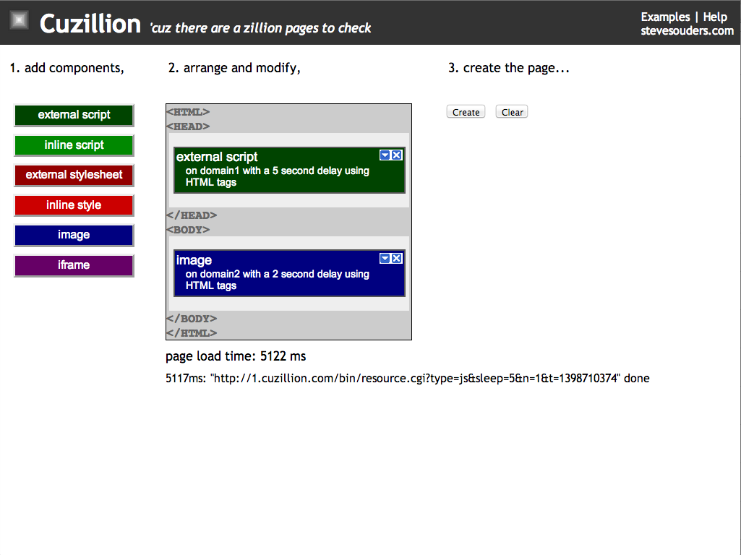

Slide 22
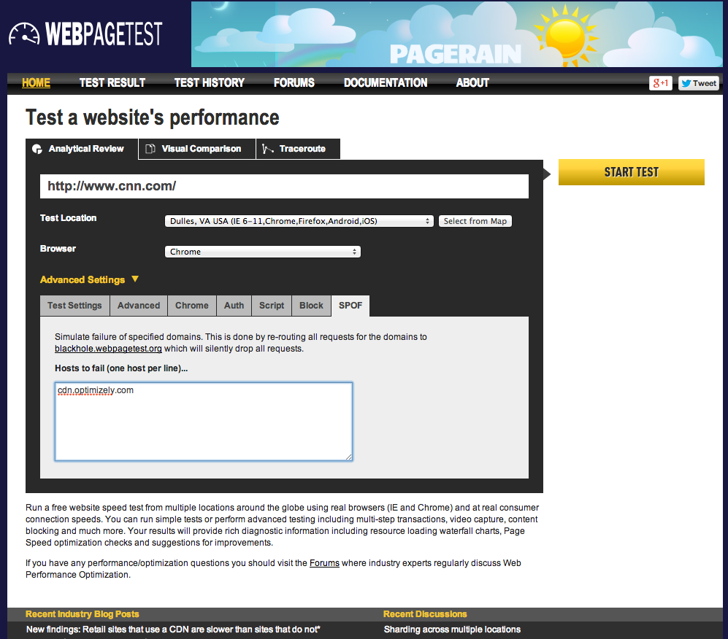
Notes:
http://www.webpagetest.org/video/compare.php?tests=140429_9G_5QD,140429_M5_5QE

Slide 23
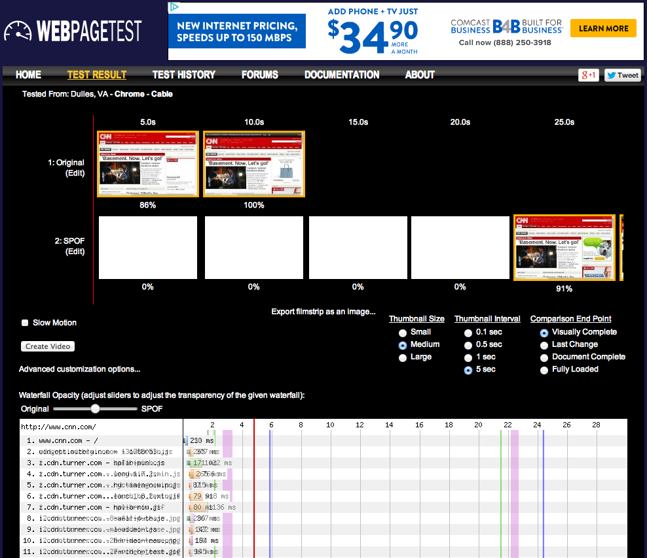

Slide 24
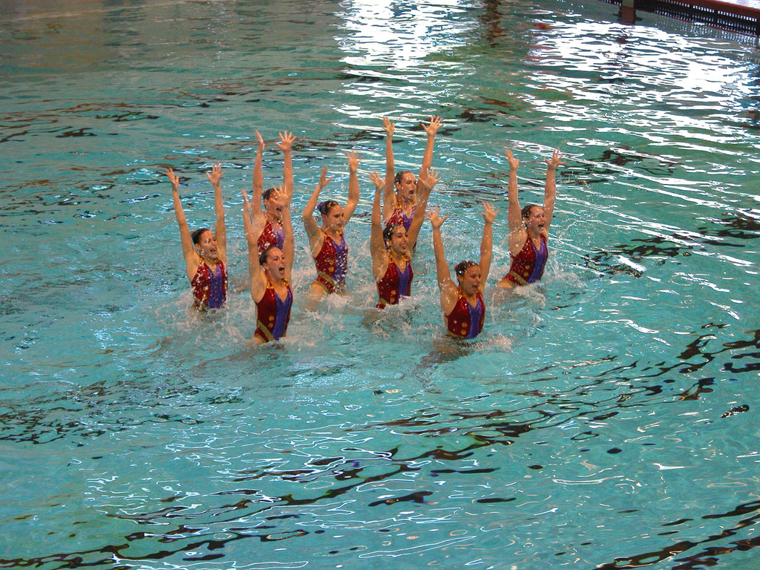
sync
flickr.com/photos/krhamm/171302038

Slide 25
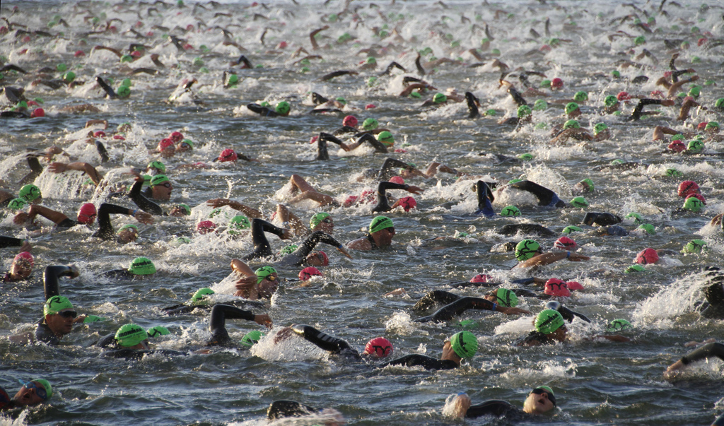
async
flickr.com/photos/8229345@N02/7980116331

Slide 26
load scripts async
var s0 = document. getElementsByTagName('script')[0];
var s1 = document. createElement('script');
s1.async = true;
s1.src = 'common.js';
s0.parentNode.insertBefore(s1, s0);

Slide 27
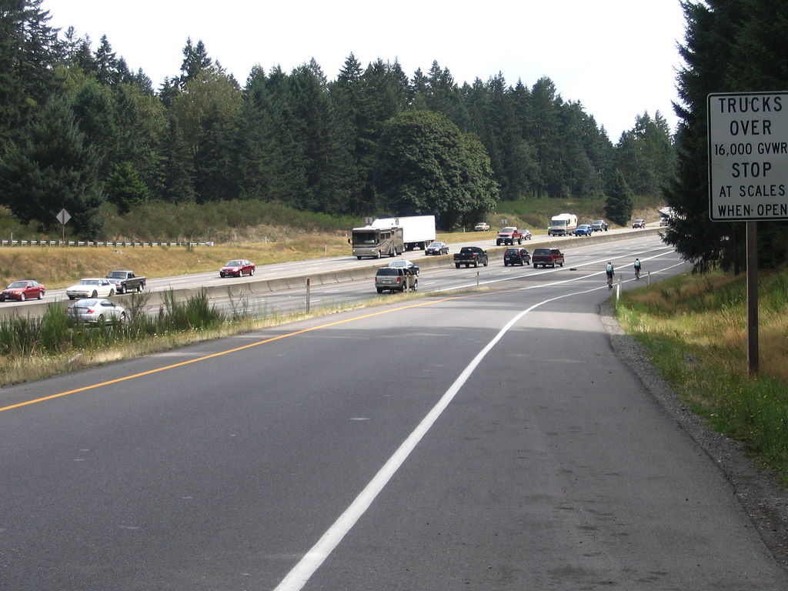
https://www.flickr.com/photos/thisisbossi/3069180895

Slide 29
HTML Templates
Shadow DOM
HTML Imports
Custom Elements

Slide 30
HTML Templates
Shadow DOM
HTML Imports
Custom Elements
Notes:
HTML Templates – download & parse HTML but DON'T render
Shadow DOM – markup encapsulation, style boundaries,

Slide 31
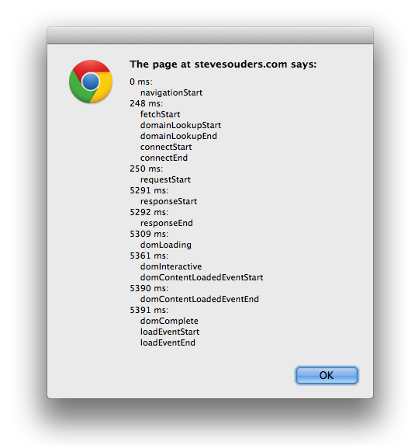

Slide 32
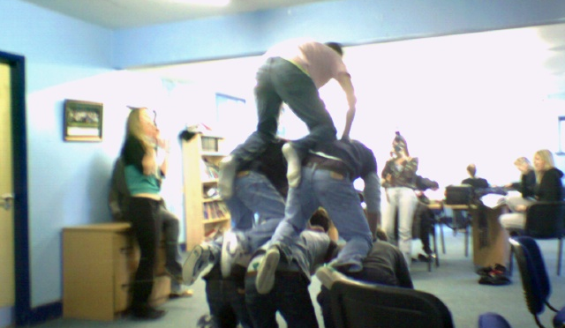
Support
Chrome 33-34 with chrome://flags/
experimental Web Platform features
Experimental JavaScript
HTML Imports
Chrome 36+: no flags
Polymer: http://www.polymer-project.org/
flickr.com/photos/callumscott2/167684986

Slide 33
HTML Imports
<link rel="import" href="navtiming.php">
navtiming.php:
<div id='navtiming-content'>
<input type=button value='Nav Timing' onclick='doNavTiming()'>
</div>
<script>
function doNavTiming() {…

Slide 34
HTML Imports
<link rel="import" href="navtiming.php">
navtiming.php:
<div id='navtiming-content'>
<input type=button value='Nav Timing' onclick='doNavTiming()'>
</div>
<script>
function doNavTiming() {…

Slide 35
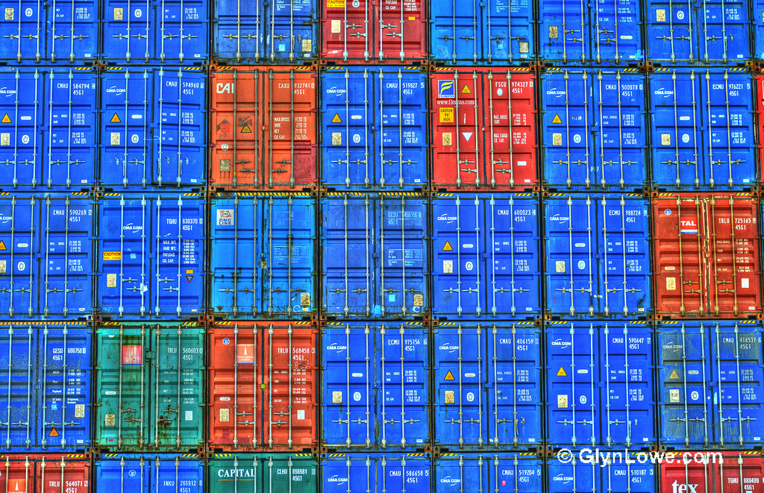
HTML Imports
<link rel="import" href="navtiming.html">
navtiming.html:
<div id="navtiming-content">
<input type=button value='Nav Timing' onclick='doNavTiming()'>
</div>
<script>
function doNavTiming() {…}
flickr.com/photos/glynlowe/10039742285

Slide 36
insert imported HTML
var link = document. querySelector('link[rel=import]');
var content = link.import. querySelector('#navtiming-content');
document.getElementById('target'). appendChild(content.cloneNode(true));

Slide 37
<html>
<head>
<link rel="import" href="navtiming.php">
</head>
<body>
<div id="target"></div>
<script>
var link = document. querySelector('link[rel=import]');
var content = link.import. querySelector('#navtiming-content');
document.getElementById('target'). appendChild(content.cloneNode(true));
</script>
</body>
</html>
Race Condition?

Slide 38
<html>
<head>
<link rel="import" href="navtiming.php">
</head>
<body>
<div id="target"></div>
<script>
var link = document. querySelector('link[rel=import]');
var content = link.import. querySelector('#navtiming-content');
document.getElementById('target'). appendChild(content.cloneNode(true));
</script>
</body>
</html>
Race Condition!

Slide 39
resolution: BLOCK
Chrome 33-34:
stop parsing at 1st SCRIPT tag
Chrome 36:
stop parsing immediately – entire BODY is blocked from rendering
start rendering after ~5 seconds
block at first script
flickr.com/photos/runneralan/9741423581

Slide 40
scripts
stylesheets
fonts
web components (new!)
flickr.com/photos/runneralan/9741423581

Slide 41
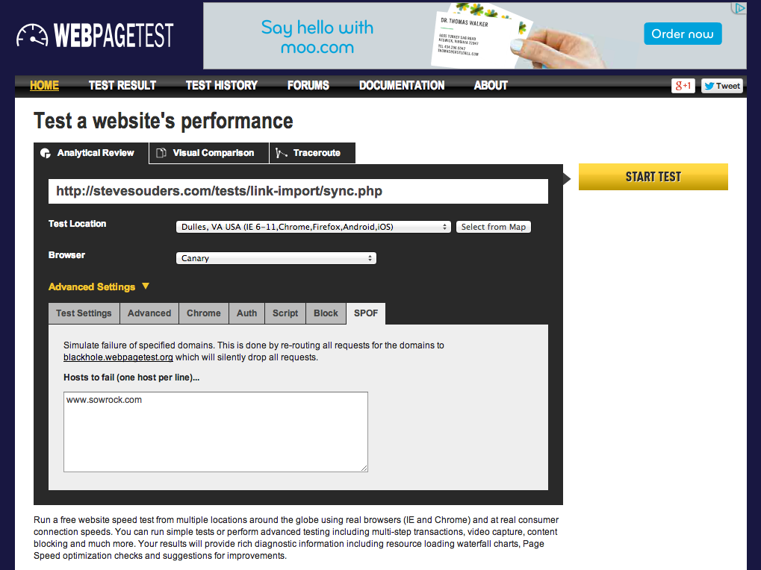
Notes:
http://www.webpagetest.org/video/compare.php?tests=140429_WZ_12SP,140429_VX_12SQ

Slide 42
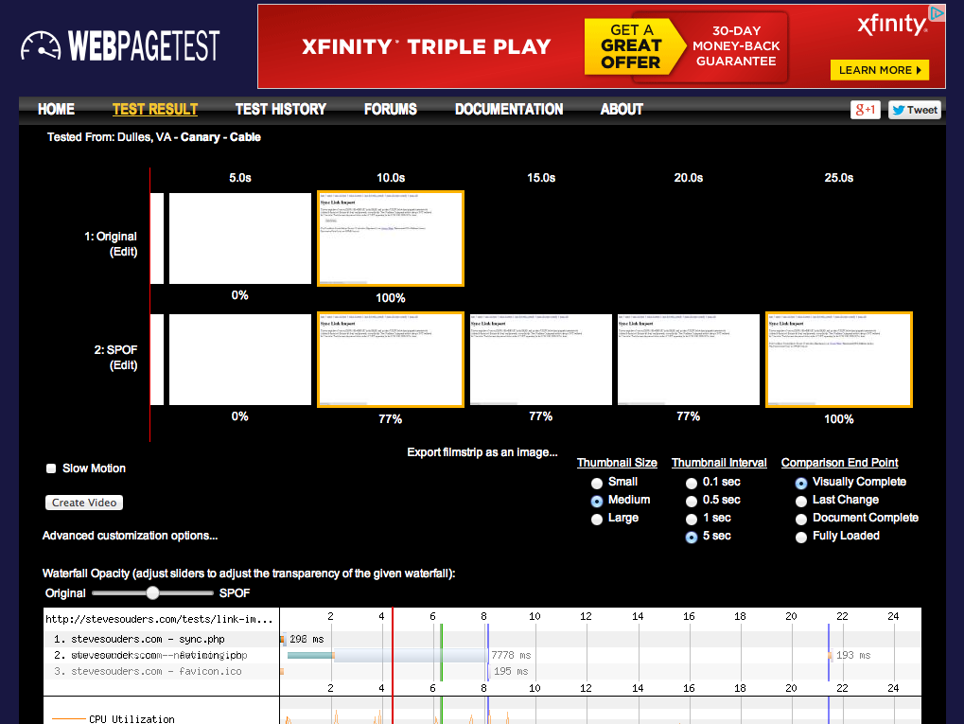
Notes:
http://www.webpagetest.org/video/compare.php?tests=140429_WZ_12SP,140429_VX_12SQ

Slide 43
load HTML Imports async
var link = document. createElement('link');
link.rel = 'import';
link.onload = function() {
var link = document.querySelector('link[rel=import]');
var content = link.import.querySelector('#navtiming-content');
document.getElementById('target').appendChild(content.cloneNode(true));
};
link.href = 'navtiming.php';
document.getElementsByTagName ('head')[0].appendChild(link);
flickr.com/photos/8229345@N02/7980116331

Slide 44
HTML Templates
Shadow DOM
HTML Imports
Custom Elements

Slide 45
Custom Elements
<link rel="import" href="navtimingce.php">
navtimingce.php:
<script>
var NavTimingProto = Object.create(HTMLElement.prototype);
NavTimingProto.createdCallback = function(){
this.innerHTML = "<input type=button…>"; };
document.registerElement('nav-timing', {prototype: NavTimingProto});
function doNavTiming() {…
MUST have hyphen!

Slide 46
insert custom element
<nav-timing></nav-timing>
That's it!

Slide 47
<html>
<head>
<link rel="import" href="navtimingce.php">
</head>
<body>
<nav-timing></nav-timing>
</body>
</html>
Race Condition?

Slide 48
<html>
<head>
<link rel="import" href="navtimingce.php">
</head>
<body>
<nav-timing></nav-timing>
</body>
</html>
Race Condition!

Slide 49
solution: BLOCK
Chrome 33-34:
stop parsing at 1st SCRIPT tag
Chrome 36:
stop parsing immediately – entire BODY is blocked from rendering
all:
ignore hyphenated tags if not registered
flickr.com/photos/runneralan/9741423581

Slide 50
load HTML Imports async
var link = document. createElement('link');
link.rel = 'import';
link.onload = function() {
var link = document.querySelector('link[rel=import]');
var content = link.import.querySelector('#navtiming-content');
document.getElementById('target').appendChild(content.cloneNode(true));
};
link.href = 'navtiming.php';
document.getElementsByTagName ('head')[0].appendChild(link);

Slide 51
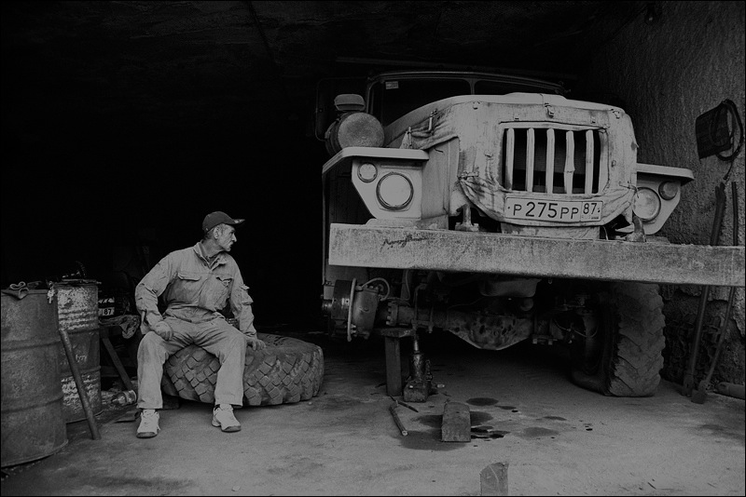
suggested fixes
"lazyload" attribute
"elements" attribute
make LINK valid w/in BODY
flickr.com/photos/chudo1909/6979697127
Notes:
http://www.whatwg.org/specs/web-apps/current-work/multipage/semantics.html#the-link-element
other bg photo: https://www.flickr.com/photos/hanspetermeyer/9146936834

Slide 52
takeaways
HTML Imports block rendering
workarounds (hacks) exist
need to change the spec
check your site for Frontend SPOF
Notes:
flickr.com/photos/myklroventine/4062102754/

Slide 53
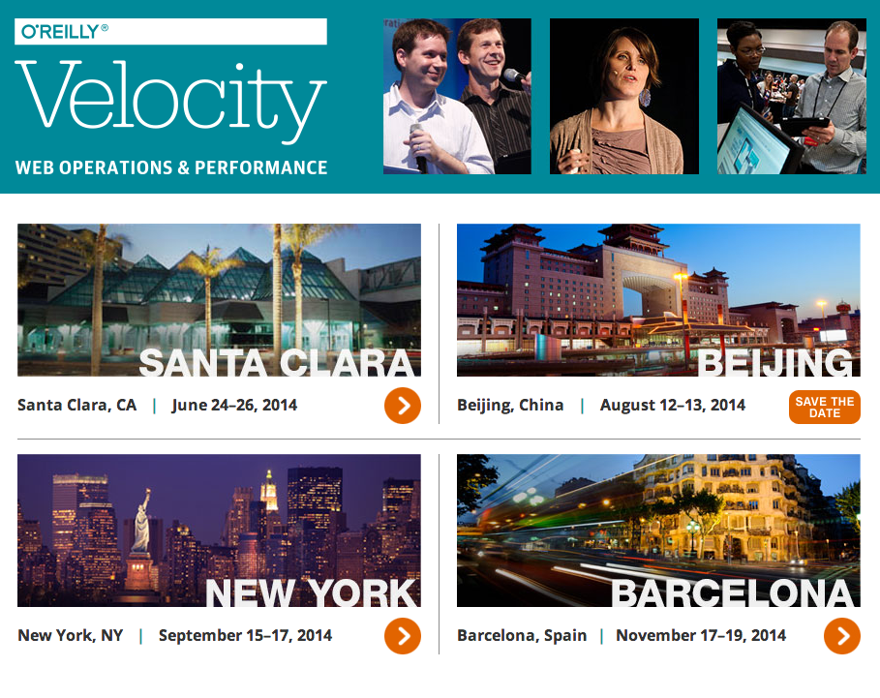

Slide 54
Steve Souders
@souders
stevesouders.com/docs/sfwebperf-webcomp-20140429.pptx
Notes:
"thank you" by nj dodge: http://flickr.com/photos/nj_dodge/187190601/

